Slide 1
Final project
User to-do list
Mantas Andriekus

Slide 2
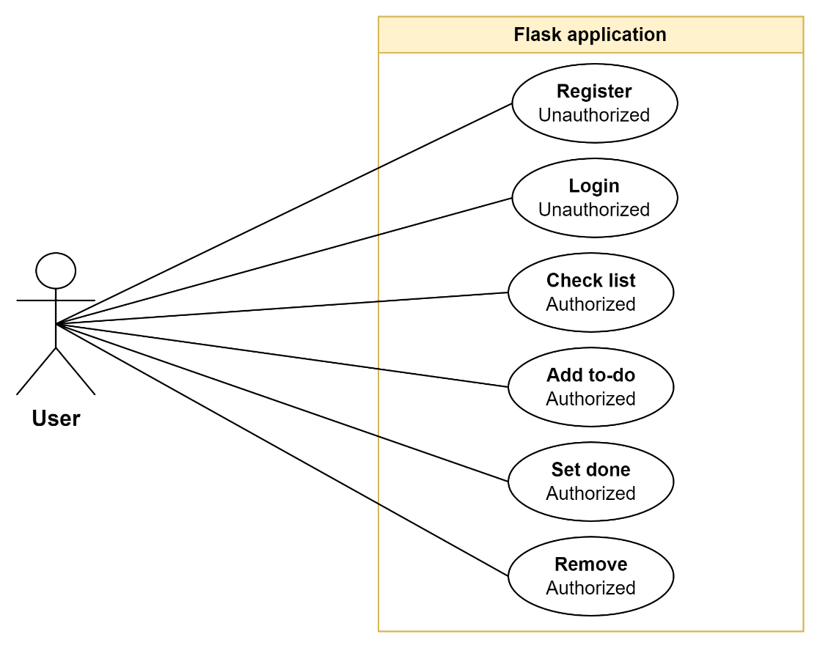
Task
Create web-based application to control users and their to-do lists.
Every user must be registered in the system to access to-do list.
Users cannot access other users to-do list.
User can perform actions:
Register to the system.
Log in to the system.
Check his to-do list.
Add to-do item to list.
Set to-do as done.
Remove to-do from list.
Application must be deployed to AWS cloud.
Use best practices of Infrastructure as a code.
Database to store data – MySQL.
Application must be written in Python programming language.
Application must use Flask framework.

Slide 3
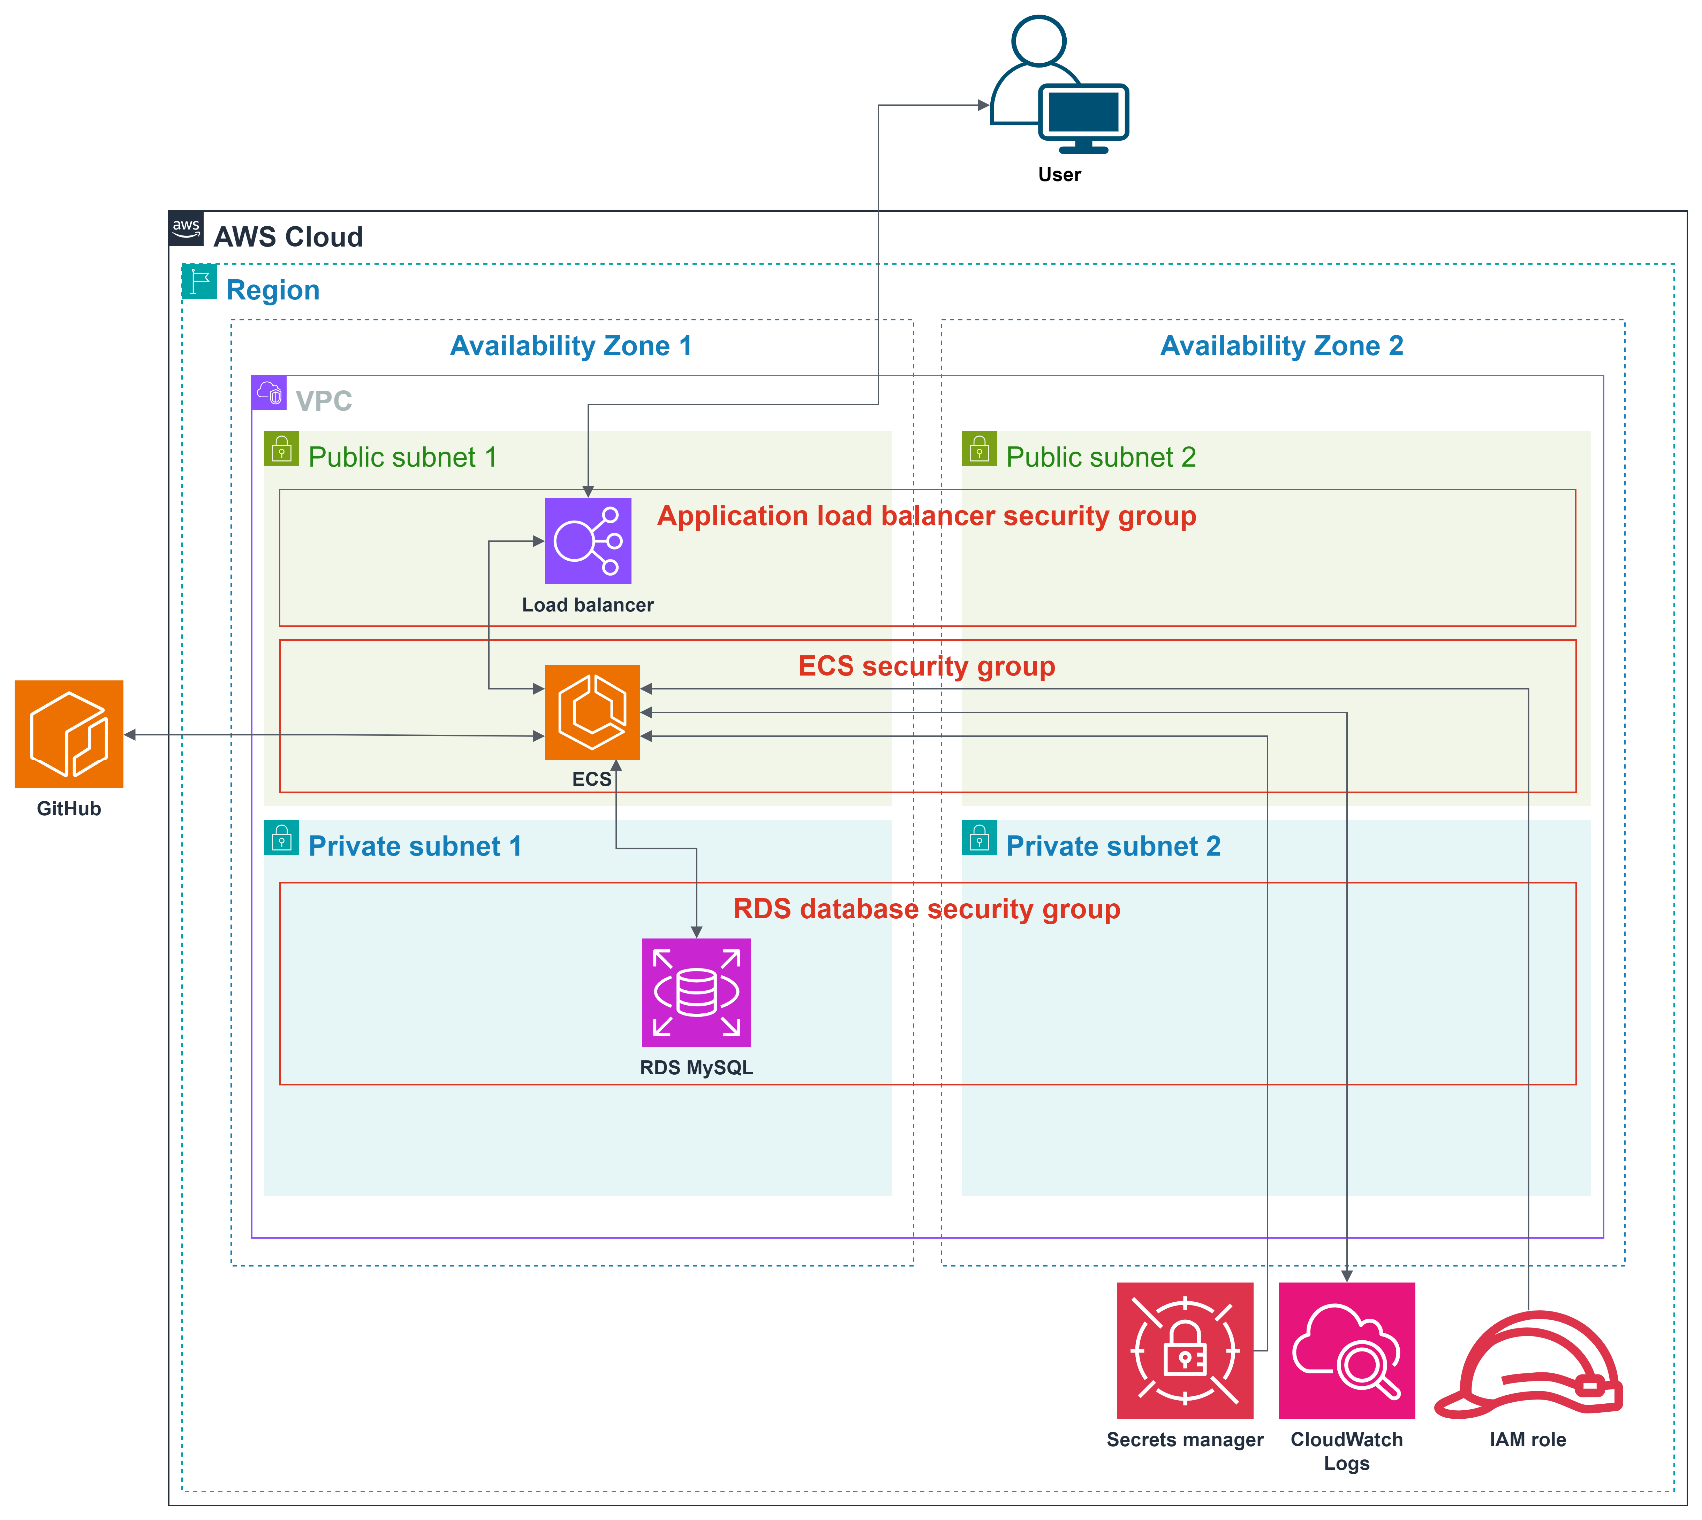
Infrastructure

Slide 4
Infrastructure
Terraform is used to accomplish infrastructure as a code task.
VPC as entry point of infrastructure.
Using two availability zones.
Two public subnets.
Two private subnets.
Three security groups.
Application load balancer.
Elastic container service.
RDS MySQL database.
Policies to IAM role to access Secrets Manager.
Secrets Manager secrets defines manually.
CloudWatch logs.

Slide 5
Infrastructure. Subnets
Public subnets with internet gateway. Two subnets used because load balancer requires at least two subnets in different availability zones.
Private subnets without internet gateway. Private subnets used for database. Database cannot be access outside VPC.

Slide 6
Infrastructure. Security groups
In cloud environment security groups acts like firewalls.
Application load balancer security group defines inbound and outbound rules for load balancer. Opens 80 port.
Elastic Container Service security group defines inbound and outbound rules for ECS service. Opens 80 port.
RDS database security group defines inbound and outbound rules for database. Opens default MySQL port 3306.

Slide 7
Infrastructure. Application load balancer
Application load balancer used to control traffic between our ECS containers.
Target group set as IP traffic.
Listener set to listen port 80 and pass traffic to target group items.

Slide 8
Infrastructure. Elastic Container Service
Elastic container service use task definition (json file) to create containers.
ECS service using task definitions checks containers health, load, auto-scales containers number.
Starts, stops containers on demand.

Slide 9
Infrastructure. RDS database
Database used to store information.
Database engine MySQL 8.0.

Slide 10
Infrastructure. Pipeline
For code versioning using git.
Repository deployed to GitHub.
GitHub Actions automates code deployment to cloud.
name: Final project. Infrastructure pipeline
on:
push:
branches:
- main
pull_request:
branches:
- main
defaults:
run:
shell: bash
jobs:
initialise-infra:
name: 'Init. infrastructure'
runs-on: ubuntu-latest
env:
AWS_ACCESS_KEY_ID: ${{ secrets.AWS_ACCESS_KEY }}
AWS_SECRET_ACCESS_KEY: ${{ secrets.AWS_SECRET_KEY }}
steps:
- name: 'Checkout repository'
uses: actions/checkout@v4
- name: 'Setup Terraform'
uses: hashicorp/setup-terraform@v2
- name: 'Init. Terraform'
working-directory: ./environments/staging
run: |
terraform fmt
terraform init
- name: 'Apply infrastructure'
working-directory: ./environments/staging
run: terraform apply -auto-approve

Slide 11
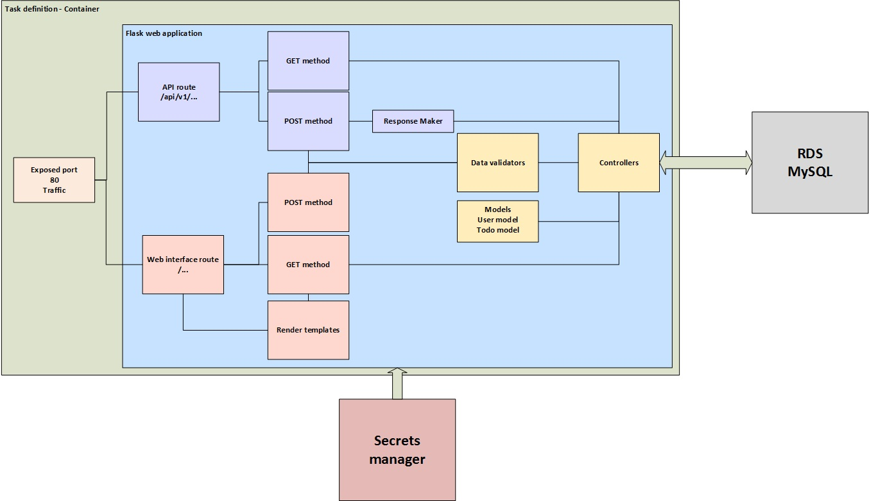
Web application
Web application written in Python.
Flask framework.

Slide 12
Web application. Routes (URL)
Flask module Blueprint separates two common routes.
First routes group used for web UI (blueprint name: views).
Second routes group used for API (blueprint name: api).

Slide 13
Web application. Views
Views represent application data.
View lets user to interact with application.
View methods renders HTML pages from templates. Templates stored in template directory.
Created layout template. Layout template used in all views to make them as identical as possible.
Style and actions stored in static directory.
Created views:
Index view (URL: “/”).
Login view (URL: “/login”).
Register view (URL: “/register”).
Index view requires authenticated user. User must log in to the system.

Slide 14
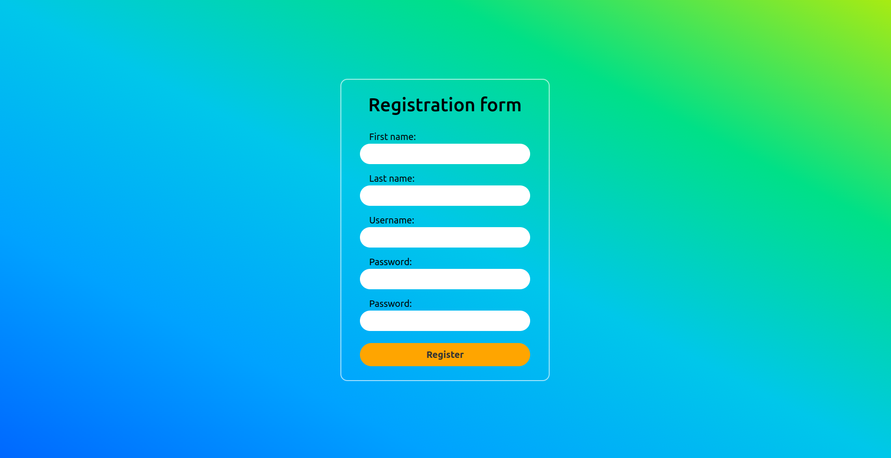
Web application. Registration view
Registration view used to register users to the system.
System validates user data. If needed, system notifies user about invalid data.

Slide 15
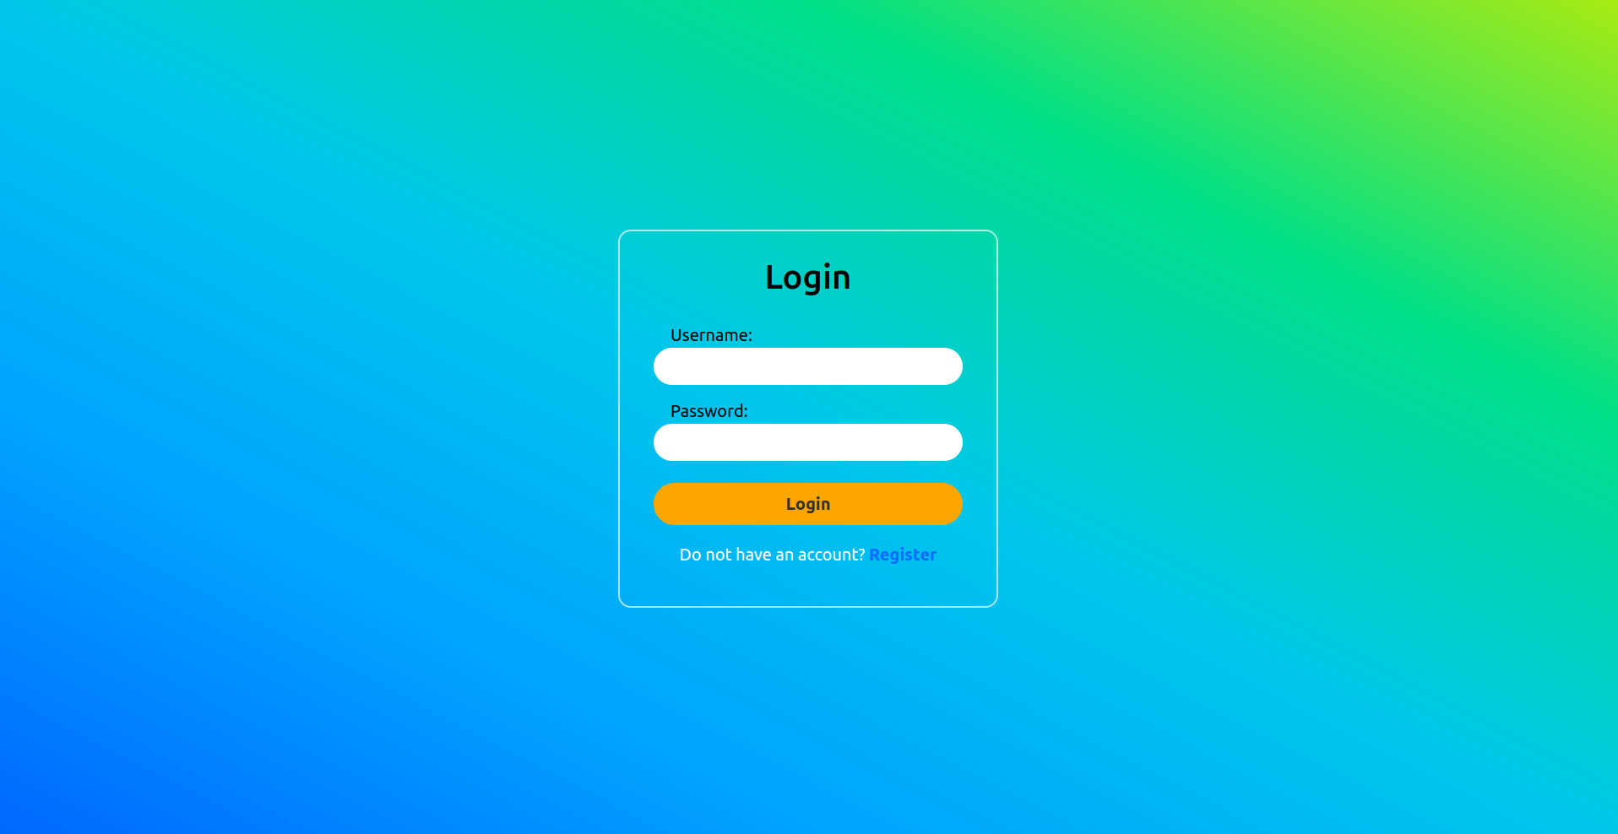
Web application. Log in view
Log in view used to log in users to the system.
System validates user data. If needed, system notifies user about invalid data.

Slide 16
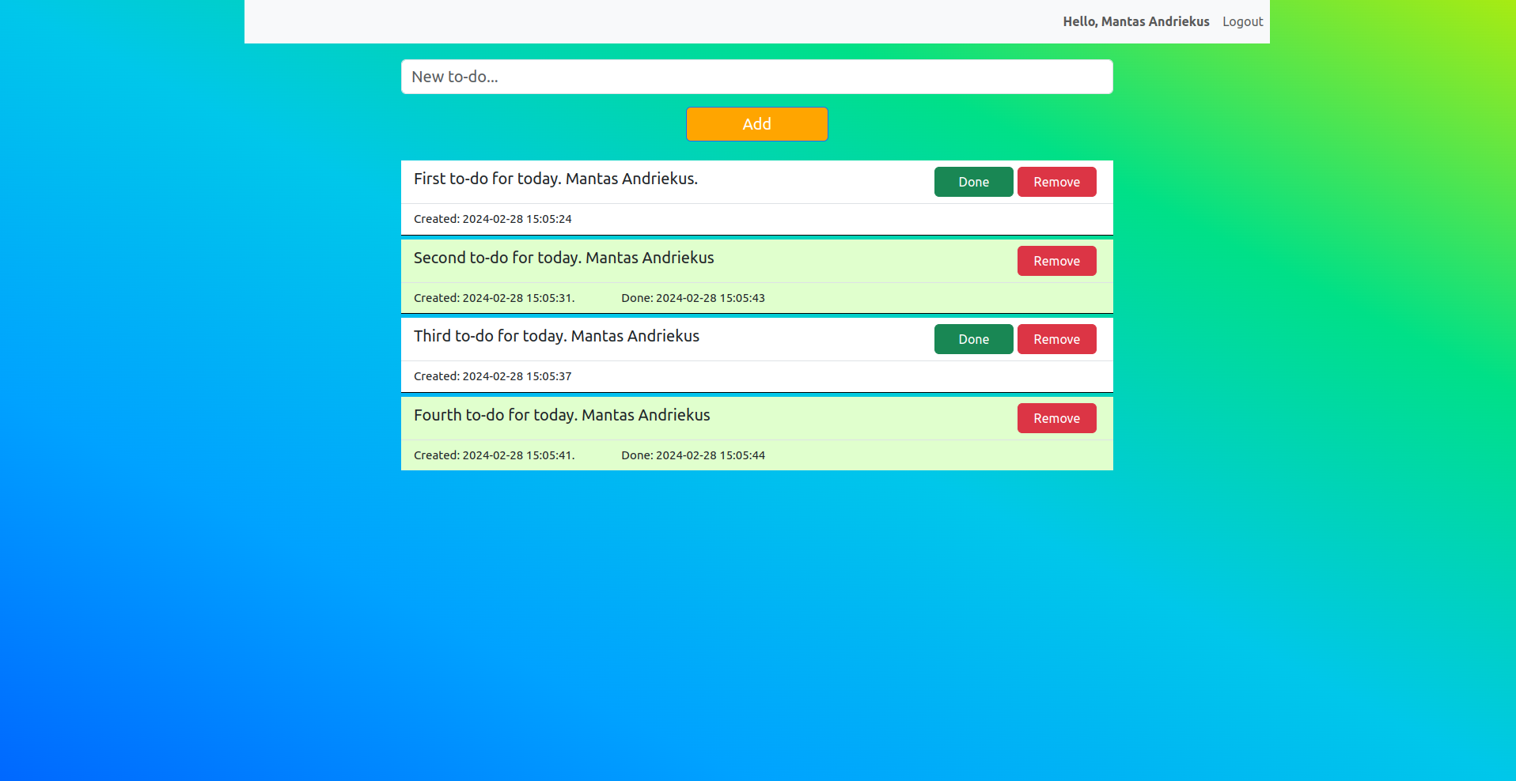
Web application. Index view
Index view used to show user to-do list and perform actions with it.

Slide 17
Web application. API
API routes used to accept requests and respond to API clients.
Using API, client can be authenticated. After successful log in, API client gets JWT token.
Route methods use decorator to validate JWT token.
Acceptable data format – JSON.
Provided data is validated.
API response – JSON data.
API routes (URLs):
dns/api/v1/register_user
dns/api/v1/login
dns/api/v1/add_todo
dns/api/v1/todo_list
dns/api/v1/update_todo_list
dns/api/v1/remove_todo

Slide 18
Web application. Token validation
Token validation is implemented using Python function @wraps.
Decorator is used to verify user and response with data.
If user token is valid decorated function gets user data.
def token_validation(func):
""" method to wrap/decorate routes """
@wraps(func)
def decorated(*args, **kwargs):
token = None
if not "auth-token" in request.headers:
return response_maker(0, 406)
token = request.headers["auth-token"]
try:
# token - token from client
# secret_key - secret key for algorithm
# algorithms - decoding algorithm - must match the algorithm used to encode.
# Decode algorithms is a list of algorithms. Algoritms must be passed to decode method
data = jwt.decode(token, SECRET, algorithms=["HS256"])
user_by_token = uc.get_user_by_username(data["user"])
if not user_by_token:
response_maker(1, 401)
except: #pylint:disable=W0702
return response_maker(2, 401)
return func(user_by_token, *args, **kwargs)
return decorated

Slide 19
Web application. Validators
Using custom Validator class to validate user data.
Same validator class used in views blueprint and api.
Using custom validator is easy to add additional patterns. All patterns can be used in both blueprints.
Validator class return error messages if found.
Validator validates:
String – min, max.
User name – checks if user name exists in database.
Passwords – checks if provided passwords match.
class Validator():
""" Validator class used to validate data """
def validate_registration_data(self, user):
""" validate user data before insert to database"""
def validate_login_data(self, username, password):
""" validate user login data """
def __validate_str_input(self, input_data, min, max, message):
""" validate string data with boundaries and other FUTURE solutions """
def __validate_username(self, username, message):
""" validate username if exists in database """
def __validate_password(self, password, password_to_match, message):
""" verify if given passwords match """

Slide 20
Web application. Controllers
Controllers used to perform actions with database.
Controllers unifies communication with database for both blueprints.
======================= To-do Controller =======================
def add_todo(description, user_id):
""" method to add to-do to database """
def remove_todo(id):
""" method to remove to-do from database"""
def update_todo(id):
""" method to update to-do status (is_done set to True)"""
def get_todo_list(user_id):
""" method to return to-do list from database by user id""“
======================= User Controller =======================
def login_user(username, password):
""" method to check login data """
def register_user(user_info):
""" method to register (add) user to database"""
def get_user_by_username(username):
"""method to get user by username"“”

Slide 21
Web application. Models
Model define data used in application.
Model class inherits Flask-SQLAlchemy models class.
Using models Flask-SQLAlchemy generates database tables and relationships.
Models class implements to_json method. Helps convert Python class to JSON object.

Slide 22
Web application. Models
class User(db.Model, UserMixin):
__tablename__ = "users"
id = db.Column("id", Integer, primary_key=True, nullable=False)
public_id = db.Column("public_id", String(100), unique=True, nullable=False)
first_name = db.Column("firstname", String(50))
last_name = db.Column("lastname", String(50))
username = db.Column("username", String(100), unique=True)
password = db.Column("password", String(200))
todo_list = relationship("Todo")
def __init__(self, public_id,firs_name, last_name, username, password):
""" Initialize model """
def to_json(self):
""" method used to convert model data to json """
class Todo(db.Model, UserMixin):
__tablename__ = "todos"
id = db.Column("id", Integer, primary_key=True, nullable=False)
description = db.Column("description", String(200))
is_done = db.Column("isdone", Boolean)
created_date = db.Column("created_date", DateTime)
done_date = db.Column("done_date", DateTime)
user_id = db.Column("user_id", Integer, ForeignKey("users.id"))
def __init__(self, description, user_id):
""" Initialize model """
def to_json(self):
""" method used to convert model data to json """

Slide 23
Web application. Pipeline
For code versioning using code versioning using git.
Repository deployed to GitHub.
GitHub Actions automates code deployment to cloud.
Repository deployed to GitHub.
GitHub Actions automates code deployment to cloud.
GitHub Actions jobs:
Lints code.
Builds and publishes docker image.
Deploys task definition to ECS.
name: Final project workflow
on:
push:
branches:
- main
pull_request:
branches:
- main
defaults:
run:
shell: bash
env:
REGION: 'eu-central-1'
ECS_CLUSTER_NAME: 'ecs_cluster'
ECS_SERVICE_NAME: 'final-project-service'
TASK_DEFINITION: 'task_definition.json'
jobs:

Slide 24
Web application. Pipeline
Lints Python code
lint-code:
name: 'Linting code'
runs-on: ubuntu-latest
steps:
- name: 'Checkout reposiroty'
uses: actions/checkout@v4
- name: 'Install dependencies'
run: |
python -m pip install --upgrade pip
pip install pylint flask flask_login flask_sqlalchemy
- name: 'Test python code with pylint'
working-directory: ./site
run: |
pylint app/*.py

Slide 25
Web application. Pipeline
Builds and publishes docker image
build-publish-image:
name: 'Build and publish final project image'
runs-on: ubuntu-latest
needs: lint-code
steps:
- name: 'Checkout reposiroty'
uses: actions/checkout@v4
- name: 'Build image'
run: |
docker build -t mantelis900726/final-project-image:latest .
- name: 'Publish image'
run: |
docker login -u ${{ secrets.DOCKERHUB_USERNAME }} -p ${{ secrets.DOCKERHUB_PASSWORD }}
docker push mantelis900726/final-project-image:latest

Slide 26
Web application. Pipeline
Deploys new task definition to ECS service
aws_ecs_task_definition:
name: 'Change task definition'
runs-on: ubuntu-latest
needs: build-publish-image
steps:
- name: 'Checkout repository'
uses: actions/checkout@v4
- name: 'Configure AWS credentials'
uses: aws-actions/configure-aws-credentials@v1
with:
aws-access-key-id: ${{ secrets.AWS_ACCESS_KEY }}
aws-secret-access-key: ${{ secrets.AWS_SECRET_KEY }}
aws-region: ${{ env.REGION }}
- name: 'Change task definition in cloud'
uses: aws-actions/amazon-ecs-deploy-task-definition@v1
with:
task-definition: ${{ env.TASK_DEFINITION }}
service: ${{ env.ECS_SERVICE_NAME }}
cluster: ${{ env.ECS_CLUSTER_NAME }}
wait-for-service-stability: true

Slide 27
Demonstration

