Slide 1
CI/CD
Mantas Boronilščikovas
Software Engineer
mantas.boronilscikovas@swedbank.lt

Slide 2
Agenda
CI/CD explanation
How it looks in practice?
Tools
Practice

Slide 3

1. What is CI/CD?

Slide 4
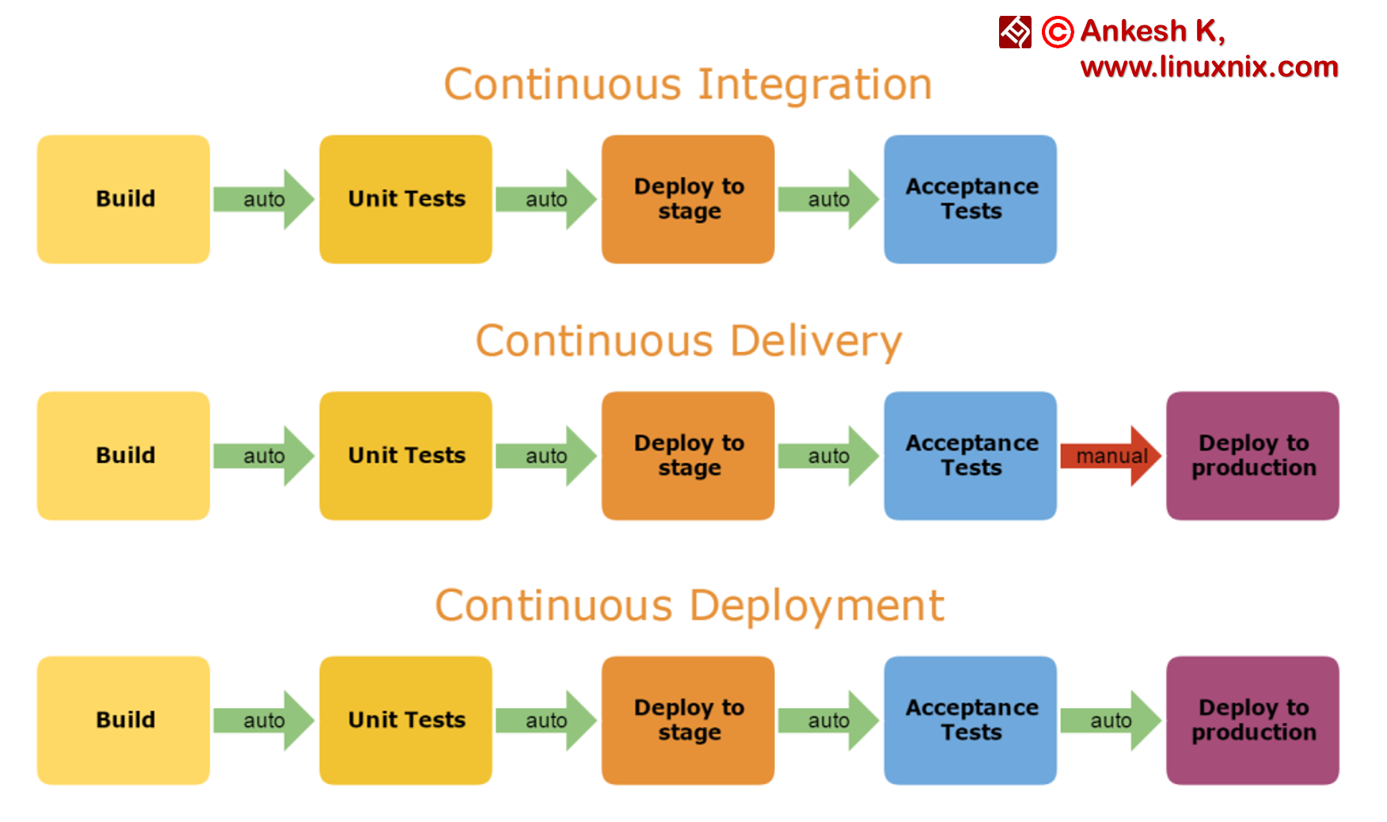
CI/CD
Linux
sudo apt-get install git
sudo yum install git
Mac
http://git-scm.com/download/mac
Windows
http://git-scm.com/download/win
Notes:
CI ir CD yra procesai kurie padeda komandai atlikti daznus kodo pakitimus, nesulauzant kitu parasyto funckionalumo.
Tikslas ir yra sumazinti defektu kieki.

Slide 5

Why we need Continuous Integration?
Many developers
Shared repository
Frequent integration of code
Notes:
Daug developeriu gali dirbti prie vieno projeto, ir jie gali pushinti koda I source control toolsa kelis kart per diena
Jeigu viska mainteninti manual, tai tiesiog kainuoja brangiau, nei naudotis CI/CD toolsais

Slide 6
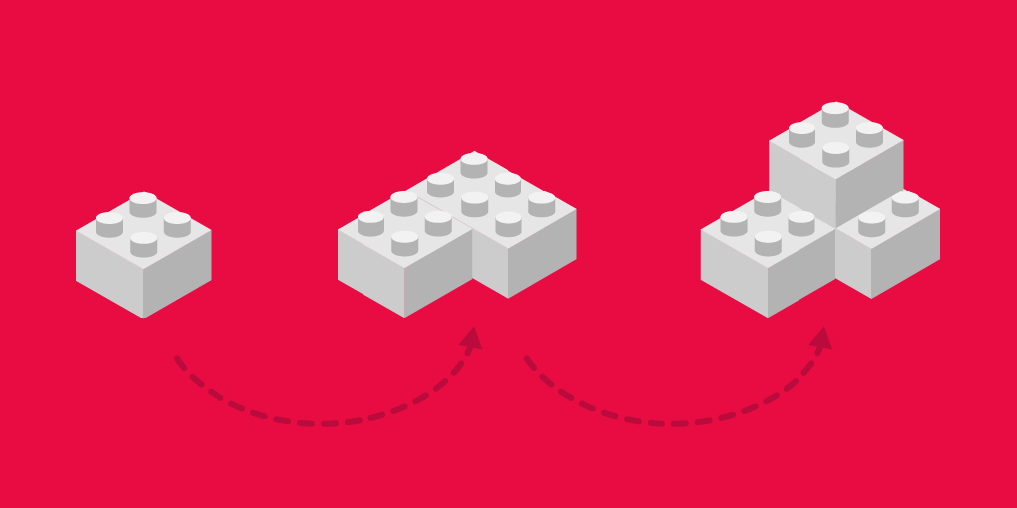
How Continuous Integration work?
As often as you want
Automated test cases
Automated builds
Notes:
Galima pushinti/merginti koda kelis kartus per diena, automatiniai testai/buildai verifikuoja ar kodas vis dar veikia kaip tikimasi
Taupo laika ir pinigus

Slide 7
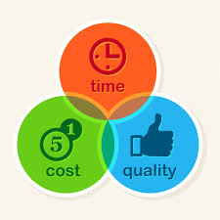
Benefits of Continuous Integration
Reduces bug detection
Automating the process
The process becomes transparent
Cos-effective process
Confidency
Notes:
Reduces Bug Count: sumazina bugu kieki, nes verifikuoja visada tiksliai automatika
Automating the Process: sumazina zmogaus reikalinga darba palaikyti kokybei
The Process Becomes Transparent: Visa komanda gali matyti automatinisu buildus, ir zinoti ar ie failina ar ne, ir kodel
Cost-Effective Process: Del sumazejusiu bugu kiekio, zmogaus darbo poreikio, ir sistemos aiskumo, tai sutaupo pinigus imonei
Confidency: Developeriams padidina pasitikejima daryti code changes, ir pushint juos I

Slide 8

Why Continuous Deployment is needed?
Deliver software with lower risk and money
Notes:
CD yra skirtas sustumti koda I produkcija, tai gali buti bet kokio tipo changes, configuration, features, fixes. Jie yra deliverinami customeriui saugiu ir greitu budu

Slide 9
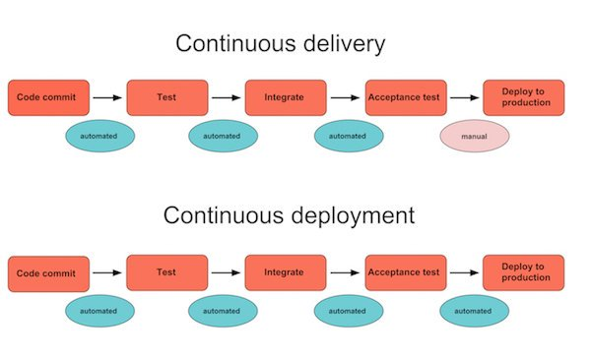
How Continuous Deployment works?
Software build will automatically deploy if it passes all tests
Notes:
Continuous deployment extends continuous delivery so that the software build will automatically deploy if it passes all tests. In such a process, there is no need for a person to decide when and what goes into production. The last step in a CI/CD system will automatically deploy whatever build components/packages successfully exit the delivery pipeline. Such automatic deployments can be configured to quickly distribute components, features, and fixes to customers, and provide clarity on precisely what has is presently in production.

Slide 10
Benefits of Continuous Deployment
Time to market
Reducing the risk
High quality application
Reduced cost
Happier team and better product
Notes:
Time to market: deployment easier, smaller and faster
Reducing the Risk: more smaller releases, almost no downtime, totally undetectable to the users.
High-Quality Application: Most of the process is automated, testers now have a lot of time to focus on important testing phases like exploratory, usability, security and performance testing.
Reduced Cost: When an investment is made on testing, build and deployment, the product evolves quite a lot throughout its lifetime. The cost of frequent bug fixes and improvements are reduced since release is faster and automatic.
Happier Team and Better Product: the team can work in a relaxing manner. Because of frequent release, the team works closely with users and learn what ideas work and what new can be implemented to delight the users.

Slide 11
2. How it looks in practice?

Slide 12
How To Perform Continuous Delivery (1)
The developer builds their code on the local system that has all the new changes or new requirements.
Once coding is completed, the developer needs to write automated unit testing scripts that will test the code. This process is optional, however, and can be done by the testing team as well.
A local build is executed which ensures that no breakage is occurring in the application because of the code.

Slide 13
How To Perform Continuous Delivery (2)
After a successful build, the developer checks if any of his team members or peers have checked-in anything new. If there are any incoming changes, they should be accepted by the developer to make sure that the copy he is uploading is the most recent one.
Because of the newly merged copies, syncing the code with the main branch may cause certain conflicts.
In case there is any conflict, they should be fixed to make sure the changes made are in sync with the main branch.

Slide 14
How To Perform Continuous Delivery (3)
The changes are now ready to be checked in. This process is known as a “code commit.”
After the code is committed, another build of the source code is run on the integration system.
The new and updated code is finally ready for the next stage, i.e. testing or deployment. In the next section, we shall discuss some basic checklist for continuous delivery.

Slide 15
Demo of Swedbank CI/CD

Slide 16
3. Tools

Slide 17



Notes:
Tip: Heroku goes to sleep after 30 seconds

Slide 18
Practice!!!

Slide 19
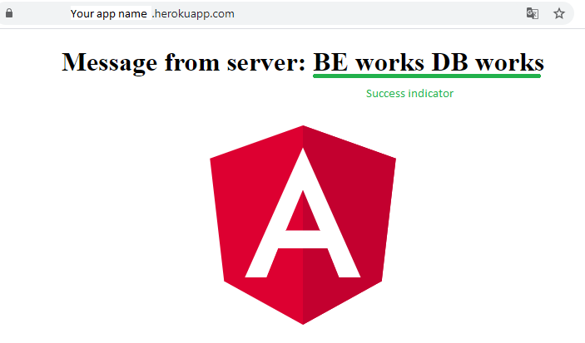
Expected result

