Slide 1
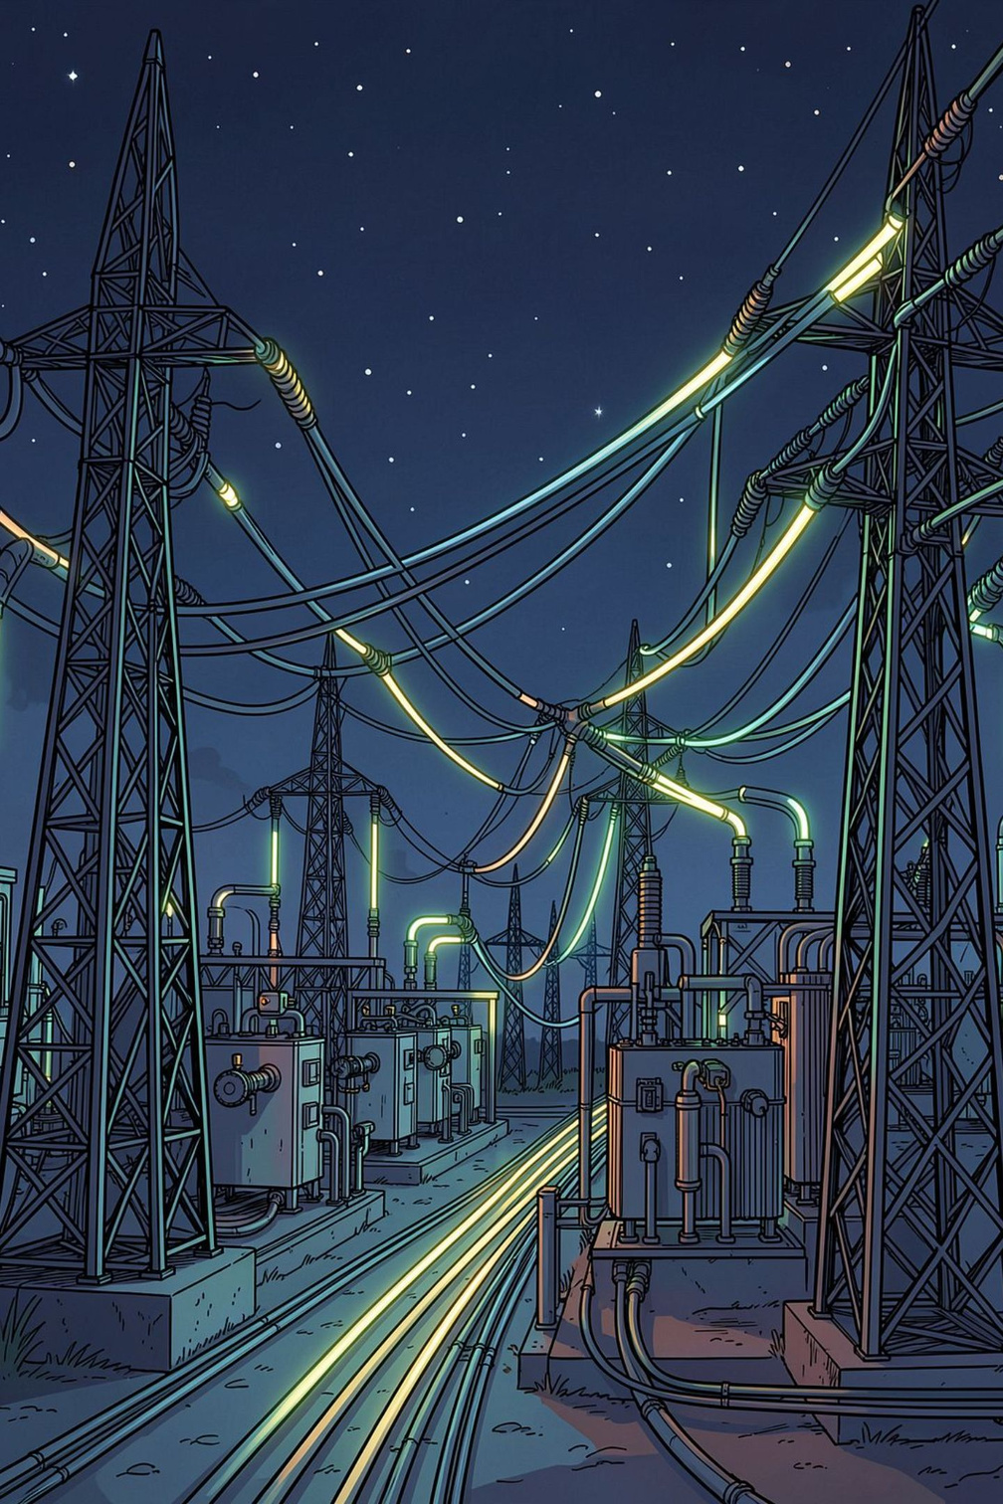

🤖 BOB AI HACKATHON — AI TRACK
⚡ ThreatOps
Predictive Grid Outage & Equipment Failure Advisor
Predict. Prevent. Keep the Grid On.
Transforming utility operations from reactive emergency repairs to proactive AI-driven failure prevention across 836+ Gujarat grid assets.
Notes:
1

Slide 2
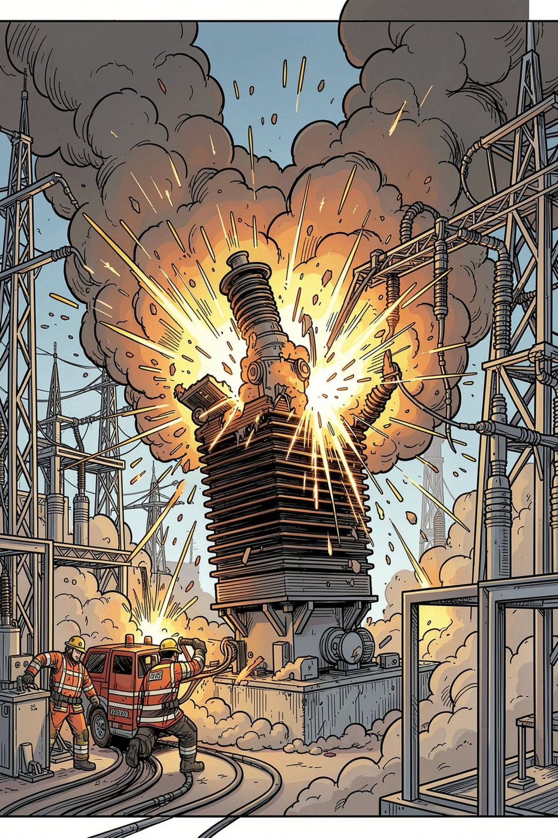

PROBLEM STATEMENT
🚨 Reactive Grid Management & Silent Equipment Failures
What Is the Problem?
Who Suffers?
High-voltage transformers fail silently due to undetected DGA gas anomalies — C₂H₂ (arcing), C₂H₄ (overheating), CH₄ (degradation) — causing regional blackouts and multi-million-dollar emergency replacements.
Grid dispatch engineers and SCADA operators at GETCO and PGCIL, alongside industrial and residential consumers facing sudden outages.
Why Now?
3+ hours wasted per incident manually correlating logs across 12+ disconnected SCADA tools. Renewable energy integration adds dynamic thermal strain on aging assets.
Notes:
2

Slide 3
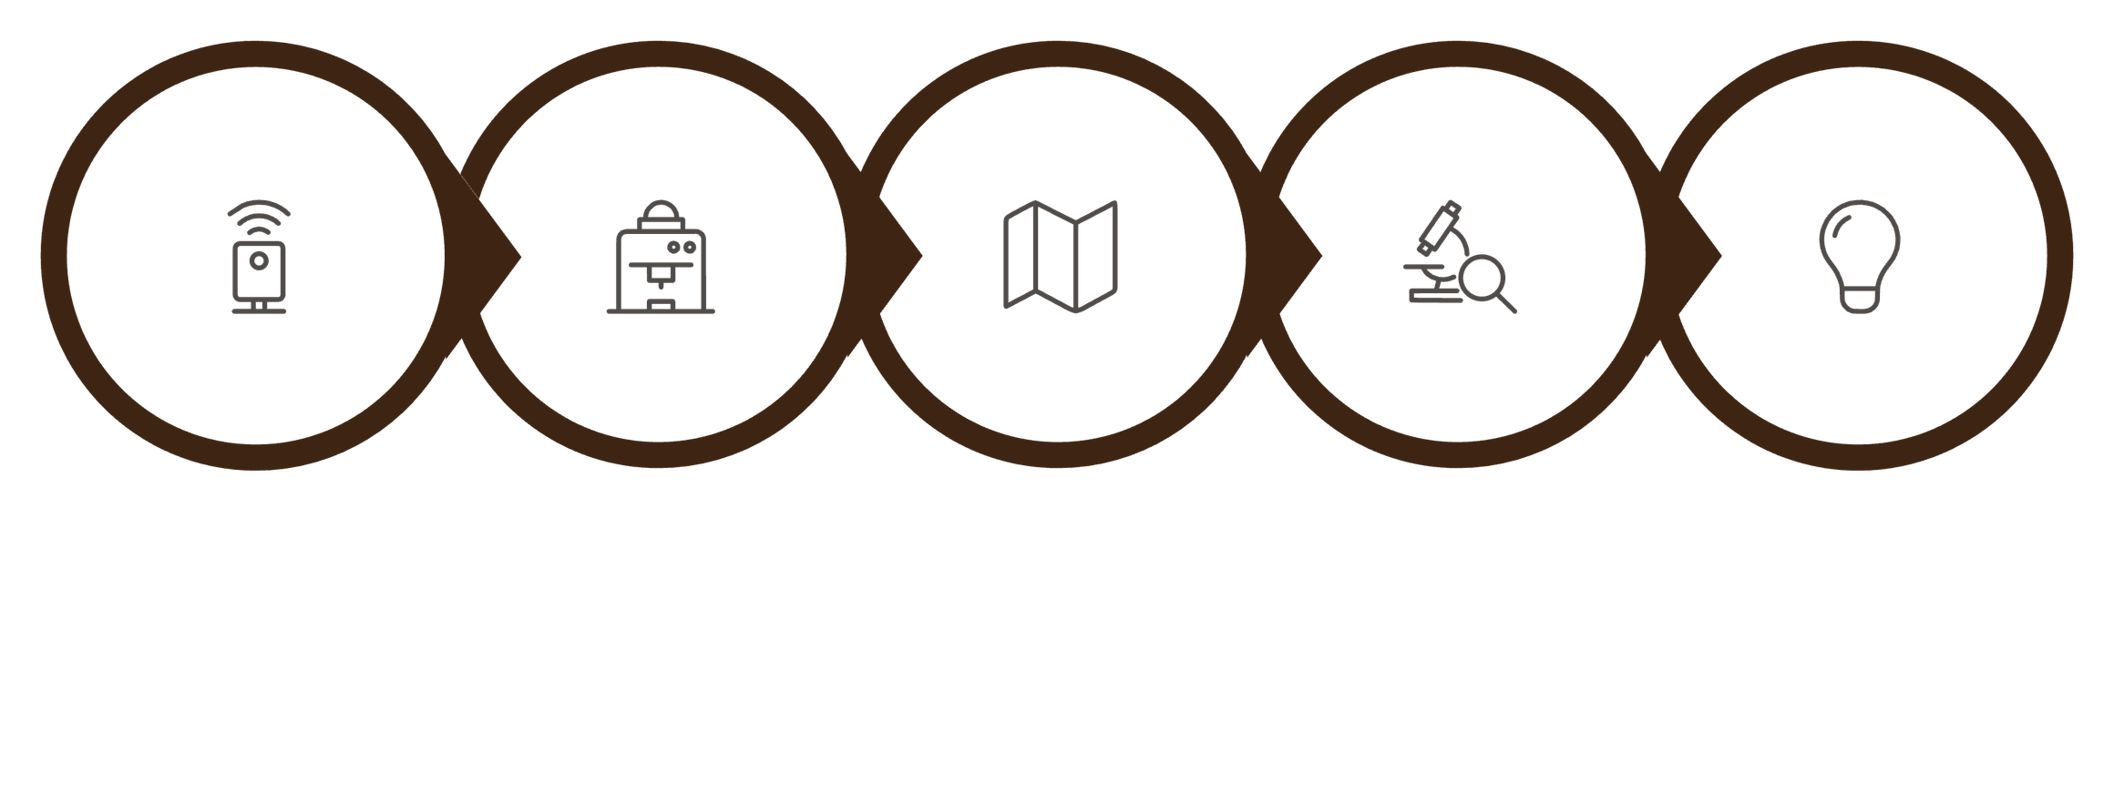
SOLUTION
💡 ThreatOps AI Grid Advisor
An AI-powered decision-support platform that ingests multi-sensor telemetry, diagnoses transformer DGA chemistry, visualizes statewide grid health, and automates crew dispatch — before outages occur.
Automated Recommendation
Multi-Sensor Telemetry
XGBoost ML Engine
Statewide GIS Grid
SHAP Attribution
🎯 96.25% Accuracy
🗺️ 836+ Assets
🧪 AI Testing Studio
Across 6 critical fault modes
33 Gujarat districts mapped
Real-time parameter simulation
Notes:
3

Slide 4
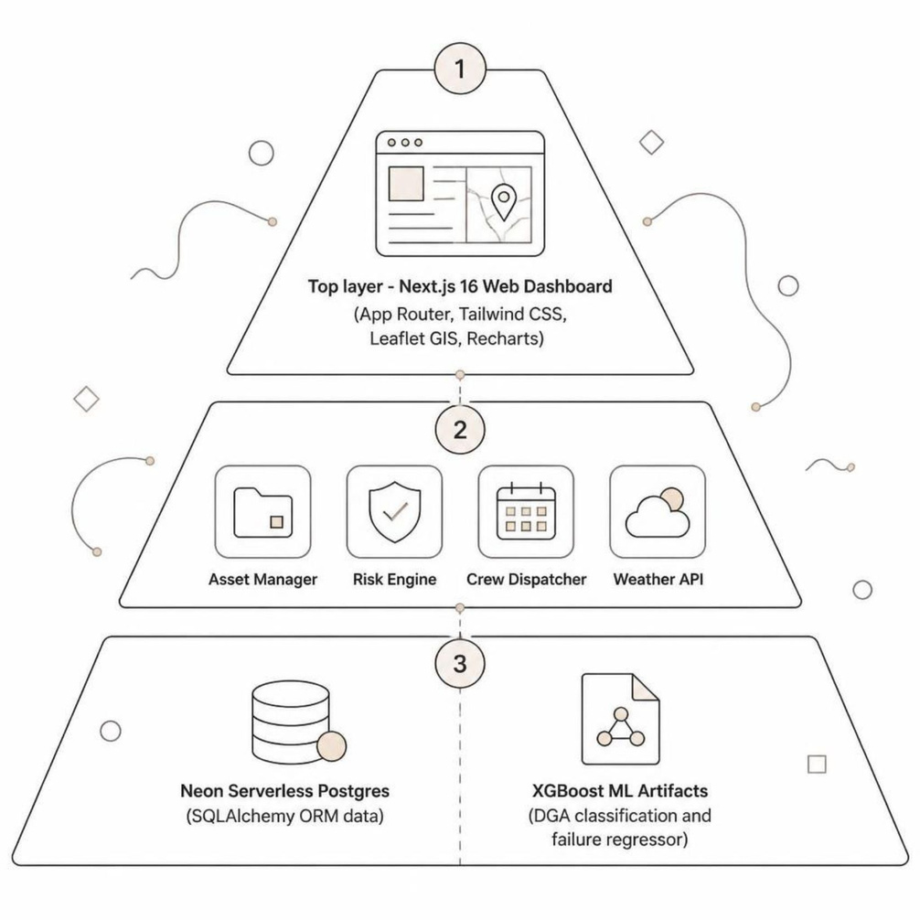
ARCHITECTURE
🏗️ Technical Architecture & System Flow
Full-Stack Tech Stack
Frontend UI | Next.js 16, React, Tailwind CSS
GIS Mapping | Leaflet.js, MapTiler Engine
API Server | Python 3.10+, FastAPI, Uvicorn
ML Engine | XGBoost, scikit-learn, SHAP, joblib
Database | Neon Serverless PostgreSQL
Notes:
4

Slide 5
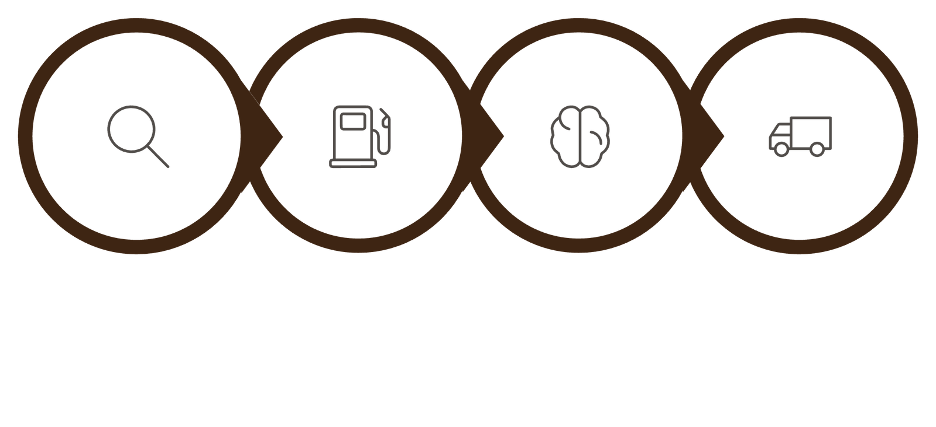

DEMO
🔬 Station-Level DGA Inspector & AI Studio
Live inspection of Acetylene (C₂H₂), Ethylene (C₂H₄), Methane (CH₄), Hydrogen (H₂), Oil Temperature, and Winding Vibration — with IEC 60599 color-coded risk badges (Normal, Warning, Critical).
Run XGBoost
Dispatch Crew
Search Asset
Inspect DGA
IEC 60599 Compliance
District Weather Threat Radar
Automated risk status badges per gas level
30-day historical trends + 7-day predictive forecast
Notes:
5

Slide 6
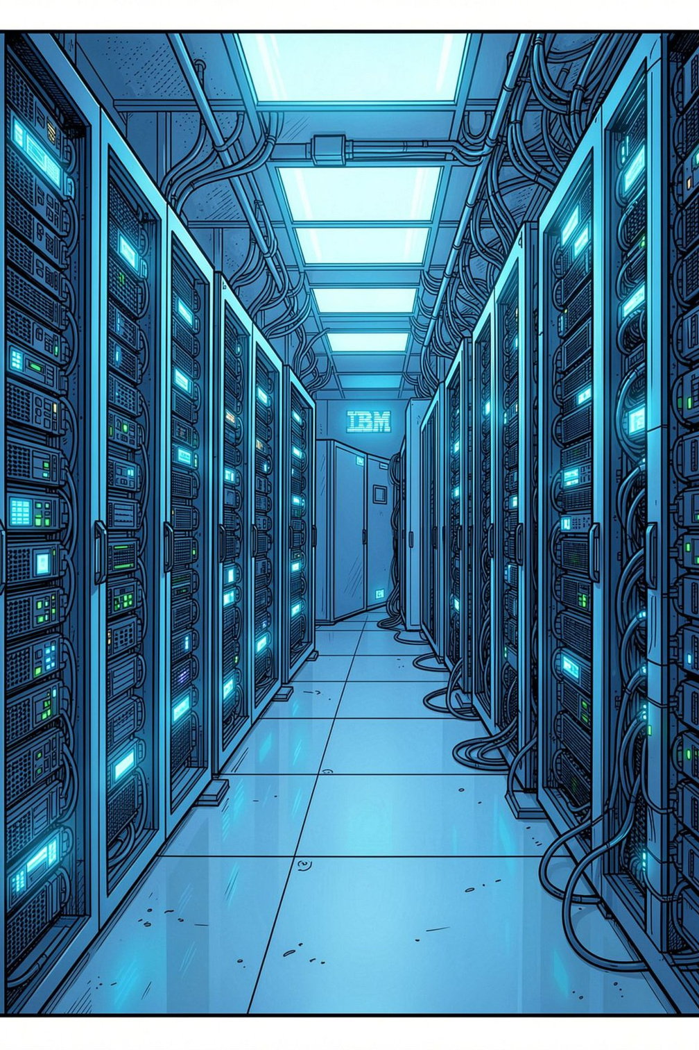



IBM INTEGRATION
⚙️ IBM Technology Integration
ThreatOps natively integrates IBM's enterprise AI and observability stack for intelligent grid management.
IBM Bob AI
watsonx.ai — Granite 3.0
Natural language incident summaries for DGA anomalies and one-click runbook execution for emergency feeder switching.
Root-cause classification across multi-sensor telemetry. Evaluates thermal, electrical, and gas ratios for operator action guidance.
IBM Instana SCADA
Real-time sensor telemetry ingestion (temperatures, gas ppm, load %, vibration) from high-voltage GETCO substations.
Notes:
6

Slide 7
RESULTS
📈 Quantitative Impact & Success Metrics
96.25%
836+
Model Accuracy
Grid Assets
XGBoost multi-class fault classification
Gujarat assets mapped and monitored
75%
$10M+
MTTR Reduction
Annual Savings
Mean time to repair reduced
Cost avoidance through preventive maintenance
Metric | Baseline | ThreatOps | Benefit
Incident Diagnosis | 3+ Hours | < 15 Seconds | 95% Faster
Grid Coverage | Sampled manual | 836 Assets, 33 Districts | 100% Visibility
Crew Dispatch | Reactive (post-outage) | Proactive (pre-positioning) | Zero emergency delay
Notes:
7

Slide 8


TEAM
👥 ThreatOps Team & Engineering Contributions
Team Lead & Full-Stack AI Engineer: Manthan — sole developer responsible for all system components.
ML & Data Pipeline
1
Built the 96.25% XGBoost DGA classification engine with SHAP explainability across 6 fault modes.
Frontend Dashboard
2
Architected Next.js 16 UI with Leaflet GIS mapping, AI Predictions Studio, and Weather Threat Radar.
Backend & Database
3
Developed Python FastAPI microservices and Neon PostgreSQL ORM schemas for assets, sensors, and crews.
GIS & Workflows
4
Mapped 836+ Gujarat assets across 33 districts with automated crew dispatcher and weather forecasting.
Notes:
8

Slide 9
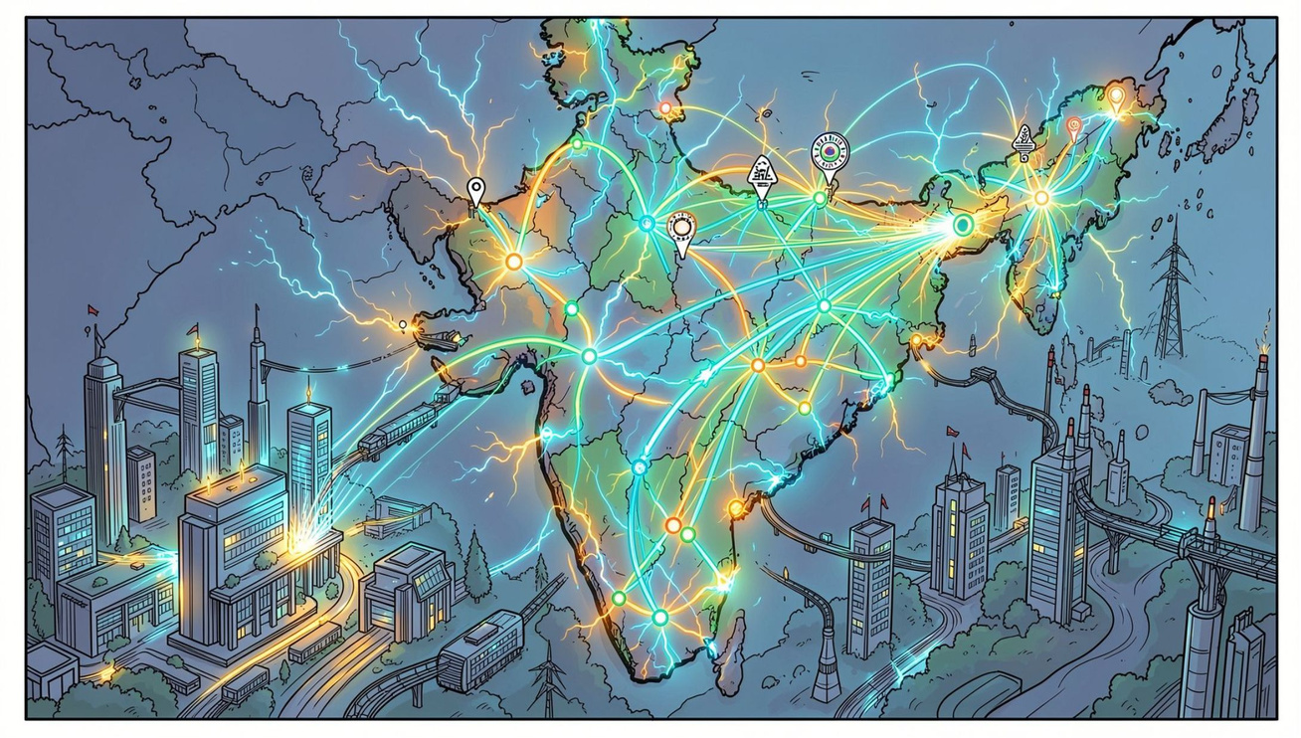
VISION
🔭 The Road Ahead: Scaling ThreatOps Nationally
Phase 1 — Gujarat State Rollout
Deploy live across all GETCO substations with real-time SCADA integration and operator training programs.
Phase 2 — National Expansion
Extend to PGCIL, NTPC, and state electricity boards across India's 4,000+ high-voltage substations.
Phase 3 — Predictive Intelligence
Integrate federated learning for continuous model improvement and cross-grid anomaly pattern sharing.
Notes:
9

Slide 10
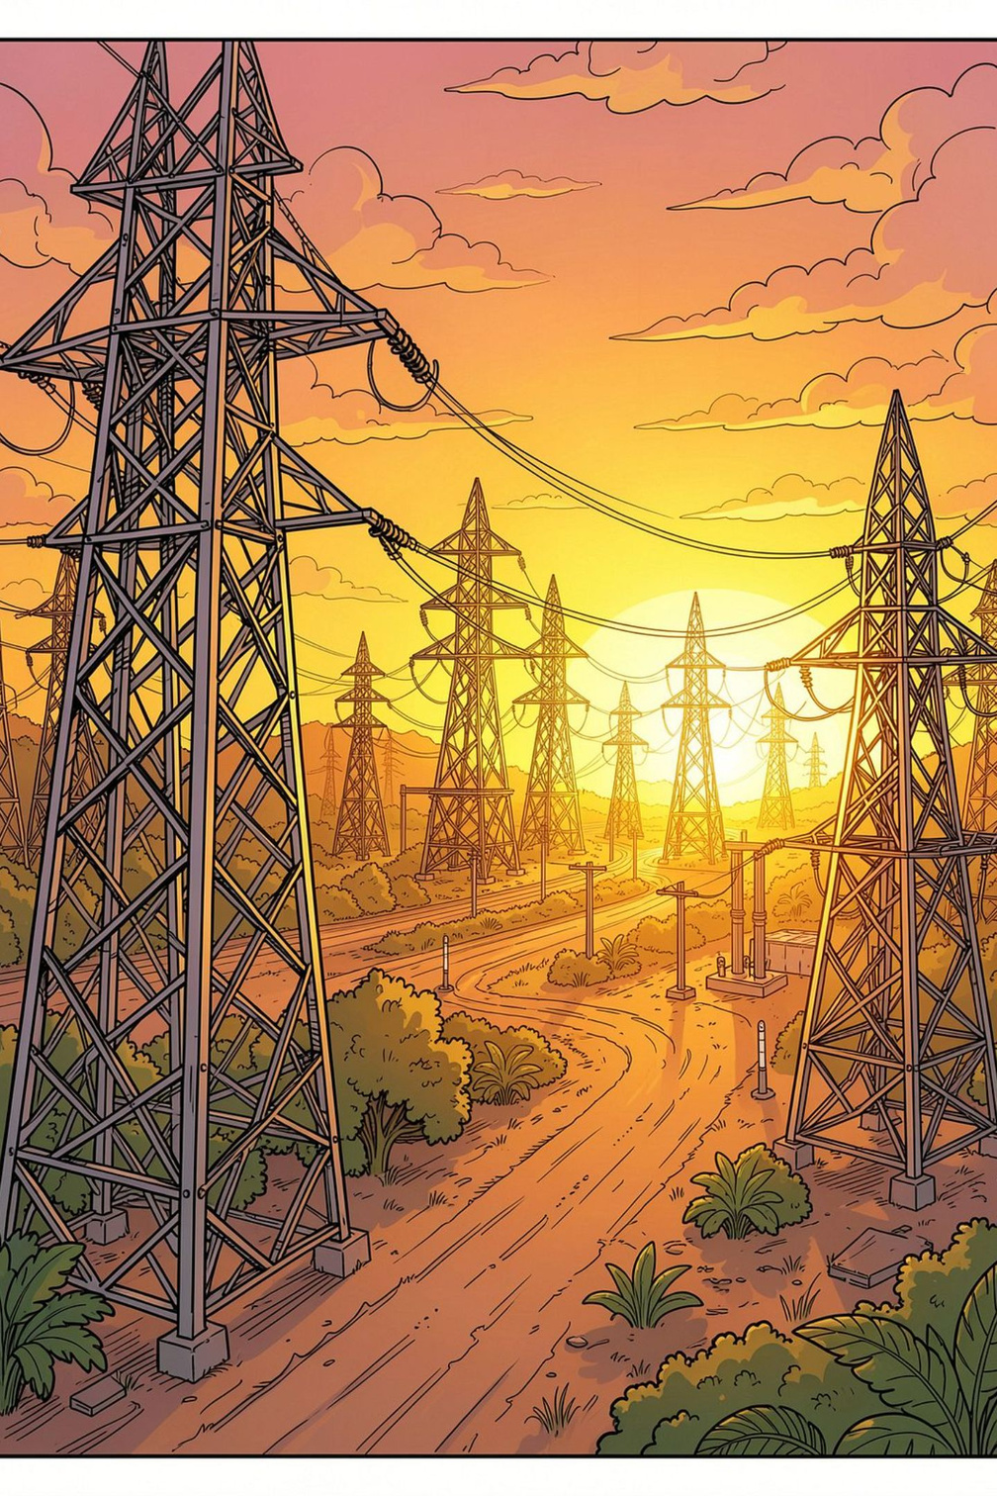
CLOSING
Predict. Prevent. Keep the Grid On.
ThreatOps eliminates silent transformer failures through explainable AI, statewide GIS visibility, and automated crew dispatch — saving lives, infrastructure, and billions in emergency costs.
🤖 AI-Powered
🗺️ Statewide Scale
96.25% accurate XGBoost fault classification
836+ assets across 33 Gujarat districts
⚡ Zero Downtime
Proactive dispatch before outages occur
ThreatOps — Built for the Bob AI Hackathon by Manthan (Team Lead & Full-Stack AI Architect). Target infrastructure: High-voltage electrical power grids across Gujarat.
Notes:
10

