Slide 1

Odoo India
Address:
401 & 402, Floor 4,
IT Tower 3 InfoCity Gate,
1, Gandhinagar, Gujarat 382007

Slide 2
Our Internship Experience At odoo India
Prepared By :
Vaghasiya Archana (12108102)
Gehlot Manthan (12108124)

Slide 3
Odoo India
Odoo is a suite of open source business apps that cover all your company needs: CRM, eCommerce, accounting, inventory, point of sale, project management, etc.
Odoo is a Belgian suite of business management software tools including, for example, CRM, e-commerce, billing, accounting, manufacturing, warehouse, project management, and inventory management.
Between the Odoo apps and the tens of thousands of Community apps, there is something to help address all of your business needs in a single, cost-effective and modular solution: no more work to get different technology cooperating.
Odoo apps are perfectly integrated with each other, allowing you to fully automate your business processes and reap the savings and benefits.

Slide 4
History
In 2005, Fabien Pinckaers, the founder and current CEO of Odoo, started to develop his first software product, TinyERP. Three years later, the name was changed to OpenERP. The company started to grow quickly and in 2010, OpenERP had become a 100+ employee company.
In 2013, the company won a Deloitte award for being the fastest-growing company in Belgium, with 1549% growth over a five-year period.
In 2014, the company was renamed Odoo, to diversify itself from the term "ERP".[15] In 2015, Inc. Magazine placed Odoo in the top 5000 fastest-growing private companies in Europe,In 2019, the company raised a $90 million investment.
In 2021, Odoo products were used by more than 5 million customers.Odoo expects to hire 1,000 new employees, according to CEO Fabien Pinckaers.

Slide 5
Initial release date:
February 2005
Developer:
Odoo SA
License:
"Community" version: GNU Lesser General Public License v3; "Enterprise" version: Proprietary license
Repository:
github.com/odoo/odoo
Operating system:
Linux, Unix-like, OS X, Windows, iOS, Android
Preview release:
master
Programming languages:
Python, JavaScript

Slide 6
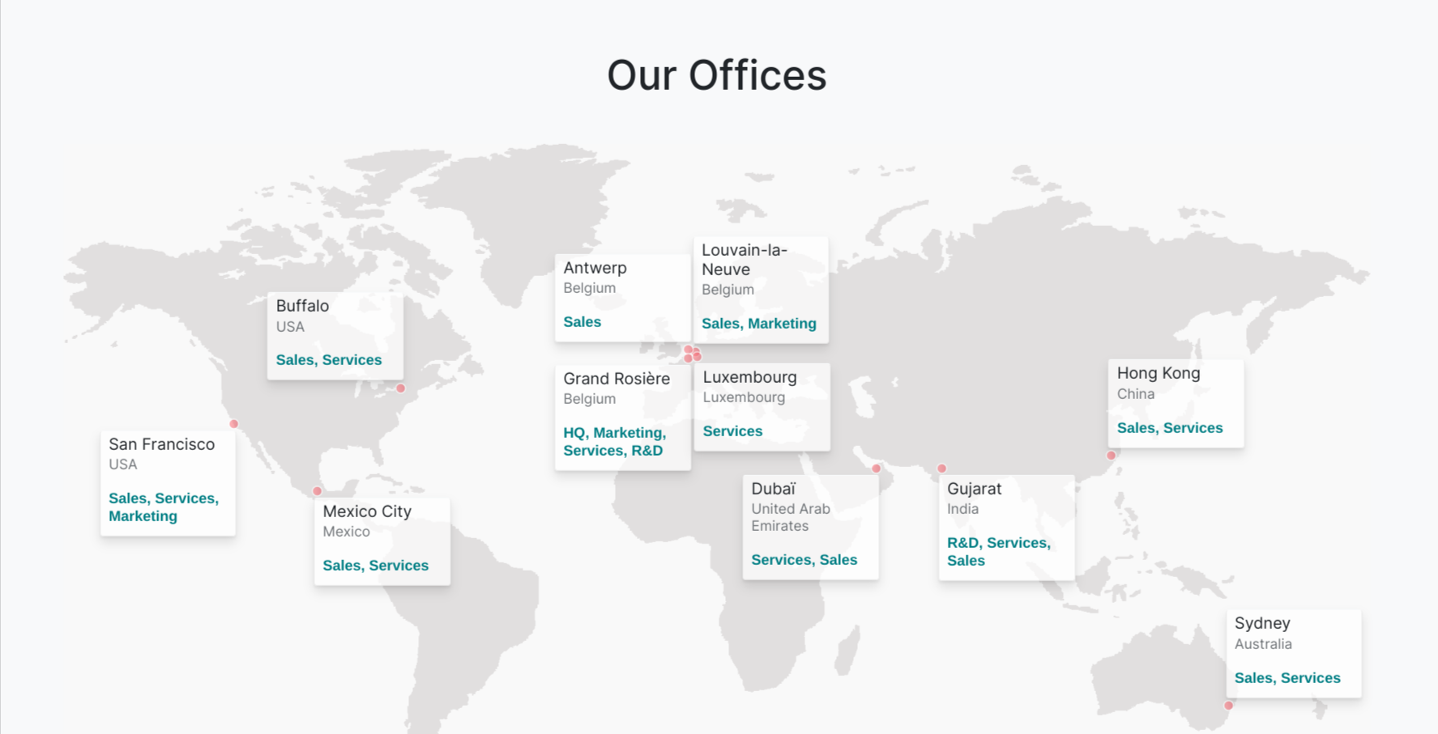

Slide 7
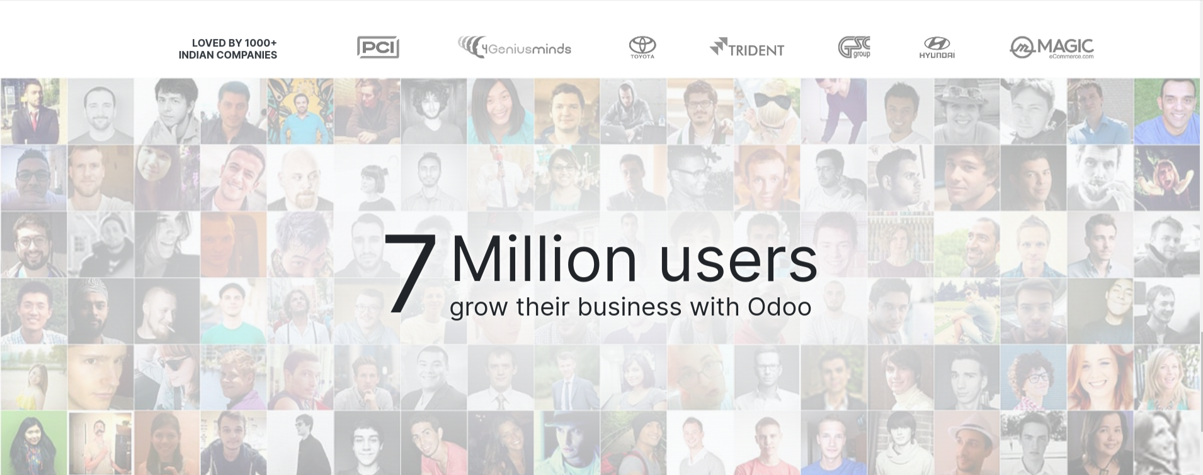

Slide 8
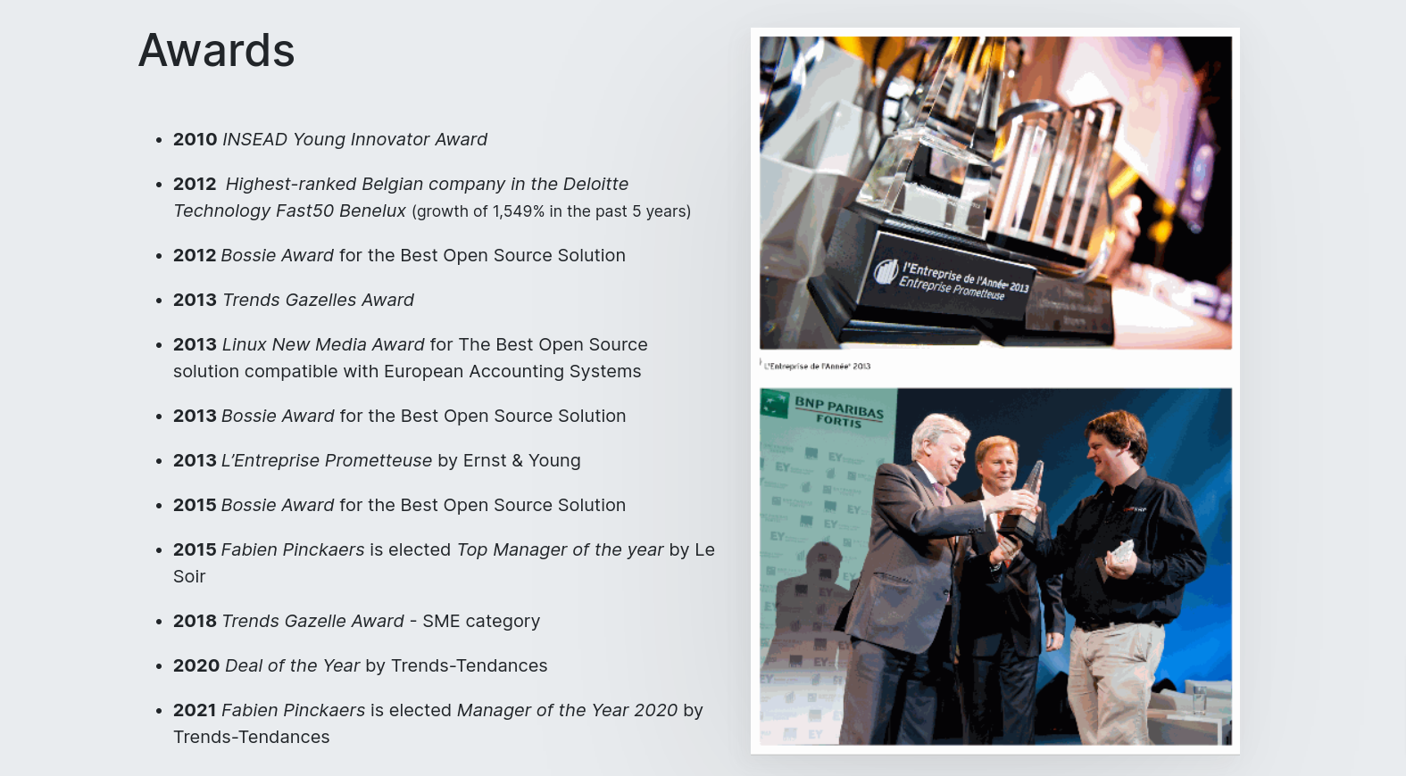

Slide 9
Odoo is open source so you write public code and contribute to the development community. Greate, is not it? moreever what you develop will be used by milions of people all over the world.

