Slide 1
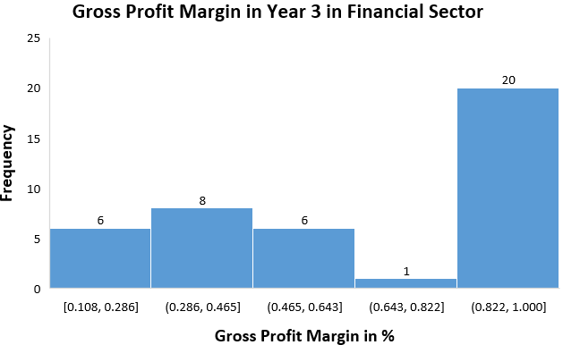
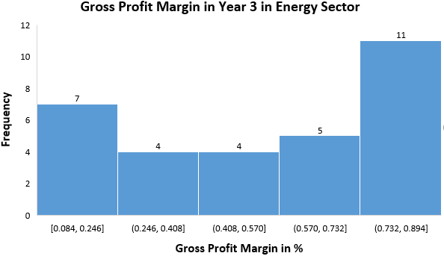
Does Financial Sector have similar gross profit margin to that of energy sector in Year 3?
Here are the histograms of Gross Profit Margin for Financial and Energy Sector Companies calculated using formula of gross profit = [1-(COGS/Total Revenue)] for all companies of both sectors for Year 3.
As we can clearly observe in both histograms that frequency increases from lower values to higher values which clearly indicates that both distributions are left-skewed or negatively skewed, which also means median is higher than mean.
Mean for financial sector is 0.667 (66.7%) and for Energy sector is 0.52 (52%) whereas median for financial sector is 0.721 (72.1%) and for energy sector is 0.634 (63.4%) which shows median is higher than mean in both sector. Thus, justifies left skewed histograms.
Standard Deviation for financial sector is 32% slightly higher than that for energy sector which is 28% which indicates that variability in financial sector is higher with 50% companies having gross profit margin greater than 72.1% whereas 50% companies of energy sector have gross profit margin grater than 63.4%.
Gross profit margin for financial sector ranges from 10.8% to 100% (range=89.2%) whereas for energy sector, it ranges from 8.4% to 89.4% (range=81%).
Sources:- N/A

