Slide 1
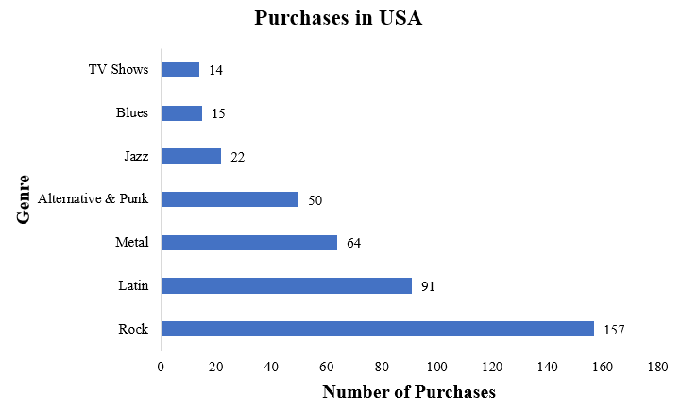
Types of puchases in USA
We can clearly seen that Rock music is most purchased music in USA.
Second most purchased music is Latin followed by Metal, Alternative & Punk, and so on.

Slide 2
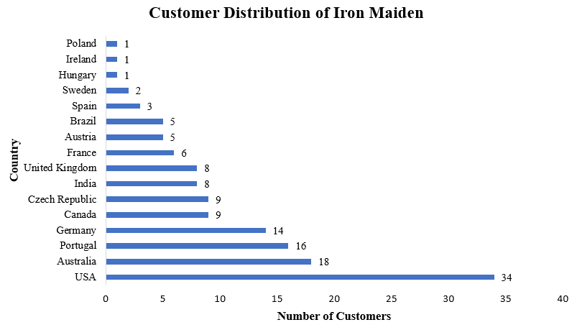
Customer Distribution of Most Popular Artist
First we found that “Iron Maiden” is most popular artist as it has maximum purchasers.
Secondly, we founded Distribution of these customers and found out that USA has most number of purchasers of “Iron Maiden”, followed by Australia, then Portugal, Germany and so on…

Slide 3
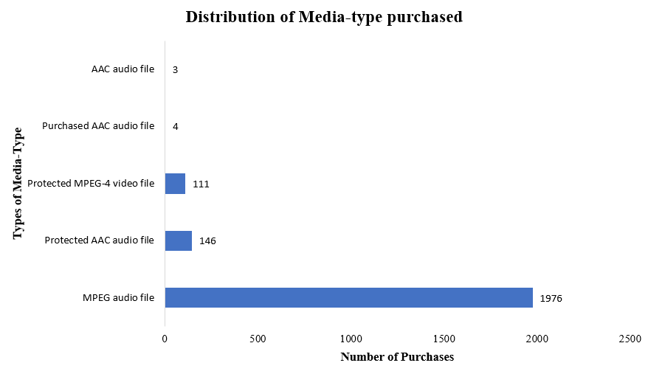
Preference Distribution of Media-Type
As from the adjacent graph, we can clearly observe that MPEG audio file is most preferred (most purchased) media-type.
Number of purchases of MPEG audio file is exponentially high than (approximately 14 times of ) second most purchased media-type.

Slide 4
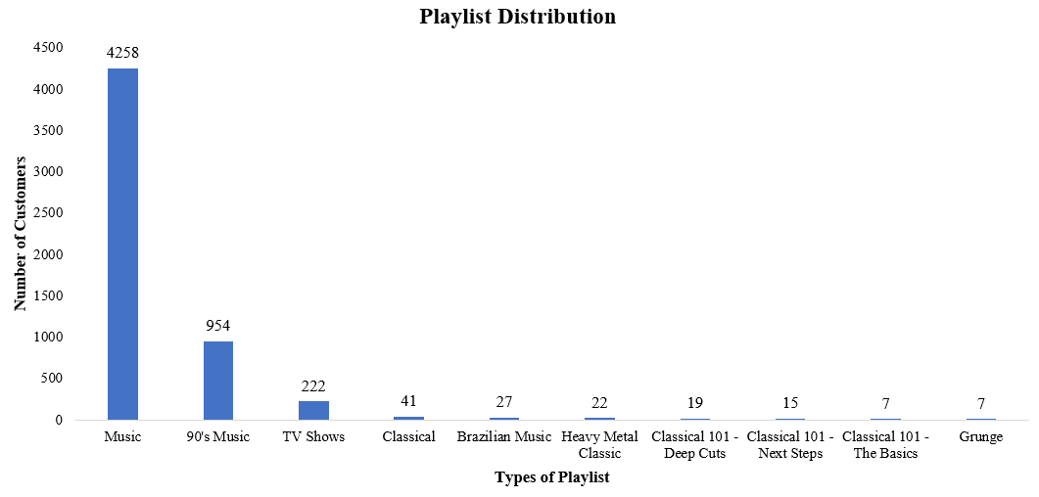
Playlist Preference of Customers
From this distribution graph, we can clearly interpret that maximum number of customers like current music.
90’s Music is second most preferred playlist followed by TV shows, Classical, Brazilian Music, and so on…

