Slide 1

RESTAURANT MARKET ANALYSIS
Zomato: Global Restaurant Analysis
Where Zomato should open its next restaurants — a data-driven expansion strategy
Manthan Gadegone

Slide 2
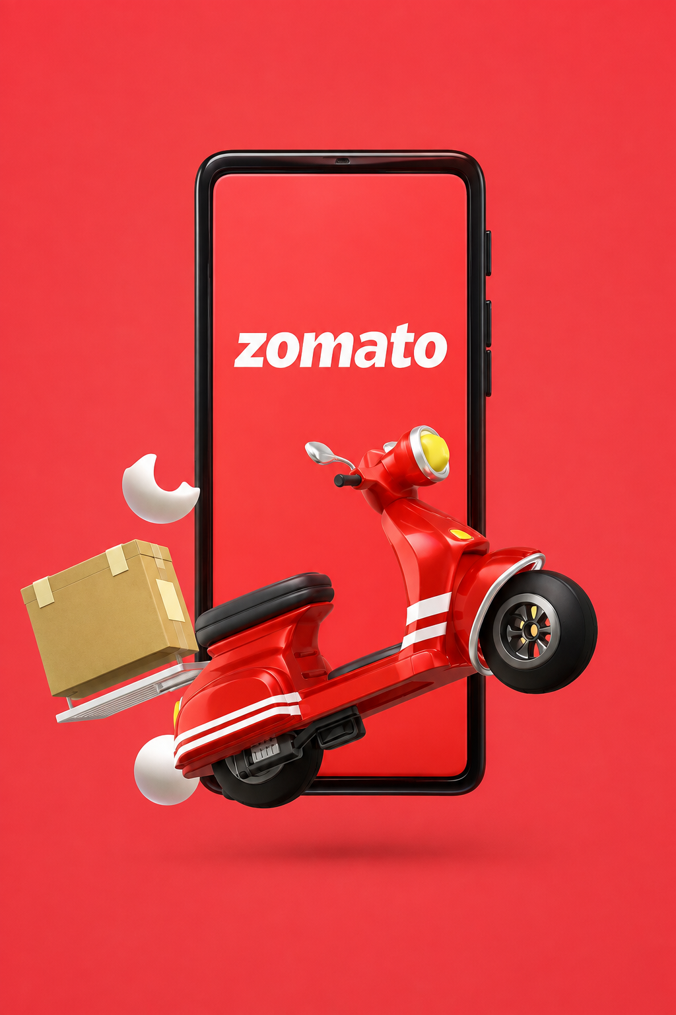
COMPANY OVERVIEW
About Zomato
India's largest platform — the country's biggest online food ordering and delivery platform.
Broad restaurant network — lists restaurants across the country spanning a wide range of cuisines.
Analysis goal — identify which cuisines and locations drive the highest customer satisfaction, to guide expansion.
2

Slide 3
THE BRIEF
Problem Statement
You are hired as a consultant data analyst by Zomato, where the team is looking for expansion and to open more restaurants.
Your task: develop strategies and suggestions for opening newer restaurants, backed by data.
3

Slide 4
THE DATASET
Data Overview
15
9,551
2.89
14,98,645
COUNTRIES
RESTAURANTS
AVG. RATING
TOTAL VOTES
DATASET STRUCTURE
SCOPE & OPERATIONAL DATA
2 tables: Raw Data and Country Description
21 attributes covering restaurant and customer data
Restaurant data: Locality, City, Address
Customer engagement data: Ratings, Votes
Scope: 9,551 restaurants across 15 countries
Operational data: Online delivery, Table booking
Engagement metrics tracked per restaurant
Basis for all downstream analysis in this report
4

Slide 5
HOW WE GOT HERE
Methodology
01
Data Integration
Built a dataset of 9,551 restaurants across 15 countries with restaurant locations and service types.
02
Currency Normalization
Normalized 'Average Cost for Two' to a standard INR currency to compare pricing worldwide.
03
Pre-processing
Cleaned the data by extracting year and month values from the date keys.
04
Aggregation
Used pivot tables to calculate overall average rating (~2.89) across ~1.5 million total votes.
05
Visualization
Built a dynamic dashboard with KPIs, geographic bar charts, and pie charts of delivery trends and favorite cuisines.
5

Slide 6
TREND ANALYSIS
Growth Trajectory
NO. OF RESTAURANTS OPENED EACH YEAR
KEY TAKEAWAYS
Steady growth in new restaurant openings from 2010 through 2018.
Peak year: 2018 saw the highest number of new restaurants (1,102).
Lowest year: 2012 recorded the fewest new restaurant openings.
6

Slide 7
MARKET PRESENCE
Global Footprint
TOTAL RESTAURANTS, COUNTRY-WISE
KEY TAKEAWAYS
Dominant market: India leads with 8,652 restaurants — by far the largest share.
International presence: the United States follows distantly with 434 restaurants.
Smallest footprint: Canada has the fewest restaurants, just 4.
7

Slide 8
MENU INSIGHTS
Culinary Trends
TOP 10 CUISINES BY RESTAURANT COUNT
North Indian leads as the most popular cuisine with 936 restaurants, followed by Chinese and Fast Food
Fusion demand: the popularity of the “North Indian, Chinese” combination points to strong appetite for fusion menus.
8

Slide 9
PRICING LANDSCAPE
Financial Analysis
AVERAGE COST FOR TWO, COUNTRY-WISE (INR)
KEY TAKEAWAYS
Most expensive: Singapore has the highest average cost for two.
Most affordable: Turkey is the most budget-friendly market.
Global average: the overall average cost for two is Rs. 838.99.
9

Slide 10
RATINGS LANDSCAPE
Customer Satisfaction
AVERAGE RATING BY COUNTRY (OUT OF 5)
KEY TAKEAWAYS
Lowest rating: India has the least average rating at 2.77, despite being the largest market.
Highest rating: the Philippines leads with an average rating of 4.47.
10

Slide 11
SERVICE AVAILABILITY
Table Booking
WHAT THE NUMBERS SAY
9,551 restaurants across 15 countries make up the full dataset.
1,158 restaurants (12%) offer table booking.
8,393 restaurants (88%) do not currently offer table booking — a major expansion opportunity.
12%
HAVE TABLE BOOKING
11

Slide 12
SERVICE AVAILABILITY
Online Delivery
WHAT THE NUMBERS SAY
9,551 restaurants across 15 countries make up the full dataset.
2,451 restaurants (26%) offer online delivery.
7,100 restaurants (74%) do not currently offer online delivery — a clear digital growth lever.
26%
HAVE ONLINE DELIVERY
12

Slide 13
WHAT WE RECOMMEND
Strategic Recommendations
01
02
03
Digital Expansion
Target High-Value Markets
Enhance Quality in India
Expand online delivery and table booking to the remaining restaurants that don't yet offer them.
Focus premium branding on the Philippines, Turkey, and Indonesia — markets with higher customer satisfaction.
India is the biggest market; raising its average rating should be the top priority for long-term growth.
13

Slide 14
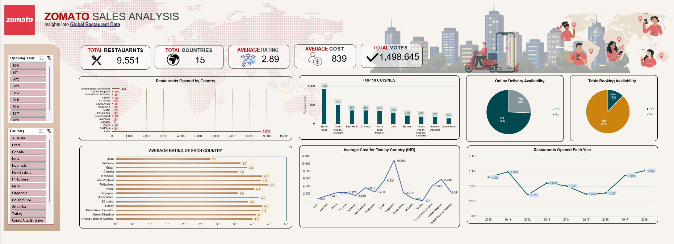
INTERACTIVE REPORTING
Dashboard
14

Slide 15
BRINGING IT TOGETHER
Conclusions
Look for high vote counts. Before choosing a location for a new restaurant, prioritize cities with high vote counts — a signal of an active, engaged customer base.
Balance cost and rating. Countries or cities with a high average cost, paired with high average ratings and fewer existing restaurants, are best suited for new openings.
Priority markets. Indonesia, Canada, and the Philippines stand out as the strongest candidates for expansion based on this analysis.
15

Slide 16
Thank You
Questions & Discussion

