Slide 1

The Problem Statement
You’ve joined The Souled Store as a Product Manager specifically for the mobile application team.
The Souled Store is an Indian e-commerce company that sells officially licensed merchandise from popular brands such as Marvel, DC Comics, Warner Bros., Disney, and more. It was founded in 2013 and has since grown to become one of the most popular online destinations for merchandise in India. The Souled Store has over 3 million monthly visitors. The company also has a strong social media presence, with over 1 million followers on Instagram and over 500,000 followers on Facebook. The Souled Store has grown at a CAGR of over 50% in recent years.
You have been given the responsibility to improve the current experience of users using the mobile app. You have to closely analyse the end-to-end journey(login to cart checkout, order tracking and user feedback) of a buyer in the app and introduce features to make the journey more seamless and effortless. Try to work on design revamp (design principles), cart customization options, loyalty/referral programs in order to find new revenue models and optimise the CX of the app in the journey.

Slide 2
About Souled Store
The Souled Store is an Indian online retail brand that sells officially licensed merchandise for various popular culture brands, including superheroes, movies, TV shows, cartoons, and celebrities. The company was founded in 2012 and is headquartered in Bengaluru, India. The Souled Store has a wide variety of products available, including t-shirts, hoodies, mugs, phone cases, and accessories. The company also has a number of exclusive designs that are not available anywhere else. The Souled Store has official merchandise for a wide variety of popular culture brands, including:
Marvel
DC Comics Warner Bros. Disney Netflix
Cartoon Network Nickelodeon
Famous personalities like Hardik Pandya, Fukrey, etc
Age distributionn
40%
30%
20%
10%
60% Male 40% Female
0%
18-24
25-34
35-44
45-54
55-64
65+
SOURCE

Slide 3



The Competition
Flipkart
Mynta
Bewakoof
Total visits on platform (October 2023)
279.3M +
103.7M+
3.4M+
Annual Revenue
$500M - $1B
$500M - $1B
$200M - $500M
Flipkart is known for its competitive pricing and frequent discounts, making it an attractive option for price- conscious shoppers
Myntra's website and mobile app provide a seamless shopping experience.
Bewakoof is known for its quirky and stylish designs that appeal to a younger, fashion- forward audience. Their collections feature a variety of prints, patterns, and graphics that set them apart from other mainstream brands.
Pros
Concerns have been raised about the presence of counterfeit products on Flipkart's platform. This issue can deceive customers and compromise their trust in the brand.
Occasional delays in delivery and shipping discrepancies have been reported, particularly during peak seasons or in remote areas.
Bewakoof primarily focuses on apparel, with a narrower range of products in other categories such as accessories
Cons

Slide 4
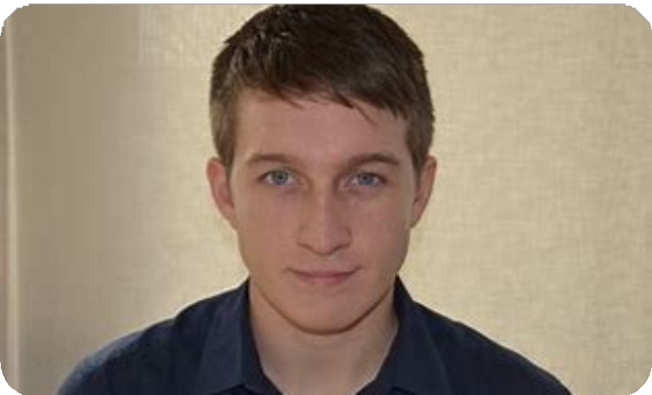
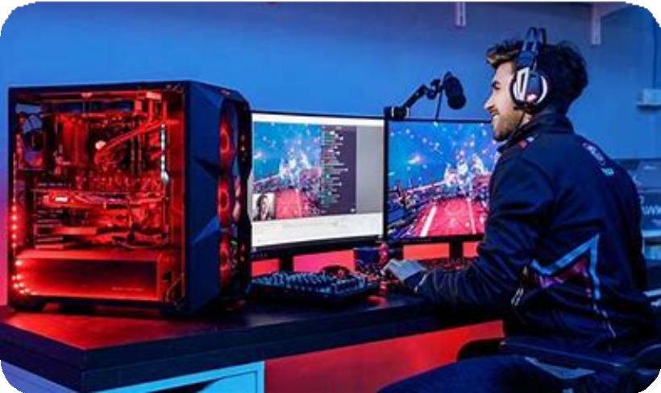

User Persona
Comic Con Carl, M, 24
Prroduct manager at Google
Gamer Gabby, M, 20
College Student
Fandom Fiona, F, 25
Music Producer
_{Interest:-} Comic book aficionado, attends
Interest:- Passionate about gaming, spends leisure time exploring various gaming worlds and
platforms.
User Goals:-
Seeks merchandise inspired by favorite video games, gaming characters, and gaming culture.
Interested in comfortable yet stylish apparel and accessories related to gaming.
Pain Points
Difficulty in discovering new and unique merchandise items beyond the mainstream. Discount coupons are not availble
Interest:- Enjoys a wide array of pop culture
references, from TV series to music and
movies.
User Goals:-
Seeks trendy and fashionable clothing with references to popular culture and memes.
Enjoys unique designs and appreciates quirky, unconventional merchandise.
Pain Points
Not able to share multiple items at once to her family Sometimes, certain sizes run out quickly for popular designs, causing disappointment.
conventions regularly, avid fan of Marvel and DC Comics.
User Goals:-
Seeks officially licensed merchandise featuring favorite superheroes.
Wants exclusive collectibles, limited-edition items, and apparel inspired by iconic characters.
Pain Points
Difficulty in finding designs that he sees on internet
Delivery charges are very high for single item
*pain poins are based on the user interviews conducted Link

Slide 5
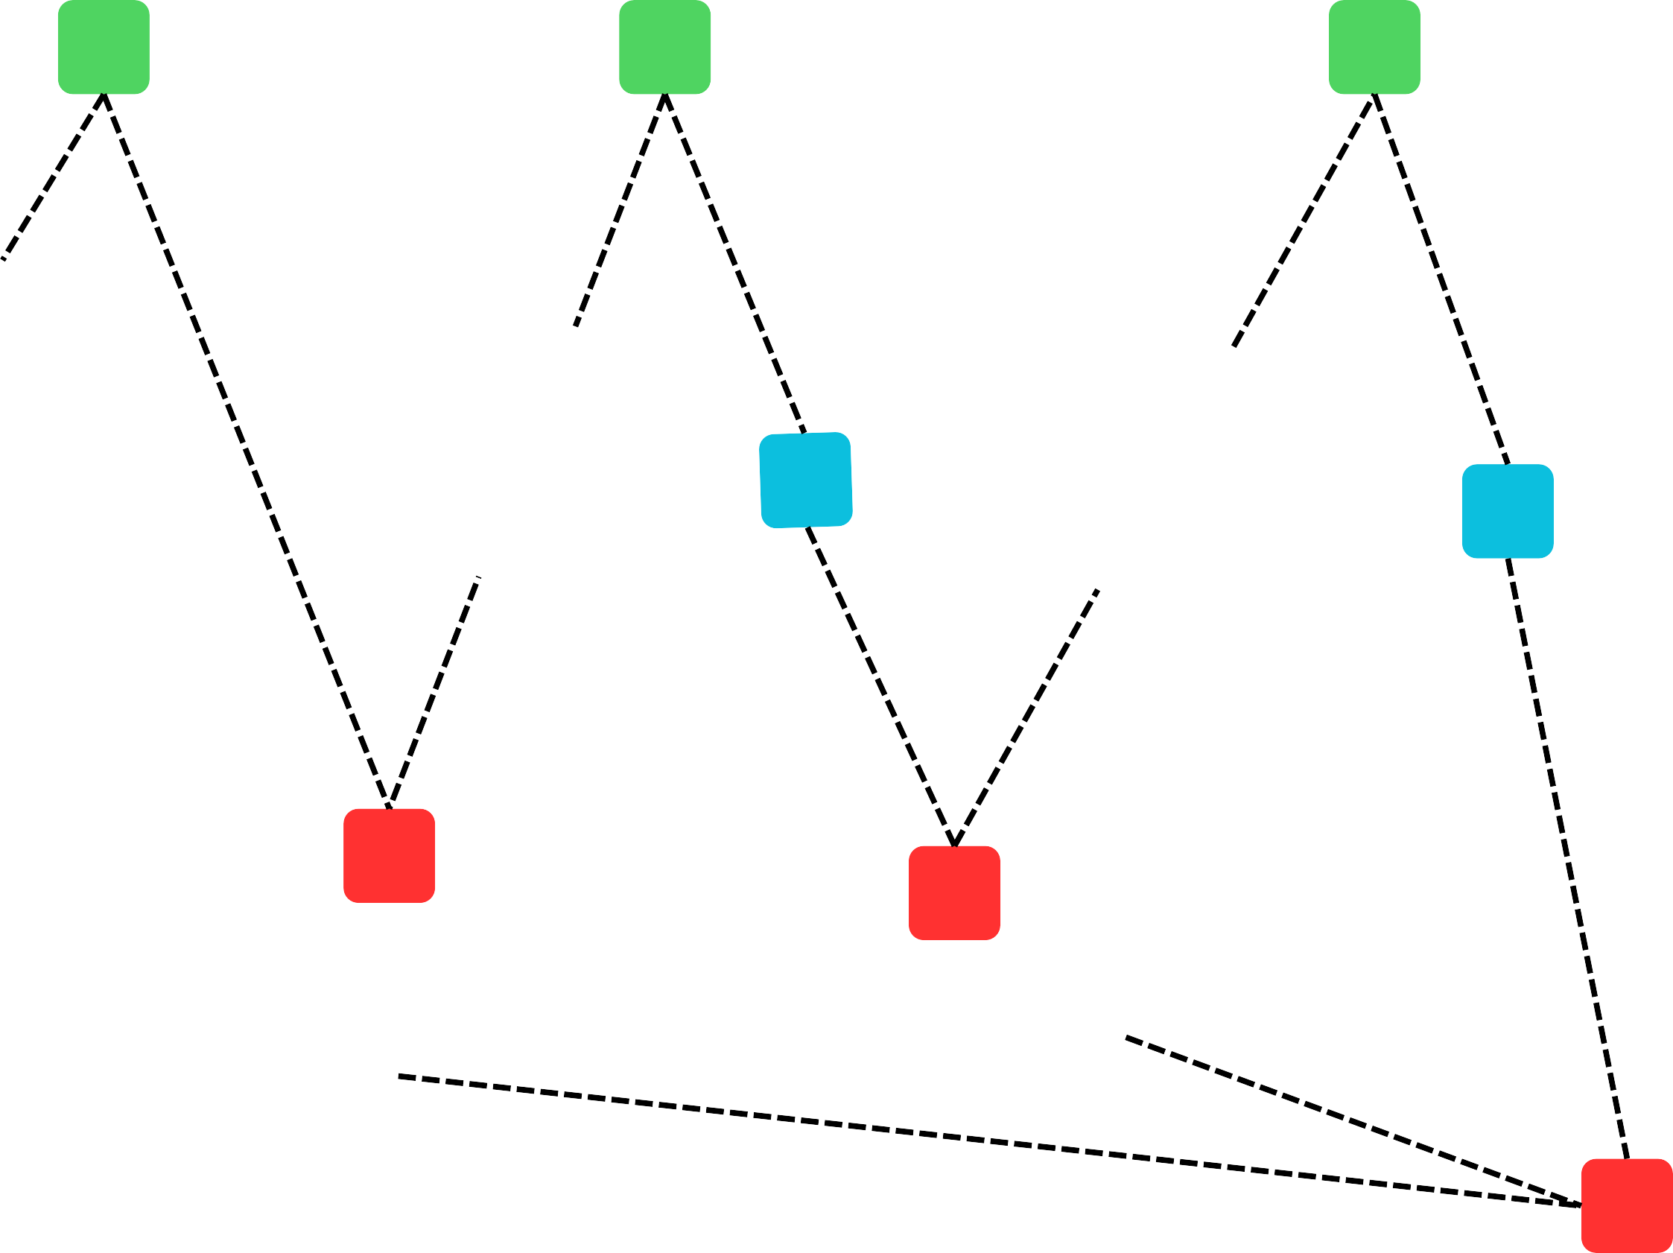

User Journey
I should try online shopping apps
Starts exploring different items
Adds few items in wishlist
Adds items to the cart
2
5
7
10
Signs up
Wants opinion on the wishlisted items from friends
Hours of searching
8
High prices and low discounts disheartens him
Finalizes few items
11
His friend suggest him souled store app
.
1
4
I want to buy some popular merchendise.
Souled gems
3
6
9
Search for apps to buy merchendise of popular brands
Couldn’t find the exact match which he saw on
internet .
No option for multiple item sharing
Magic Scanner
12
Leaves the app !!
Wishlist Sharing

Slide 6
Solution 1: Magic Scanner
What is magic scanner :-
The Magic Scanner uses advanced image recognition algorithms to analyze pictures of t-shirts, hoodies, or other merchandise captured by users.
Once the image is scanned, the feature recommends similar or exact items available for purchase on The Souled Store's platform.
How does magic scanner works:-
Utilizes machine learning and AI-powered algorithms to analyze and identify visual patterns in scanned images.
Compares scanned images with the vast database of products available on The Souled Store's platform.
Considers various attributes such as color, design, patterns, and brand to provide accurate recommendations.
Need for magic scanner :-
Allows users to easily find and purchase merchandise they discover on ads, social media, or the internet.
Eliminates the need for manual searching by providing instant recommendations based on scanned images.
Offers a more personalized shopping experience tailored to users' specific interests and preferences.
User Flow :-
Clicks on magic scanner
Camera access granted
Clicks / upload images
User can view details , price.
Similar items are displayed
System analyses the image

Slide 7
The user first click on the camera button
A popup appears where he gets option to either select image from gallery or directly capture image from camera .
Users open camera and click the picture of the design he wants and scans for the items
User gets a list of items which nearly resembles the image uploded by the user.

Slide 8
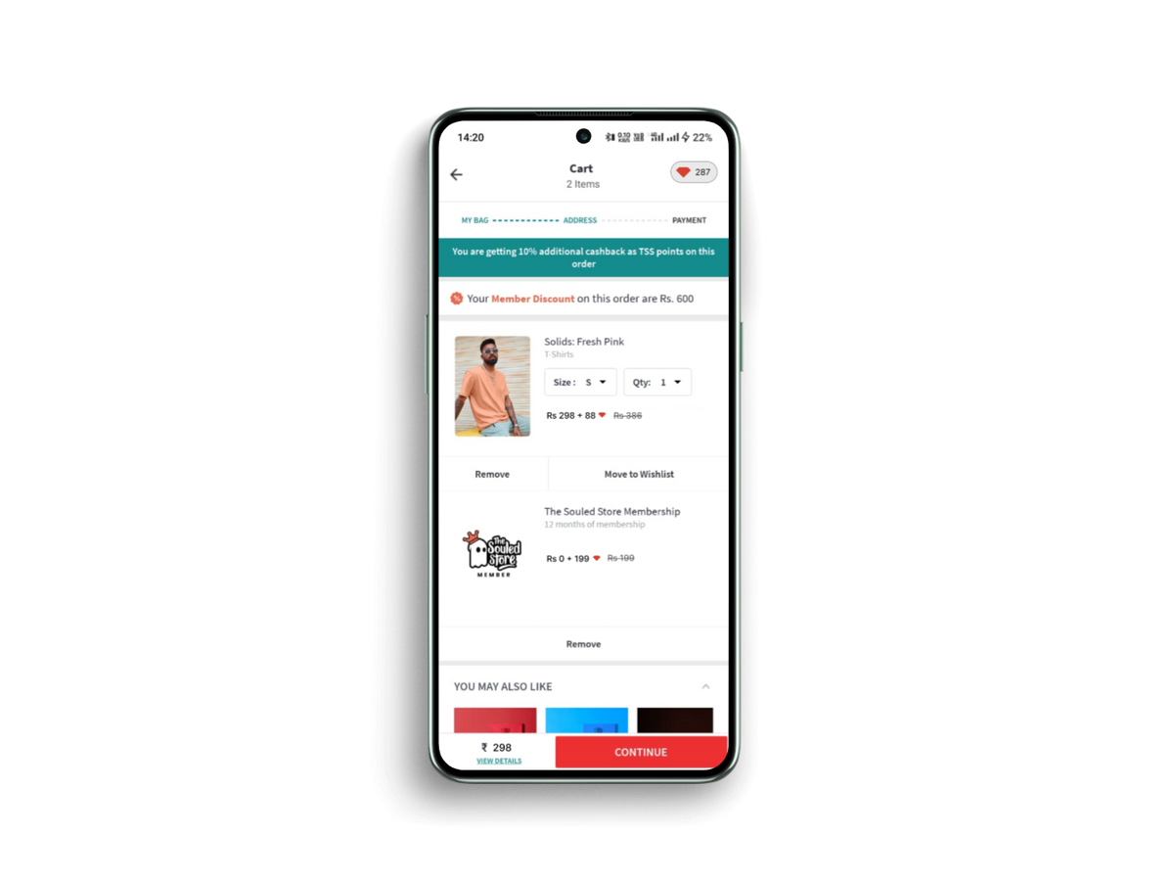
Solution 2: Souled Gems
Feature Overview:
Award users with a set amount of coins for each successful referral who completes a purchase.
Additional bonus coins if the referred user makes their first purchase.
Users earn coins based on the value of their purchases (e.g., earn 1 coin for every Rs100 spent).
User gets to see the total no of gems he owns
User gets discount on their purchases upto Rs 100 by using 100 gems.
Gems Utilization :-
Allow users to redeem coins for discounts on their purchases.
Offer users the option to use accumulated coins to buy or partially pay for an annual subscription plan.
User can get the yearly subscription of souled store by using these gems .

Slide 9

Solution 3: Wishlist Sharing
What is wishlist sharing :-
This feature allows users to curate a selection of multiple items from their wishlist and share them collectively with others .
It enables users to seek opinions on a range of desired products at once rather than sharing one item at a time.
Need for wishlist sharing :-
Reducing the effort of sharing each item individually. Facilitates informed decision-making by gathering opinions on a variety of items simultaneously.
Allows users to involve others in their shopping journey
Users can create new wishlists from here
Whenever a users wishlists a item he gets option to add the item in whicheverwhishlist he wants .
Users can share a particular wishlists to ohers via whatsapp, telegram and other social media platforms

Slide 10
Rice Priortization
Reach (10)
Impact (5)
Confidence (100)
Effort (10)
Feature
Score
Magic Scanner
9
4
90
9
3.6
Souled gems
8
4
80
8
3.2
Wishlist sharing
9
5
100
8
5.6

Slide 11
GTM Stratergy
Magic Scanner
Souled Gems
Wishlist Sharing
Pre-launch:
Pre-launch:
Develop and refine the image recognition algorithms and product matching capabilities.
Partner with fashion and tech influencers for early access testing and feedback.
Pre-launch:
Design and implement the referral program infrastructure and reward system.
Draft clear and concise referral program guidelines and terms and conditions.
Integrate the wishlist sharing feature into the website and mobile app.
Create tutorials and in-app prompts to educate users about the feature's functionality.
During launch:
Highlight the wishlist sharing feature prominently on the website and app. Encourage users to share their wishlists and engage with each other's selections.
During launch:
Offer bonus Souled Gems or exclusive discounts to users who start using the feature within the initial launch period. Host a giveaway or contest related to Souled Gems to generate excitement and participation.
Post- Launch:
Regularly communicate with users through social media about their gem balance, new earning opportunities, and redemption options.
Analyze user data to refine the Souled Gems program, introducing improvements based on user feedback and usage patterns.
During launch:
Monitor user feedback and address any technical issues promptly.
Run targeted promotions and contests to
encourage feature usage.
Post- Launch:
Continuously improve the accuracy and efficiency of the image recognition algorithms.
Expand the feature to include a wider range of merchandise categories.
Post- Launch:
Track the usage and impact of wishlist sharing on user engagement and purchases.
Collaborate with fashion influencers to create shareable wishlist content and inspire users.

Slide 12
Success Metrics
AWARENESS:
Monitor website traffic
related to each feature. Track social media engagement and influencer mentions.
Analyze email open rates and in-app notification engagement.
ACQUISITION:
Measure the number of users who interact with or utilize each feature.
Track signups, and
feature usage patterns.
ACTIVATION:
Measure the percentage of users actively using at least one of the new features.
Track the number of interactions with each feature
ENGAGEMENT:
Track metrics such as time spent using features. Track metric of interactions per session.
RETENTION:
Analyze how often
users return to engage with the features.
Track user retention rates specific to users who have actively used the features.
REVENUE:
Customer Lifetime Value (CLTV): The total revenue generated from a customer over their lifetime.
Track the conversion rates from
feature interactions to purchases. Track change in the average order value of users
REFERRAL:
Track the number of new users acquired through referrals related to these features.
Track the NPS score of each user
North Star Metrics - Average order value & Monthly active users .

Slide 13
THANK YOU
Manthanraj Patil (22JE0673)
Institute - IIT ISM DHANBAD

