Slide 1

IT452 - Minor Project
AI-POWERED SMART FARMING
Guided By : Prof. Rajnik Katariya
Member :
Kunj Lunagariya
Manthan Kuvadiya

Slide 2
Outline
Technology Stack
Key Functionalities
Project Implementation Plan & Proposed Solution
Current Progress & What We Have Built
Current Results
Next Development Plan

Slide 3
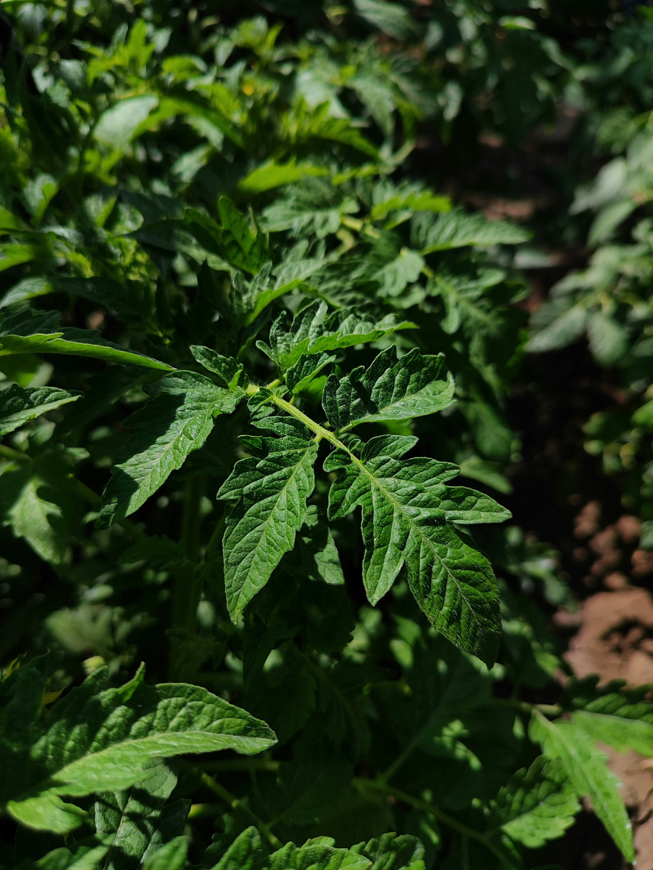
Problem Statement
Introduction:
Agriculture faces several challenges that affect crop productivity and farmer decision-making.
Key Challenges:
Crop diseases are often identified after significant damage has occurred.
Pest attacks are difficult to identify at an early stage.
Farmers may not always have immediate access to expert guidance.
Crop health monitoring is still largely manual and time-consuming.
A lack of integrated insights makes timely decision-making difficult.
Objective:
To develop an AI-powered smart farming system that analyzes crop images, identifies crop health conditions, assesses disease severity, analyzes pest presence, and ultimately provides actionable recommendations to farmers.

Slide 4
Technology Stack
AI
Backend
Frontend
Python
OpenCV
PyTorch
EfficientNet
YOLO
FastAPI
Python-based AI Pipeline
React.js
HTML
CSS
Future Intelligence Layer
Future Application Layer
LLM-based Recommendation System
Weather Data Integration
Web / Mobile Dashboard
Database & Cloud Storage

Slide 5
Functionalities
📷 Image-Based Crop Analysis
🌿 Crop Identification
Allows farmers to seamlessly capture photos via a mobile camera or upload existing images, automatically performing initial checks for image quality, resolution, and leaf presence before pipeline execution.
Automatically detects and categorizes the specific crop type from the uploaded imagery to ensure the system routes data to the correct, customized crop-specific disease model.
📊 Severity Estimation
🩺 Disease Classification
Calculates the exact percentage of affected crop leaf area to quantify how widespread the damage is, moving beyond binary results to provide an objective measure of infection intensity.
Analyzes foliage health to precisely pinpoint crop-specific diseases, infections, or deficiencies utilizing deep-learning models trained on extensive agricultural datasets.
🤖 Smart Recommendations
🐛 Pest Classification
Translates raw AI diagnostics into clear, step-by-step, actionable guidance for farmers, designed to integrate weather context and regional factors to suggest precise preventive measures.
Identifies the primary pest classes present on the crop from visual indicators, providing confidence scores for potential threats (such as leaf miners or aphids) to guide targeted treatment.

Slide 6
Project Implementation Plan
Phase 1
Phase 2
Phase 3
Phase 4
AI Analysis
Image Understanding
Smart Decision Support
Crop Identification
↓
Crop-Specific Disease Analysis
↓
Severity Estimation
↓
Pest Classification
Farmer Application
Capture Crop Image
↓
Image Quality Analysis & Leaf Detection
Weather & Context Data
↓
Smart Recommendation Engine
Backend API
↓
Dashboard / Mobile Application
Main Solution Flow
Farmer Image → Image Processing → Crop Identification → Disease Model Selection → Disease Analysis → Severity & Pest Analysis → Smart Recommendation

Slide 7
Current Progress
Component | Status
Image Quality Analysis & Leaf Detection | ✅ Completed
Crop Identification Model | ✅ Completed
Crop-Specific Disease Model | ✅ Completed
Disease Model Routing & Severity Estimation | ✅ Completed
Pest Classification | ✅ Completed
Integrated AI Pipeline | ✅ Completed
Recommendation Engine | 🔄 Pending
We have integrated these individual modules into a single working AI pipeline.
The system currently processes a crop image and performs:
Preprocessing → Crop Identification → Decision Routing → Disease Classification → Severity Estimation → Pest Classification

Slide 8
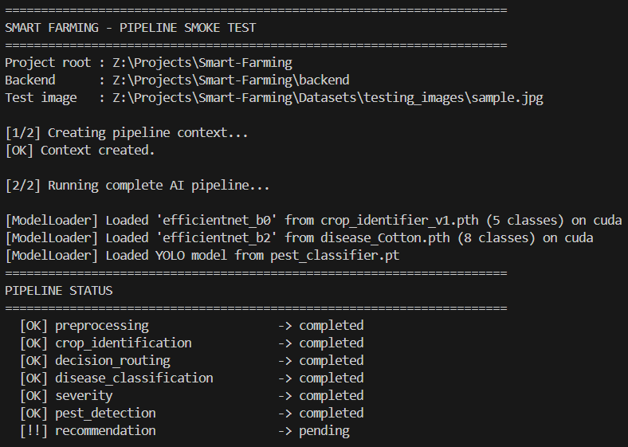
Result

Slide 9
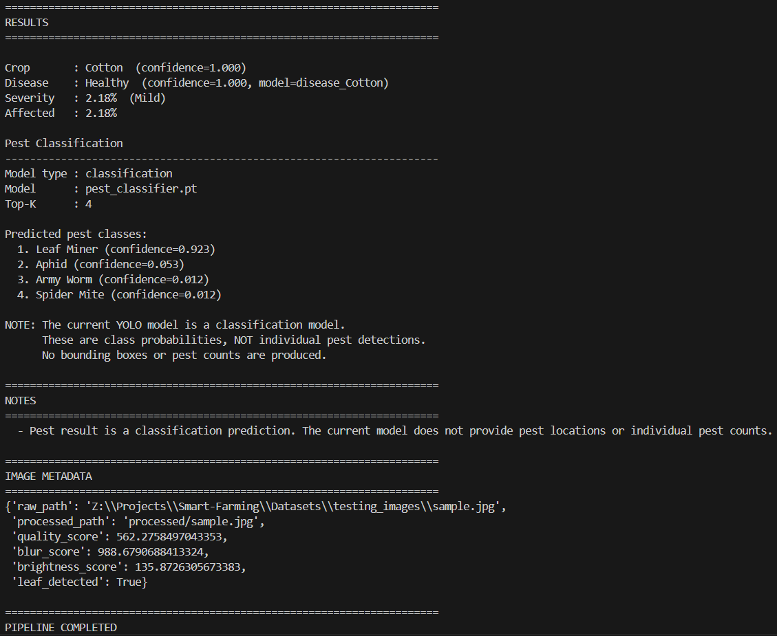
Result

Slide 10
Next Development Plan
🔄 Smart Recommendation Engine
Convert the AI analysis into actionable recommendations for farmers.
🌤 Context Integration
Integrate:
Weather data
Location context
Crop-specific information
🔌 Backend API Development
Expose the complete pipeline through application APIs.
📱 Farmer Dashboard
Develop a simple interface for:
Image upload
Analysis results
Crop health reports
Recommendations
🌱 Future Expansion
Soil condition analysis
IoT sensor integration
Drone & satellite imagery
Regional language support
AI farming assistant

Slide 11
Thank you!

