Slide 1
AI-Powered Monitoring of Crop Health, Soil Condition & Pest Risks
Using Computer Vision, AI & Smart Data Analytics
Smart India Hackathon 2025
Presented By
Problem Statement ID: SIH25099
Manthan Kuvadiya | Kunj Lunagariya | Madhav Ajwalia
Department: CSPIT-IT

Slide 2
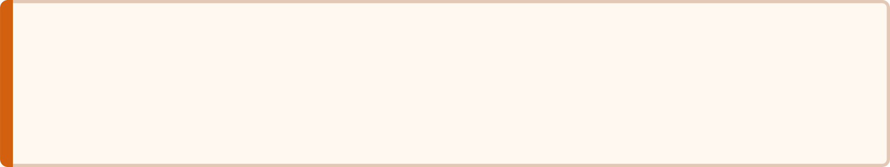

Problem Statement
Agriculture is the backbone of India's economy, but farmers still face several critical challenges that limit productivity and sustainability across the sector.
Core Challenges
Objective
Traditional monitoring methods are manual, time-consuming, costly, and inaccurate for large farms. There is an urgent need for an intelligent, automated solution.
Late Disease Detection
Crop diseases are identified only after visible damage has already occurred, making intervention too late.
Develop an AI-powered system that continuously monitors crop health, predicts pest risks, analyzes soil conditions, and provides timely recommendations to farmers.
Unexpected Pest Attacks
Farmers lack predictive tools to anticipate and prevent pest infestations before they spread.
Poor Soil Understanding
Inadequate knowledge of soil conditions leads to improper fertilizer application and nutrient imbalances.
Excessive Inputs & Low Yield
Overuse of fertilizers and pesticides raises costs and degrades soil, while crop productivity remains low.

Slide 3
Existing System & Challenges
Current Approach — A Reactive Cycle
Key Challenges with This Model
01
Too Late
Human Error
Manual Inspection
Disease detected only after crop damage
Inaccurate identification by untrained eyes
Farmer physically walks fields to inspect crops — slow and impractical at scale.
02
No Experts
High Cost
Post-Damage Identification
Lack of accessible agricultural expertise
Expensive manual monitoring at farm scale
Disease is identified only after visible damage has already appeared on the crop.
03
Waste
Expert Consultation
Water wastage & excessive pesticide usage
Farmer consults an agriculture expert — often unavailable, delayed, or costly.
04
Apply Inputs
Fertilizers and pesticides are applied broadly, often excessively and inaccurately.
05
Crop Loss Already Occurred
By the time action is taken, significant yield loss has already been sustained.

Slide 4









Proposed AI Solution
Our system acts as an AI-based Smart Farming Assistant — from data ingestion to actionable farmer recommendations.
Input Sources
AI Pipeline Output & Key Features
Crop Images
Disease Detection
Farmer-uploaded field photos for real-time visual analysis.
Early identification of crop diseases before visible damage.
Satellite Images
Large-area remote sensing for regional crop health mapping.
Soil Health Analysis
Weather Data
Nutrient and condition profiling for precision fertilization.
Live meteorological feeds for pest risk correlation.
Pest Risk Prediction
IoT Sensor Data
Weather-correlated forecasting of pest infestation likelihood.
Optional soil moisture and temperature sensor integration.
Farmer Dashboard / Mobile App
AI Recommendation Engine delivers crop health reports & smart alerts.

Slide 5
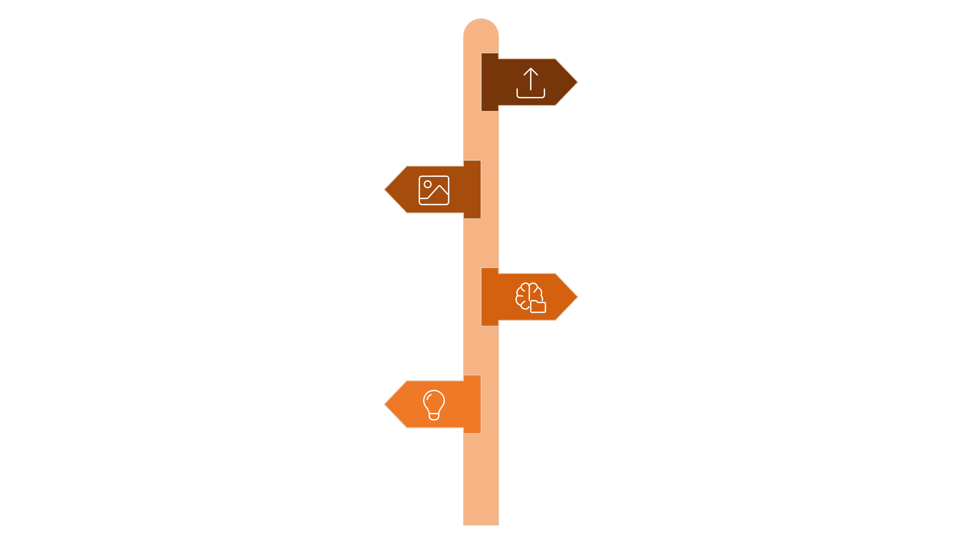
System Architecture
A vertical AI pipeline from farmer input to actionable output — with parallel inference branches for comprehensive crop intelligence.
Upload Image
Farmer submits crop photo via dashboard or mobile app.
Image Processing
OpenCV preprocessing pipeline for enhancement.
Model Inference
CNN / Vision Transformer performs analysis.
AI Recommendations
Aggregate outputs into actionable plans.
Future Integration: Drone imagery, IoT sensors, and satellite data feeds will be incorporated as additional input channels into the preprocessing stage, expanding the system's monitoring coverage without altering the core inference pipeline.

Slide 6
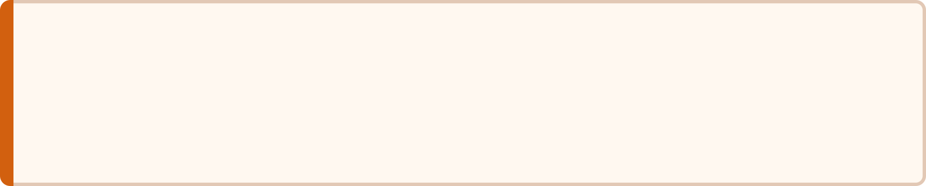
Technology Stack
A modern, production-ready stack spanning frontend, backend, AI/ML inference, external APIs, and cloud deployment.
Frontend
AI / ML Core
AI Assistant & APIs
React.js, HTML, CSS, Chart.js
PyTorch, TensorFlow, OpenCV
YOLOv11, Vision Transformer (ViT), Scikit-Learn
LangChain + Llama 3
Gemini API (Optional)
OpenWeather API
Backend & Database
FastAPI (Python) | MongoDB Atlas
Deployment
Docker | Render / Railway | Hugging Face Spaces

Slide 7







Proposed Methodology
A structured, end-to-end AI pipeline — from raw data collection through model training to real-time farmer-facing output.
1. Collect
2. Preprocess
Crop images from farmers, drones, or satellites
Resize, normalize, data augmentation
3. Train AI Model
4. Detect Disease
CNN / ViT on labeled crop disease datasets
Classify crop health from processed images
5. Predict Pest Risk
6. Generate Recommendations
7. Display Dashboard
Correlate with weather and historical data
Fertilizer, irrigation, and treatment plans
Real-time alerts and reports for farmers

Slide 8
Expected Outcomes & Benefits
Expected Results
Who Benefits
Early Disease Detection
🌾 Farmers
🏛 Government
Before visible crop damage — enabling timely, targeted intervention.
Better decisions, lower costs, and improved livelihoods through precision agriculture.
Improved agricultural planning, policy formulation, and subsidy targeting.
Reduced Crop Losses & Increased Yield
Proactive monitoring translates directly to higher farm productivity.
🔬 Researchers
🌍 Society
Better Fertilizer & Water Utilization
Rich, structured crop analytics datasets for academic and applied research.
Increased food production, food security, and sustainable farming practices.
Precision recommendations reduce waste and conserve resources.
Reduced Pesticide Usage
Precision targeting eliminates broad-spectrum chemical application.
Data-Driven Farming Decisions
AI-assisted insights replace guesswork with evidence-based action.

Slide 9









Future Scope
The platform is architected for extensibility — each of the following capabilities represents a planned enhancement to the core system.
🌾 Drone Integration
Aerial crop surveillance at scale for large farm coverage.
🛰 Satellite Image Analysis
Large-area monitoring across entire agricultural regions.
🌡 IoT Sensors
Real-time soil moisture & temperature data integration.
📱 Android Application
Offline-capable mobile access for rural connectivity.
🌍 Regional Language Support
Accessibility for all farmers across India's linguistic diversity.
🤖 AI Voice Assistant
Voice-guided farming advice for low-literacy users.
☁ Cloud-based Monitoring
Scalable multi-farm management infrastructure.
📊 Predictive Yield Analysis
Season-ahead forecasting for proactive farm planning.
🧠 LLM-based Farming Assistant
Conversational AI advisor for natural language farm queries.

Slide 10






Innovation: What Sets Us Apart
Unlike traditional farming solutions, our project unifies multiple cutting-edge technologies into one intelligent platform — delivering end-to-end crop intelligence where others offer only point solutions.
Computer Vision
Deep Learning
Real-time image-based disease detection using state-of-the-art visual AI.
CNN & Vision Transformer models for high-accuracy crop classification.
Weather Analytics
AI Recommendation System
Pest risk correlated with live weather data for predictive early warnings.
Actionable, personalized advice tailored to each farmer's specific conditions.
Future IoT Integration
Farmer-Friendly Dashboard
Sensor-ready architecture designed for seamless hardware expansion.
Simple, intuitive UI designed for non-technical users in rural settings.

Slide 11
Thank You
We welcome your questions and feedback.
Smart India Hackathon 2025
Team
Problem Statement ID: SIH25099
Manthan Kuvadiya | Kunj Lunagariya | Madhav Ajwalia
Department: CSPIT-IT
AI-Powered Crop Health Monitoring
End-to-End Intelligent Platform
Built for India's Farmers
Computer Vision · Deep Learning · Smart Data Analytics
Disease Detection · Soil Analysis · Pest Risk Prediction
Accessible · Actionable · Scalable

