Slide 1
Online Fitness Application
- Manthan J. Deshmukh

Slide 2
Problem Statement:-
People with intellectual disabilities have high prevalence of physical inactivity and high rates of preventable health conditions, including obesity and cardiovascular disease.
Increased participation in fitness and wellness activities can improve their overall health and well-being.
However, many fitness and wellness organizations do not know how to effectively serve this population nor how to support their inclusion into their programs.

Slide 3
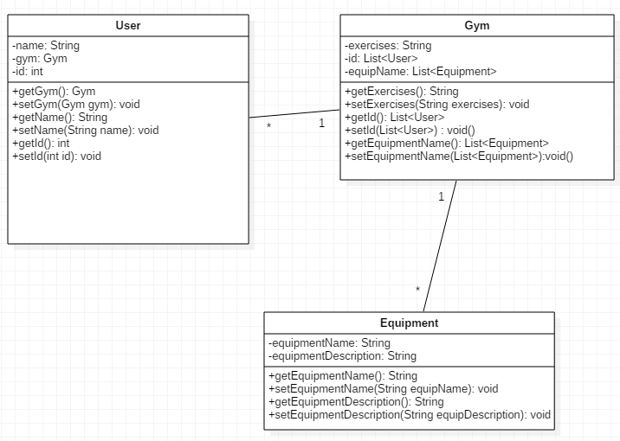
PoJo Class:-

Slide 4
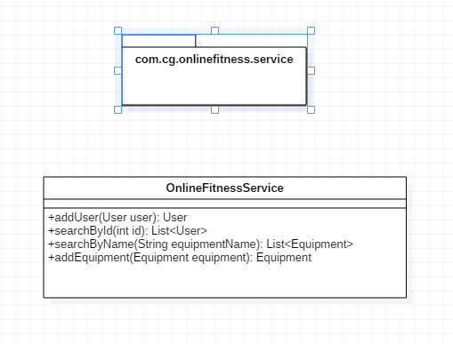
Service Interface:-

Slide 5
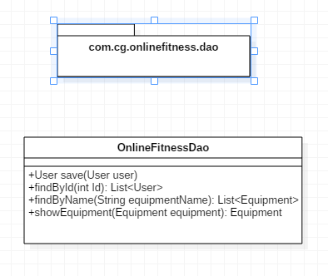
Repository Interface:-

Slide 6
Thank You..

