Slide 1
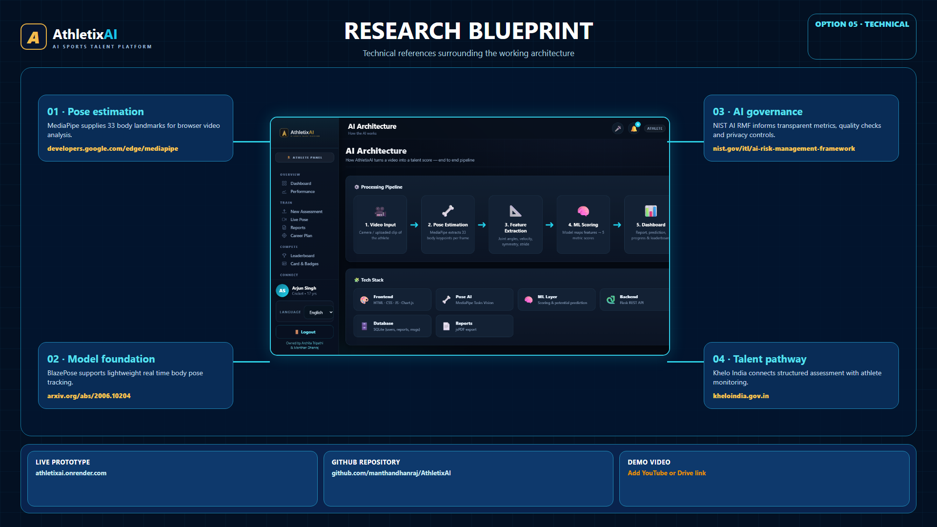
Notes:
Selected Research and References Option 5. Project evidence comes from the AthletixAI repository and production UI.

Slide 2
ATHLETIXAI SYSTEM ARCHITECTURE
Athletix
AI
AI SPORTS TALENT PLATFORM
Browser-side movement analysis keeps raw video local while reports power athlete progress and coach discovery.
ATHLETE DEVICE
SECURE PLATFORM
PRODUCT EXPERIENCES
1
Video input
2
Pose model
6
Assessment API
11
Athlete
12
Coach
Phone camera or uploaded training clip
MediaPipe extracts 33 landmarks per sampled frame
Authentication, request validation, CSRF protection and rate limits
Dashboard, reports, progress, training plan and badges
Squad analytics, athlete profiles and messaging
LOCAL PROCESSING
3
Quality gate
4
Biomechanics
7
Service layer
Recruiter Hub
Compare
13
14
Reject low visibility, too few frames or insufficient movement
Joint angles, velocity, symmetry, cadence and range of motion
Re-derives overall score, attaches ownership and coordinates analytics
REPORT DATA
Talent filters and AI Scout recommendations
Two-athlete radar and metric comparison
DERIVED METRICS
8
Repository and unit of work
5
Sport-aware scoring
Transactional access to users, reports, messages and notifications
15
Leaderboard
16
Privacy
Category rules produce five metrics, an overall score and confidence metadata
Weekly improvement points and rank
Consent, data export and account deletion
9
SQLite
10
Jobs
Clear migration path to PostgreSQL
Email dispatch
OWNER CONSOLE
Live statistics, records and activity log
RAW VIDEO STAYS ON THE DEVICE
Only derived report values cross the boundary
TECH STACK
Vanilla JavaScript MediaPipe Pose Flask REST API SQLite Chart.js and jsPDF Render and Gunicorn Installable PWA
Privacy rule
Raw training footage never enters the server data path.
Notes:
Architecture mapped from the AthletixAI repository, README, service modules, API routes and production UI. MediaPipe Pose runs in the browser. Raw video remains on-device; the server receives derived report values and metadata.

