Slide 1
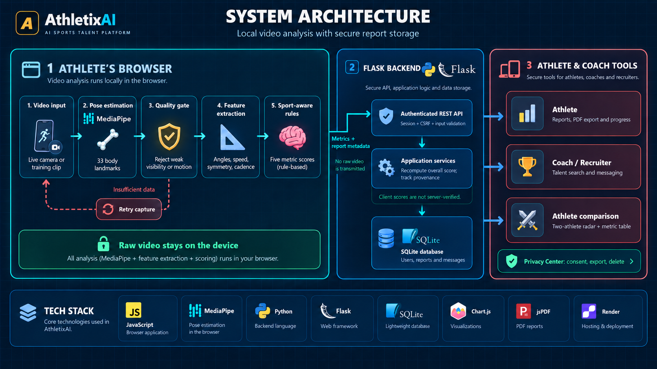
Notes:
System Architecture
Source: user-supplied image ChatGPT Image Sep 29, 2026, 11_52_19 PM.png.
Original image embedded without visual modifications. Image-based slide; individual text and diagrams are not editable.

Slide 2
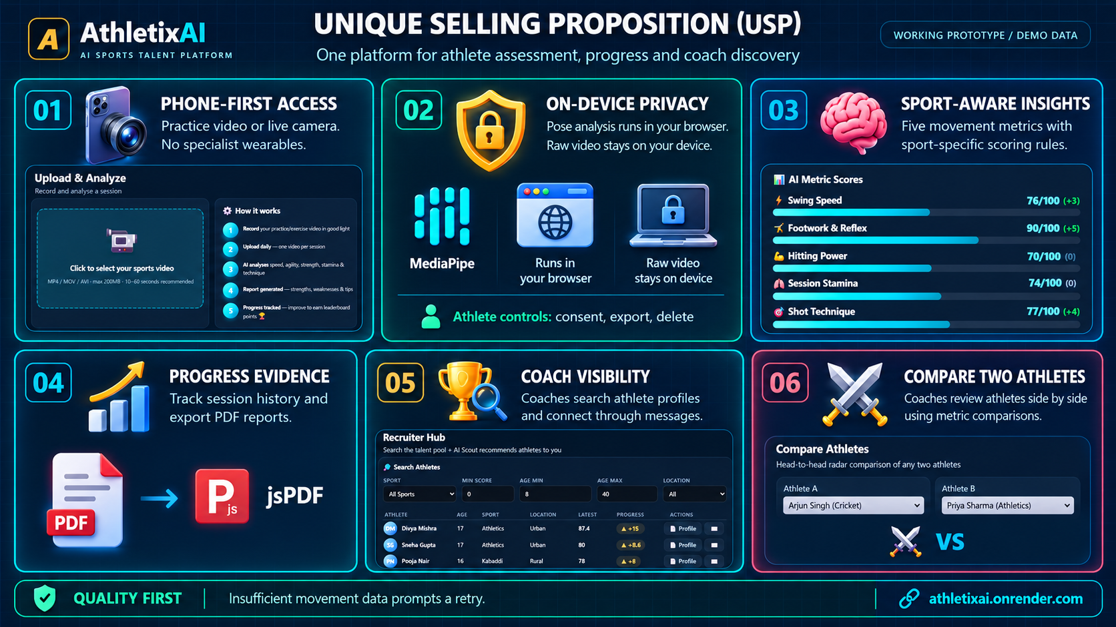
Notes:
Unique Selling Proposition
Source: user-supplied image ChatGPT Image Sep 29, 2026, 11_52_04 PM.png.
Original image embedded without visual modifications. Image-based slide; individual text and diagrams are not editable.

Slide 3
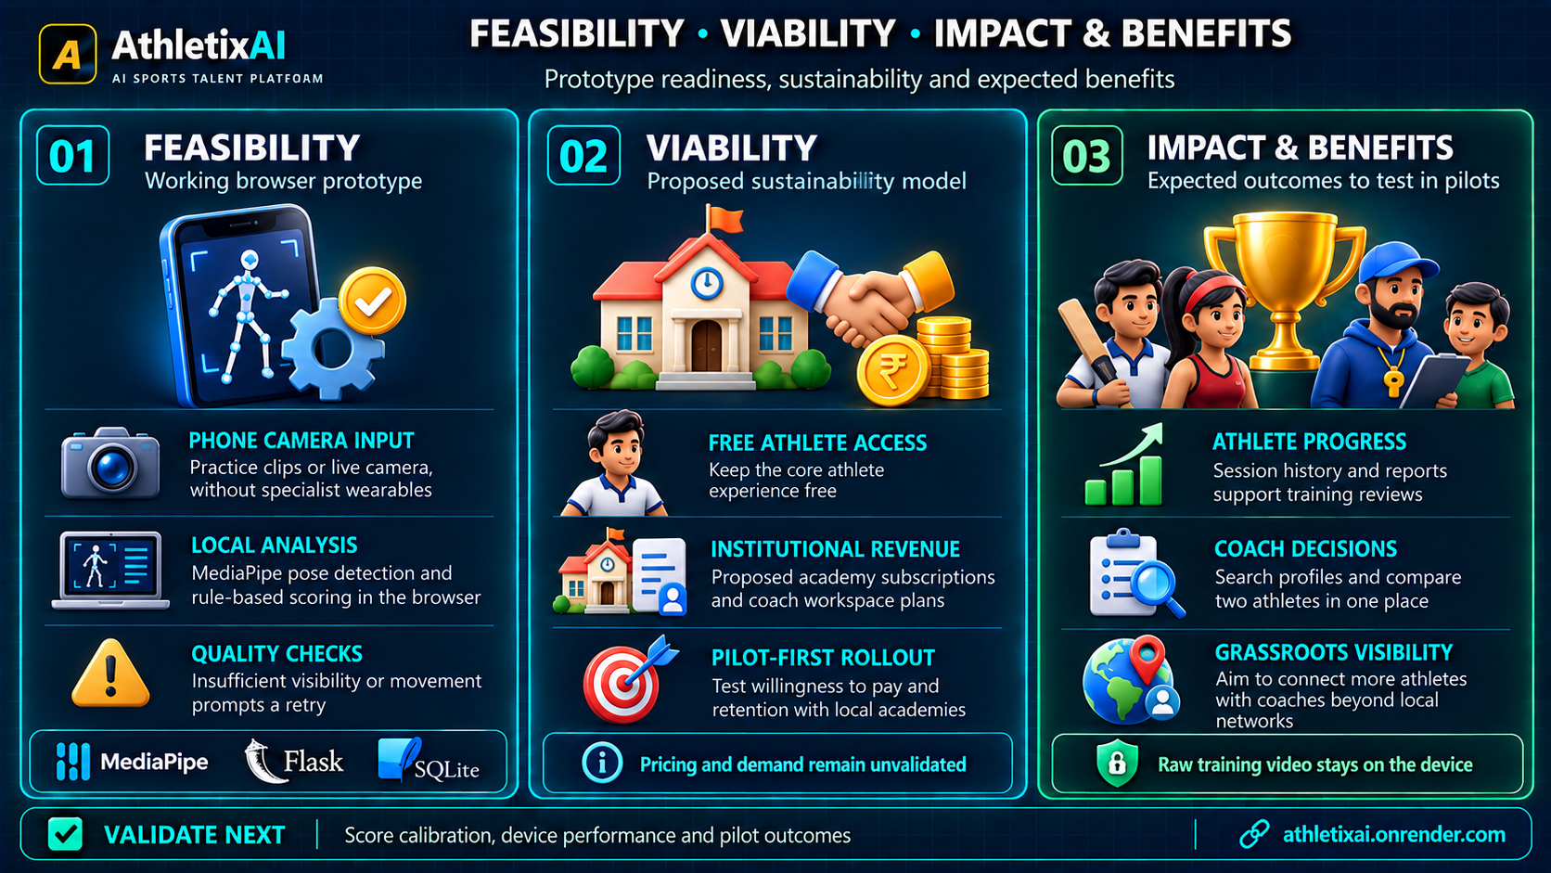
Notes:
Feasibility, Viability, Impact and Benefits
Source: user-supplied image ChatGPT Image Sep 29, 2026, 11_51_58 PM.png.
Original image embedded without visual modifications. Image-based slide; individual text and diagrams are not editable.

Slide 4
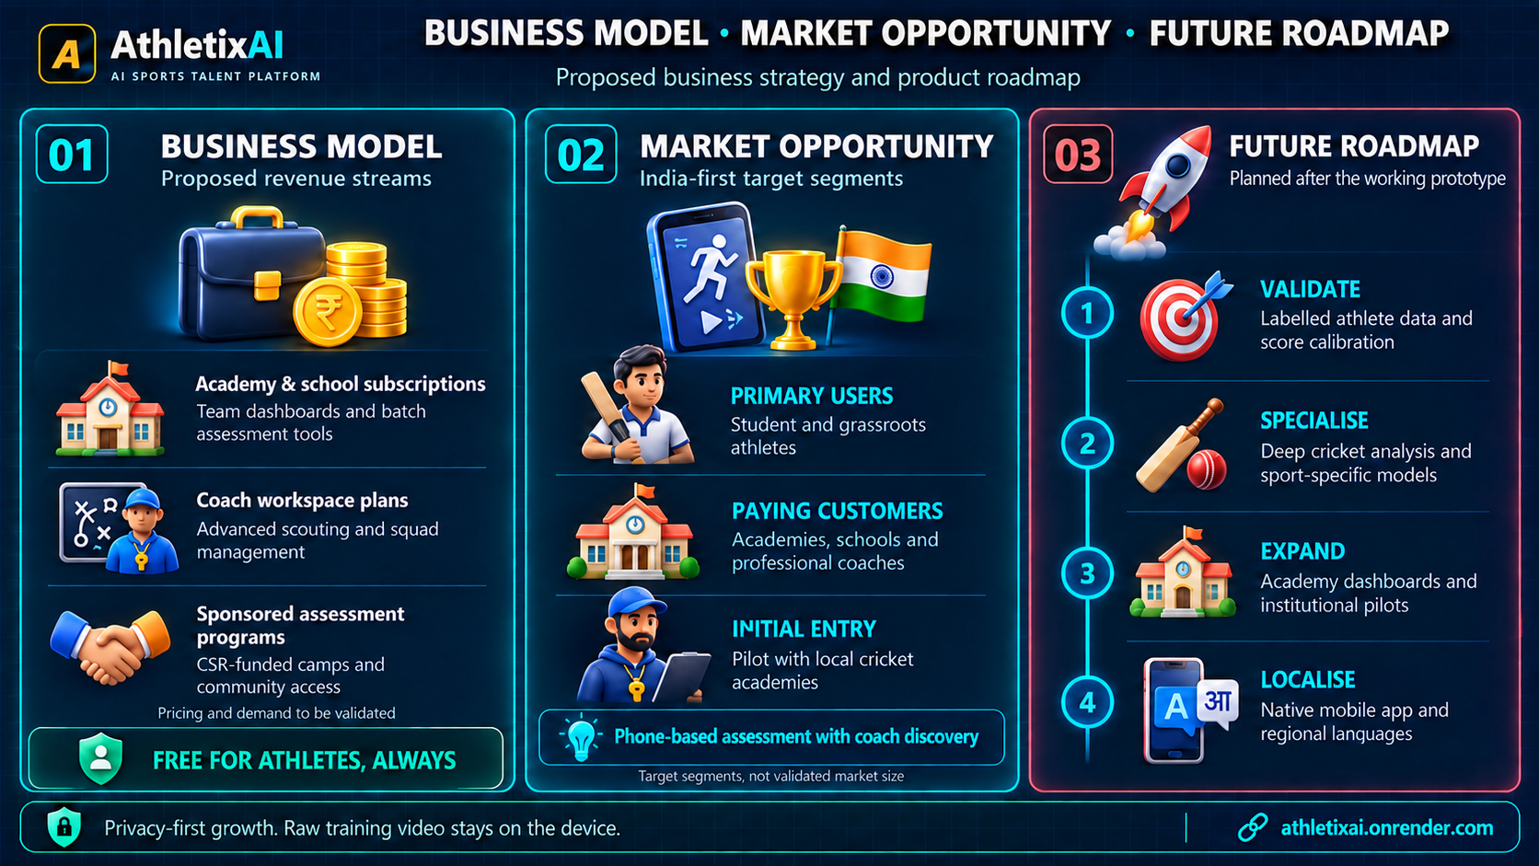
Notes:
Business Model, Market Opportunity and Future Roadmap
Source: user-supplied image ChatGPT Image Sep 29, 2026, 11_51_50 PM.png.
Original image embedded without visual modifications. Image-based slide; individual text and diagrams are not editable.

Slide 5
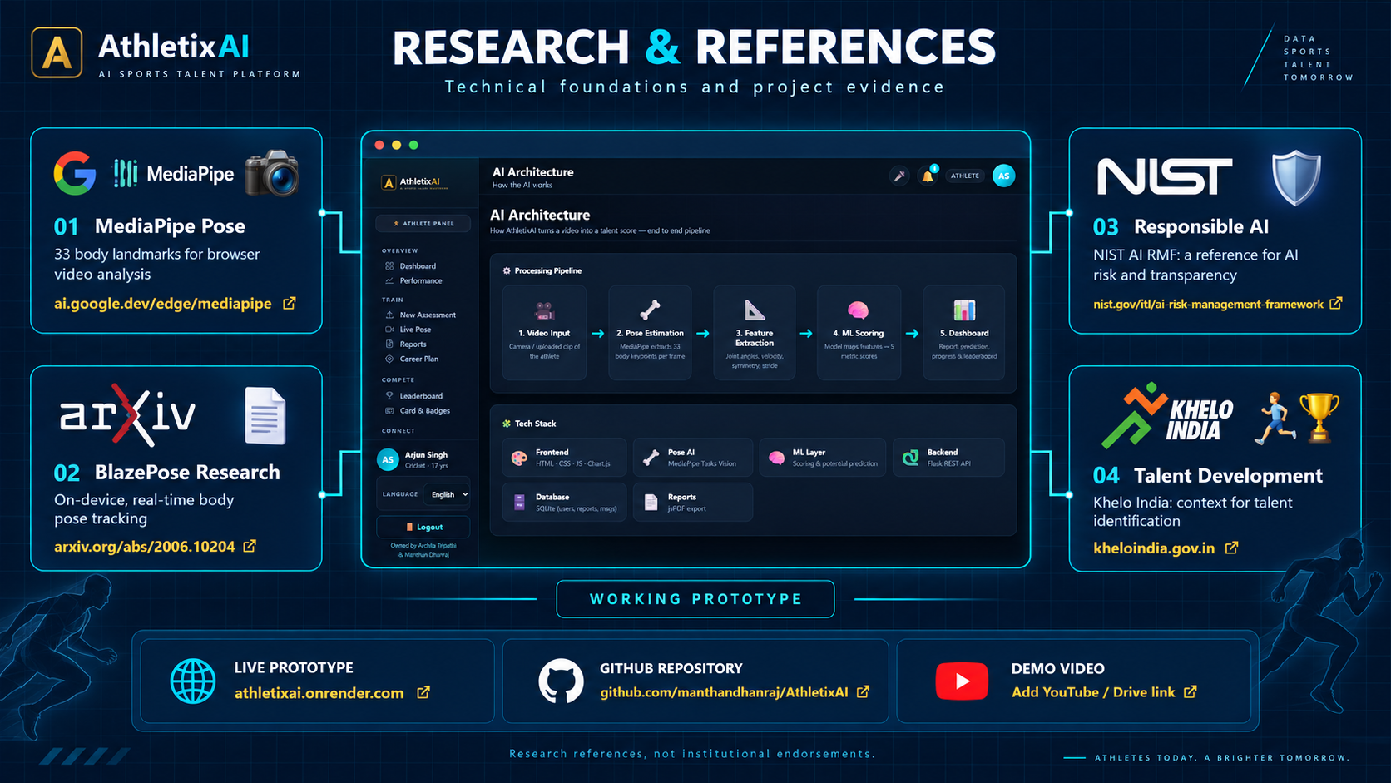
Notes:
Research and References
Source: user-supplied image ChatGPT Image Sep 29, 2026, 04_08_14 PM.png.
Original image embedded without visual modifications. Image-based slide; individual text and diagrams are not editable.

