Slide 1
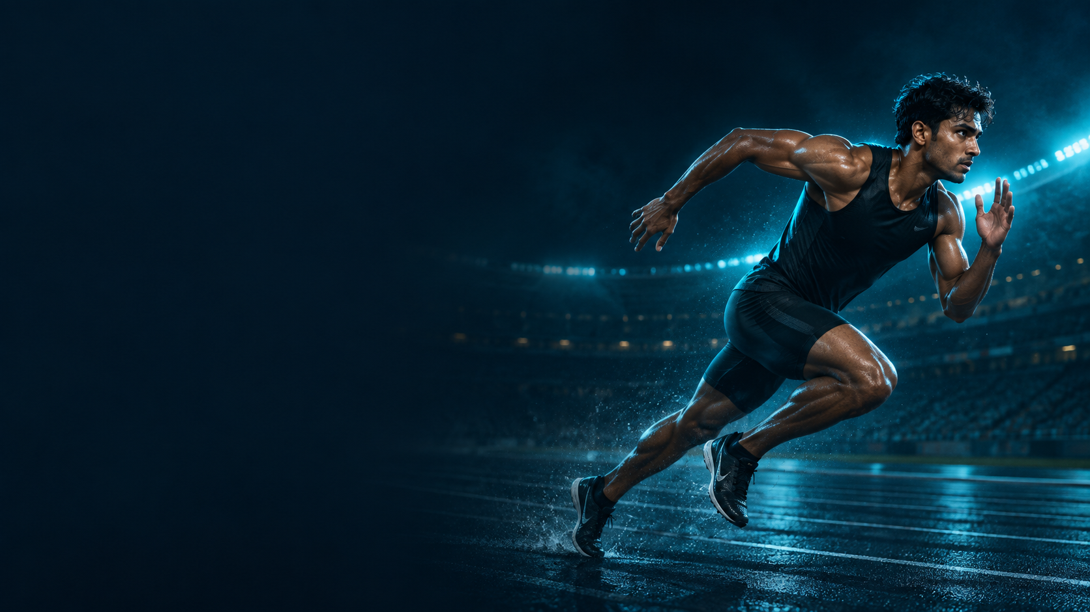

AthletixAI
WORKING PROTOTYPE
A I S P O R T S T A L E N T P L A T F O R M
ATHLETE ASSESSMENT & COACH DISCOVERY
AthletixAI
AI SPORTS TALENT PLATFORM
Phone-based movement assessment
for athletes and coaches.
BUILT BY
Archita Tripathi & Manthan Dhanraj
PRIVATE VIDEO. VISIBLE PROGRESS.
athletixai.onrender.com
Notes:
Project sources: README.md: problem, product description and creators; static/images/auth/athlete-hero.png. Decorative artwork: user-supplied AthletixAI reference images dated 29 September 2026. Product capabilities describe the current prototype. Scoring uses hand-authored rules and requires calibration against measured performance.

Slide 2





AthletixAI
PROBLEM STATEMENT
A I S P O R T S T A L E N T P L A T F O R M
Challenges AthletixAI is designed to address
TALENT CAN BE
HARD TO SEE
01
02
ACCESS TO ASSESSMENT
UNCLEAR PROGRESS
Specialist setups and in-person
reviews can be hard to access.
Practice clips need a consistent
way to compare training sessions.
03
04
How can athletes show progress
and reach coaches beyond
local training environments?
FRAGMENTED RECORDS
LIMITED COACH VISIBILITY
Reports and feedback need
a single place for review.
Coaches need searchable profiles
and comparable performance evidence.
Accessible assessment.
Evidence coaches can review.
DESIGN CHALLENGE
A practical assessment and discovery workflow for grassroots athletes.
athletixai.onrender.com
Notes:
Project sources: README.md: The problem and Features. Problem framing comes from the project brief, not a measured population study.. Decorative artwork: user-supplied AthletixAI reference images dated 29 September 2026. Product capabilities describe the current prototype. Scoring uses hand-authored rules and requires calibration against measured performance.

Slide 3
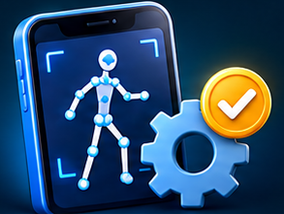




AthletixAI
OUR SOLUTION
A I S P O R T S T A L E N T P L A T F O R M
A browser platform for athlete assessment and coach discovery
01
ASSESS MOVEMENT
02
FOLLOW PROGRESS
03
CONNECT WITH COACHES
SESSION HISTORY & PDF REPORTS
DISCOVER & COMPARE ATHLETES
PHONE CAMERA INPUT
PERFORMANCE REPORTS
RECRUITER HUB
Practice clip or live camera
No specialist wearables required
Five movement metrics with
sport-specific labels
Find athlete profiles and
review report history
ON-DEVICE ANALYSIS
TRAINING EVIDENCE
COMPARE & CONNECT
MediaPipe pose estimation
Sport-aware scoring rules
Review session history and trends
Download reports as PDFs
Compare two athletes side by side
Connect through messages
Prototype scoring still needs calibration against measured performance.
LOCAL VIDEO ANALYSIS
Raw video stays on the device. Only metrics and metadata reach the server.
athletixai.onrender.com
Notes:
Project sources: README.md: What it does, Features, Honest limitations; templates/index.html: analyzeVideoFile, reportFromMetrics, renderRecruiter, Compare Athletes; athletix/services/assessment.py. Decorative artwork: user-supplied AthletixAI reference images dated 29 September 2026. Product capabilities describe the current prototype. Scoring uses hand-authored rules and requires calibration against measured performance.

Slide 4





AthletixAI
FLOW OF SOLUTION
A I S P O R T S T A L E N T P L A T F O R M
The athlete journey, coach review and the next training session
ATHLETE
TRAINING INPUT & FEEDBACK
Insufficient data: retry
01
02
03
04
PROFILE & CAPTURE
POSE & QUALITY
METRICS & REPORT
REVIEW PROGRESS
Choose a sport and record
a clip or use live camera.
Track 33 landmarks. Check
visibility and movement.
Apply sport-aware rules.
Save the performance report.
View session history,
trends and PDF reports.
COACH REVIEW & FOLLOW-UP
08
07
06
05
TRAIN & REASSESS
CONNECT
COMPARE TWO
DISCOVER ATHLETES
Practise, capture again
and review the next session.
Use messages to discuss
reports and next steps.
Review the radar chart
and metric comparison.
Search and filter profiles
in the Recruiter Hub.
NEXT SESSION
Coaches guide training decisions. Prototype scores need calibration.
PRIVACY BOUNDARY
The browser keeps raw video local. The backend stores structured results.
athletixai.onrender.com
Notes:
Project sources: README.md: The complete flow and Features; templates/index.html: analyzeVideoFile quality checks, Reports, Progress, Recruiter Hub, Compare Athletes and Messages; athletix/services/assessment.py; athletix/scoring/client_submitted.py. Decorative artwork: user-supplied AthletixAI reference images dated 29 September 2026. Product capabilities describe the current prototype. Scoring uses hand-authored rules and requires calibration against measured performance.

Slide 5








AthletixAI
TECH STACK
A I S P O R T S T A L E N T P L A T F O R M
Browser inference with a Python backend and persistent report storage
01
FRONTEND
02
POSE ESTIMATION
03
BACKEND
04
DATA STORAGE
HTML5 / CSS3 / JavaScript
MediaPipe
Python + Flask
SQLite
Responsive browser interface
Installable PWA shell
33 body landmarks
Inference inside the browser
Authenticated REST APIs
Application services
Users, reports and messages
Repository-backed data layer
05
VISUALISATION
06
PDF EXPORT
07
SECURITY
08
DEPLOYMENT
Chart.js
jsPDF
bcrypt + Flask controls
Render + Gunicorn
Progress charts
Two-athlete radar comparisons
Downloadable report PDFs
Shareable athlete cards
Password hashing, CSRF checks
and login rate limiting
Python web service
HTTPS deployment
ML FOR POSE
RULES FOR SCORING
NO SERVER GPU FOR POSE ANALYSIS
COMPUTE BOUNDARY
Video analysis runs locally. The server validates and stores report data.
athletixai.onrender.com
Notes:
Project sources: README.md: Tech stack and Honest limitations; requirements.txt; render.yaml; templates/index.html: MediaPipe, Chart.js and jsPDF imports; static/manifest.json; static/sw.js; athletix/security/passwords.py; athletix/security/http.py; athletix/scoring/client_submitted.py. Decorative artwork: user-supplied AthletixAI reference images dated 29 September 2026. Product capabilities describe the current prototype. Scoring uses hand-authored rules and requires calibration against measured performance.

