Slide 1
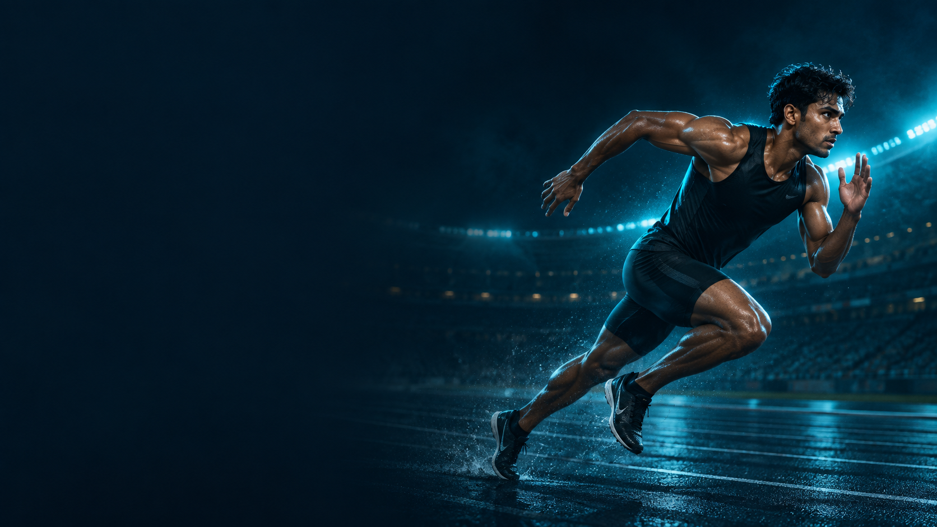

AthletixAI
WORKING PROTOTYPE
A I S P O R T S T A L E N T P L A T F O R M
ATHLETE ASSESSMENT & COACH DISCOVERY
AthletixAI
AI SPORTS TALENT PLATFORM
Phone-based movement assessment
for athletes and coaches.
BUILT BY
Archita Tripathi & Manthan Dhanraj
PRIVATE VIDEO. VISIBLE PROGRESS.
athletixai.onrender.com
Notes:
Project sources: README.md: problem, product description and creators; static/images/auth/athlete-hero.png. Decorative artwork: user-supplied AthletixAI reference images dated 29 September 2026. Product capabilities describe the current prototype. Scoring uses hand-authored rules and requires calibration against measured performance.

Slide 2





AthletixAI
PROBLEM STATEMENT
A I S P O R T S T A L E N T P L A T F O R M
Challenges AthletixAI is designed to address
TALENT CAN BE
HARD TO SEE
01
02
ACCESS TO ASSESSMENT
UNCLEAR PROGRESS
Specialist setups and in-person
reviews can be hard to access.
Practice clips need a consistent
way to compare training sessions.
03
04
How can athletes show progress
and reach coaches beyond
local training environments?
FRAGMENTED RECORDS
LIMITED COACH VISIBILITY
Reports and feedback need
a single place for review.
Coaches need searchable profiles
and comparable performance evidence.
Accessible assessment.
Evidence coaches can review.
DESIGN CHALLENGE
A practical assessment and discovery workflow for grassroots athletes.
athletixai.onrender.com
Notes:
Project sources: README.md: The problem and Features. Problem framing comes from the project brief, not a measured population study.. Decorative artwork: user-supplied AthletixAI reference images dated 29 September 2026. Product capabilities describe the current prototype. Scoring uses hand-authored rules and requires calibration against measured performance.

Slide 3
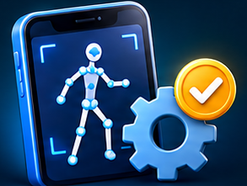




AthletixAI
OUR SOLUTION
A I S P O R T S T A L E N T P L A T F O R M
A browser platform for athlete assessment and coach discovery
01
ASSESS MOVEMENT
02
FOLLOW PROGRESS
03
CONNECT WITH COACHES
SESSION HISTORY & PDF REPORTS
DISCOVER & COMPARE ATHLETES
PHONE CAMERA INPUT
PERFORMANCE REPORTS
RECRUITER HUB
Practice clip or live camera
No specialist wearables required
Five movement metrics with
sport-specific labels
Find athlete profiles and
review report history
ON-DEVICE ANALYSIS
TRAINING EVIDENCE
COMPARE & CONNECT
MediaPipe pose estimation
Sport-aware scoring rules
Review session history and trends
Download reports as PDFs
Compare two athletes side by side
Connect through messages
Prototype scoring still needs calibration against measured performance.
LOCAL VIDEO ANALYSIS
Raw video stays on the device. Only metrics and metadata reach the server.
athletixai.onrender.com
Notes:
Project sources: README.md: What it does, Features, Honest limitations; templates/index.html: analyzeVideoFile, reportFromMetrics, renderRecruiter, Compare Athletes; athletix/services/assessment.py. Decorative artwork: user-supplied AthletixAI reference images dated 29 September 2026. Product capabilities describe the current prototype. Scoring uses hand-authored rules and requires calibration against measured performance.

Slide 4





AthletixAI
FLOW OF SOLUTION
A I S P O R T S T A L E N T P L A T F O R M
The athlete journey, coach review and the next training session
ATHLETE
TRAINING INPUT & FEEDBACK
Insufficient data: retry
01
02
03
04
PROFILE & CAPTURE
POSE & QUALITY
METRICS & REPORT
REVIEW PROGRESS
Choose a sport and record
a clip or use live camera.
Track 33 landmarks. Check
visibility and movement.
Apply sport-aware rules.
Save the performance report.
View session history,
trends and PDF reports.
COACH REVIEW & FOLLOW-UP
08
07
06
05
TRAIN & REASSESS
CONNECT
COMPARE TWO
DISCOVER ATHLETES
Practise, capture again
and review the next session.
Use messages to discuss
reports and next steps.
Review the radar chart
and metric comparison.
Search and filter profiles
in the Recruiter Hub.
NEXT SESSION
Coaches guide training decisions. Prototype scores need calibration.
PRIVACY BOUNDARY
The browser keeps raw video local. The backend stores structured results.
athletixai.onrender.com
Notes:
Project sources: README.md: The complete flow and Features; templates/index.html: analyzeVideoFile quality checks, Reports, Progress, Recruiter Hub, Compare Athletes and Messages; athletix/services/assessment.py; athletix/scoring/client_submitted.py. Decorative artwork: user-supplied AthletixAI reference images dated 29 September 2026. Product capabilities describe the current prototype. Scoring uses hand-authored rules and requires calibration against measured performance.

Slide 5








AthletixAI
TECHNICAL APPROACH
A I S P O R T S T A L E N T P L A T F O R M
How the AthletixAI AI brain turns movement into a report
ON THE ATHLETE’S DEVICE
SECURE BACKEND
01
02
03
04
05
06
VIDEO INPUT
POSE AI
MEASURE
QUALITY GATE
SCORE RULES
SAVE & REVIEW
Practice clip or
live camera.
Frames read locally;
no raw-video upload.
MediaPipe estimates
33 body landmarks
using a pretrained
pose-detection model.
Joint angles, motion,
symmetry, cadence
and movement range
become score inputs.
Uploaded clips:
20 usable frames;
person detected in
≥40% of samples.
Sport-aware rules
convert signals into
five metric scores
with quality limits.
Metrics + metadata
sent to Flask.
Validate inputs;
recompute overall.
INSUFFICIENT DATA → RETRY CAPTURE
Only accepted measurements continue to scoring.
INSIDE THE AI BRAIN
FROM SCORES TO ACTION
ML detects the pose. Hand-authored rules calculate the scores.
Flask + SQLite
1 · MOVEMENT SIGNALS
2 · SPORT CONTEXT
3 · SCORE LIMITS
Stores reports, metrics and video metadata.
Peak limb motion + cadence
Joint range + body symmetry
Pose tracking confidence
Precision → stability & symmetry
Combat → explosive movement
Lifting → knee bend & range
Activity factor moderates output
Confidence sets an upper cap
Scores are rounded and bounded
Chart.js + jsPDF: trends, comparisons & PDFs.
OUTPUT → Speed · Agility · Strength · Stamina · Technique
Client scores are not server-verified.
PRIVACY FIRST
Video stays on device. Performance proxies still need real-world calibration.
athletixai.onrender.com
Notes:
TECHNICAL APPROACH — IMPLEMENTATION NOTES
Sources: templates/index.html, ensurePoseModel(), analyzeVideoWithPose(), scoreFromBiomechanicsStrict(); athletix/scoring/contracts.py; athletix/services/assessment.py.
MediaPipe Tasks Vision 0.10.14 loads the pretrained Pose Landmarker Lite float16 model with the GPU delegate, VIDEO mode and one person. This trained model estimates 33 body landmarks; it is not a model trained to predict athletic talent.
The uploaded-video path reads a local object URL, limits duration to 180 seconds and samples approximately four frames/second with a 300-frame cap. Features include wrist/ankle displacement, knee/elbow angles, shoulder/hip symmetry, hip movement range and direction-change cadence proxies. These are normalized movement signals, not calibrated physical velocity, force or endurance measurements.
Strict uploaded-video gates require at least 12 detected frames, at least 20 usable biomechanical frames and detection in at least 40% of sampled frames. Insufficient data prompts recapture. The live-camera path has different scoring/gating behavior; these numerical gates must not be described as universal.
The strict scorer combines hand-authored formulas with activity scaling, sport category adjustments, and confidence-based upper caps. Representative dynamic-category formula: speed = 20 + (1.05 × peak limb-motion proxy + 7 × cadence proxy) × activity factor. Precision, combat, endurance, lifting and artistic categories emphasize different movement signals. Confidence caps are 78 below 55, 90 below 70, otherwise 99; final outputs are rounded and clamped. No trained performance scoring model or validated prediction accuracy is claimed.
Five general metric categories are speed, agility, strength, stamina and technique; the interface may relabel them for the selected sport. Uploaded-clip scores and video metadata are submitted to the authenticated Flask backend. The backend validates the metrics and recomputes overall score; it records scoring provenance but marks client-submitted scores as unverified. SQLite persists reports/metrics and metadata, not raw video. Chart.js and jsPDF support progress/comparison visualizations and PDF reports.
Decorative symbols are extracted from user-supplied AthletixAI reference artwork. All ordinary text, panels, dividers and arrows are native editable PowerPoint objects. Score calibration and real-device validation remain required.

