Slide 1
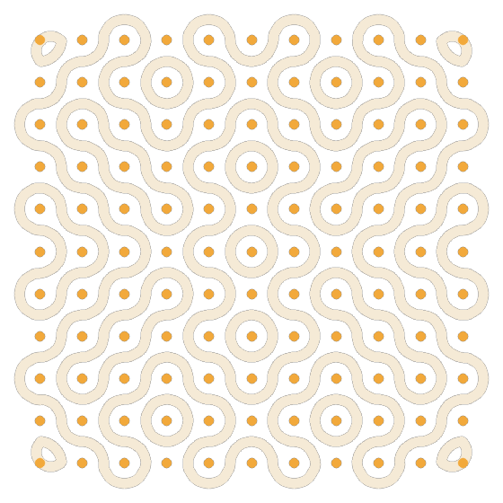
SIH12507 · AICTE · HERITAGE & CULTURE
Kolam Studio
Reading the hidden mathematics of a vanishing art —
identify it, recreate it exactly, and generate it anew.
Live: kolam-studio.onrender.com
Team Kolam · Smart India Hackathon 2025

Slide 2
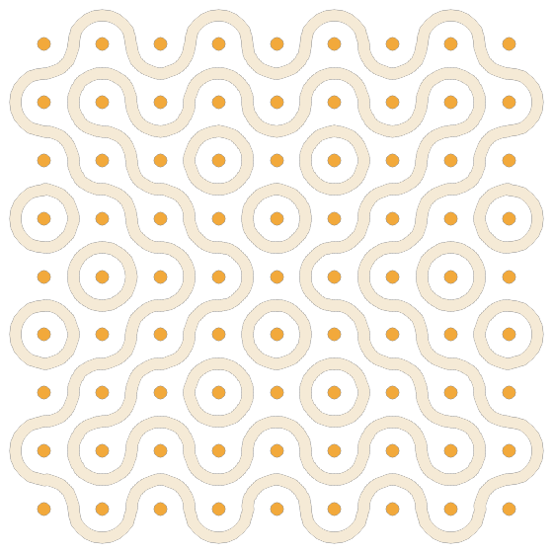
THE PROBLEM
A living art that's quietly disappearing
Across South India, a kolam is drawn fresh at every doorstep at dawn. The art survives in photographs — but the knowledge of HOW each pattern is constructed (its dot grid, its symmetry, its single unbroken loop) is fading with every generation. We can photograph a kolam, yet we have never captured the RULES that make one.
PROBLEM STATEMENT — SIH12507
“Develop computer programs to identify the design principles behind Kolam designs and recreate the kolams.”

Slide 3
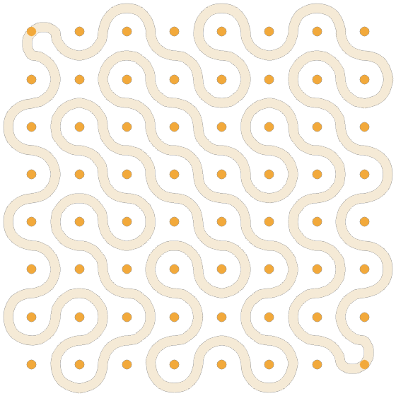
UNDERSTANDING THE ART
A kolam is hidden mathematics
Rice flour, a grid of dots, and one looping line — but underneath sits real structure that a computer can read and reproduce:
1
Pulli
A precise lattice of dots — the skeleton of every pattern.
2
Symmetry
Mirror and rotational rules give the design its balance.
3
Single loop
One continuous line that ideally closes without lifting the hand.

Slide 4
OUR SOLUTION
One tool, three moves
Identify
1
Upload or pick a kolam — it is analysed in the browser: dot grid, symmetry and structure are detected, and non-kolam images are rejected.
Recreate
2
The exact kolam is reconstructed cell-by-cell from inferred tile orientations, drawn as closed loops with a glowing pen-head animation.
Generate
3
Endless new, original kolams under the same rules — including a single unbroken line and custom dot layouts.

Slide 5
HOW IT WORKS
From a photo to a principle — and back
Kolam image
›
In-browser analyzer
›
Design principles
›
Tile generator
upload / sample
dots · symmetry · tiles
structured data
closed-loop canvas
Everything runs client-side — no server, no cold-start.
Python + OpenCV (reference) → vanilla JavaScript analyzer (shipped, in-browser)

Slide 6
FEATURE · IDENTIFY & RECREATE
It doesn't copy pixels — it understands
Detects
dot grid (pulli), cells and symmetry type
→
Infers
the tile orientation of every single cell
Rebuilds
the exact kolam, cell-for-cell, as closed loops
Input
Tile-inference accuracy on clean kolams: 100% (verified on the test set)

Slide 7
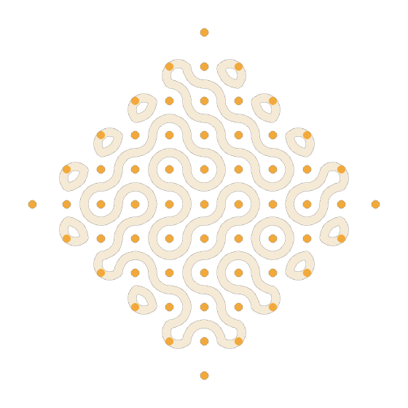
FEATURE · GENERATE
Because it knows the rules, it can create
Single unbroken line
Custom dot layouts (Square / Diamond / Plus + editor)

Slide 8
TECHNOLOGY & ENGINEERING
Built to be real, fast, and robust
Tile-grammar engine
Single-loop solver
One curved tile per cell, joined into guaranteed closed loops around the dots.
Tile-flip loop-merging reduces the whole kolam to one continuous line.
Fully client-side
Exact reconstruction
Analyzer ported to vanilla JS — no backend, deployable static, no cold-start.
Per-cell tile inference reproduces an uploaded kolam cell-for-cell.
Photo fallback
Offline PWA + SVG
Illumination-normalise + Otsu + line-period estimate when dots aren't visible.
Installable, works offline; export crisp vector kolams. Pytest + CI.

Slide 9

LIVE & DEPLOYED
Not a mock-up — try it right now
Runs in any browser
desktop or phone, nothing to install
Works offline
installable PWA, no network needed
Open source
code on GitHub, with tests + CI
No cold-start
Scan to try
static hosting — the demo can't time out
kolam-studio.onrender.com

Slide 10
IMPACT & WHAT'S NEXT
Preserving the rules, not just the pictures
Heritage
Archive the design rules of a fading tradition, not just images.
Education
Teach symmetry, grids and topology through a familiar cultural lens.
Design & craft
Generate motifs for textiles, rangoli, packaging and decor.
Roadmap: sharper real-photograph handling (RANSAC grid-fit, perspective) · regional kolam styles · learn a motif from one example.
“We didn't just preserve a heritage —
we taught a machine to keep drawing it.”
Team Kolam · SIH12507 · kolam-studio.onrender.com

