Slide 1

Exploratory
Data
Analysis

Slide 2

Initial Assumptions¶
• 1: Claimed, 0: Not Claimed
• Unit of Duration: Days
• Unit of Net Sales and Commission is USD
• Value of 0 in Commission: No commission was charged
• Total Premium Charged = Net Sales + Commission Charged, as commission is exclusive of the product premium
• We are assuming a 'No Covid' situation when analyzing the data
Observations from Initial Data Exploration¶
• There are no NULL values in the dataset
• Duration, Net Sales and Commission are Right Skewed
• There are 5 numerical columns and 5 categorical columns

Slide 3
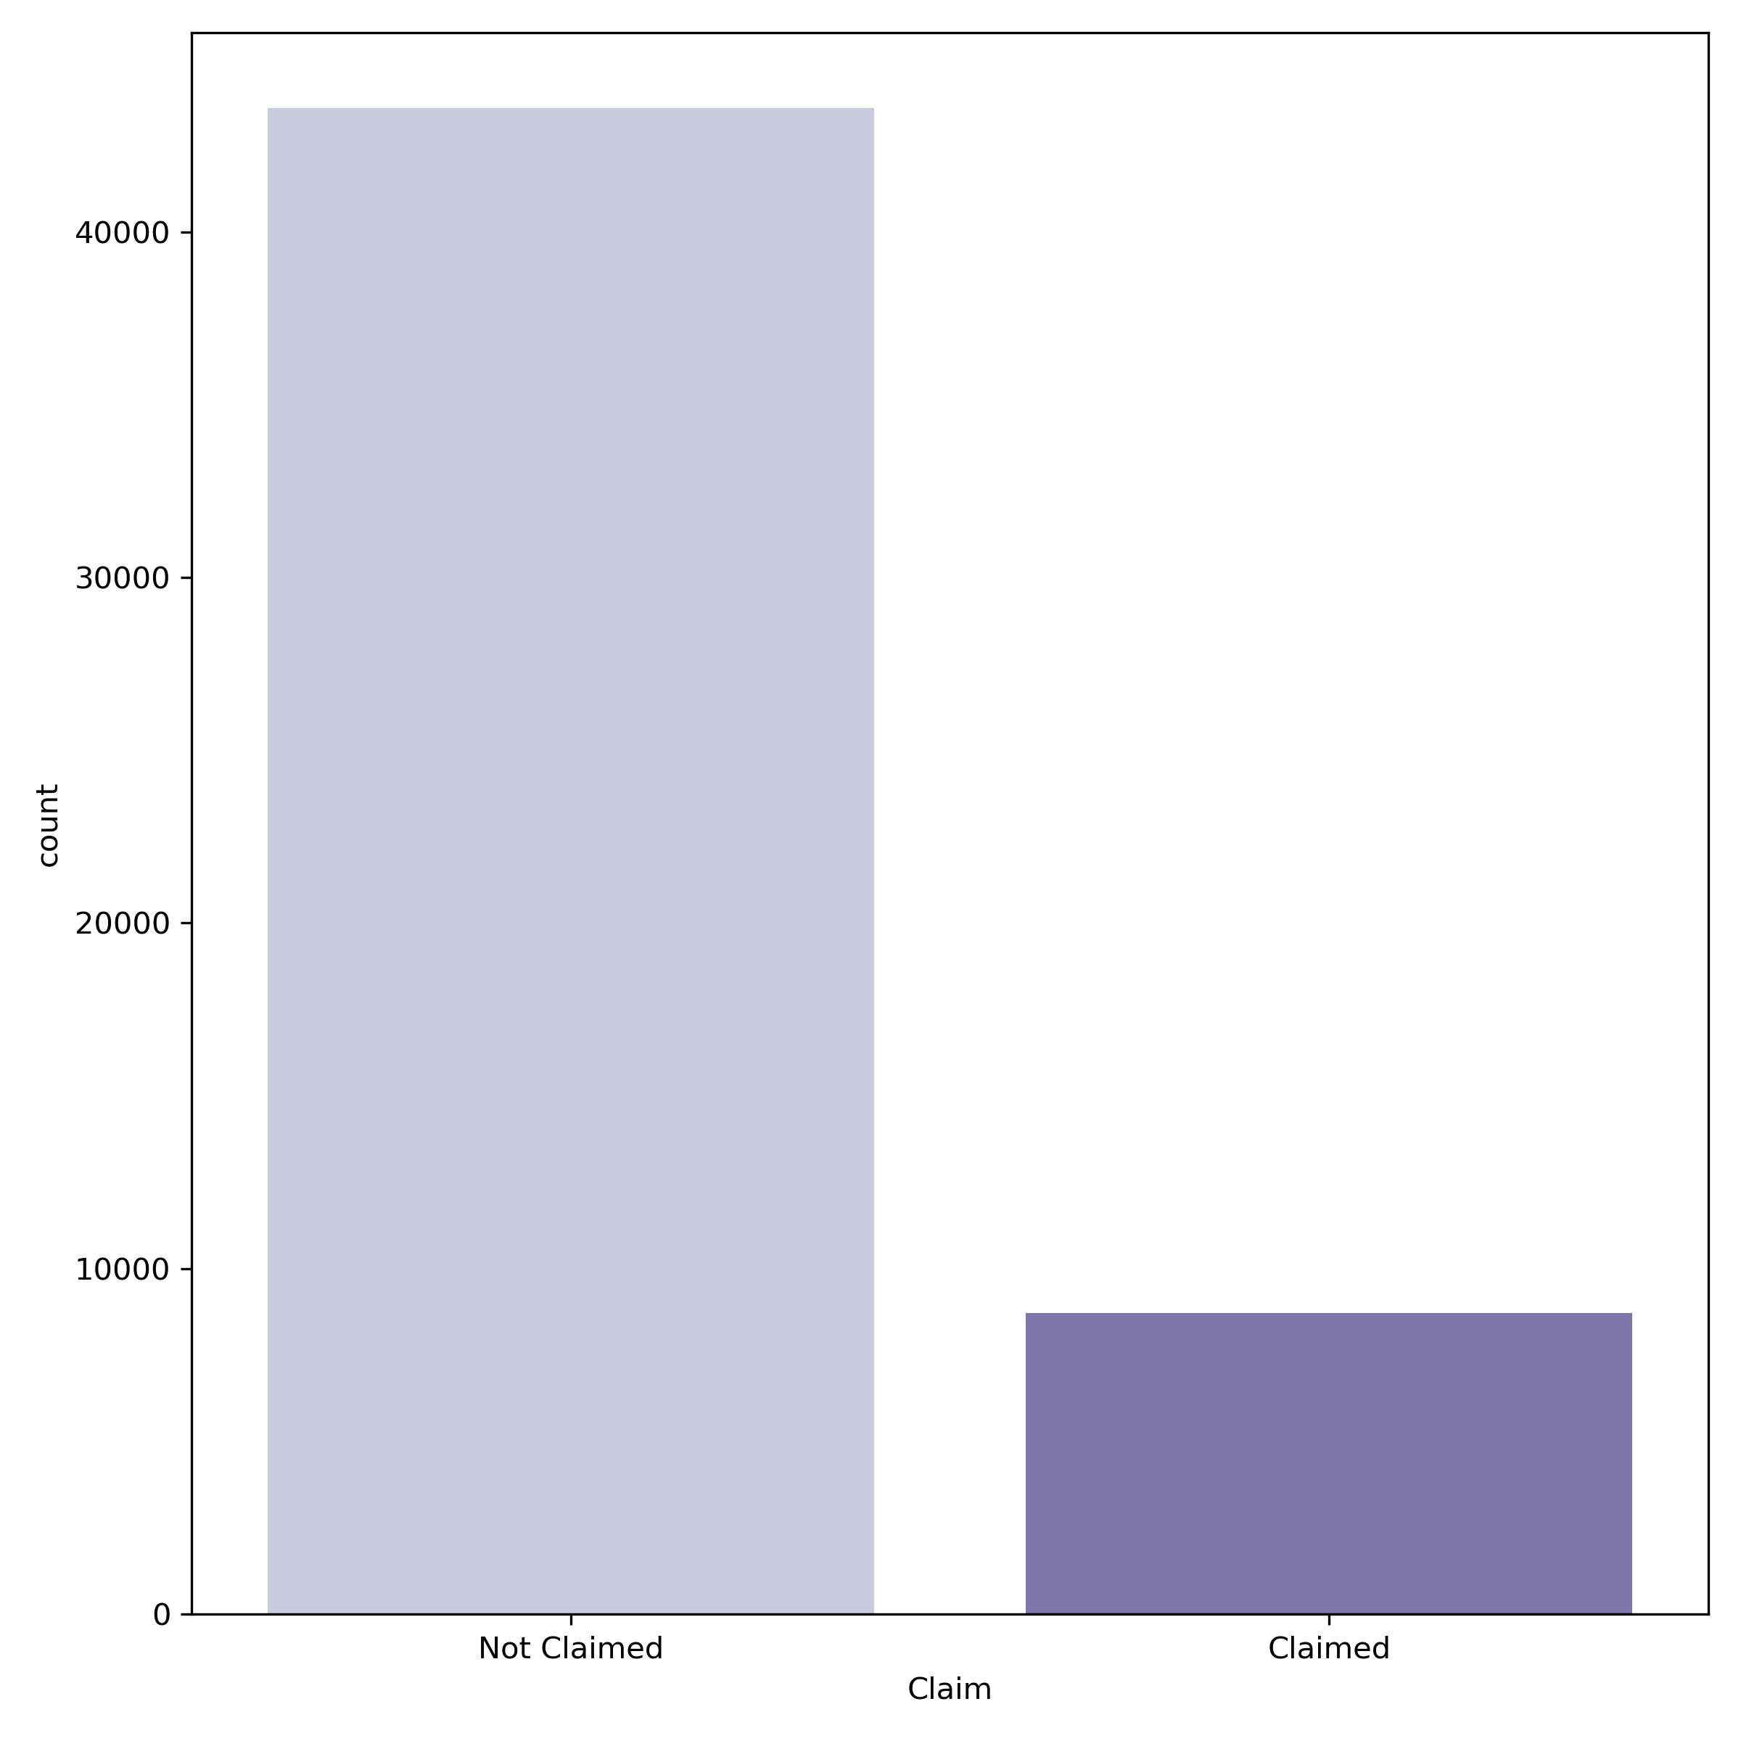


How many Claims were made?
43590
Observation
Data is Imbalanced as
the number of customers who have not made any claim is 5 times the number of customers who have made the claim
Recommendation
To make payment of claims more affordable for the company, we need to pool low risk clients i.e. customers who have low probability of claiming in the future
8720

Slide 4
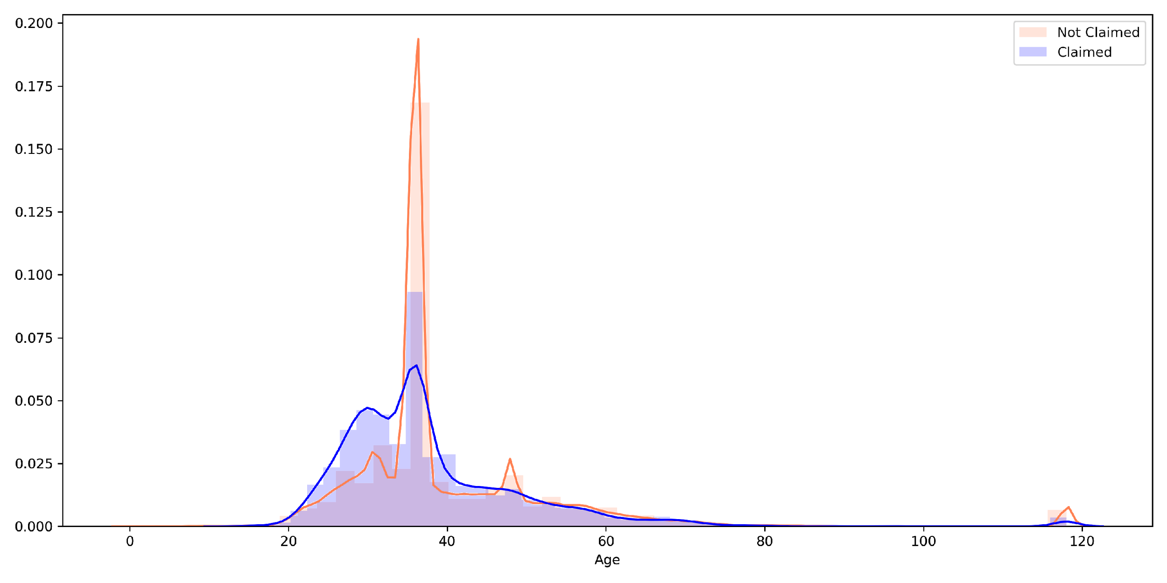
Does Age affect the Claim likelihood?
Insight
To Ashreet: I have manually shown quartiles here. Can you plot the lines in your graph?
Age group of 30-42 years tends to claim more
Customers above the age group of 70 years form 2.5% of customer base
Assumption:
2.5% of customers above the age group of 70 years could have bought Travel Medical Insurance for medical tourism
Recommendation:
As the age increases, the risk to the insurance company increases. We see that the claim ratio (11%) is low for the higher age group. However, to further reduce the risk we can cap the duration of insurance to 30 days from the current average duration of 46 days
Q1
Q3

Slide 5
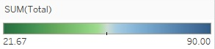
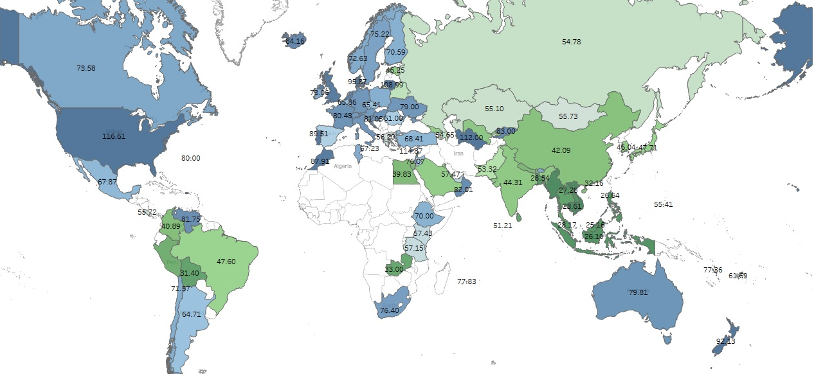

Average Total Sales* by Destination
Lithuania (108.9)
Denmark (95.9)
Turkmenistan (112)
USA (116.6)
Cyprus (114.9)
Singapore (94.6)
*Total Sales = Net Sales + Commission

Slide 6

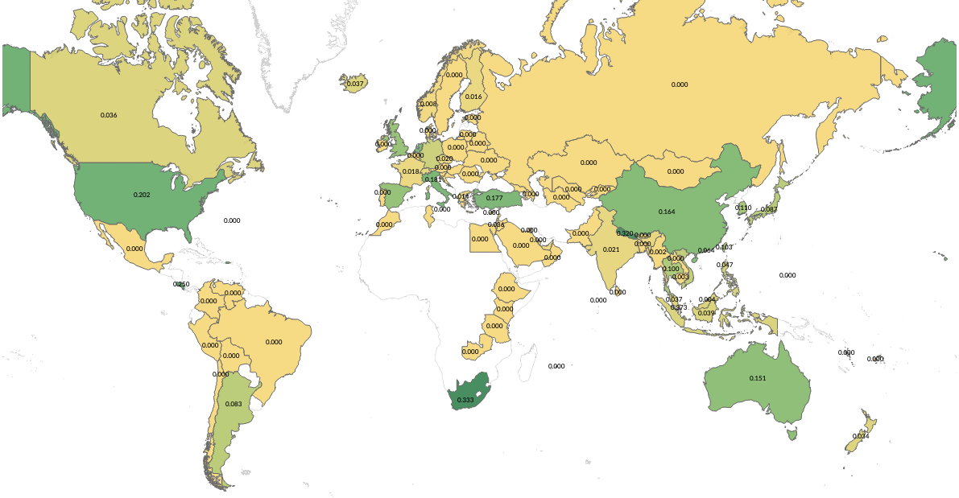
Claim Rates by Destination
Insight: Travellers to Singapore, South Africa and USA have claimed the highest
USA (20%)
Nepal (32%)
Recommendation: We should charge higher premium for travel to South Africa, Nepal and Costa Rica
Singapore(37%)
Costa Rica (25%)
Future:
1. High risk customers travelling to Singapore, South Africa and USA have majorly bought the insurance from online channel
2. We will be able to analyse the data if we know the source location and purpose of travel.
South Africa (33%)

Slide 7
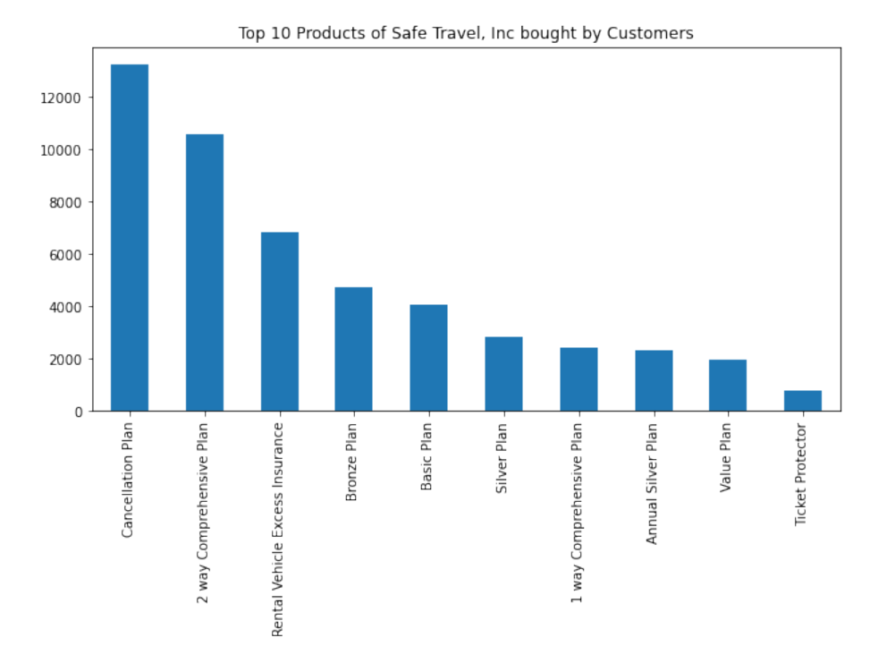
Which are the top 10 products of Safe Travel, Inc bought by the customer?
Observation
Cancellation Plan is the most preferred plan followed by 2 way Comprehensive plan and Rental Vehicle Excess Plan
Let us further deep dive into these products to see which products carry high risk and which are low risk products

Slide 8
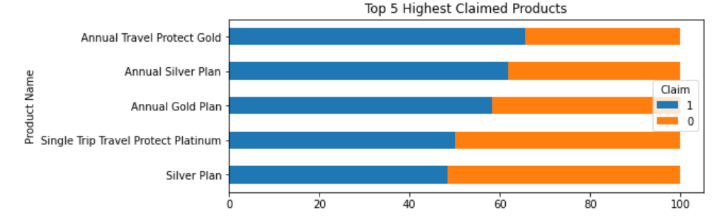
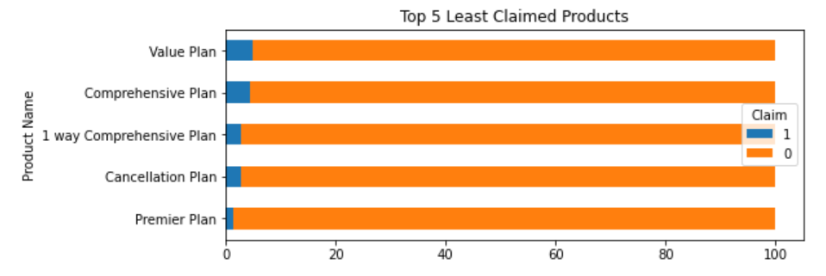
Which products have received highest and lowest claims?
Observation
- Annual Travel Protect Gold, Annual Silver Plan and Annual Gold Plan have less buyers and highest claims
- The above plans have claims in the range of 48-66%
To Ashreet: Can you change color palette of one of the graphs?
Observation
- Cancellation Plan, 1 Way Comprehensive Plan, Value Plan are amongst the top 10 most preferred products
- The above plans have claims in the range of 1.5-5%

Slide 9
What is their Claim Pattern?
 | Top 5 Claimed Products | Top 5 Least Claimed Products
Average Age of customer who make claims | 37 years | 45 years
Destination most visited by people who make the claim | Singapore (94%) | Thailand (25%), USA (11%), China (10%)
Where did they buy insurance from? | From Airlines (94%) through Online channel (100%) | From Travel Agency (91%) through Online channel (93%)
Avg. Net Sales and Avg. Commission charged to them | Net Sales: 167.53 Commission: 46.23 | Net Sales: 33.08 Commission: 3.80
Median Duration of Travel | 364 days | 28 days

Slide 10
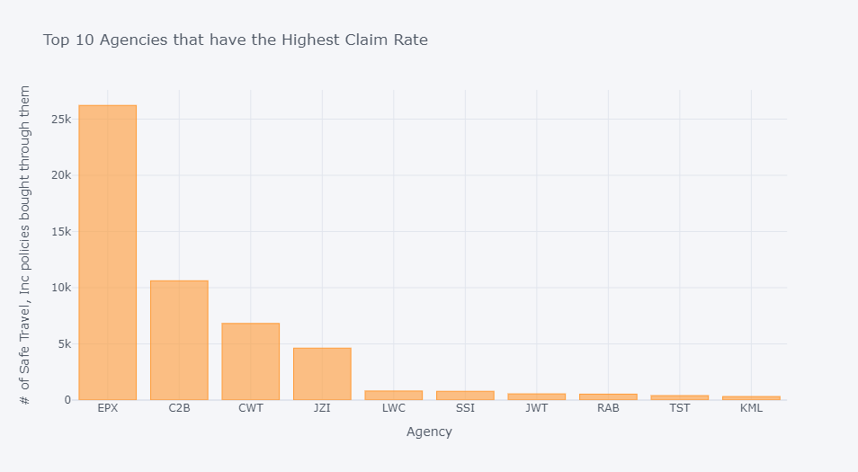
Which are the top 10 Agencies preferred by the Customers of Safe Travel, Inc?
Observation
EPX is the most preferred agency followed by C2B, CWT and JZI
Let us further deep dive into EPX and explore the products sold by them and the profile of their high risk customers

Slide 11
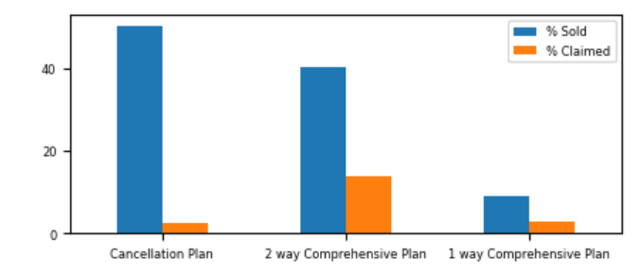
EPX
Which are the products sold by them? What is their claim rate?
EPX is a Travel Agency which is into low risk products with the highest claim rate being 13.8% for 2 way comprehensive plan
Average Net Sales | 28.59 | 53.95 | 33.97
Average Commission | 0.28 | 0.19 | 0.64
Distribution Channel | Online (100%) | Online (98.6%) | Online (66.17%)
Destination | Thailand (33%), US (11%), China (10%) | China (28%), US (17%), Thailand (12%) | China (29%), US (21%), Singapore (18%), Thailand (13%)
Average Age | 34 years | 37.5 years | 62 years
- EPX is preferred for travel to China, Thailand and US amongst the higher age range
- 1 way comprehensive plan preferred by the older age group, making it a high risk product
Distribution channel is online
- Since these are low cost products, online channel helps reduce the paperwork cost

Slide 12
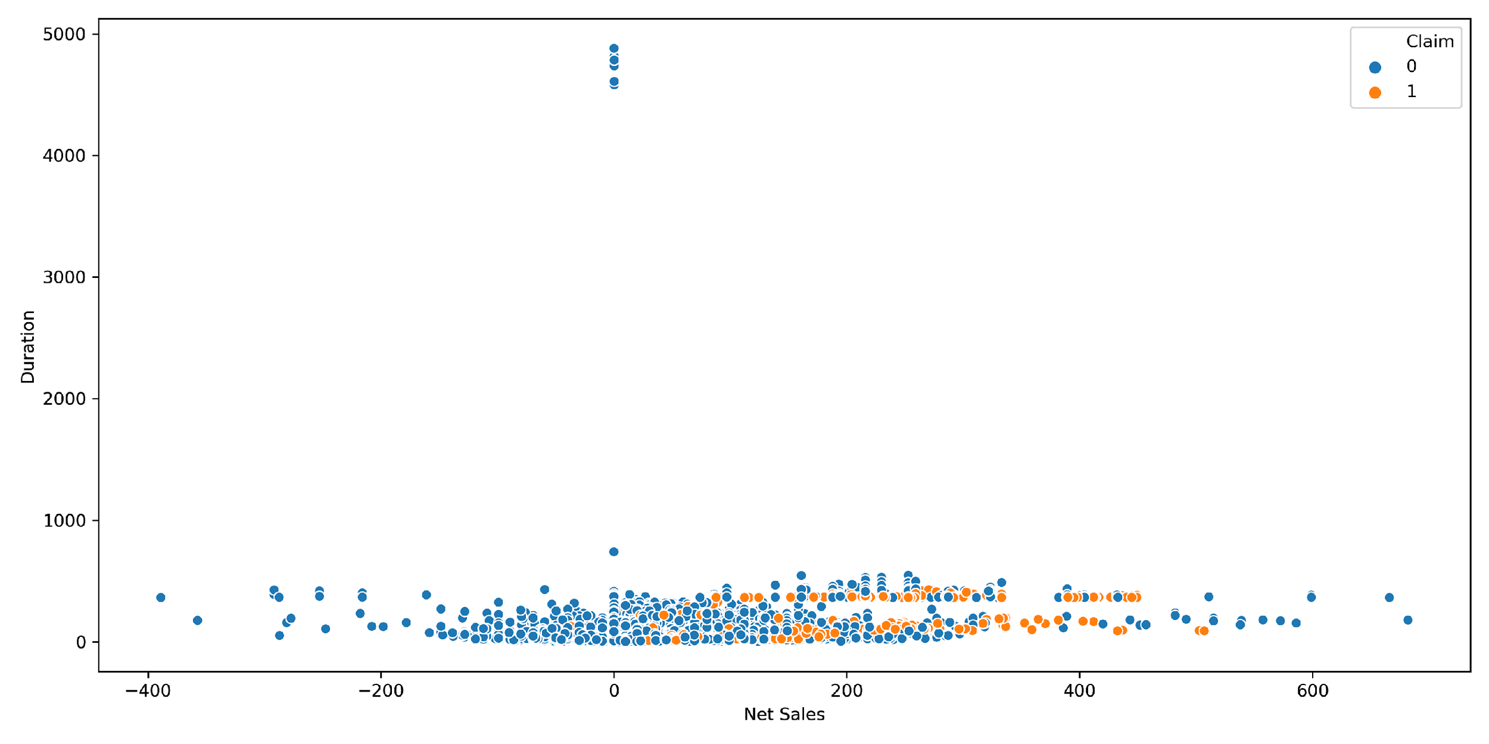
How Net sales and Duration affect Claim?
Do we need this slide?
Insight
While the Net sales range is -400 to +600, claims are majorly done when Net Sales is positive
There are few outliers having duration more than 1000 days. However, the claims are within 540 days (approx. 1.5 years)
Recommendation?

Slide 13
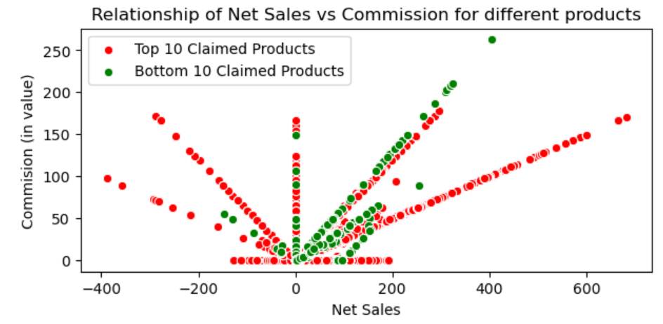
What is the relationship between Net Sales & Commission?
Insight
- High claimed products have high commission for high Net Sales and for products that were sold at a high negative sales
However, it has low commission for products that were sold at a low negative sales with majority of the policies being sold at 0 commission
Average commission for high claimed products is 12.26
- For products that have low claim rate, the net sales is in the range of -200 to 400 with the commission lying in the range of 0-50
Recommendation
- Low risk profile customers should be charged a low commission to ensure that we have more people buying our products

Slide 14
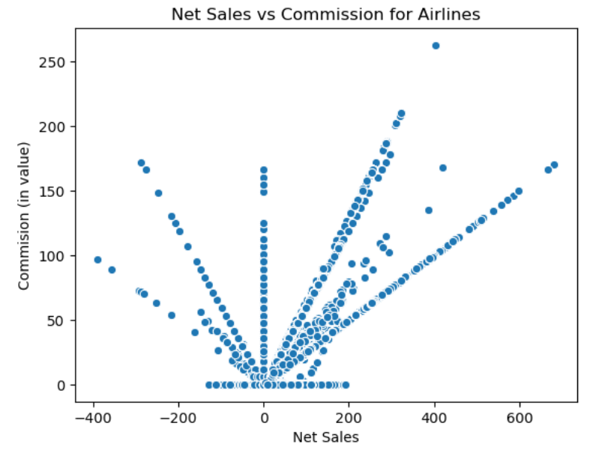
Are the negative values an error in data entry?
Observation
On first inspection, we observe that there is a symmetry between the positive and negative sales value when plotted against commission
Our Assumption: If there is no difference between commission charged for positive net sales value and negative net sales value, the negative net sales value are error in data entry and we can impute them with absolute values
Hypothesis
Null Hypothesis: There is no difference in the commission charged at Net Sales>0 and Net Sales<0
Conclusion
We rejected the Null Hypothesis - There is a significant difference in the commission charged at Net Sales>0 and Net Sales<0
We also found that the average commission charged for negative sales was higher than at positive sales
Alternate Hypothesis: There is a difference in the commission charged at Net Sales>0 and Net Sales<0
We conducted two-tailed t-test and found a p-value of 2.71
Negative sales could be a result of discounts/ promotional offers

Slide 15
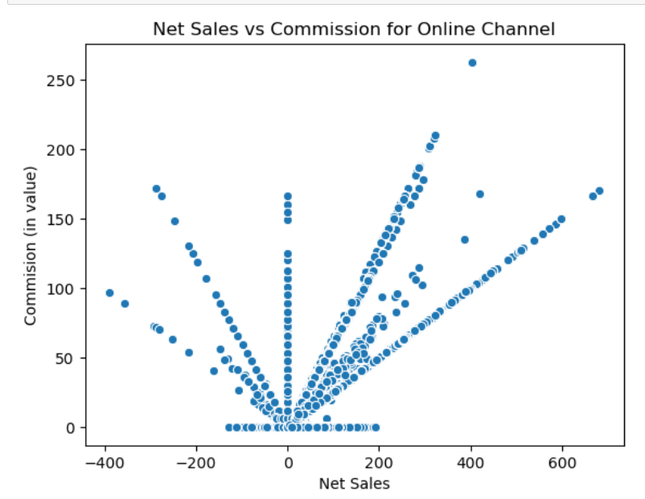
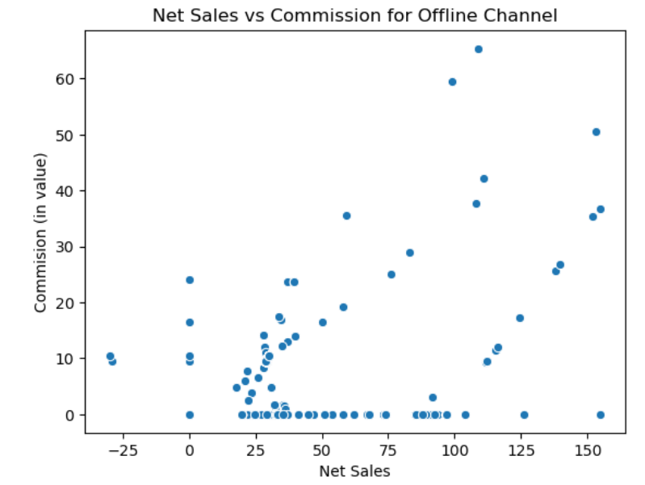
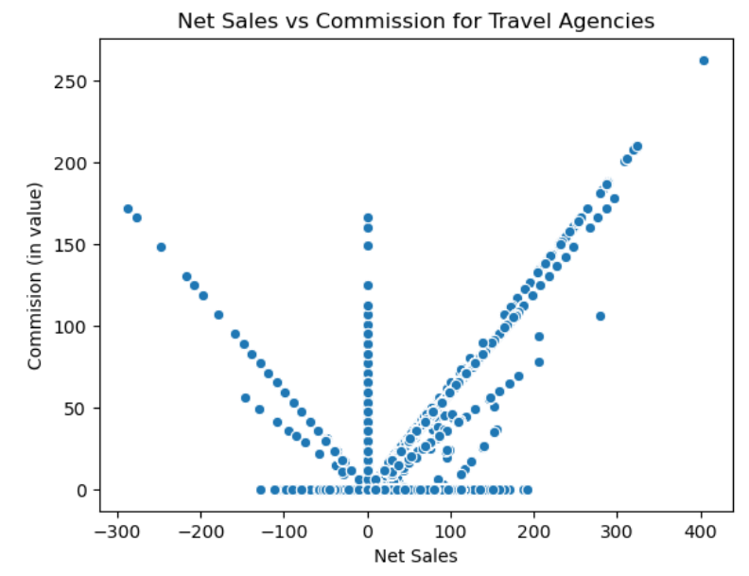
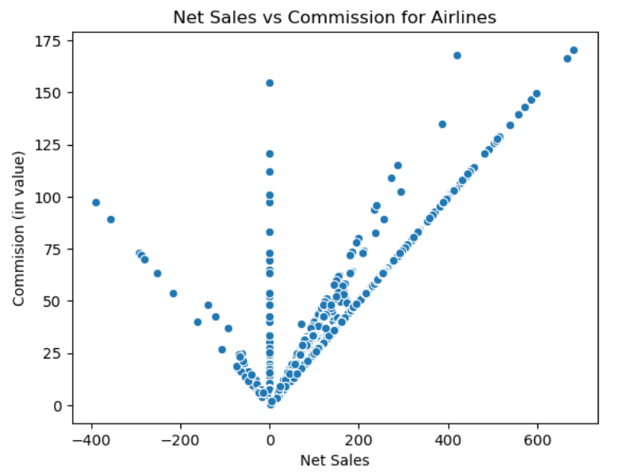
How does Distribution Channel and Travel Agency affect Sales and Commission?
Insight
Please change color palette
We see that the policies sold online and through travel agency and airlines have negative net sales
Since the negative net sales value is very high, we are assuming that online channel must have given heavy discounts (something like buy 1, get 1) to attract more customers
We also observe that Airlines don't work with 0 commission; while the travel agencies do work with 0 commission
- Assumption: Some Travel Agencies also work as tour operators and could be including the commission in the tour package instead of charging it exclusively

