Slide 1

Details:
Team name: Hacoholics.
Problem statement: Black spot alert on mobile phones for travellers.
Ministry category : Min. of Road Transport.
Description of Idea:
Road accident deaths is a cause of major concern of highway.Black spots are the place where historically accidents are concentrated.
So by using GIS technology and various machine learning algorithm commuters can safely negotiating these black spots on roads by which number of accidents can be reduced.
Hence we have come up with a mobile application with following salient features:
By taking the destination from the user showing all available black-spots in the route well in advance before starting the journey.
Using GIS technology inform the user regarding all black spot within 250mts radius from their current location.
Based on the current road condition ,weather , black-spots data suggesting a safe speed for negotiating the black-spot using machine learning algorithm.
Providing a provision for users and concerned authority to upload new black-spots detected.
Other special features:
Providing a search tab to find all black spots by location name.
Provide time to time vehicle service reminders for users to ensure safe drive on roads.
Provide time to time reminder for concerned road authority for inspecting the road conditions at all black spots to ensure safety of commuters.
Provides a SOS button feature so that required ambulance services can be provided and also inform the concerned family member through message service in case of any accidents.
Automatically checks and ensures the alertness of the driver when the black-spot is about 100mts from the current location.

Slide 2
Technology stack:
Android studio - Client side
Fire base - Server side
Tensor-flow - Machine learning
Google eras -Machine learning
Use case
Primary actors:
Drivers and passengers
Emergency service providers like ambulance service
Highway and road development authority
Preconditions :
Internet
GPS location service in mobile phone
Show stoppers/requirements :
List of block spots with there locations.
Basic flow of events:
Application installation and registration of user.
Selection of destination.
Find out the black spots in the upcoming journey.
Enable the location service in the mobile phone and get the intimation of black spots within 250 mts radius along with the safe speed with which the black spot can be handled.
The above intimation is through voice command only so no need of explicit use of mobile phone.
User can also add new black spots by specifying the location.

Slide 3
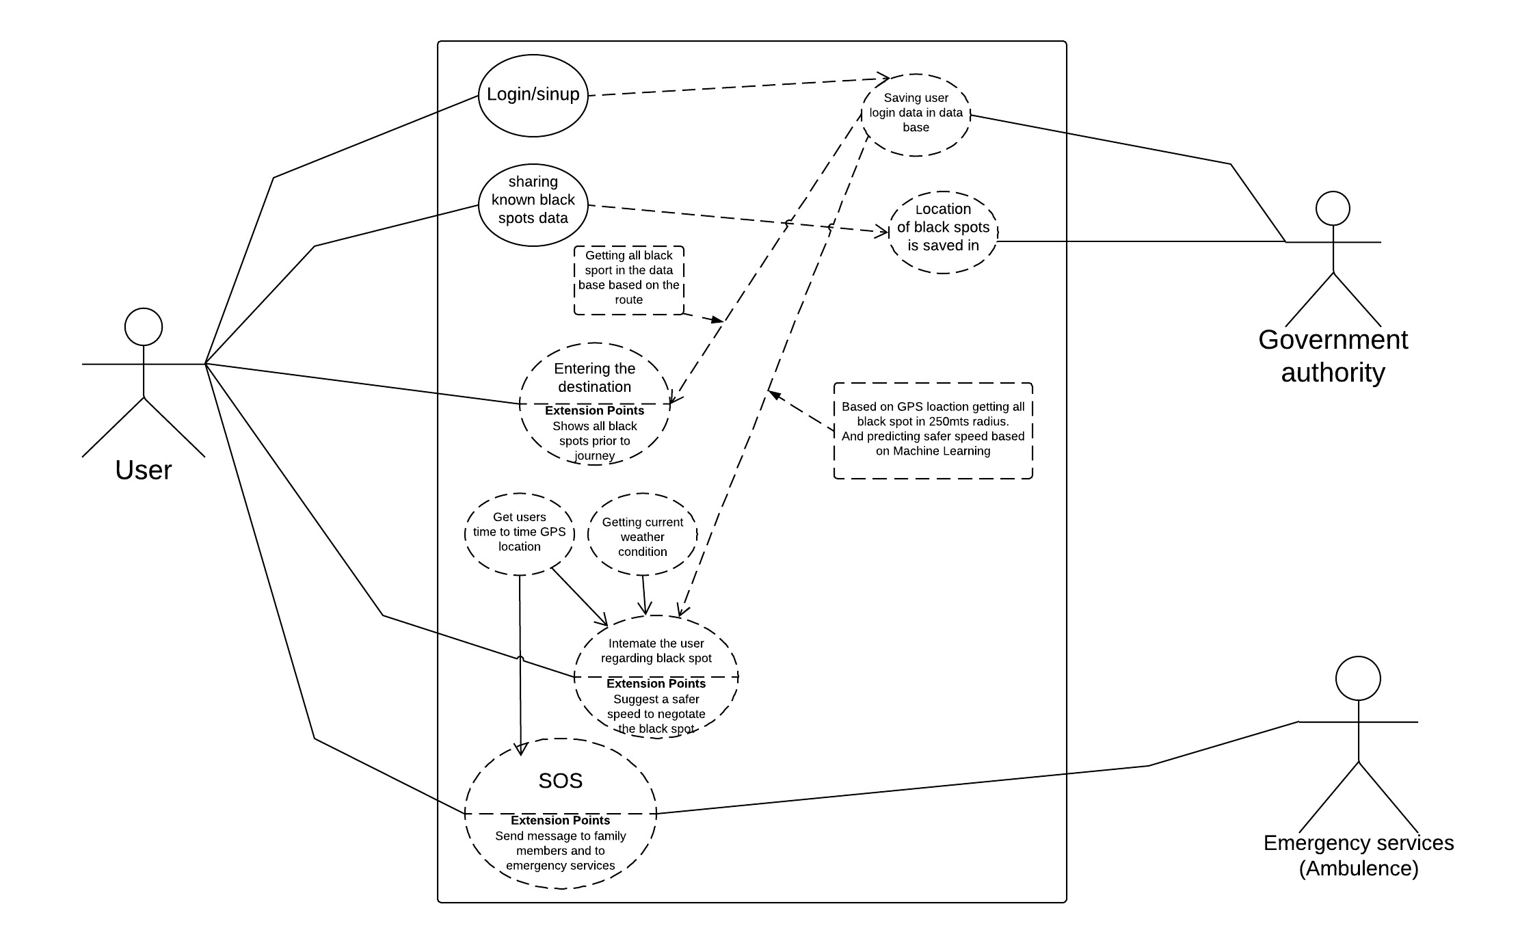
Use case diagram

