Slide 1

Technology Bucket:Software-Mobile app development Category:Software
Company Name : Paytm Problem Code:
Team Leader Name :Manthan M Kulakarni College code:U-0931
Description of idea:
Building an APP using Artificial Intelligence to reduce the amount of push notifications and email sent by e-commerce apps.So that only interested user get the notification related to the product/services.
By sending proper notification to the user improper reviews and negative impact on the product can be reduced.
So we have come up with a mobile application with the following features:
When new products notification is to be pushed in to the crowd ,first response for that new products notification is tested on small mass of people from various class .Based on this response data a good notification is sent to the crowd.
Most popular and common notifications are given for new users .And based on average number of clicks and viewing time of notifications sent to the new user we can measure the deviation of new users from the common crowd.
With the statistics based on the deviation of the new user from the common trend the various classes of notifications for new user is decided and there after notifications are sent based on that.
The notifications are sent only during selected time time slot based on users activity like ,they are avoided during working hours and sleeping hours so that notification are properly read by user.This time slot for each user is predicted using machine algorithm based on the users routine.
Even if a relevant notification is sent during odd time it is stored and given only during the best time slot in-order to prevent the ignoring of notification.
Using GPS location of the user recommendation of notification are made based on the region, culture, lifestyle and local weather.

Slide 2
When new products notification is to be pushed in to the crowd ,first response for that new products notification is tested on small mass of people from various class .Based on this response data a good notification is sent to the crowd.
Based on the online streaming behaviour of user the product list and there priority is decided and notifications are sent accordingly.
Inverse Recommendation method is used where users are recommended the products .Based on previous buys of products by the user ,his rank for that product is decided and notification/emails similar products are sent based on the ranking of the user for that products.
Mobile application keep tracks about the products bought by the user in e-commerce website .And sing machine learning the life of products bought by the customer is predicted and notifications for same type of products are send at the end of products life which prevents the repetitive recommendation of already existing products so that the chances of buying the product will be high.
Based on the age , only relevant notification/emails are predicted based on machine learning and sent to customers.
Data regarding number of notifications blocked by the use is sent to the company for improvement automatically.
Notification regarding various products are first compared with the other with other similar products in market ,then only after analysing the notification that weather its fake or not and then notification is shown to the user using various machine learning classifier algorithm.
Create custom notification spam box for each user ,using this popup notification and emails are sent to the user.
Technology Stack
Android studio. Machine Learning - Tensor-flow , Keras
Server side - Fire Base

Slide 3
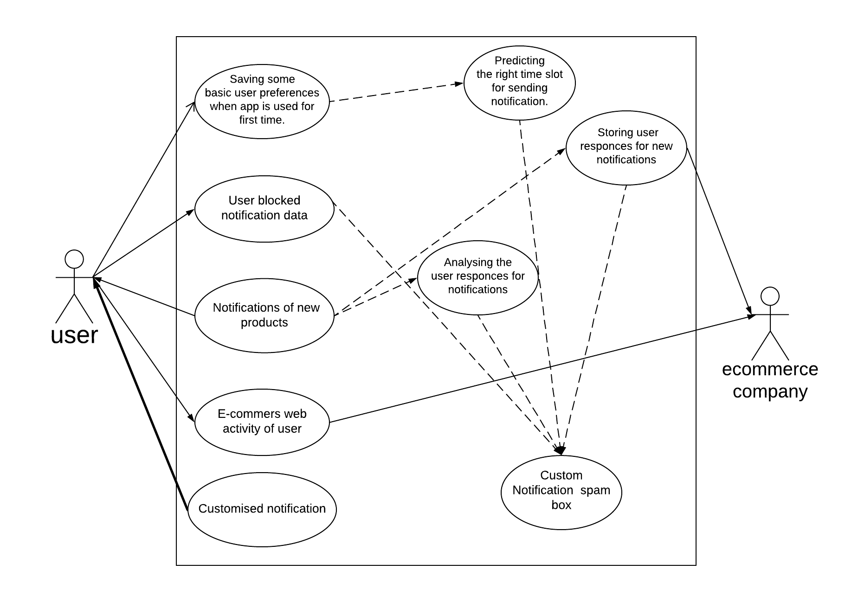
Primary users
Customers
Secondary users
E-Commerce companies
Social Medias
Dependencies
Internet connection
GPS Location service
Show stoppers
Lazy users
Unavailability of users response
Improper reviews given by the user
Challenges
Too much of customised notification to
a user leads to problem related in
introducing a new product to the
customer.
Product information that a customer
gets through notification gets becomes
more narrow.
Not suitable for short time users.

