Slide 1
Demystifying the MCU: Audio
2021/04/29
Daniel Ogorchock

Slide 2
Overview
Provide general overview of the SOC-side audio stack
Explain how the SOC notifies the MCU of its audio needs
Describe the audio hardware in use on milan
Go into detail regarding render and capture pipelines

Slide 3
High Level Audio Hardware Diagram
DMIC0
SOC
MCU
PDM
HiFi4 Audio DSP
SPI/STP/Bluelink
DMIC1
PDM
Smart Amp
I2S
I2S
I2C
Speaker

Slide 4
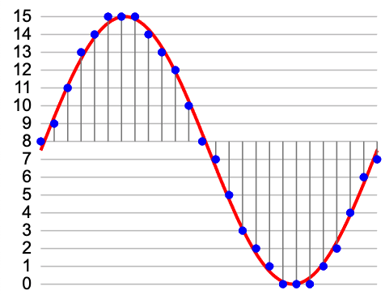
Pulse Code Modulation (PCM)
A way to store digital samples of an analog signal
Amplitude of the signal is sampled at a given rate (sampling frequency)
Resolution of the samples are dictated by number of bits used to store them
For most cases we are using:
48MHz sampling frequency
16 bit samples
We exchange PCM samples between ICs

Slide 5
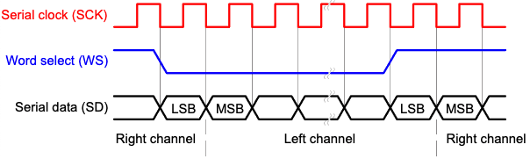
I2S (Inter-IC Sound)
Digital serial bus for exchanging PCM audio samples
The bus’ lines:
Bit clock (SCK/BCLK)
Word select (WS/LRCLK/FS) - used to specify which channel (left vs. right)
One or more serial data lines (SD)
Each bus has a device acting as bus master (drives the bit clock and word select)

Slide 6
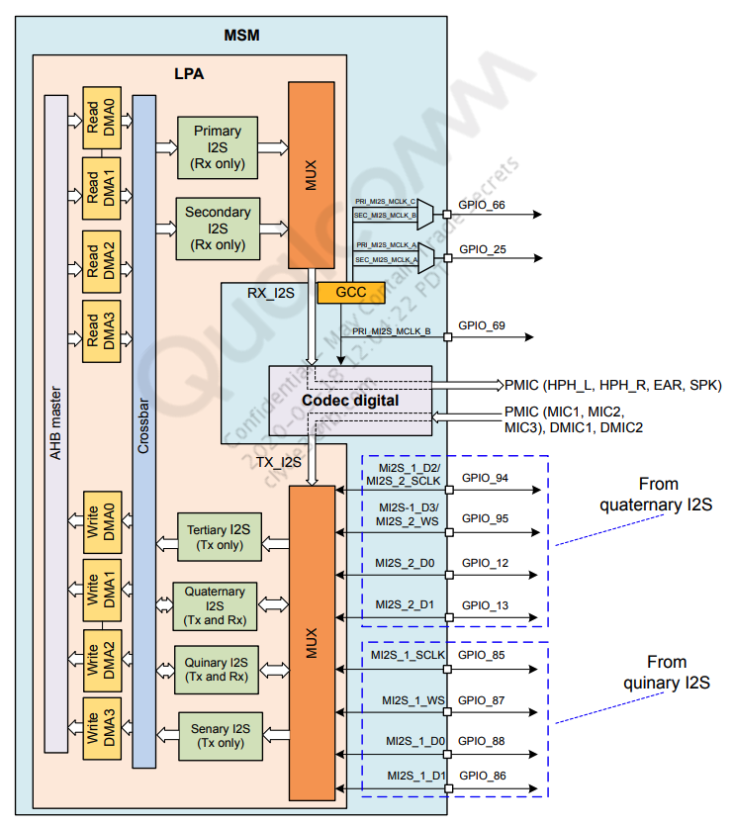
SOC MI2S Interface
Qualcomm provides two I2S buses for external customer use (the quaternary and quinary MI2S buses)
We use the quaternary MI2S bus to exchange audio samples between the MCU and SOC
The MCU is configured as bus master

Slide 7
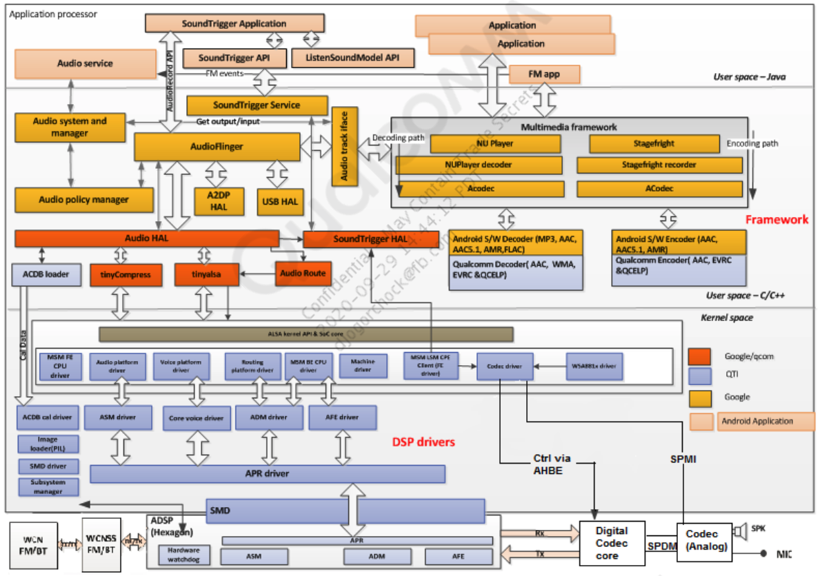
SOC - Audio Software Architecture

Slide 8
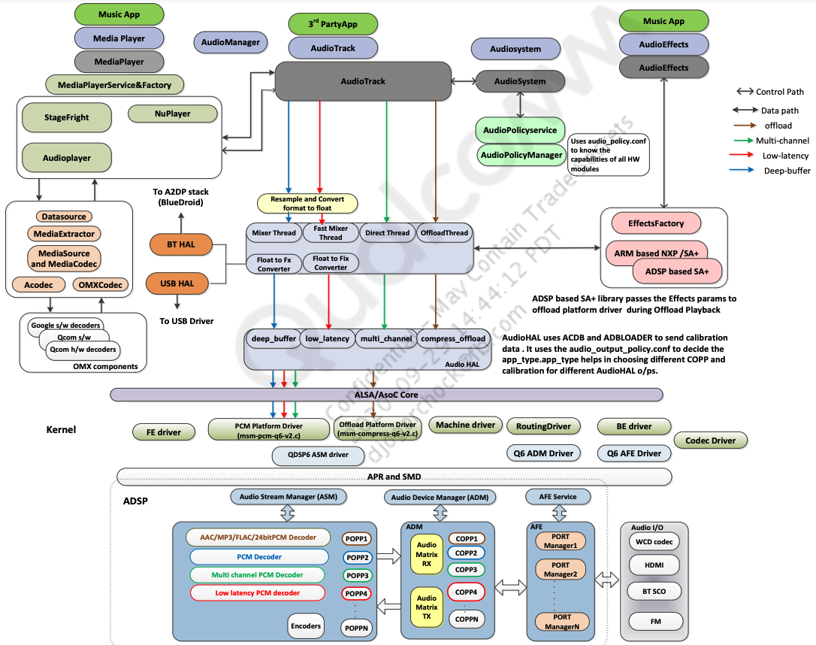
SOC - Playback Flow

Slide 9
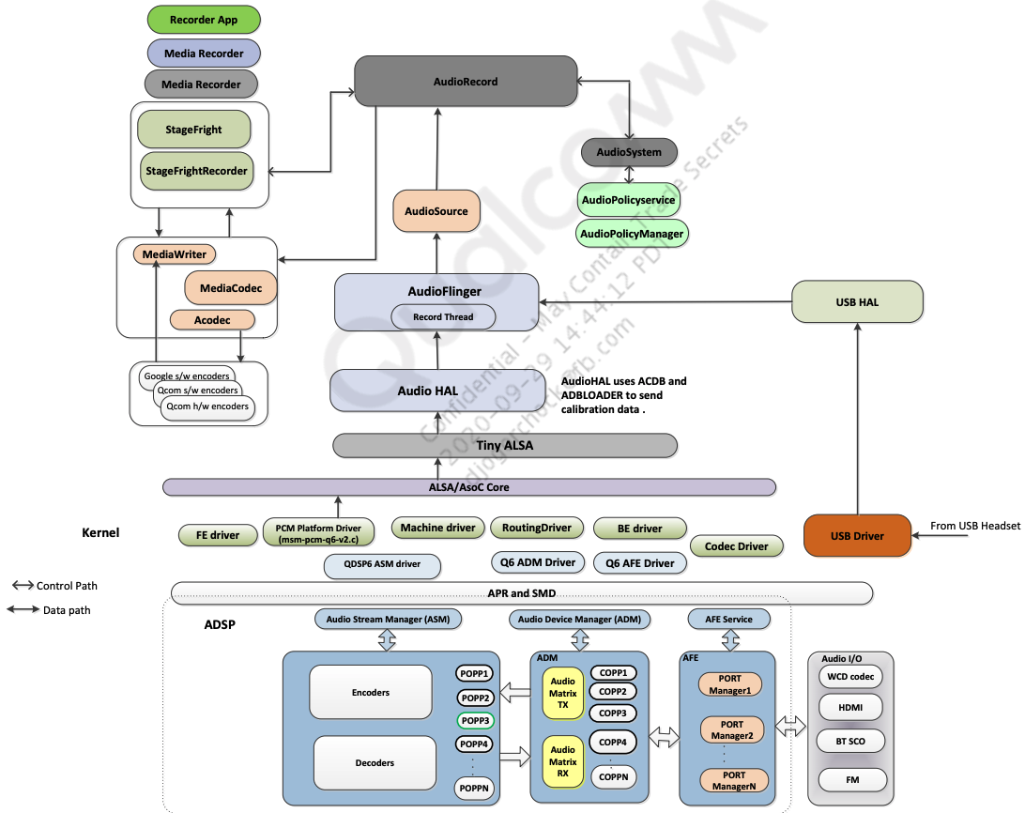
SOC - Recording Flow

Slide 10
Audio Power Saving
We cannot leave our audio features enabled when not in use lest our battery life will suffer
By default, we keep the smart amp in standby, dmics powered off, and the HiFi DSP’s render/capture pipelines disabled
We react to requests from the SOC when it needs either microphone samples or speaker output
We will also support enabling the DSP/dmics in reaction to a wrist tilt event (for wakeword support)

Slide 11
Audio HAL Notifications
We have added hooks in the qualcomm audio HAL that allow us to react to sound devices being enabled/disabled
We notify the MCU via a bluebox service when a device is needed or no longer needed
If command router restarts, the audio HAL extension will send its cached state of the speaker/mics to the MCU so things can quickly get back in sync
If the MCU does not respond to a request, an error will be logged
Look for “audio_hw_bluebox” in logcat

Slide 12
Speech Service
The speech service on the SOC is reliant on an audio stream optimized for automatic speech recognition (ASR)
The service uses the same bluebox service as the audio HAL to request that the MCU enables the ASR stream
The stream is published over bluebox rather than I2S
This grants us more flexibility, since android has tight restrictions on multiple applications using microphone input at the same time
This stream is to be used for dictation and assistant

Slide 13
MCU - HiFi Audio DSP
The rt600 has both an m33 arm core in addition to a HiFi4 audio digital signal processor
The DSP processes our raw microphone input samples to produce audio streams consumed by the SOC
The HiFi firmware is maintained by the XR Audio team

Slide 14
MCU - HiFi Audio DSP - Communication with M33
Our rt600 memory layout has sections carved out related to the HiFi
A shared region for access by the M33, HiFi, and DMA
Command region - used to send commands/notifications between the m33 and HiFi
Audio buffer region - used to exchange audio samples between m33, hifi, and DMA
DSP fw SRAM - solely for use by the HiFi firmware
The m33 populates this region with the HiFi firmware found in the assets catalog during initialization
The two cores can trigger interrupts for each other, causing the other to read pending commands from the shared region
M33 controls which pipelines/features are enabled on the HiFi

Slide 15
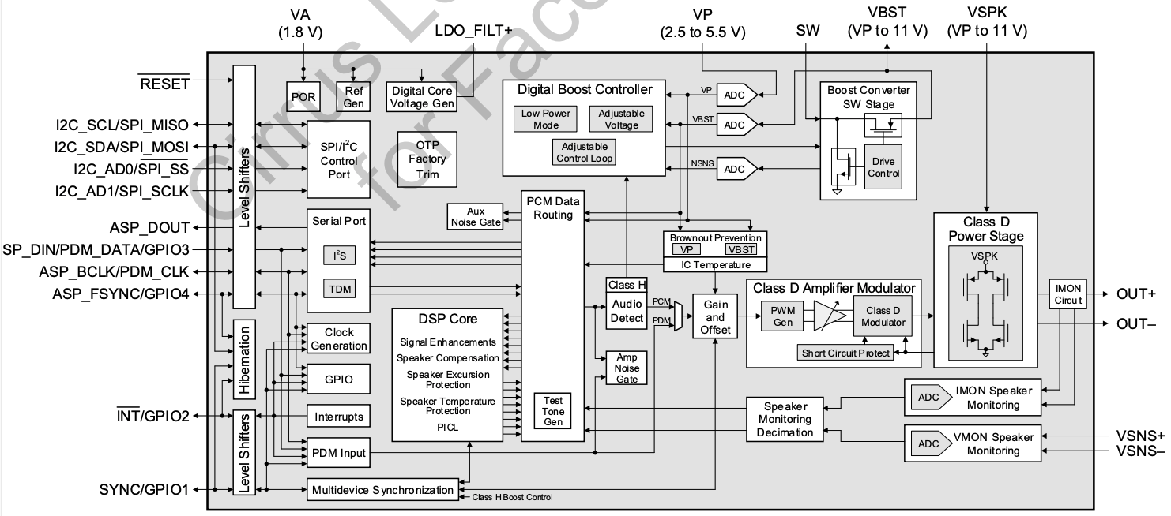
MCU - Cirrus CS35L41B Smart Amplifier
Class-D (switching) amplifier - more efficient than linear amps
Serial audio input/output interface - (we use in I2S mode)
Has onboard programmable Halo DSP core
Controlled via SPI or I2C - (we use I2C)

Slide 16
MCU - Smart Amp - Onboard DSP
Handles our render path audio processing
Tuned based on the mechanical properties of the watch
Offers several protection features:
Over-temperature protection
Brownout prevention (preventing scenarios where playing audio of high amplitude can overtax the power rails)
Plan is to use predictive input current limit (PICL), but Cirrus will not be able to tune this until more finalized hardware/software
Currently using Vbat tracking features of the amp as a temporary solution

Slide 17
MCU - Smart Amp - Echo Reference
The amp receives the speaker audio samples on one of the I2S data lines, but it can also send samples back to the MCU on the other line such as:
VPMON - battery voltage
VBSTMON - power supply for high-power output stage of the amp
VMON - output voltage to the speaker
IMON - current flowing through the load (speaker)
We use VMON as an echo reference
The HiFi DSP firmware uses these samples for echo cancellation

Slide 18


MCU - Digital Microphones (SPW0690LM4H-1)
We have two digital microphones
Use pulse density modulation (PDM) to send samples to the rt600

Slide 19
MCU - Render Path
SOC MI2S
MCU Flexcomm I2S
We receive speaker output audio samples from the SOC via the I2S bus
We populate audio buffers in the shared SRAM region with those samples for the HiFi DSP’s consumption
We don’t do any render processing on the HiFi, so it just passes the samples directly through to other audio buffers
Those samples are sent via I2S for the smart amp; its onboard DSP conducts render processing
DMA1
Shared Audio SRAM
HiFi Audio DSP
Shared Audio SRAM
DMA1
Amp I2S
Smart Amp

Slide 20
MCU - Capture Path
DMICs
RT600 DMIC Peripheral
The RT600’s DMIC peripheral converts the PDM samples into PCM samples
We DMA those samples into the shared audio buffer region for the HiFi DSP’s consumption
The HiFi has multiple processing paths (more on this on following slide)
Audio streams sent to SOC:
I2S for most use
Bluebox for the ASR stream
DMA1
Shared Audio SRAM
HiFi Audio DSP
Shared Audio SRAM
SPI/STP/bluebox
DMA1
SOC/MCU I2S
SOC

Slide 21
MCU - HiFi Capture Pipeline
The HiFi DSP firmware produces three different audio streams that process the raw microphone input in differing ways:
Voice optimized stream: This stream has gone through aggressive noise suppression. It is intended for cases such as voice recordings or voice calls.
Video record stream: This stream is optimized for video recording (e.g. recording a video with the camera app).
Assistant stream: This stream is optimized for machine interpretation of the audio stream. It is used by dictation and assistant.
This assistant stream is the only one sent to the SOC via bluebox
Currently we are always sending the video record stream over I2S, but we plan to switch between the video/voice streams based on use case in the near future

Slide 22
MCU - Wakeword
When a wrist tilt event is detected, we will enable the dmics and the HiFi DSP’s keyword spotter (KWS)
If the DSP detects the keyword “Hey Facebook”, it will notify the m33
The m33 will then send the buffered audio to the SOC for processing

Slide 23
Thank You

