Slide 1
DataOps by DataKitchen
DataKitchen software
Observe
Automate every data journey in an organization
from source to customer value
in development and production
so that teams can deliver insight to their customers with few errors and a high rate of new insight creation.​
It allows data and analytic teams to
observe
Test
automate the tools, data, processes, and environments
in their entire data analytics organization
providing massive increases in quality, cycle time, and team productivity

Slide 2
Fundamentals of DataOps
Topics
DataOps Intro
Problems in Data & Analytical Industry
Root Cause : Organizational complexity
Solution : DataOps
DataOps Production Pipeline
Three DataOps Pipelines
Meta-Orchestrate Tools, Teams, & Processes
Automate Tests for Error Detection
Types of Tests
Measure Production Processes, Reflect & Improve
DataOps Development Pipeline
Development Lifecycle Complexities
Data & Analytics Development
How to Achieve Fast Deployments
DataOps Deployments: Beyond DevOps

Slide 3
Fundamentals of DataOps
DataOps Environment Pipeline
DataOps Environment Challenges
Environment Management: Components
Principles of DataOps Environments
DataOps Implementation
Lean DataOps Implementation
Four Phases of Lean DataOps
Six-Step Process to DataOps
Conclusion

Slide 4
DataOps- Problems in Data & Analytical Industry
What are Data & Analytics industry problems ?
Data analytics plays a critical role in every stage of the value chain, from data collection to visualization, helping to ensure that the customer receives the most value from the data.
It could be data preparation, or ETL, or data science or AI, machine learning, data visualization, data governance.
We know that data analytics is hot, It has become increasingly popular in recent years as the amount of data available to individuals and organizations has grown significantly. With the help of data analytics, businesses, governments, and individuals can gain insights into patterns, trends, and correlations in the data, which can then be used to make informed decisions and improve outcomes

Slide 5
DataOps- - Problems in Data & Analytical Industry
Cycle Time Issues
Poor Team work - Lack of group collaboration - waiting for access to data- poor quality of data- Over calculation issues
As per the recent Survey there are many data science projects that do not make it into production, and the failure rate of data projects is relatively high.
There can be several reasons for this.
Lack of alignment with business goals: If the data science projects are not aligned with the overall business goals and objectives, they are unlikely to be successful. Data science teams need to work closely with business leaders to understand their needs and objectives and align their work accordingly.

Slide 6
DataOps-Problems in Data & Analytical Industry
Lack of data quality: Poor data quality can be a significant obstacle in data science projects. If the data used in the project is inaccurate, incomplete, or inconsistent, it can lead to incorrect or misleading insights. Data science teams need to ensure that the data they use is of high quality, and they may need to invest in data cleaning, transformation, and integration processes.
Lack of clear goals and KPIs: Data science projects need to have clear goals and key performance indicators (KPIs) to measure their success. If these are not defined clearly, it can be difficult to measure the impact of the project and make necessary adjustments.
Lack of collaboration: Successful data science projects require collaboration between business leaders, data scientists, and IT teams. If there is a lack of communication and collaboration between these stakeholders, it can result in misaligned expectations and a lack of understanding of the business context.

Slide 7
DataOps- - Problems in Data & Analytical Industry
Lack of talent: Data science projects require a diverse range of skills, including statistical analysis, programming, data engineering, and data visualization. If the team does not have the right mix of skills, it can impact the quality of the project outcomes.
To overcome these challenges, organizations need to adopt a more structured and collaborative approach to data projects.
To address these issues, organizations need to focus on
Building a strong data culture
Investing in the right infrastructure and tools
and developing a cross-functional team
The data and analytic industry may need to adopt new techniques and methodologies to improve the quality of the artifacts they create.

Slide 8
DataOps-Problems in Data & Analytical Industry
The Japanese auto industry was able to produce better cars that were faster and lasted longer by using Lean manufacturing techniques
Value: Focusing on delivering value to the customer and eliminating activities that do not add value
Flow: Streamlining the flow of materials and information through the production process to minimize delays and reduce inventory.
Pull: Using customer demand to drive production, rather than pushing products into the market based on forecasts.
Standardize: Establishing standardized work processes and procedures to improve quality and efficiency.
Continuous Improvement: Embracing a culture of continuous improvement, where all employees are encouraged to identify and eliminate waste and inefficiencies.

Slide 9
DataOps- - Problems in Data & Analytical Industry
These principles have been applied not only in manufacturing but also in other industries
includes
software development and project management
To improve
Efficiency
Quality
Customer satisfaction.
Similarly, the data and analytic industry may need to adopt new approaches, such as
Agile methodologies
DevOps practices
continuous integration and deployment
To improve the quality of their projects and deliver value to the business more quickly.

Slide 10
DataOps- - Problems in Data & Analytical Industry
Challenges:
Complex Organization & roles
Complex tool chains
Complex data
Complex collaboration and
coordination across teams, locations, and cloud/data centers
New Features
Percentage teams spends per week
Errors & Tasks
Team's time is not really well spent.

Slide 11
DataOps- - Problems in Data & Analytical Industry
Challenges:
Complicated organizations and roles between data scientists, and data visualization and engineers.
There's a complex tool chain-Tool chain is all the tools and engines that people use to derive data.
There's obviously complex data, big and small, unshaped and shaped.
And there's a complex collaboration across people and locations and tool chains.
Teams don't spend enough time on the things that they want to do.
As per the survey about data management, and its struggles to balance innovation and control, that talked about that very point. That only 22% of the time is spent on new initiatives and the rest with the operational execution,
As a result, the innovation that the customer desires can't be delivered.

Slide 12
DataOps- Root cause : Organisational Complexities
We have lot people who works with data.
Data analysts -who work with tools like Tableau,PBI
Data engineers- who work with Informatica/Bigdata
data architects or database administrators.
How they source data ?
From internal and external systems
Lot of data that could come in from inside your company data that could come from outside of your company like census data or open data
Overall comes in a lot of different forms.

Slide 13
DataOps- Root cause : Organisational Complexities
Peoples Chain
There's a whole chain of different people-who work in different roles, and they've all got different skills.
But if you look at how teams work, they actually kind of work in a linked process.
For instance,
Data engineer sources a table
Data science applies a model to it and creates a segmentation.
Someone in visualization may add and visualize it.
The data governance person tries to actually figure out where all the data comes from.
And then the ops person has to put all that stuff into production.

Slide 14
DataOps- Root cause : Organisational Complexities
And if you look at it from a process standpoint, each one of these has their own separate development-production-QA cycle
And each one has their own peculiar challenges
These processes actually have to work together.
They may work for the same boss, but sometimes they don't.
In traditional software development: one-to-one relationship
The development team writes code
The operations team is responsible for deploying and maintaining that code in production.
This is typically a one-to-one relationship where each development team has corresponding operations team.

Slide 15
DataOps- Root cause : Organisational Complexities
However, in the context of data and analytics : many-to-many relationship between
There can be many different development teams working on a variety of projects
Each with their own unique requirements and timelines.
Similarly, there may be multiple operations teams responsible for deploying and maintaining different parts of the analytics infrastructure, such as data pipelines, storage systems, and visualization tools.
This is many-to-many relationship between

Slide 16
DataOps- Root cause : Organisational Complexities
For example
Suppose there is a software development company that has
2 Development teams
based
Banglore - works on Backend of company web application
Hyderabad - works on Frontend of company web application
Each team has its own set of tools and deployment operations, which can create problems when it comes to collaboration and communication.
For example:
if the Banglore team wants to change the database schema, they may not know how it will affect the frontend components that the Hyderabad team is working on.
Similarly, if the Hyderabad team makes changes to the user interface, the Banglore team may need to update their backend components to match.

Slide 17
DataOps- Root cause : Organisational Complexities
To overcome these challenges, the teams need to establish a process for communication and collaboration.
Schedule regular meetings
Discuss changes and updates,
Ensure that their tools and deployment operations are compatible with each other.
By working together and establishing clear communication channels, the teams can minimize the risk of conflicts and ensure that their development efforts are aligned towards the same goals.
In a lot of cases, one of the symptoms of a problematic data and analytics organization is that there's not a trust in data.
Data providers give you crappy data
And a lot of times people will copy & paste these reports and put them in different locations.
So these challenges with coordination are quite important.

Slide 18
DataOps- Root cause : Organisational Complexities
One way to look at these challenges is something called Conway's Law,
which says that any organization that designs a system will inevitably produce a design of that system that is reflecting of the company's communication structure.
let me explain Conway's Law in more detail:
Conway's Law is a principle that states that the structure of a system reflects the communication structure of the organization that created it.
In other words, the way that people within an organization communicate and collaborate with each other will directly impact the way that the products or systems they create are designed and built.
DataOps follows Conway's Law.

Slide 19
DataOps- Root cause : Organisational Complexities
For example,
if a company has separate teams
for
frontend Development
Backend development
Those teams may end up creating separate components that don't integrate well with each other.
On the other hand
if a company has cross-functional teams that work closely together, they may be more likely to create a cohesive and integrated system.

Slide 20
DataOps- Root cause : Organisational Complexities
Describing the concept of a "factory of insight" in the context of data analytics.
The data goes through a series of steps or pipelines, similar to a manufacturing line, in order to be transformed, visualized, catalogued, or have a predictive model applied.
This factory view is important because it allows organizations to better understand how their pipelines are producing and how to improve them.
Implementing DataOps, which emphasizes feedback, short cycle times, and continuous deployment, can help teams learn more about what their customers want and ultimately produce higher quality data more efficiently. a lot of potential for improvement in the field of data analytics, and believes that implementing DataOps can help teams overcome the challenges they are facing

Slide 21
DataOps- Solution Dataops
To summarize, the perspective of DataOps is focused on how you do something rather than what you do.
This perspective comes from manufacturing, where building the machine that makes the machine is crucial.
In DataOps, the focus is on :
people
Processes
Pipelines
That make the whole team work together and give customer value.
The idea is to
lower error rates
Decrease cycle time of change
Empower people to change with safety and control.
"DataOps is a solution to poor processes, and it provides a set of technical practices, cultural norms, and architecture patterns that focus on rapid cycles of innovation, low error rates, collaboration, and clear measurement and monitoring of results".

Slide 22
DataOpsDataOps Production Pipeline
The Three DataOps Pipelines
We have the following Pipelines
Value Pipeline / Production
Innovation Pipeline / Deployment
Environment Pipeline / ( Production & Deployment )

Slide 23
DataOpsDataOps Production Pipeline
The Three DataOps Pipelines
VALUE PIPELINE / PRODUCTION PIPELINE
DATA
PRODUCTION
VALUE
Transform:
SQL code,ETL
model:
R code
Prep:
Workbook
Report:
Tableu
Acess:
Python code
IT TEAM
DATA SCIENCE TEAM
LINES OF BUSINESS

Slide 24
DataOps-DataOps Production Pipeline
The Three DataOps Pipelines
Value pipeline is focused on orchestrating data to customer value.
This is akin to a manufacturing process,
where data is taken on the left-hand side and transformed into
Artifacts such as charts Graphs
Refined datasets
that are delivered to the customer on the right-hand side.
This value or production pipeline is made up of different manufacturing stations
where data can be
Accessed
Transformed
Modeled
Visualized

Slide 25
DataOpsDataOps Production Pipeline
The Three DataOps Pipelines
There are various tools that can be used at each station
such as
Data visualization tools
Data science tools
Data catalog tools
Data pipeline tools.
It's important to note that these pipelines are often distributed and not owned by a single team.
For example, IT team may own one part of the pipeline
Data team may own another part

Slide 26
DataOpsDataOps Production Pipeline
The Three DataOps Pipelines
Innovation Pipeline / Deployment Pipeline
Diverse Customers
PRODUCTION
Diverse Team
DEVELOPMENT
Diverse Tools
IDEA

Slide 27
DataOpsDataOps Production Pipeline
The Three DataOps Pipelines
The innovation pipeline is used to get new features and improvements into production.
It is similar to software development, with a focus on deploying code and continuously integrating new changes.
The team may use a diverse set of tools and techniques, such as R, Python, Tableau, or Looker, to create and configure new features.
The deployment process involves moving code from
Development team to production
without breaking anything
with low errors and
fast cycle time.
It requires collaboration and high measurement to ensure that the code works as intended and provides value to the customer.

Slide 28
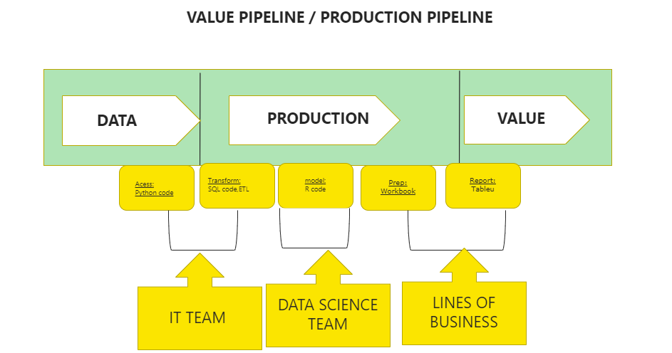
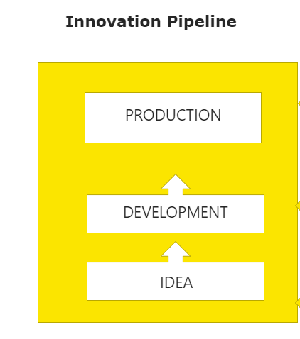
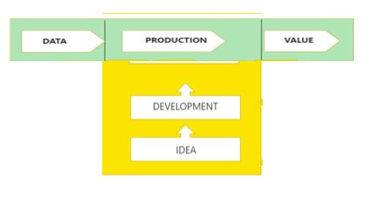
DataOpsDataOps Production Pipeline
The Three DataOps Pipelines
Environment Pipeline:
Environment Pipeline

Slide 29
DataOpsDataOps Production Pipeline
The Three DataOps Pipelines
The environment pipeline is focused on
creating environments that reflect both
Development
Production environments
This involves building
sandboxes
creating the necessary hardware
Software
Data-security environments
That are required to support the development and deployment of new features and improvements

Slide 30
DataOpsDataOps Production Pipeline
The Three DataOps Pipelines
The environment pipeline is critical to the success of the other pipelines
as it provides a stable and secure platform for running the value and innovation pipelines.
Overall, the three pipelines -
Value Pipeline / Production
Innovation Pipeline / Deployment
Environment Pipeline / ( Production & Deployment )
The environment pipeline is the foundation that supports the other two pipelines, ensuring that they can run smoothly and effectively.

Slide 31
DataOpsDataOps Production Pipeline
Meta-Orchestrate Tools, Teams, & Processes
We're going to talk a lot about
How they have a lot of errors
How they are constructed
how they map into organizations and
how we can improve them
Data Analtiycs There are lot of tools, and they keep Growing
They are open source and closed source
There's tools that are in the cloud or on-prem
you know, it's just a big marketplace, and people love their tools.

Slide 32
DataOpsDataOps Production Pipeline
Meta-Orchestrate Tools, Teams, & Processes
A per the recent survey, just asked this question
How many errors--incorrect data, broken reports, late delivery, customer complaints--do you have each month?
The Answer is Most companies have just way too many That's the problem
If we run good production line
we don't produce defects.
so, we as an industry are just producing
a lot of defective analytics
which leads to a bunch of problems.

Slide 33
DataOpsDataOps Production Pipeline
Meta-Orchestrate Tools, Teams, & Processes
Data Ops, comes in
it's really not about data quality, it's really about low rates of error.
Because you could have poor data quality,
which actually could lead to an error,
or you could have perfect data quality,
and something happened in the processing.
So really focusing on error rates, as opposed to data quality is another perspective in DataOps.

Slide 34
DataOpsDataOps Production Pipeline
Automate Tests for Error Detection
The teams that create things for the value pipeline work in an integrated value chain for their customers.
This value chain involves a lot of tools, such as
Servers
Storage
Databases
Software
that are used to access and transform data.
Each tool has its own workflow or DAG (directed acyclic graph)
These tools are often used independently by different teams.
As a result, there is a need for a meta-workflow or a DAG of DAGs to organize the production system.

Slide 35
DataOpsDataOps Production Pipeline
Automate Tests for Error Detection
Automation in production pipelines has several benefits, and one of them is the
improved quality of products
By thinking of production pipelines as a manufacturing line and focusing on the processes, it is possible to
Reduce rework
Increase employee satisfaction
which leads to higher profits.
To ensure that production pipelines are running smoothly
it is important to add automated tests and monitoring in production.

Slide 36
DataOpsDataOps Production Pipeline
Automate Tests for Error Detection
Testing every step and every tool in the value pipeline is crucial
Adding a set of tasks or logic to see
if the data is correct
business logic is still valid based on that data is also essential.
It is also important to have tests earlier in the production process
so that problems can be corrected before they get out of hand.
This way, it is possible to stop production and correct the problem before it gets too late.
Just like in an assembly line, if a wheel is flat, it doesn't make sense to put it on the car, and it is better to stop the line and get a new wheel.

Slide 37
DataOpsDataOps Production Pipeline
Types of Tests
Support – Different Test Types
Error – stop line
Warning – Investigate later
Info – list of changes
Keep Test history
Statistical process control

Slide 38
DataOpsDataOps Production Pipeline
Types of Tests
The Recipe runs test that ensure
The quality of streaming data
Alert to users if conditions are not met
Alerts can be sent to
Jira
Email
Slack

Slide 39
DataOpsDataOps Production Pipeline
Types of Tests
Different Test Types
Basic Tests
Input Test
Count Verification Check that row counts are in the Right Range
Conformity zip codes are five digits , phone no are 10 digits
History The no's prospects always increases
Balance Week over week , sales should not vary
Field validation All required Fields are present are not
Business logic Test
Customer validation Each customer should exists in dimensional Table
Data Validation Data shall match entries in dimensional table
Output Test
Completeness As per the requirement
Range verification As per the requirement
Location balance
Historical Balance

Slide 40
DataOpsDataOps Production Pipeline
Types of Tests
We can write those tests in lots of different ways.
we can write them in SQL
Or In our favorite tool.
And there are test engines out there.
Location Balance Test :
The location balance test is a type of data integrity test that ensures the consistency of data throughout a data pipeline or system. It involves comparing the expected row count of data with the actual row count at various stages of the data pipeline, such as from a blob storage to a database table or from one level in a database to another level. By doing this, it helps to identify any discrepancies or losses in data during the data transformation process. This test is particularly useful when dealing with large and complex data pipelines to ensure that data is accurately processed and maintained throughout the pipeline.

Slide 41
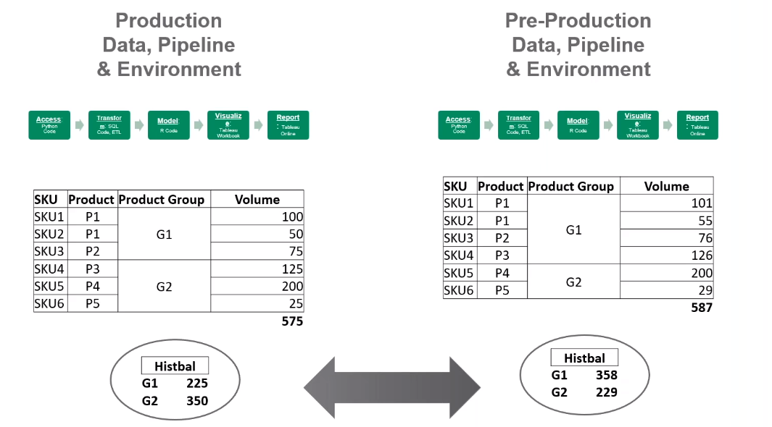
DataOpsDataOps Production Pipeline
Types of Tests
Historical Balance Test:

Slide 42
DataOpsDataOps Production Pipeline
Types of Tests
Certainly! Let's say we're running a production pipeline for a grocery store chain, and one of the product groups we're tracking is "cereals". We have a table in production that lists all of the cereals we're currently carrying, along with their respective volumes.
In pre-production, we have a similar table that we use as a reference point to ensure that our production table is accurate and up-to-date. Now, let's say that we run our comparison test and notice that the product groupings have suddenly changed in the production table - maybe a new cereal brand has been introduced, or an existing brand has been moved to a different product group.
Even if the total volume of cereals remains similar, this sudden change in product groupings could be a cause for concern. It might indicate that we're not accurately tracking our inventory or that a competitor's cereal has suddenly become much more popular.
By catching these types of changes early on, we can investigate and address any issues that may be affecting our production pipeline, ensuring that we're consistently providing our customers with accurate and valuable products.

Slide 43
DataOps- Production Pipeline Measure Production Processes, Reflect & Improve
Analytical Teams are not analytical about measuring and improving their internal work
Technical Characteristics of good pipeline
Meta-Orchestration
Plugin your existing tools into pipelines
Monitored,tested,'Observability'
Automated Testing
Test data and Articarft
Send alerts
SPC,end to end and other test types
Stores Pipeline definition as code
Keep tool code and pipeline code together
Keep database of pipeline operations metrics

Slide 44
DataOps-DataOps Production Pipeline Measure Production Processes, Reflect & Improve
Keep track of all errors
On periodic basis meet with a team to review those errors
Find Patterns and root causes
Creating new test or procedures to mitigate those problems
Focus on error reduction
Have dev and ops teams members

Slide 45
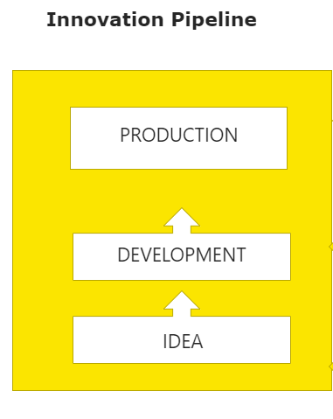
DataOps
Development Pipeline -Development Lifecycle Complexities

Slide 46
DataOps
Development Pipeline -Development Lifecycle Complexities
The main problem is that the process of moving software or code from a development environment to production is not smooth.
There are different groups of people involved, using different tools and working on different code versions.
The environments are also different, with variations in operating systems, libraries, and test data.
This leads to a patchwork of manual processes and scripts that are error-prone, slow, and create a lot of waste.
This problem is particularly acute in data and analytics teams, where deploying changes into production can take weeks or months.
This leads to frustration among business customers who expect faster results and may even lead them to hire external consultants to get the work done more quickly.

Slide 47

DataOps
Development Pipeline -Data & Analytics Development
Production Data
Access
Transform
Model
Visualize
Report
Analytic Customers
Production Team
Think of all your data and Analytical works as "Big Factory"
In those tubes are pipelines
Everybody works in pipeline( weather they know it or not)
Lots of tools working on data
Lots of data in ,lots of customers
Companies have hundreds of these pipelines
You want a ''big red/green light on the pipeline telling you everything is OK.

Slide 48
DataOps
Development Pipeline -Data & Analytics Development
DataOps Principles
Continuously satisfy Your Customer
Our highest priority is to satisfy the customer through the early and continuously delivery of valuable analytic insights
2. Value working analytics
We believe the primary measure of data analytics performance is the degree to which insightful analytics are delivered, incorporating accurate data, atop robust frameworks and systems.
3. Embrace changes
We welcome evolving customer needs, and in fact, we embrace them to generate competitive advantage. We believe that the most efficient, effective and agile methodology

Slide 49
DataOps
Development Pipeline -Data & Analytics Development
Create a repeatable ,reliable process for releasing data analytics (new data set, data science models, schemas, code, visualization)
Automate everything
Keep everything under version control
Build quality in through automated testing
Done means released to production
Everybody is responsible for release process
Love your errors and improve continuously
Measure your cycle time from deploy to production and improve

Slide 50
DataOps
Development Pipeline -How to Achieve Fast Deployments
Describing a scenario in which a VP of marketing has a
Data engineer and
Data analyst working
The team works with
Data in Redshift
Pentaho as an ETL tool
Tableau for visualization.
while it is important to be able to deliver results quickly, it is equally important to do so without causing stress to the team, incurring technical debt, or creating risk.

Slide 51
DataOps
Development Pipeline -How to Achieve Fast Deployments
Introduces the concept of a "kitchen,"
which is a workspace for the team to collaborate and work on their data projects.
Every tool in data analytics has an Editor Engine file that stores the work.
For example,
Pentaho creates XML files called KTR files.
The team runs these files in a Docker container and
tests them to ensure they are correct.
They create an order run when the process is complete,
which shows that the analytics are working in front of the customer.

Slide 52
DataOps
Development Pipeline -How to Achieve Fast Deployments
There is testing at every step of the process and software is decorated with a bunch of tests to ensure that if something changes or breaks in the back, they can quickly identify the issue and fix it.
To facilitate development and analytics, t it is important to have an environment that can be spun up quickly and shut down, like in Amazon.
This environment allow for the teams to collaborate, run recipes, and test changes without waking up the production team if there are errors.
It is important to build a little, test a little, and learn a lot, and that this software provides variables and controls to help with this process.
It is important to have a repository of all the team's work, and this software allows for branching and merging changes back into the original copy.

Slide 53
DataOps
Development Pipeline -How to Achieve Fast Deployments
Components of a DataOps Dev Environment
Sandbox environment vs. Fixed server
People access for all or some of a team
Run function for just the current work
Variables and controls to focus the work
Repository branch for making changes
Merge function to move changes into the original code base

Slide 54
DataOps
Development Pipeline -How to Achieve Fast Deployments
We have recipes. What is it ?
Recipe refers to a series of steps or tasks that are executed to produce a desired outcome. It can be can be
Data transformations
Cleaning
Merging
Aggregation, and many
It is is designed to help data teams create and manage their analytics workflows from end to end, including
Development
Testing Deployment

Slide 55
DataOps
Development Pipeline -How to Achieve Fast Deployments
A recipe is a collection of connected nodes:
with each node representing a specific step in the data process. The nodes can be connected in a linear fashion, or they can be connected in a more complex fashion, allowing for conditional branching or looping.
Recipes are built using a visual interface:
making it easy for users to drag and drop nodes and configure them based on their specific data needs. This helps to streamline the data workflow process and reduce the risk of errors or inconsistencies in the data.
Once a recipe is built:
It can be tested in a separate environment to ensure that it produces the desired outcome. Any errors or issues can be addressed before the recipe is deployed to the production environment.
This helps to ensure that the production environment remains stable and reliable.
what are ingredients in datakitchen
In DataKitchen, the "ingredients" are the various data components used to build data pipelines. These can include:
Source data: The raw data that is used as the starting point for a pipeline.
Transformations: The steps used to manipulate or clean the data.
Metrics: The data points used to evaluate the quality of the data or the success of a pipeline.
Tests: The automated tests used to ensure that the pipeline is functioning correctly.
Deployment components: The components used to deploy the pipeline, such as scripts or deployment configuration files.
These ingredients are combined to create a data pipeline that transforms raw data into a usable format for analysis, reporting, or other purposes. By managing these ingredients effectively, data teams can ensure the accuracy, reliability, and efficiency of their data processes.

Slide 56
DataOps
Development Pipeline -How to Achieve Fast Deployments
We have Ingredients . What is it ?
The "ingredients" are the various data components used to build data pipelines.
These can include:
Source data: The raw data that is used as the starting point for a pipeline
Transformations: The steps used to manipulate or clean the data
Metrics: The data points used to evaluate the quality of the data or the success of a pipeline
Tests: The automated tests used to ensure that the pipeline is functioning correctly
Deployment components: The components used to deploy the pipeline, such as scripts or deployment configuration files.
These ingredients are combined to create a data pipeline that transforms raw data into a usable format for analysis, reporting, or other purposes. By managing these ingredients effectively, data teams can ensure the accuracy, reliability, and efficiency of their data processes.

Slide 57
DataOps
Development Pipeline -DataOps Deployments: Beyond DevOps
DataOps Goals
Make it fast and automated
Deployments takes minutes, not months
Low risk of failure
High rate of success

Slide 58
DataOps
Development Pipeline -DataOps Deployments: Beyond DevOps
Develop
Build
Test
Deploy
Run
DataOPs
Process
Sandbox Management
Develop
Orchestrate
Test
Deploy
Orchestrate
Monitor
DevOPs
Process
CI
CD

Slide 59
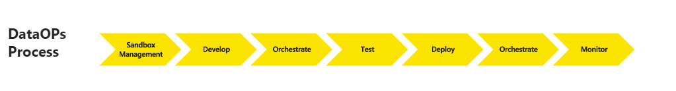
DataOps
Development Pipeline -DataOps Deployments: Beyond DevOps
Sandbox Management : Easy Creation of sandbox with needed Data, software, hardware and libraries
Orchestrate : Data Pipelines + container orchestration + parameterization
Test: Test framework embedded into the pipeline
Monitor : Operation Data Quality monitoring and alerting
Collaborate : many to many relation between dev and ops

Slide 60
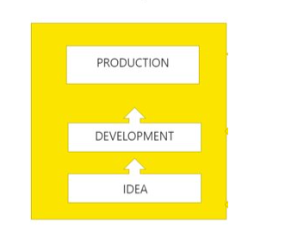
DataOps
Development Pipeline -DataOps Deployments: Beyond DevOps
Unit Tests: Testing aimed at each component as a stand-alone entity
Functional Tests: Verification against functional spec or user stories
Regression Tests: Rerun every time a change is made to prove that it is still functioning
Performance Tests: Verify responses stability and availability on a given workload
Smoke Tests: quick, preliminary validation that the major system functions are operational
End to End Tests: make sure the pipeline as w whole is working

Slide 61
DataOps
Development Pipeline -DataOps Deployments: Beyond DevOps
In a DevOps process
software developers work together with IT operations staff to streamline
The development and
Deployment of software applications.
This includes processes such as continuous integration and continuous deployment, which are used to automate the build, testing, and deployment of software applications.
DevOps is focused on
Agile software development – using tools such as
project management
source control
Automated testing

Slide 62
DataOps
Development Pipeline -DataOps Deployments: Beyond DevOps
DataOps on the other hand, brings together
Development
Deployment of data analytics pipelines.
This includes the management of large volumes of data,
creation of sandbox environments for testing,
and the orchestration of multiple data tools and analytics technologies
Business and IT stakeholders to optimize the delivery of data pipelines.
DataOps is also focused on Enabling data management capabilities including
Data catalogues
Data lineage
Data quality
Along with data preparation or transformation capabilities.
The focus is on data, and its ability to support the delivery of business goals and objectives.

Slide 63
DataOps
Environmental Pipeline-DataOps Environment Challenges
Weak Environment management is a leading challenge for data and analytic organization and departments
Without effective management of Environments, Organization are exposed to an array of challenges, which include
Environments not being fit for purpose i.e., not supporting Testing
Manual, slow and untimely service operations
System outages and instability leading to delivery disruption
Footprint ( infrastructure, license and service) Over proliferation
Difference in Test Data vs Production Data Cause deployment
This all translates to impact on quality, data and analytic Organization overspends, project delays & consequently slow delivery of change to your customers

Slide 64
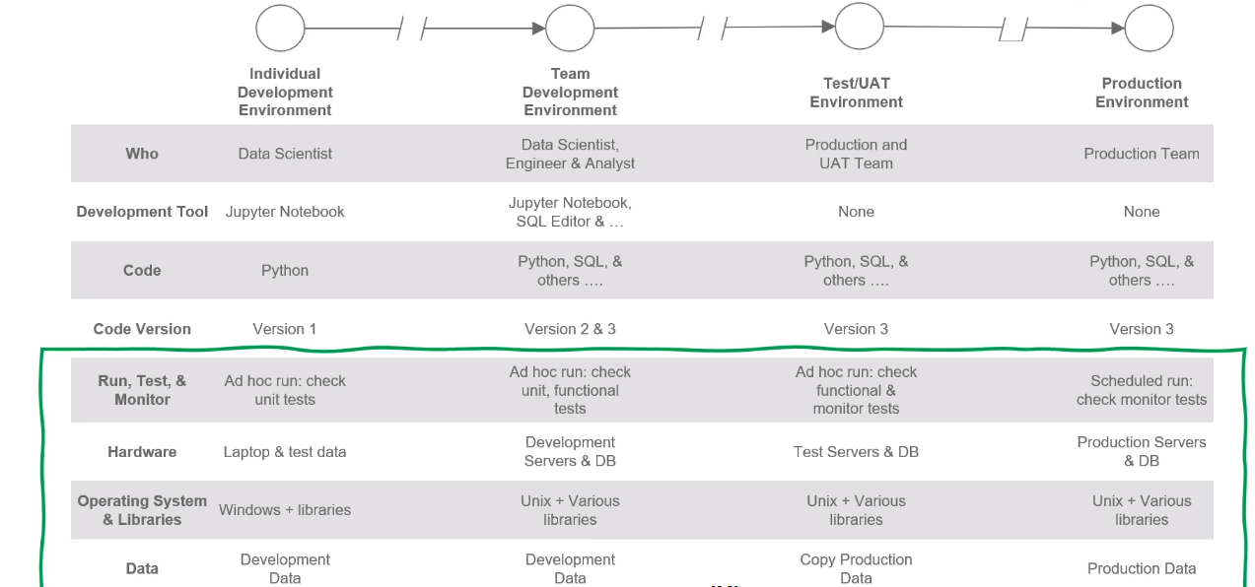
DataOps
Environmental Pipeline-DataOps Environment Challenges

Slide 65
DataOps
Environmental Pipeline-DataOps Environment Challenges
The environment in which data analytics work is a complex system that encompasses various aspects,
such as
hardware, software,
Test data, Libraries,
network configuration, code branch,
Tools, and people.
Different environments are used for
Development, Testing &production,
Each with its own set of hardware, software, data, and tools.
The provisioning of these environments is often slow, manual, and error-prone, leading to delays, outages, and overspend.
Ensuring consistency and compatibility between different environments is a significant challenge for analytic organizations.
However, adopting DataOps principles can help streamline the process and enable faster and more reliable deployment of changes to production.

Slide 66
DataOps
Environmental Pipeline-Environment Management: Components & Use Cases
Components of DataOps Environment
Environment Hardware, software, test data
People who work the data
Workflows/recipes and their runs
Variables, controls and other parameters
Repository branch for making merging changes
Connection to Agile tools to organize the work

Slide 67
DataOps
Environmental Pipeline-Environment Management: Components & Use Cases
When developing software,
There are many different parts that need to work together like
The hardware and software components,
The data used for testing,
The people working on the project.
To solve these challenges, it's a good idea to use
Automation tools to make things easier and reduce the chance of errors.
This can involve writing scripts or using software to automatically set up the system and create test data.
It's also important to communicate well with everyone involved in the project to make sure that everyone understands the importance of these tasks and how to do them correctly.

Slide 68
DataOps
Environmental Pipeline-Environment Management: Components & Use Cases
For Example:
In every organization,
There will be someone like Eric who manages the production environment.
His goal will be minimizing errors and perfect the daily delivery of data and analytics.
There's also a DataOps Engineer like Chris who's responsible for optimizing the operations from development to production.
They have DevOps skills, cloud skills, and skills in the software that the organization uses.
There are also data doers like data scientists, data engineers, and BI professionals who want flexibility and use various tools to create new features for customers.
NoProd is an example of a data doer who doesn't have production access, but there are typically dozens of them in organizations, and they work in different environments.

Slide 69
DataOps
Environmental Pipeline-Environment Management: Components & Use Cases
Production is managed separately from development with separate software in a secure environment, which is sometimes completely encapsulated, and developers may not have access to production data or the network that production is on in some cases.
The organization needs to be able to build something in development and easily push it to production. This requires a different way to run something in development than in production, which we call an agent in our system.
Development and production have separate hardware and software, different access levels, different management teams, and different credentials that go in.
All these factors need to be considered when managing the interaction between people and technology in the development and production environments of an organization.

Slide 70
DataOps
Environmental Pipeline-Environment Management: Components & Use Cases
In the production environment, there's a VPC that runs the agent along with other components such as
SFTP servers
Redshift database
S3 database
Slack channel for alerts, etc.
There are different development environments for the team working on creating new features for customers.
To move things quickly from development to production, it's important to organize the people and their technologies.
.

Slide 71
DataOps
Environmental Pipeline-Environment Management: Components & Use Cases
There are components are called "variables" which are pointers to configuration settings.
For example,
DK_Implementation_Dev
DK_Implementation_Prod
are pointers to variables in the system which can be set differently.
Now, let's say the VP of Marketing wants to see some new profitability data as soon as possible.
The DataOps Engineer, Chris, working with the data scientists and engineers, creates a new pipeline for this specific use case in the development environment.
They use the DK_Implementation_Dev variable to point to the specific components needed for this pipeline.
Once the pipeline is tested and validated in the development environment
.

Slide 72
DataOps
Environmental Pipeline-Environment Management: Components & Use Cases
They use the same pipeline with the DK_Implementation_Prod variable pointing to the production components.
Before deploying the pipeline to production, they ensure that it has gone through proper testing, quality assurance and security checks.
Once the pipeline is deployed to production, the VP of Marketing can access the new profitability data in a secure manner.
In summary, the key to moving things quickly from development to production is to have an organized system of people and technologies.
use variables to point to the configuration settings and ensure proper testing and security checks before deployment.

Slide 73
DataOps
Environmental Pipeline-Environment Management: Components & Use Cases
In this scenario, we are looking at how DataKitchen organizes their production environment to move things quickly from development to production with low errors and low regression risks. They use a kitchen-based approach where each kitchen represents a specific environment such as production, development, or testing.
To illustrate this,
we go to the DataKitchen UI and look at the kitchen for the woman, "No Prod", who has access only to the demo kitchen. Inside the kitchen, there is a recipe with different nodes that perform various tasks including Redshift, Python pandas transform, and S3 to Redshift.
The numbers represent the number of tests that happen in each node.

Slide 74
DataOps
Environmental Pipeline-Environment Management: Components & Use Cases
For example
The customer has data engineering and data science teams working on different environments
Amazon and Google Cloud.
They use different tools for data processing such as Redshift, Talend, Python, GCS buckets, and BigQuery.
The customer wants to combine the results of the analytics produced by both the teams
The challenge is to ensure that the process is coordinated and that each team has different levels of control over their environment.
To address this challenge, the team uses DataKitchen software,
.

Slide 75
DataOps
Environmental Pipeline-Environment Management: Components & Use Cases
which allows them to define
Different kitchens or environments for each team,
with different agents running in them and
Different variables and overrides to define the environment system.
DataKitchen also allows users to
Embed recipes within recipes, which they call ingredients.
This allows each team to work on their sub-recipes within their respective kitchens and combine them with the overall recipe that runs across both Amazon and Google Cloud.
.

Slide 76
DataOps
Environmental Pipeline-Environment Management: Components & Use Cases
The overall recipe can be
Tested across both environments to ensure that the customer gets the desired result.
By managing sub-recipes in individual environments
Each team has both freedom and control over their work, allowing them to collaborate effectively while maintaining their unique workflows and preferences.
This use case illustrates how DataKitchen's software enables multi-cloud data processing and
collaboration across different teams and environments while ensuring coordination and control.
.

Slide 77
DataOps
Environmental Pipeline-Environment Management: Components & Use Cases
For Example,
There's a Home Office team in Boston that uses
SQL Server and Python to update the data warehouse once a week.
There are also local teams around the country that use Alteryx and Tableau for self-service data analysis.
The challenge here is coordinating across these different teams and environments to ensure that any changes made to the data, models, or visualizations are correctly reflected in the final result that the customer sees.
To address this challenge, each team has their own recipes that have shared responsibilities and run in their own environments.
.

Slide 78
DataOps
Environmental Pipeline-Environment Management: Components & Use Cases
The local teams can create a local office kitchen based on the current version of the central data, do their work in that, and test it to see if it provides value to the customer.
They can add tests across the new data that they put in and the new columns they put in Alteryx and Tableau.
Once they've verified that their changes are valuable and aligned with the central data and code, they can deploy them back into production.
This allows the Home Office team to know that there's a new file merged in a new Tableau workbook and Alteryx workbook that are put into production to manage that.
They can then run tests against it anytime they make changes based on what's in production.
This way, the local and Home Office teams can work together, have aligned code, and use aligned environments to deliver better results to the customer.
.

Slide 79
DataOps
Environmental Pipeline-Principles of DataOps Environments
DataOps Principles
Reproducible
Results are required and therefore we version everything data. Low-level hardware and software configuration specific to each tool in tool chain
Disposable
We believe it is important to minimize the cost for analytical team members to experiment by giving them to easy to create, isolated, safe and disposable technical environments that reflect their production environment

Slide 80
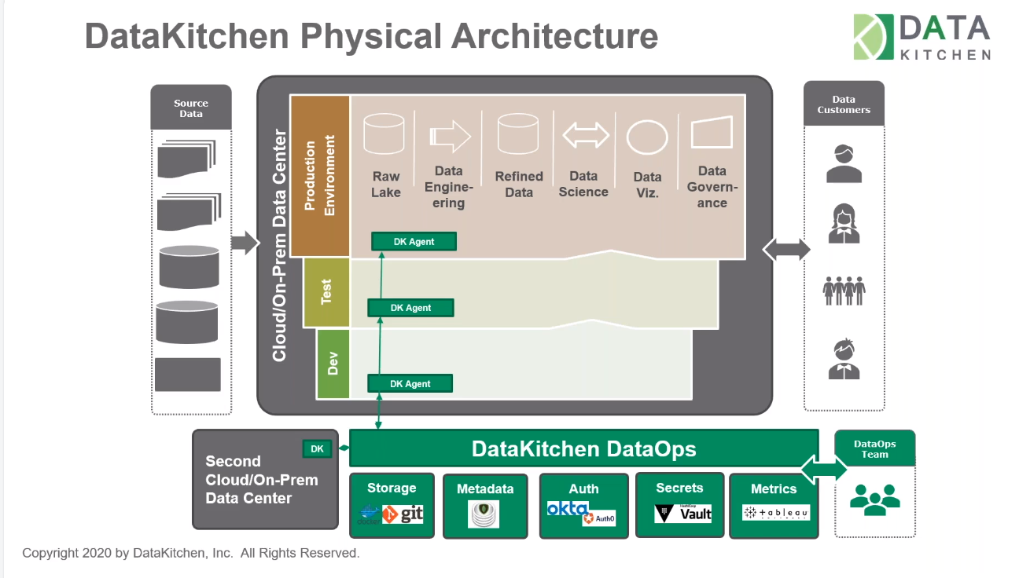
DataOps
Environmental Pipeline-Principles of DataOps Environments

Slide 81
DataOps
DataOps Implementation-Lean DataOps Implementation
Jump Strat Your DataOps program with Lean DataOps
Address Your high Error Rates
Speed up yor slow dev/deployment cycle times
Improve your poor collabration and nonexixtent process anlaytics
Apply Lean concepts to implement DataOps Incrementally

Slide 82
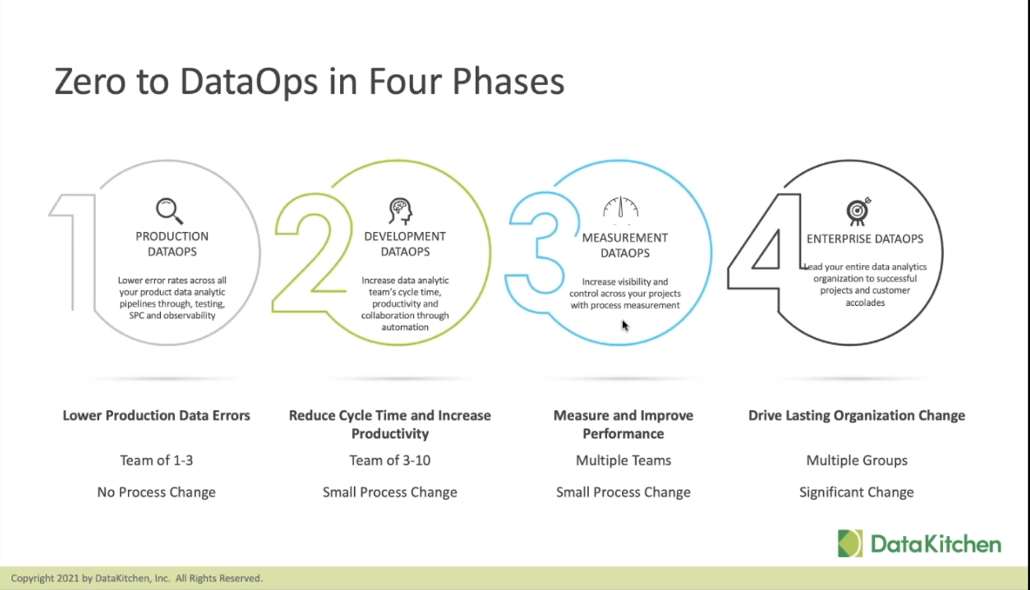
DataOps
DataOps Implementation-Lean DataOps Implementation

Slide 83
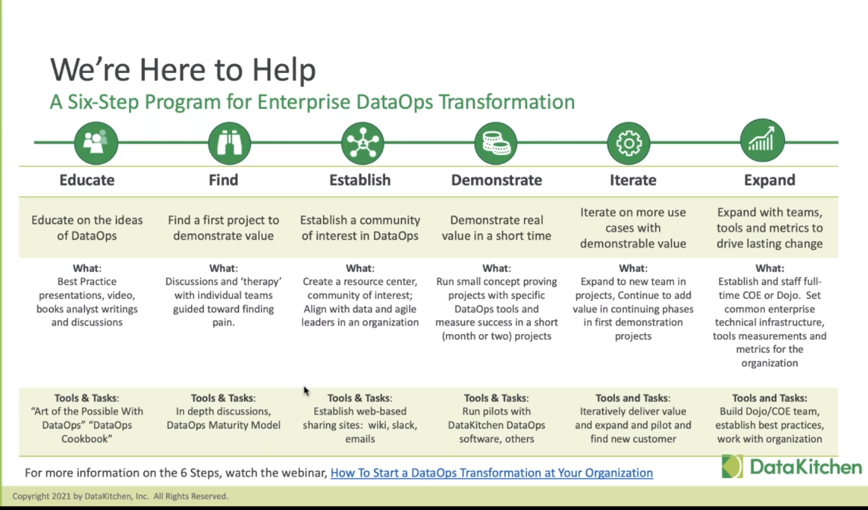
DataOps- Implementation-Six Step Process

Slide 84
DataOps Implementation-Six Step Process to DataOps
The six steps to establish DataOps across an organization are:
Educate your team on the value of DataOps:
Start by socializing the idea and discussing the benefits of DataOps. This will help your team understand the changes you want to make
.
Find your first project:
Identify a project that will showcase the benefits of DataOps and demonstrate the value of the methodology.

Slide 85
DataOps Implementation-Six Step Process to DataOps
Establish a community of interest:
Create a group of stakeholders who can help promote DataOps and drive its adoption across the organization.
Demonstrate value in a short time:
Focus on delivering value quickly to gain momentum and build support for DataOps.
Iterate on more use cases:
Expand DataOps to other use cases and departments, and iterate on the methodology to improve its effectiveness.
Expand to more use cases across the organization:
Implement DataOps across the organization to ensure consistent data quality and efficient data management.

Slide 86
DataOps -Conclusion
To implement DataOps successfully
It's important to prioritize
Collaboration
Automation
Data quality is high
The DataOps transformation should be approached in an
Agile
terative way
starting small and building from there.
Cultural transformation and the soft aspects of the DataOps implementation should not be ignored, and organizations should focus on measuring their progress and successes.

Slide 87
DataOps -Conclusion
Organizations can start implementing DataOps today by focusing on
creating automated tests
lowering error rates
improving collaboration, and tracking metrics.

