Slide 1
FINAL-YEAR PROJECT REVIEW
An Evidence-Adaptive, OCR-Resilient Hybrid Retrieval
Framework for Document Question Answering
Extending QuIM-RAG (Saha et al., IEEE Access, 2024) with a calibrated
retrieval-sufficiency decision layer
Manthira Moorthy P · Vijay S K · IV ECE-A
Mentor: Dr. V. Karthikeyan, AP (Sl. Grade) · Dept. of ECE, Mepco Schlenk Engineering College

Slide 2
INTRODUCTION
Document Question Answering, at scale
• Lets users retrieve precise answers from large document collections using natural-language queries.
• Used across healthcare, legal, finance, education, government archives, insurance and research.
• Growth of scanned PDFs and digitised records is driving demand for intelligent document understanding.
REAL-WORLD CHALLENGE
• Most enterprise documents exist as scanned PDFs or images, requiring OCR before processing.
• OCR frequently introduces: character errors, broken text, layout and table-extraction distortion.
• These errors propagate through retrieval, causing wrong document selection and hallucinated answers.
QuIM-RAG / EAR Review
1/23

Slide 3
BACKGROUND
Where today's RAG systems fall short
Information dilution
OCR fragility
Fixed-size chunking breaks semantic continuity.
Recognition noise degrades retrieval accuracy.
Semantic compression loss
Poor multi-hop reasoning
Basic K-Means quantisation discards fine detail.
Flat chunk retrieval misses chapter/section structure.
Weak exact-term retrieval
No self-awareness
Dense embeddings miss IDs, codes, acronyms.
Every system answers regardless of retrieval confidence.
QuIM-RAG / EAR Review
2/23

Slide 4
REVIEW 2 PROPOSAL
Seven proposed upgrades to QuIM-RAG
1
OCR robustness layer for noisy scanned documents
2
Semantic chunking to preserve complete context
3
Hierarchical question-tree generation
4
Residual Vector Quantisation (RVQ) for compact storage
5
Query rewriting for better intent understanding
6
Hybrid retrieval: Dense + BM25
7
Cross-encoder reranking before answer generation
All seven were delivered and measured — see slide 8 for the one item the proposal itself did not anticipate.
QuIM-RAG / EAR Review
3/23

Slide 5
LITERATURE SURVEY
Five studies that shaped the design
Study
Finding
Our takeaway
Gap it leaves open
QuIM-RAG
Saha, Saha & Malik, IEEE Access, 2024
Question-to-question matching index
Motivated this project's architecture
No OCR, no hierarchy, no abstention
Embedding Quality in RAG
Amaral Cejas, Guo & Tang, 2025
Embedding choice shifts retrieval accuracy
Motivated this project's architecture
No OCR, no hierarchical indexing
EvaRAG
Elkiran & Rasheed, IEEE Access, 2025
Indexing + similarity-metric benchmarking
Motivated this project's architecture
No OCR robustness, no question indexing
Retriever/Reranker Evaluation
Elkiran & Rasheed, IEEE Access, 2026
Reranking has the largest QA-quality effect
Motivated this project's architecture
No OCR-aware preprocessing, no RVQ
Max–Min Semantic Chunking
Kiss, Nagy & Szilagyi, 2025
Clustering-based chunking beats fixed-size
Motivated this project's architecture
Chunking only, no full RAG pipeline
QuIM-RAG / EAR Review
4/23

Slide 6
OBJECTIVES
What the project set out to achieve
• Enhance retrieval accuracy via hierarchical question indexing, hybrid retrieval and cross-encoder reranking.
• Develop an OCR-robust framework that corrects noisy scanned documents before indexing.
• Reduce hallucinations by preserving semantic context and giving the LLM complete, relevant evidence.
• Enable fast, scalable retrieval using Residual Vector Quantisation and multi-level inverted indexing.
• Preserve semantic information by minimising quantisation error and chunk-boundary information loss.
QuIM-RAG / EAR Review
5/23

Slide 7
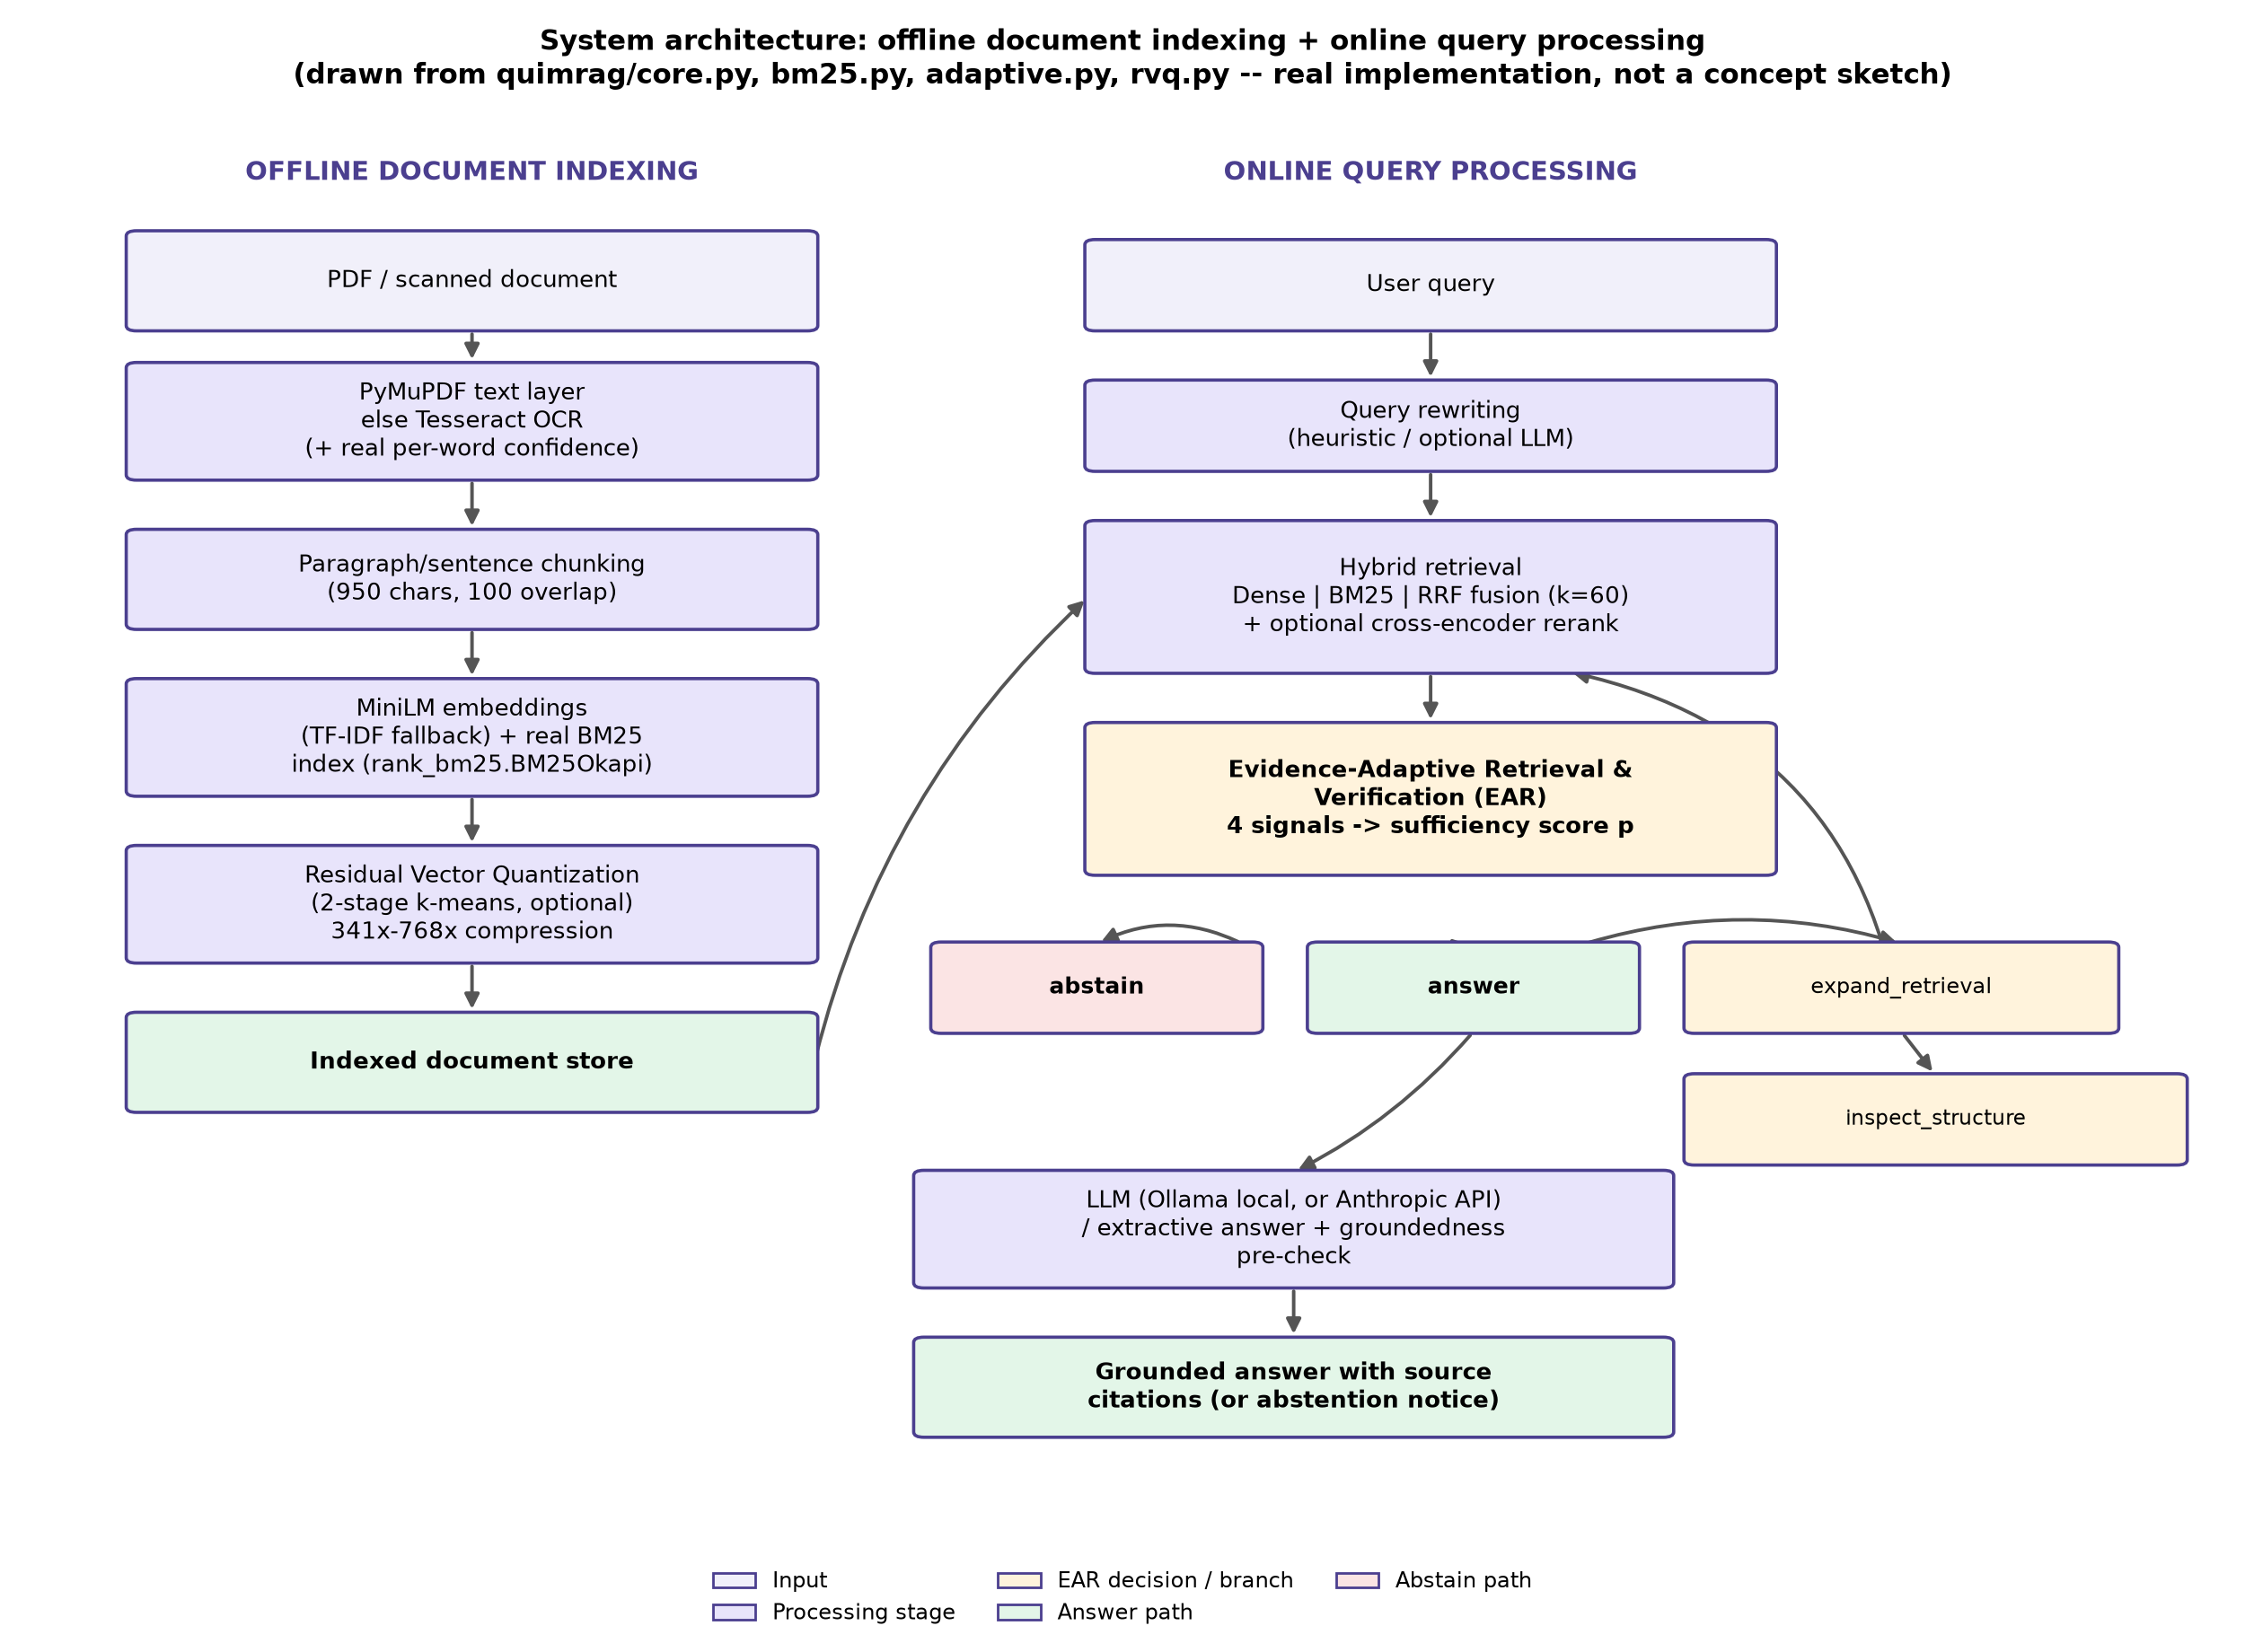
SYSTEM DESIGN
End-to-end architecture
QuIM-RAG / EAR Review
6/23

Slide 8
BEYOND THE PROPOSAL
None of the seven upgrades answer one question:
“Should this system trust its own retrieval enough to answer at all?”
• Every RAG system studied — including QuIM-RAG itself — retrieves passages and always answers.
• Wrong retrieval, garbled OCR, or contradictory evidence: the system never notices.
• This project's actual new contribution: Evidence-Adaptive Retrieval and Verification (EAR) — a calibrated decision layer that lets the system answer, pull more evidence, flag a conflict, or abstain.
QuIM-RAG / EAR Review
7/23

Slide 9
THE INNOVATION
EAR: four signals, computed almost for free
1
2
3
4
Agreement
OCR confidence
Contradiction
Complexity
Do dense search and BM25 agree on the top results?
Mean Tesseract per-word confidence of the evidence
Do passages share a topic but report different numbers?
Is this a short query or a long, multi-part one?
2 EXTRA RETRIEVE() CALLS
FREE — CACHED AT INGESTION
CHEAP REGEX CHECK
FREE — LENGTH HEURISTIC
p = σ( w₀ + w₁·agreement + w₂·ocr_confidence + w₃·contradiction + w₄·complexity )
Weights fit by logistic regression on held-out calibration data — never on the data results are reported against.
QuIM-RAG / EAR Review
8/23

Slide 10
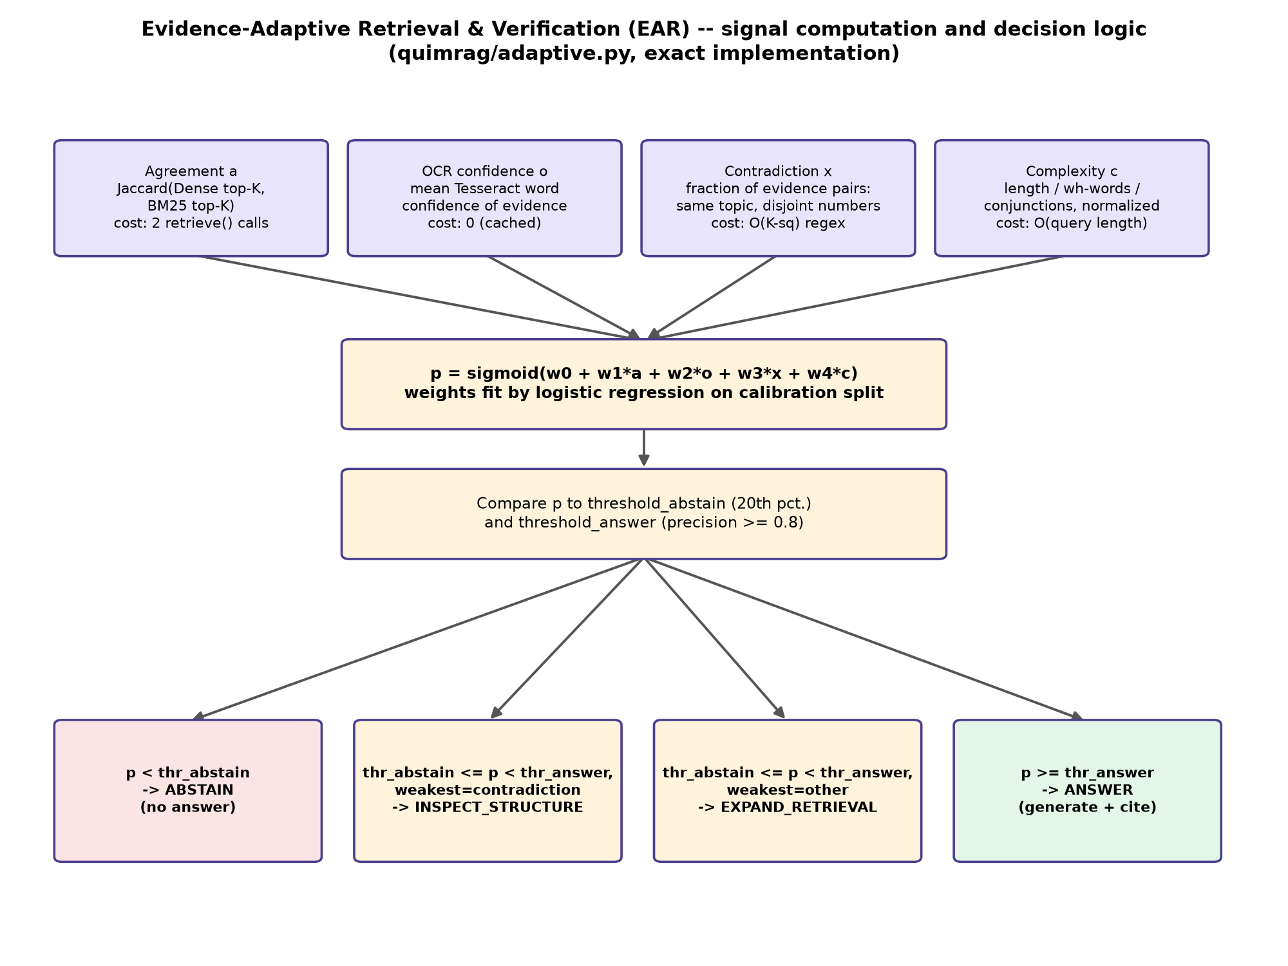
THE INNOVATION
From sufficiency score to decision
QuIM-RAG / EAR Review
9/23

Slide 11
WHY IT MATTERS
Two orders of magnitude cheaper
~95 ms
10.6–15.1 s
110–160×
vs.
FASTER FOR A COMPARABLE TRUST DECISION
EAR'S FULL DECISION COST
AN LLM-JUDGE ALTERNATIVE
• Both measured on identical hardware, for the same category of decision: “should I trust this evidence?”
• Gating generation on EAR's decision still produces a measured faithfulness improvement (next slide) — the speed is not traded against quality.
QuIM-RAG / EAR Review
10/23

Slide 12
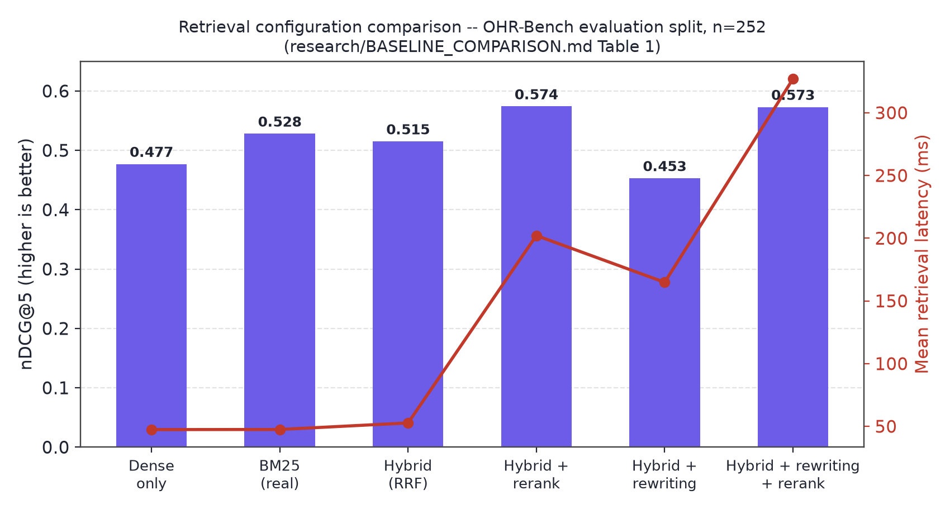
RESULTS
Retrieval configuration comparison
Honest finding: real BM25 alone (nDCG@5 = 0.528) outperforms the fused hybrid (0.515) on this benchmark — exact keyword matching beats semantic similarity more often than expected here.
QuIM-RAG / EAR Review
11/23

Slide 13
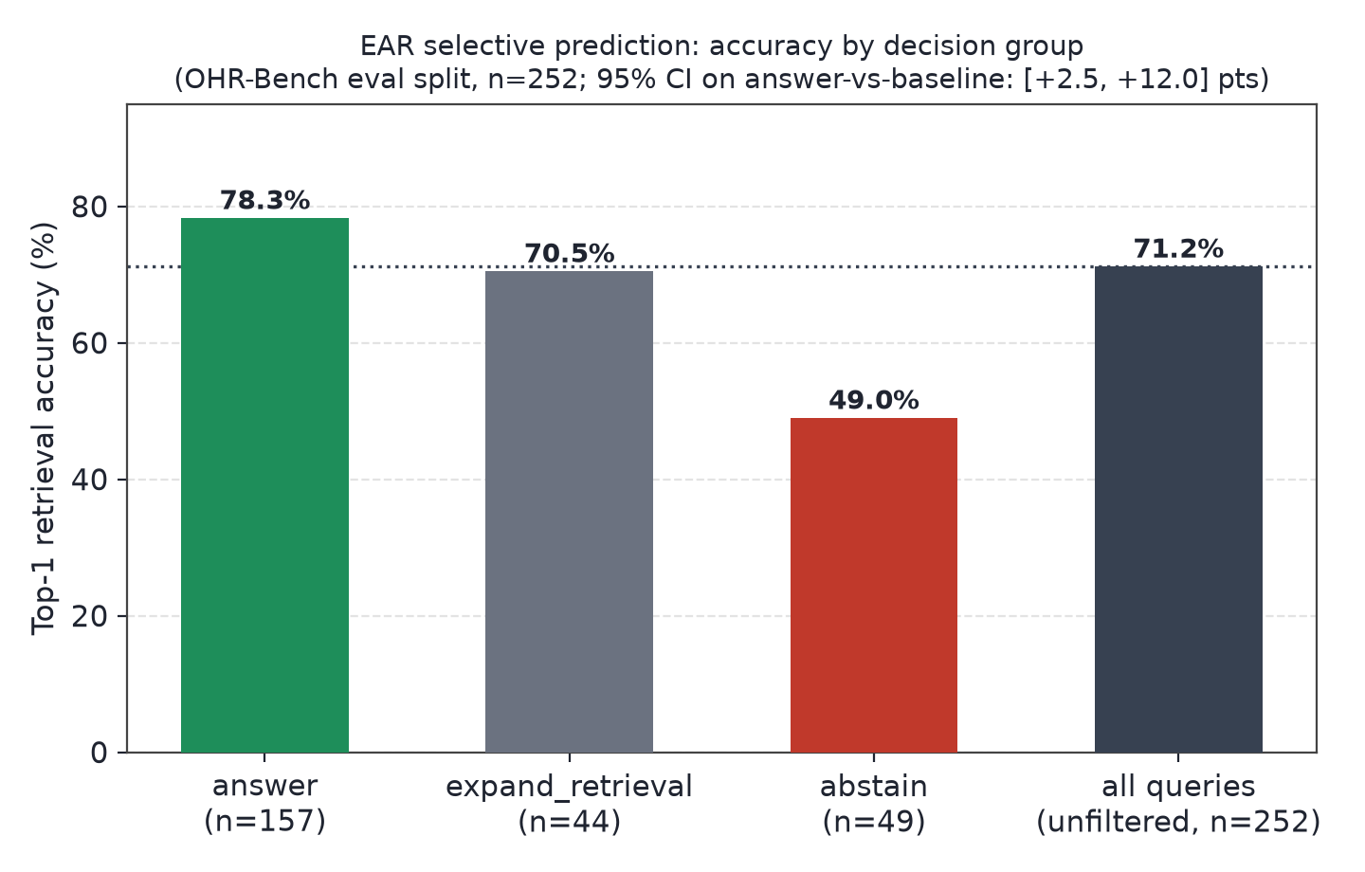
RESULTS
EAR raises accuracy where it chooses to answer
71.2% → 78.3%
84.3% → 96.0%
49.0%
MAIN BENCHMARK (N=252)
INDEPENDENT 2ND SAMPLE
ACCURACY ON ABSTAINED QUERIES
QuIM-RAG / EAR Review
12/23

Slide 14
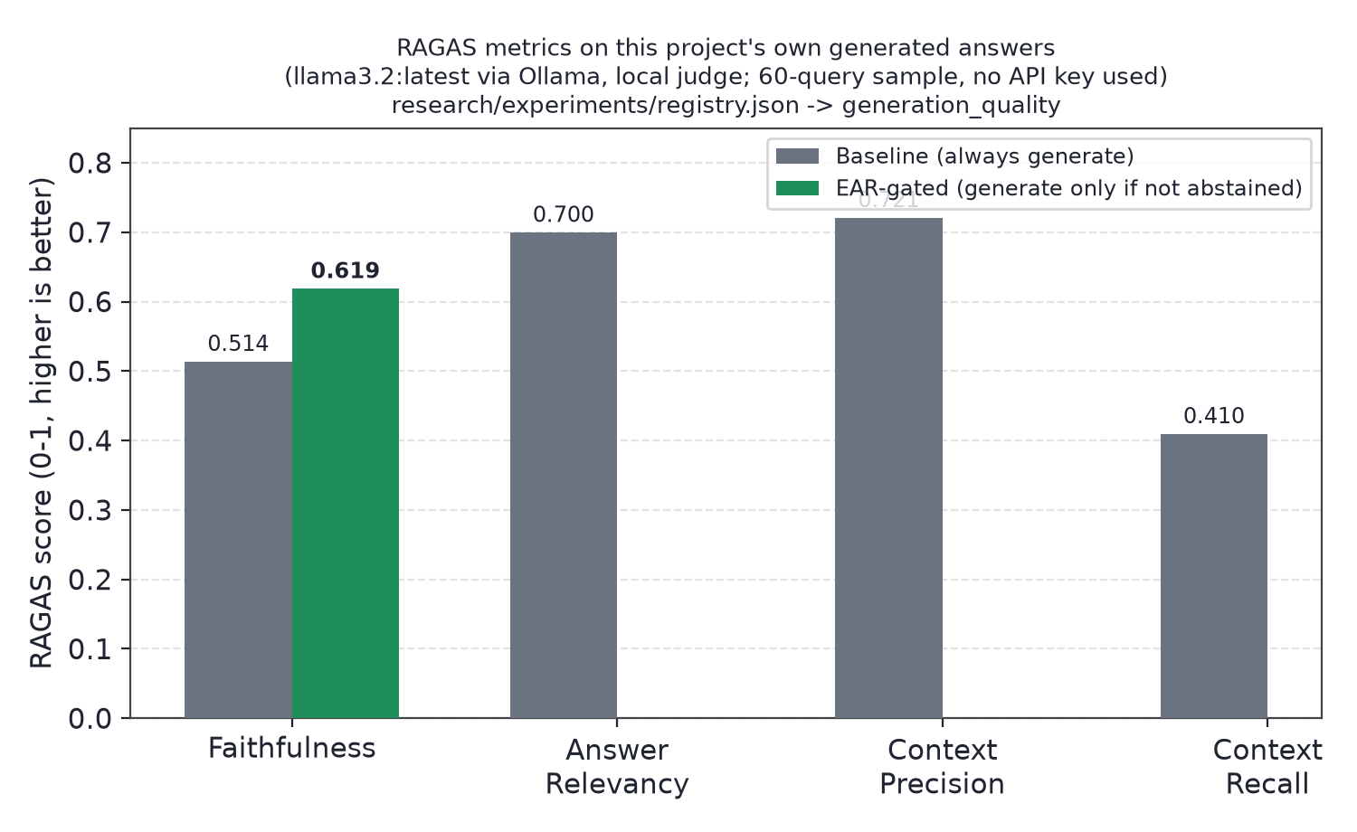
RESULTS
RAGAS evaluation on real generated answers
60-query sample, local llama3.2 judge via Ollama — no paid API key required or used.
QuIM-RAG / EAR Review
13/23

Slide 15
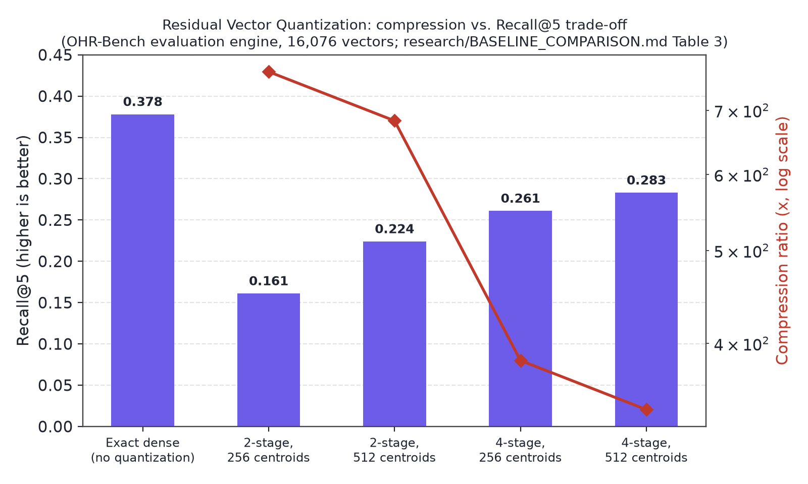
RESULTS
Residual Vector Quantisation: an honest trade-off
No tested configuration fully closes the recall gap. Root-caused statistically (Welch's t = −4.71, p = 3.5×10⁻⁶); a candidate fix recovers 79% of lost recall at no added latency.
QuIM-RAG / EAR Review
14/23

Slide 16
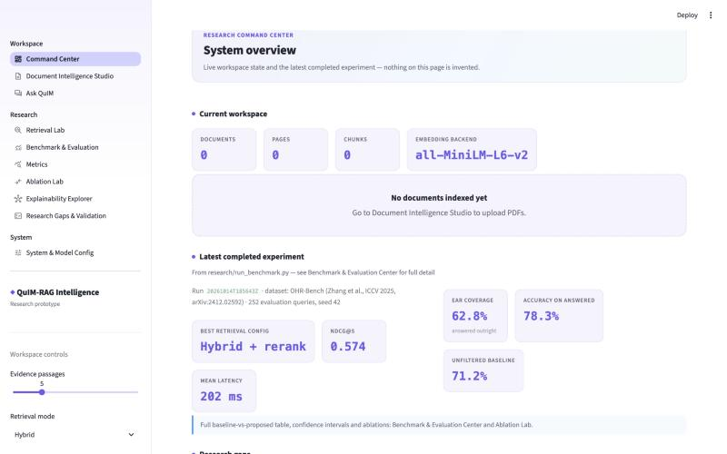
LIVE SYSTEM
Research Command Center — running application
QuIM-RAG / EAR Review
15/23

Slide 17
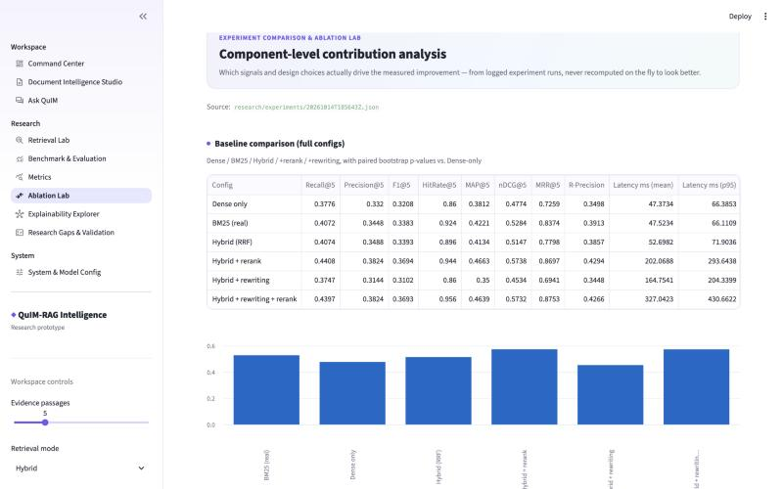
LIVE SYSTEM
Ablation Lab — every number read from logged runs
QuIM-RAG / EAR Review
16/23

Slide 18
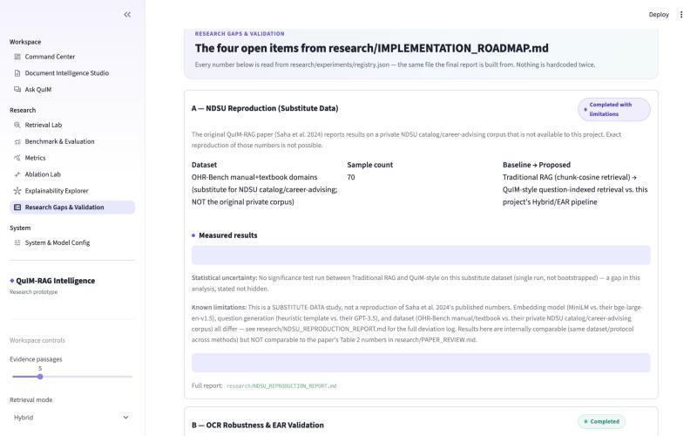
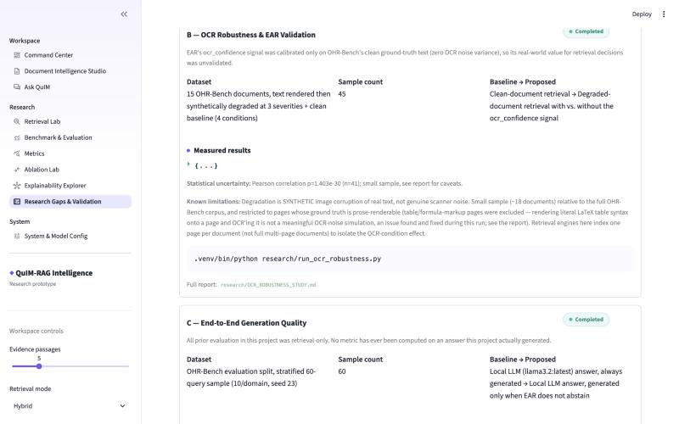
LIVE SYSTEM
Research Gaps & Validation — four studies, tracked live
QuIM-RAG / EAR Review
17/23

Slide 19
PROGRESS
Status since the Review 2 proposal
Literature survey & problem definition
Completed
Dataset: OHR-Bench (public benchmark adopted in place of unavailable private corpus)
Completed
OCR ingestion, chunking, hybrid retrieval, reranking
Completed
Residual Vector Quantisation + root-cause analysis + fix
Completed
Hierarchical question tree (rule-based)
Completed
Evidence-Adaptive Retrieval & Verification (new, beyond proposal)
Completed, validated twice
RAGAS evaluation on real generated answers (local LLM judge)
Completed
67-test automated suite
Completed, 0 failures
OCR-confidence signal validated on genuinely noisy (non-synthetic) scans
Open
Cloud-scale RAGAS judge model comparison
Open
QuIM-RAG / EAR Review
18/23

Slide 20
ACADEMIC INTEGRITY
What is not being claimed
• Not a reproduction of QuIM-RAG's published numbers — their NDSU dataset is private; a substitute-data attempt did not replicate their reported advantage, with a stated hypothesis why.
• OCR-confidence signal validated in isolation (r = −0.984 vs. real character error rate) but not yet on genuinely noisy real-world scans, only controlled synthetic degradation.
• RAGAS numbers use a local 3.2B-parameter judge model — directionally informative, not a calibrated probability against a cloud-scale judge.
• “Confidence-gated RAG abstention” is an active 2026 research area; EAR's specific four-signal design is a real contribution within it, not a claim of inventing the category.
QuIM-RAG / EAR Review
19/23

Slide 21
SOCIAL IMPACT
Where OCR-resilient, evidence-aware retrieval matters
Healthcare
Legal
30 years of scanned patient records
M&A due diligence, 10,000+ scanned agreements
OCR resilience + hierarchical patient→visit→diagnosis navigation
BM25 finds exact clause numbers; citations trace every answer
Banking & Insurance
Education
KYC documents, scanned claims
100,000 scanned theses, searchable
Exact-ID retrieval + semantic policy understanding
Hierarchical thesis→chapter→section navigation
Government
Enterprise
RTI response automation from aging records
20 years of scanned minutes and memos
OCR robustness + cited, accountable answers
Hybrid retrieval: exact codes (BM25) + concepts (dense)
QuIM-RAG / EAR Review
20/23

Slide 22
REFERENCES
Primary sources
• [1] B. Saha, U. Saha, M. Z. Malik, "QuIM-RAG: Advancing RAG With Inverted Question Matching," IEEE Access, vol. 12, pp. 185401–185410, 2024.
• [2] J. Zhang et al., "OCR Hinders RAG: Evaluating the Cascading Impact of OCR on RAG" (OHR-Bench), ICCV 2025, arXiv:2412.02592.
• [3] P. Sarthi et al., "RAPTOR: Recursive Abstractive Processing for Tree-Organised Retrieval," ICLR 2024.
• [4] H. Jégou, M. Douze, C. Schmid, "Product Quantization for Nearest Neighbor Search," IEEE TPAMI, vol. 33, no. 1, 2011.
• [5] S. Robertson, H. Zaragoza, "The Probabilistic Relevance Framework: BM25 and Beyond," Found. Trends Inf. Retr., vol. 3, no. 4, 2009.
• [6] O. Amaral Cejas, Y. Guo, Q. Tang, "Tracing the Impact of Embedding Quality in RAG Systems," IEEE Access, 2025.
• [7] H. Elkiran, J. Rasheed, "EvaRAG: Evaluating Advanced RAG Techniques With Indexing and Distance Metrics," IEEE Access, 2025.
• [8] C. Kiss, M. Nagy, P. Szilágyi, "Max–Min Semantic Chunking of Documents for RAG," Discover Computing, 2025.
QuIM-RAG / EAR Review
21/23

Slide 23
Thank You
Questions and discussion welcome.
Manthira Moorthy P · Vijay S K · Mentor: Dr. V. Karthikeyan

