Slide 1

Project Title –Steganography Hiding Message In An Image
Name: Manthri Vamshi
AICTE ID:STU63a011fac6c081671434746

Slide 2

PROBLEM STATEMENT
Steganography, the practice of concealing information within other non-secret text or data, poses significant challenges in modern digital communication.
The primary challenge is to develop strong techniques for concealing and retrieving data without being detected, while also preserving the integrity and quality of the host medium.
It's crucial to ensure steganographic methods are resilient against analysis and attack to preserve hidden information.

Slide 3
Project Description This project leverages steganography, an art of concealing data within other non-secret data, to hide confidential messages within digital images by using Python and the OpenCV library. This method guarantees the integrity and confidentiality of the data during transmission by securely embedding and extracting the confidential information. The program conceals the message within the pixel values of the image and then saves the modified image as encryptedImage.jpg. Furthermore, it incorporates an additional layer of security by requiring a passcode for decoding the hidden message.

Slide 4

WHO ARE THE END USERS?
Journalists and Activists
Government and Military
Corporate Sector
General Public
This steganography project aims to provide a practical and accessible solution for secure communication, catering to various user groups who require a reliable method to protect their sensitive information.

Slide 5

Technology Used
Python
OpenCV
Dictionaries
OS Module
These technologies collectively enable the development of a robust and secure steganography tool for embedding and extracting hidden messages within digital images.

Slide 6
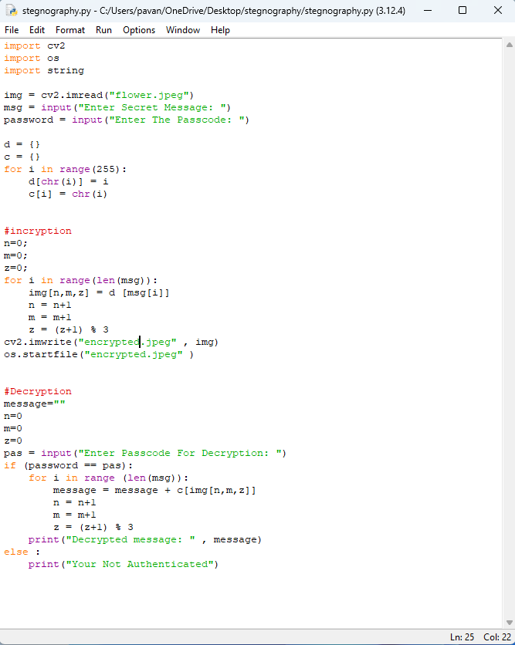
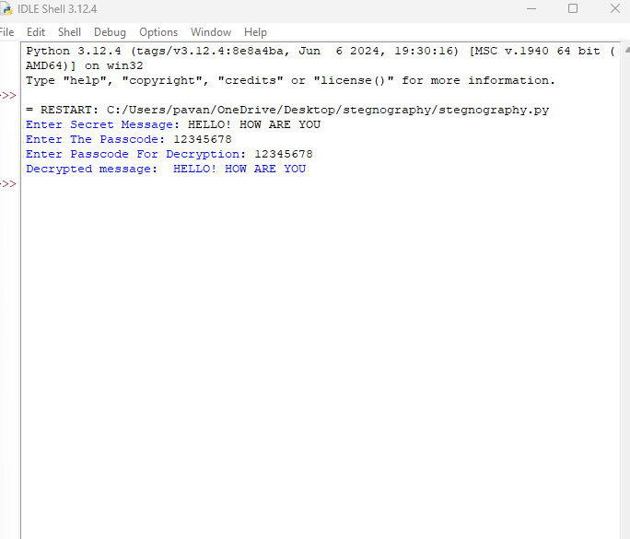
RESULTS
DEMO LINK

Slide 7
Thank you
.
.

