Slide 1
Performance
Overall a very broad topic
I will focus mostly on matching engine performance

Slide 2
Benchmarking
Optimize the right queries
  more real-worlds benchmarks
  less synthetics
Our customers should get the results we optimize for
  see query cache
Are we benchmarking the right code?
  e.g. query execution time takes 0.01 ms by our internal profiler
  then we are not actually testing matching engine performance

Slide 3
Matching performance
Matching engines spend most time in conjunctions and disjunctions (AND/OR)
  not exactly true in our case
  we also spend a lot of time copying data from node to node
  our use of skiplists is inefficient in most cases
  we are processing matches that we should have skipped

Slide 4
Single keyword
Lucene does single-term queries faster
Not much we can do here
Limited by doclist decompression speed
We need more efficient doclist storage format

Slide 5
Chunk legacy 1
prior to 3.0 we had nodes that put out docs and hits in chunks of 512 elements each
the idea was that it gives us a small memory footprint
real-world testing shows that for an expanded tree the memory footprint could be huge
one of the reasons why we had to implement memory trimming

Slide 6
Chunk legacy 2
we still have GetDocsChunk
lowered the value from 512 to 32 docs per chunk
most nodes can do one skiplist call per document block
lowered skiplist block size accrodingly

Slide 7
Chunk legacy 3
GetDocsChunk() or GetNextDoc()?
GetDocsChunk avoids one extra virtual call per doc
increases query tree memory footprint
  each node has to keep N=32 docs
  each node has to keep hitlists for all N docs
instead of virtual calls we have to copy docs+hits in every node

Slide 8
Chunk legacy 4
Chunks complicate code
  OR node has to output no more than N docs at a time
  Each of its subtrees outputs N docs
  OR node pauses in the middle of doclist merge

Slide 9
Chunks or not?
removing GetHitsChunks() was good
lucene uses plain nextDoc(), no chunks
need to benchmark chunk-less performance

Slide 10
AND performance
limited by
  inefficient use of skiplists
  chunk-based architecture
  redundant data copying

Slide 11
MultiAND
works directly with qwords, not nodes
efficient doclist intersection (leapfrog)
efficient hitlist merge (n-way)
efficient use of skiplists
  one call per doc, not per block
  child nodes collect chunks
  but qwords don’t
no redundant data copying in child nodes

Slide 12
Leapfrogging
see lucene
we sort doclists by size
take a doc from the lowest-frequency doclist
try to rewind other doclists
if failed, go back to first doclist
no unnecessary skiplist calls

Slide 13
MultiAND benefits
up to 60% performance boost
faster than plain AND in all cases

Slide 14
MultiAND deficiencies
limited applicability
  can be improved
  SENTENCE, phrase matching, etc
performance limited by
  index decompression speed
  skiplist size (32 vs 16)

Slide 15
Advance() vs HintRowID()
we have HintRowID() in 3.x
HintRowID() rewinds (or not) doclist to the value <= provided tRowID
values between [rewind_position; tRowID) are never used
lucene uses Advance()
Advance() rewinds to >= of provided tRowID
Advance() works better
  no multiple GetNextRowID() virtual calls

Slide 16
Advance() details
we now have Advance()
but only at qword level
used only by MultiAND
need it at search node level
so that nodes could skip unnecessary docs
and do it at the lowest possible level

Slide 17
OR nodes
limited by doclist intersection
limited by index decompression speed
some overhead from operating on nodes and not qwords
  rough estimate - 10-15%
can't benefit from existing skiplists
solution comes from lucene

Slide 18
WAND
Weak AND
can't speed up doclist conjunction?
let’s throw away some docs!
only need 1000 most relevant matches, after all
implemented in lucene in 2018

Slide 19
WAND details 1
prerequisites
  match rank is directly proportional to TF
  OR node sums TF from both subtrees
how it works
  at every moment ExtOr can get the score of current worst-of-the-best match from the ranker (=X)
  if incoming document contain only one term
  we know that the max score for this term is max1
  max1 < X? docs with only this term won’t make it to best matches, this term is now optional
  need to evaluate only the second term
  max1+max2<X? stop

Slide 20
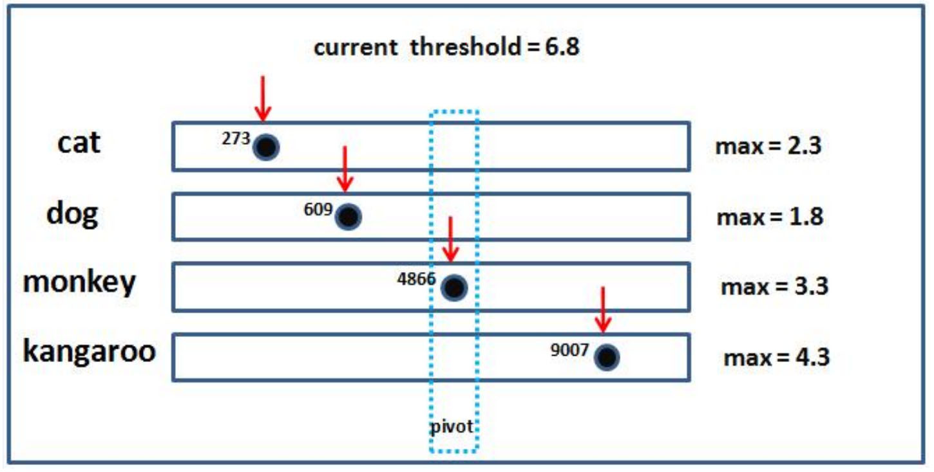
WAND details 2

Slide 21
WAND details 3
overall pretty simple, but
  we have to estimate max score for each term
  over all documents (that contain that term)
  such global max score is not very precise
    too high
BMW!

Slide 22
BMW
block-max WAND
stores max score estimate per block of docs
still keeps global max score
basically skiplists by score/rank
unsorted (by score)
pivoting won’t work

Slide 23
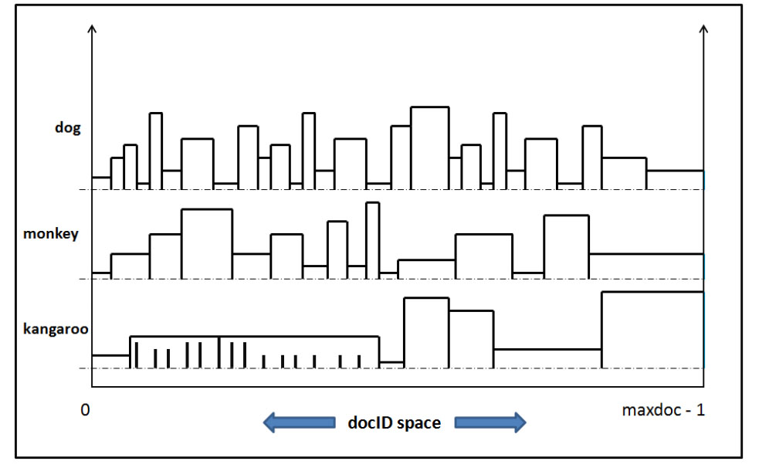
BMW details 1

Slide 24
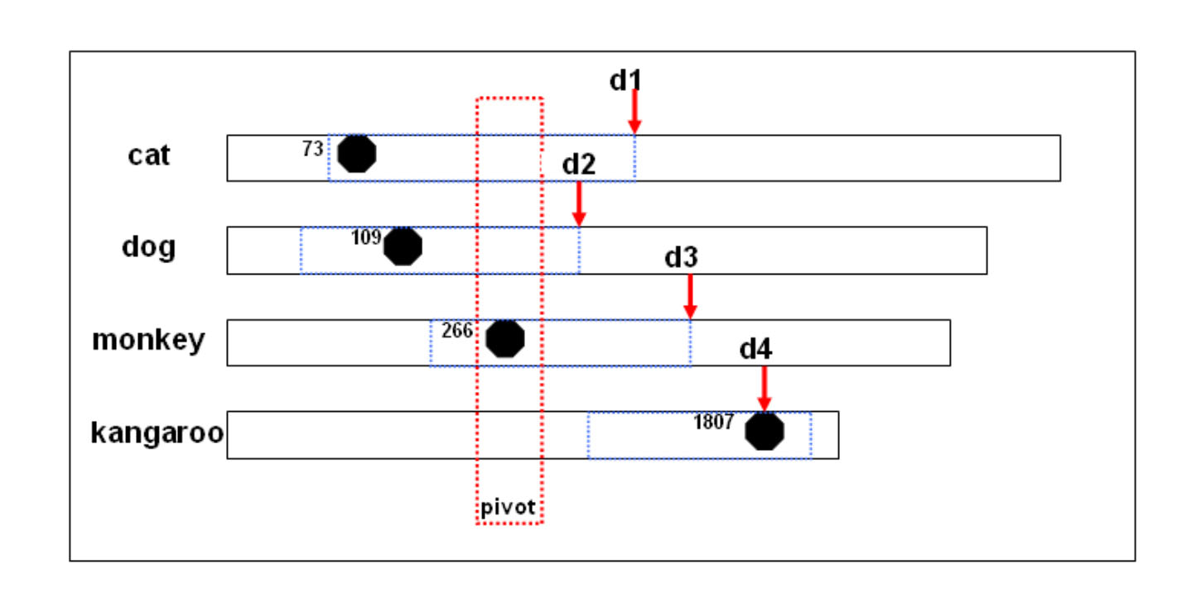
BMW details 2

Slide 25
BMW detail 3
check global scores
check block scores
  if ok, rewind first doclists to this rowid
  check for candidate
  rewind 1st doclist to rowid+1
if block score check fails
  get the rowid for the next score block before pivot (d1,d2,d3)
  rewind 1st doclist to min(d1,d2,d3,d4)

Slide 26
BMW details 4
lucene stores max(TF), max(doc_length)
we can just store max(TF) for now
maybe in the actual skiplist
works for OR
works for AND
even works for single-term queries

Slide 27
WAND/BMW benefits
1-term queries: 3x .. 7x faster
AND queries: 3% ... 7x faster
OR queries: -8% (slightly slower) .. 5x faster

Slide 28
WAND/BMW drawbacks
total hit count not always accurate
can’t compute aggregate functions
great optimization
still need to retain the old code path
it still needs to be optimized

Slide 29
Ranking change
Our BM25 doesn’t use document weights
And it should!
sorting speedups via getting more diverse relevance (a lot of docs have similar weights now).
we can add document length in words to doclist-entry of doclist and use in BM25.
1-byte value might be enough if we scale it
that would give us better ranking
  possible negative query cache impact
  it relies on the fact that weights are not that much different for packing
more diverse weights = better BMW performance
no negative weights!

Slide 30
Index format change
nodes are limited by index decompression speed
we use varint-based codec
tries to pack each number with min bytes
used on lists, but doesn’t take advantage of that

Slide 31
Index codecs
list-adaptive vs oblivious codecs
faster varint implementations
  use AVX, SSE
other oblivious codecs
  simple family
use the fastest oblivious codec

Slide 32
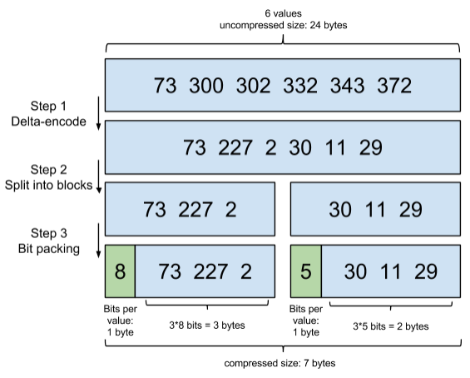
List-adaptive
Frame Of Reference

Slide 33
FOR
more complex versions exist (PFOR)
  tries to fit most numbers in 2^{b}
  stores exceptions after the encoded numbers
optimized implementations exist
  https://github.com/powturbo/TurboPFor
  https://github.com/lemire/FastPFor
benchmarks vs varint
  better compression ratio
  better performance

Slide 34
FOR in lucene
used by lucene since 2012
initial tests report
  0-40% better performance
  7% smaller index
lucene uses hybrid codec
  FOR for complete blocks of docs
  varint for incomplete blocks
makes sense to implement in Manticore

Slide 35
Our index format
doclist-entry =
  rowid-delta : VInt
  hitlist-offset-delta : VInt
  fields-mask : VInt
  TF : VInt
hitlist-entry =
  word-position-delta : VInt

Slide 36
Index format complications
doclist: inline hits
  can be disabled using an undocumented `hit_format` option
hitlist: hitless words
  save disk space (1.5x)
  no ranking support
will overcomplicate new index format
inline hits don’t work well with FOR
do users need these?

Slide 37
Lucene index format
lucene uses similar index format
  .doc and .pos files
  skiplists are stored inside .doc file
when block compression is used
  instead of [rowid1, TF1, rowid2, TF2…]
  we have [rowid1,rowid2], [TF1,TF2]

Slide 38
Our new index format 1
new doclist-entry
  base-rowid : VInt
  base-hitlist-offset : VInt (also used for skiplist)
  [rowid_delta_1… rowid_delta_N] : FOR
  [hit_offset_delta_1...hit_offset_delta_N] : FOR
  [TF_1...TF_N] : FOR

Slide 39
Our new index format 2
store base-rowid and base-hitlist-offset before each block
skiplist changes
  skiplists reside in RAM
  remove hitlist-offset from skiplists
  maybe add max(TF)
  maybe even max(doc_length)
  always point at the beginning of the block

Slide 40
Our new index format 3
interleaved blocks of rowid, hitlist_offset and TF
  lazy TF block decoding
  use skiplists to jump to next block
  maybe lazy hitlist_offset block decoding
fields-mask in the doclist
  bad compression ratio
  optimization precomputed from hitlist
  early rejection test
  disable it, benchmark performance

Slide 41
Our new index format 4
hitlist-entry:
  int field_id : 8; // bits 25-21
  int is_last : 1; // bit 24
  int word_position_in_field : 23; // bits 0-23
can’t be compressed as-is
interleaved blocks of [field_id] and [flags/positions]
lazy decoding of [flags/positions]

Slide 42
RT-specifics
no skiplists for ram chunks
hard to add, bad implementation, all over the code

Slide 43
Caching
a simple way to get better performance
we do it wrong
  we don't do enough caching
  we don't do it good enough
  we don't test it

Slide 44
Query cache
current query cache
stores filtered results
can be reused only if
  a new query has the same match() part
  and new query filters are a subset of old query filters
  that approach doesn't work with OR filters
  but our code doesn't know about it

Slide 45
Query cache performance 1
we do our benchmarks w/o qcache
we are worried about matching engine performance
but qcache is enabled by default
  our benchmarks is not what the customers are going to get
  performace degradation in some cases
  unpacking some queries is slower than running them

Slide 46
Query cache performance 2
what can we do about it?
  make sure cache packing is as fast as running the query
  improve cache heuristics
  don't waste time storing lightweight queries
disabled for ram chunks
  stores rowids local to segments
  need cache invalidation on insert/update
  need separate ids for rt ram chunks

Slide 47
Subtree cache
we (used to) have a subtree cache
it never existed in RT
caches matching results between queries
requires extra actions from users (running queries as multiqueries)
doesn't work for simple consecutive queries
disabled since 3.0
affects FACET performance
not sure if we need to fix and re-enable it

Slide 48
Matching engine result caching
our query cache stores filtered results
we could cache the results of the whole matching tree
  that match() could be reused with a completely different set of filters
make it simple
don't try to be universal and cache all data
just collect rowids
better packing, simpler code
add a hint node to the existing tree, don't replace a part of the tree

Slide 49
Fullscan caching
nonexistent as of now
store results of selective filters (packed)
we already have histograms for all attributes
easy to estimate result set size
needs to be faster than re-executing the filters
later it can added as a special term to the matching engine (so that Advance()) will work ok
attribute index integration

Slide 50
Filter caching details
cached filters must be stored in memory
space-efficient storage is necessary
possible storage options
  integer lists (for small result sets)
  bitmaps (for large result sets)
  roaring bitmaps (what lucene uses)

Slide 51
Roaring bitmaps
data is split into several containers of 65536 numbers each
each container can be (based on heuristics)
  array (for small result sets)
  uncompressed bitmap (for large dense sets)
  RLE-compressed bitmap (for large sparse sets)
  can be inverted storage (data that's missing from the set)
overall good performance
good skip performance

Slide 52
Filter performance
can be increased by using attribute indexes
they do value->rowid lookups
also range lookups
work for fulltext w/filters and for fullscan
basic framework already implemented
used by id filters
can use b-tree or inverted index
can be made to work with json attributes
  good if we implement "schemaless" json-only inserts

Slide 53
Attribute indexes
replace one or more filters with an iterator
iterator gives a list of rowids
fullscan
  applies the remaining filters to iterator results
fulltext
  adds a special node to query tree
  only used for HintRowID()

Slide 54
Query optimizer
take all possible combinations of filters
estimate execution costs
use the fastest combo
fullscan: sum all operation costs
  reading
  intersecting
  evaluating filters
fulltext
  each node estimates its cost
  not easy with HintRowID()
  even worse if we add BMW

Slide 55
Some conclusions
we are lagging behind lucene in terms of core matching engine tech
no major improvements for at least 7 years
"sphinx is fast" myth still seems to be working
matching engine performance (over conventional DBs) is one of the things we're selling

Slide 56
Some more conclusions
we do have some advantages
  the "R" in R&D was already done in lucene
  breaking changes with our user base are not as painful
need more focus on core engine development

