Slide 1
Adding MuESR to Mantid
Anthony Lim*
Anders Markvardsen
* Anthony.lim@stfc.ac.uk

Slide 2
Contents
What is MuESR?
General Comments.
Options For Development.
Conclusions.

Slide 3
What is MuESR?
Code for identifying muon sites by calculating the local fields.
Requires the atomic and magnetic structures.
Requires the proposed muon site.
It is a computationally cheap method.
Uses C++ and python code.

Slide 4
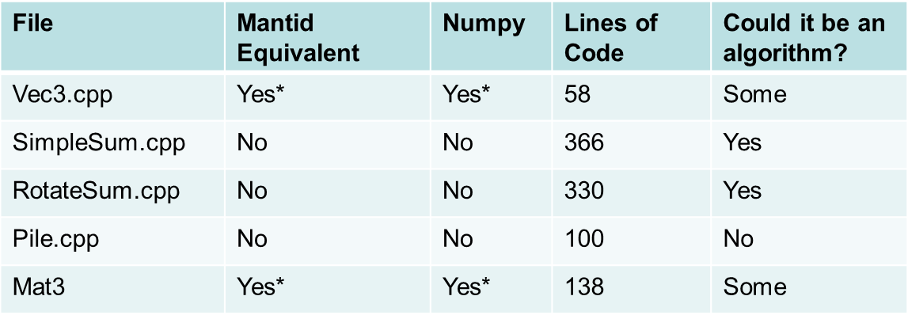
General Comments
* No type safety (by default)

Slide 5
General Comments
The C++ code prevents a straightforward compilation on different platforms.
  If we keep the C++ then the executable will have to be shipped with the code.
Python code is easy to transfer between different platforms.
The code does have some speed up due to the C++.

Slide 6
General Comments
Is it worth keeping the C++ code or having a pure Python code?
Reason for OpenMP is unclear.
Development will initially be on the original branch.

Slide 7
Options For Development
There are three options:
  Mantid script repository
  Mantid script folder
  3rd Party Software to Mantid

Slide 8
Script Repository
General holding area for short codes.
  Easy to update the code and maintain history.
  Straightforward uploading.
  Can write a script to update the repository.
  No units tests.
  No guarantee it will work with future versions of Mantid.
  Anyone can edit the code.
To convert C++ to Python: 4 weeks FTE.
To use Mantid: 6 Weeks FTE.

Slide 9
Script Folder
Maintained area (by Mantid team) for short codes.
  Unit tested and maybe system tested.
  Know changes will not break the code.
  Maintained by Mantid team.
  Needs unit tests.
  Needs to satisfy Mantid coding standards.
  Has to be a pure Python code.
  Time burden on Mantid team.
To convert to Algorithms: 4 Weeks FTE.

Slide 10
3rd Party Software
Stand alone code that uses Mantid.
  No direct burden on Mantid team.
    If muon group depend on the code, the burden is similar to previous option.
  Could have a bespoke GUI interface or be a script.
  Will not run from Mantid plot.
  No automatic testingMaintained area (by Mantid team) for short codes.

Slide 11
Conclusions
There are 3 main options; script repository, script folder or 3rd party software.
There is overlap between each option.
To release the code to users quicker, each option could be completed in turn.

