Slide 1
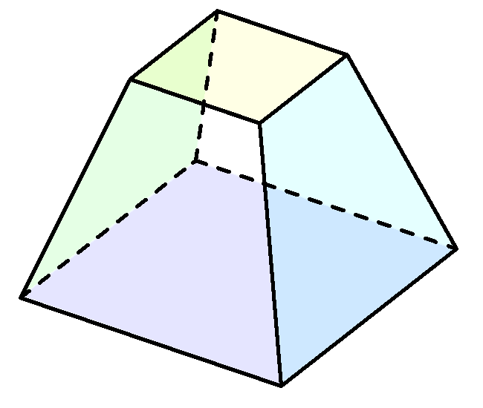
<left-back-top-point />
<right-back-top-point />
<left-front-top-point />
<right-front-top-point />
<left-back-bottom-point />
<right-back-bottom-point />
<left-front-bottom-point />
<right-front-bottom-point />

