Slide 1


Instrument Independent Data Reduction and Analysis
Nick Draper
03/11/2011

Slide 2
Project Aims
Aims
  To provide a framework for Data Analysis that is not instrument or technique/dependent.
  Support multiple target platforms (Windows, Linux).
  Easily extensible by Instruments Scientists/Users.
  Freely redistributable to visiting scientists.
  Provide low-level functionalities for
    Scripting
    Visualization
    Data transformation
    Implementing Algorithms
    Virtual Instrument Geometry

Slide 3
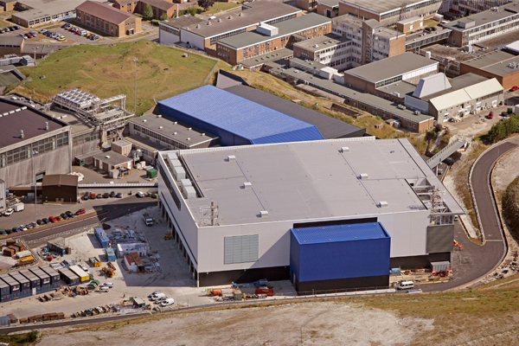
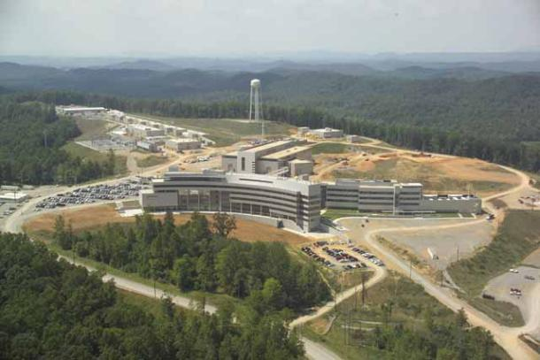
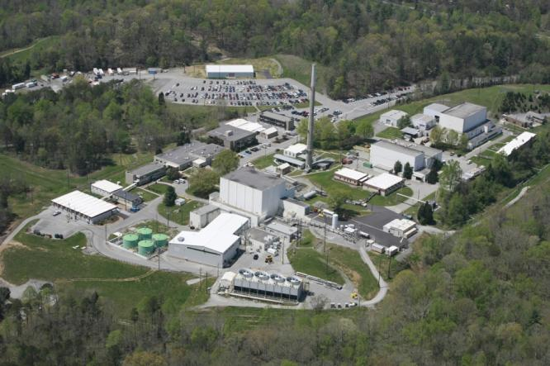
ISIS - SNS & HFIR collaboration

Slide 4
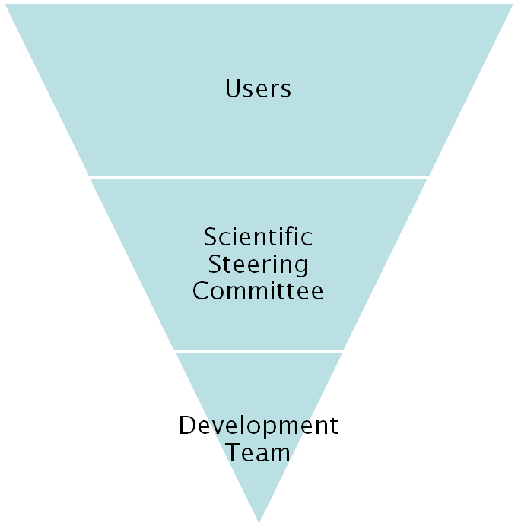
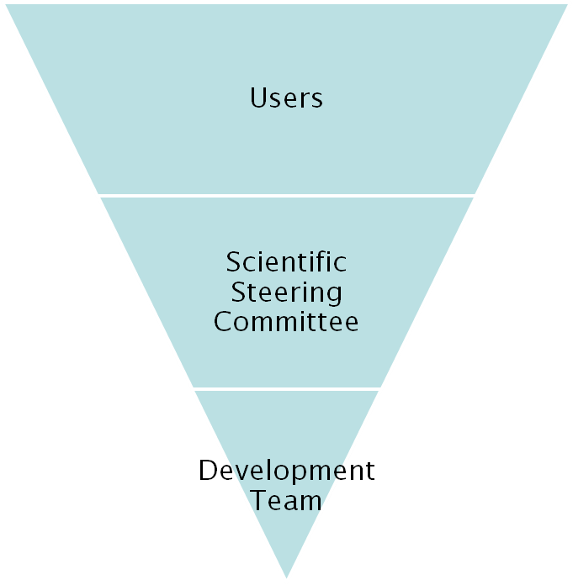
Project Organisation
ISIS
SNS/HIFR
27 beamlines, 1600 users
26 beamlines, 850 unique users
9 Key scientists
4 Key scientists
PM &
16 Developers
Project Management Board

Slide 5
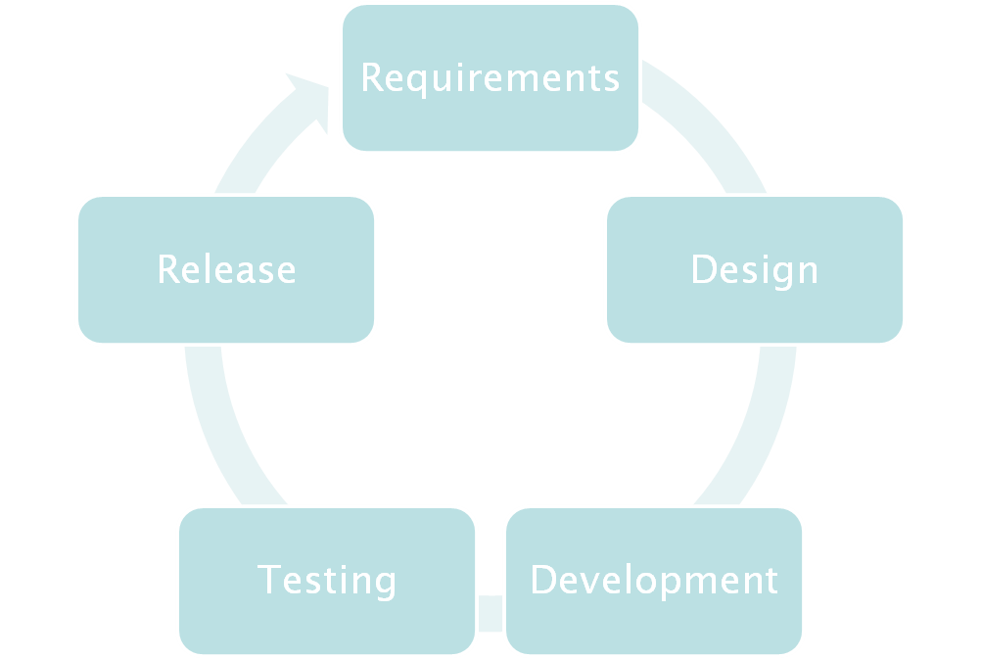

Iterative Development Process

Slide 6

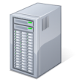

Continuous Integration Environment
Deploy to
Download site
Mantid Project Wiki
Automated
System test
SVN
Repository
Build + unit test
-RHE 5 & 6
-Ubuntu
-Mac OSX
-Windows 32
-Windows 64
trac
Issue
tracking
system
Developers

Slide 7
Design Criteria
Separation of Data and Algorithms
Encapsulated “User Code” in specific places
  Algorithms
  Workspaces
Use of well designed interfaces to allow generic use of components
Reuse of existing components
Careful memory management when handling large datasets

Slide 8
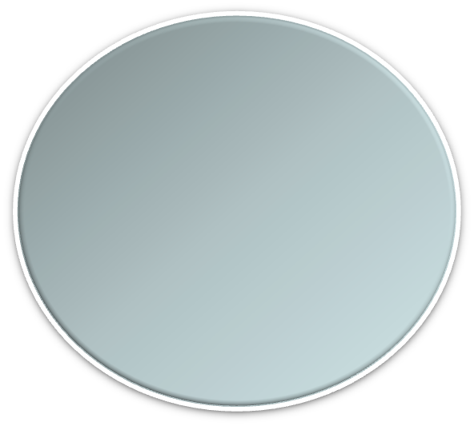


Architectural Design - Overview
Instrument log files
MantidScript
Command line & Scripting interface
RAW data files
Mantid Framework
API
Algorithms
Workspaces
MantidPlot Graphing and analysis
NEXUS data files
User Defined
User Defined
Matlab Interface
DAE direct access
Future Instrument specific UI
Future Instrument specific UI

Slide 9
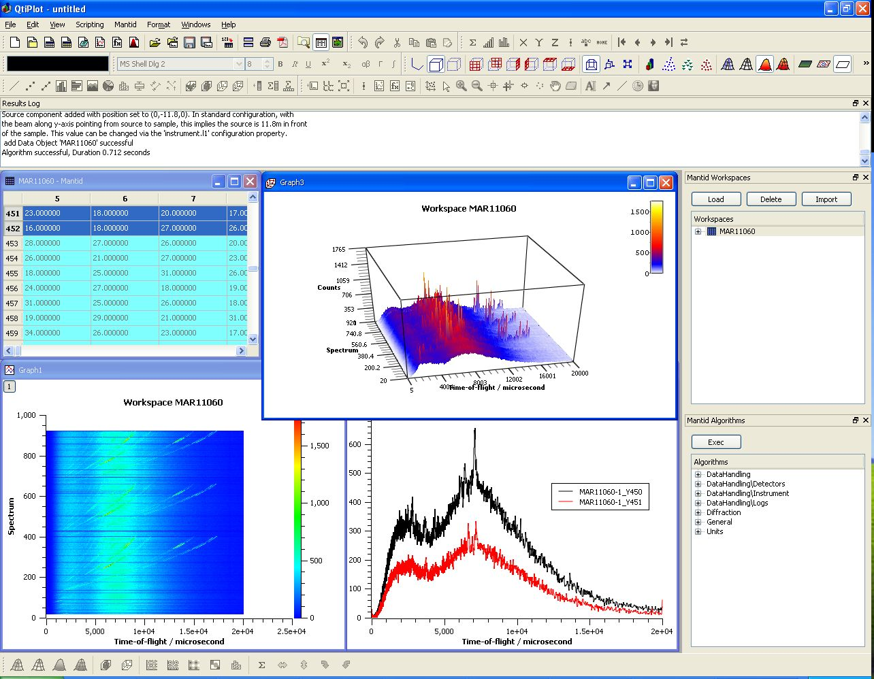
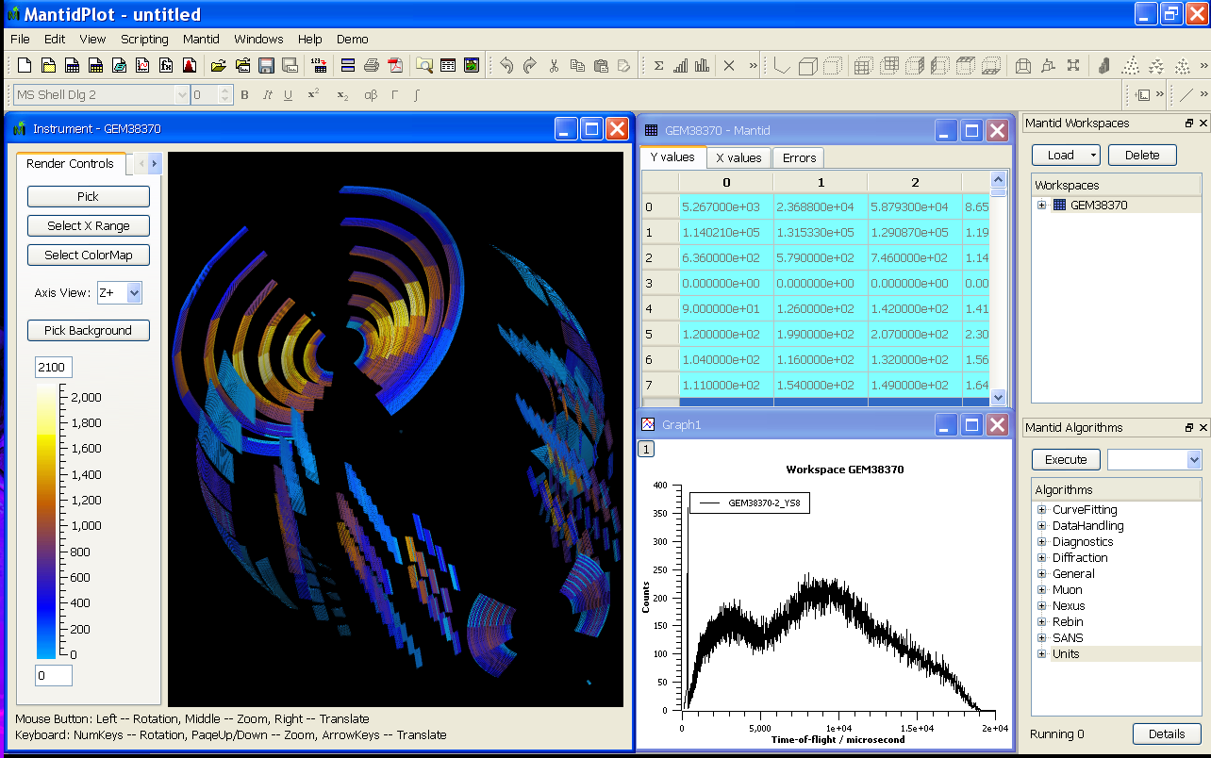
User Interfaces
Current Interfaces
  MantidPlot
    Plotting tool
    Data interaction and analysis.
    Instrument visualization

Slide 10
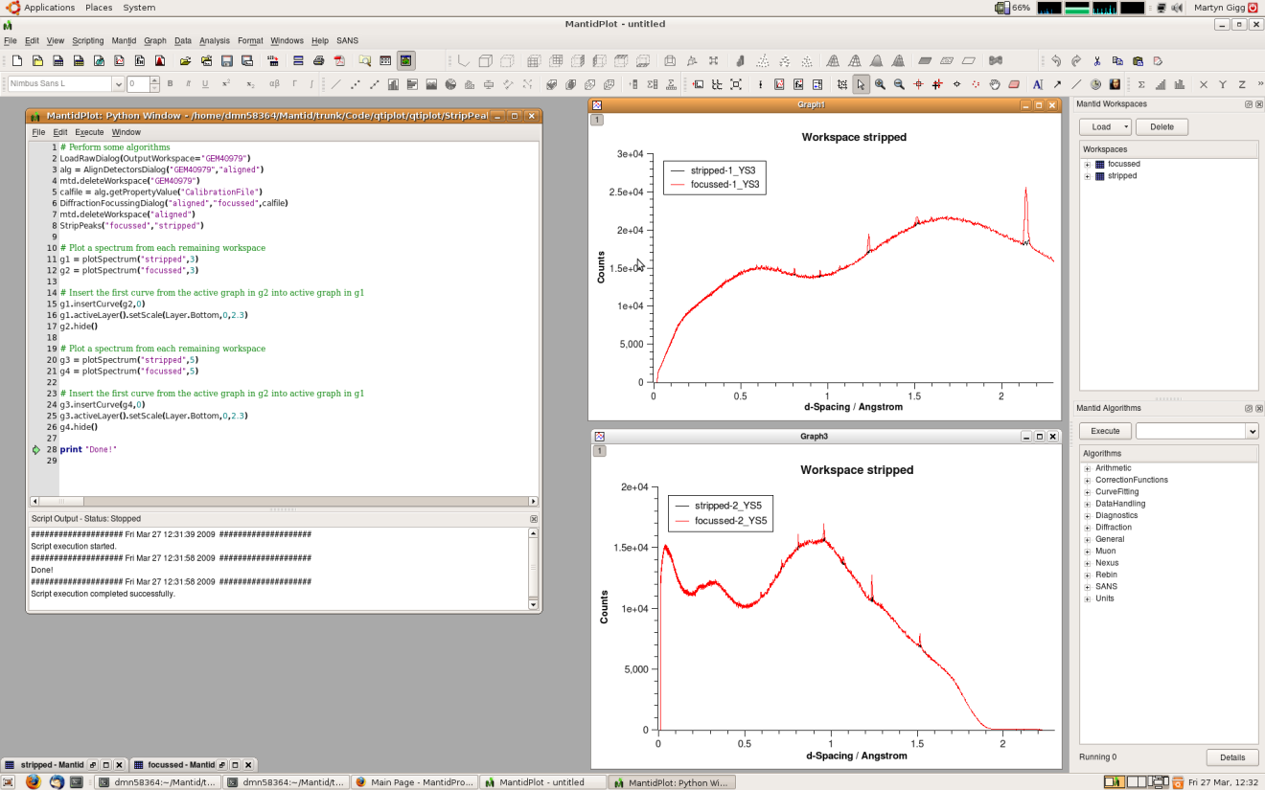
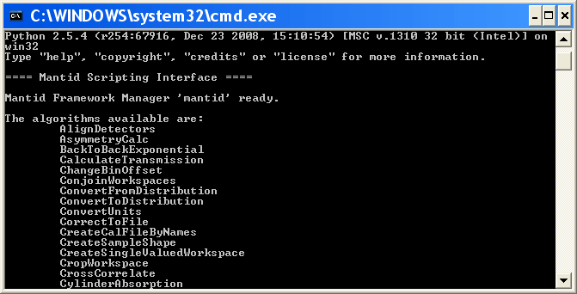
User Interfaces
Current Interfaces
  Python
    Command line access and scripting
    Python scripting language

Slide 11
Algorithms
Arithmetic (+,-,*,/)
Correction & Normalisation
Curve Fitting & Peak finding
Data Handling
  Various file formats inc Nexus
  Load direct from ISIS DAE
Diagnostics
Diffraction
Muon
Rebining
SANS
Unit conversion

