Slide 1


Toby Perring

Slide 2
VATES
Visualisation &
Analysis
Toolkit
Extensions

Slide 3

Project Goals
Visual Data Reduction
  Terascale Visualisation
  Exploration of nD Datasets Qx, Qy, Qz, ω temp, field, etc
  On-the-fly rebinning of sparse data
Consolidation of Existing tools
  TobyFit, Horace knowledge
  Build upon and extend Mantid
Seamless working environment

Slide 4
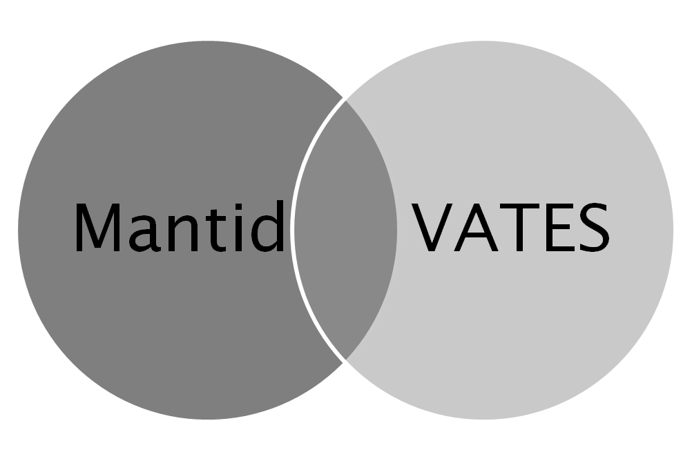
Design Choice: Mantid
  Mantid: Instrument and technique independent Data Reduction and Analysis.
Overlap in end-goals
  Overlap in common functionality

Slide 5
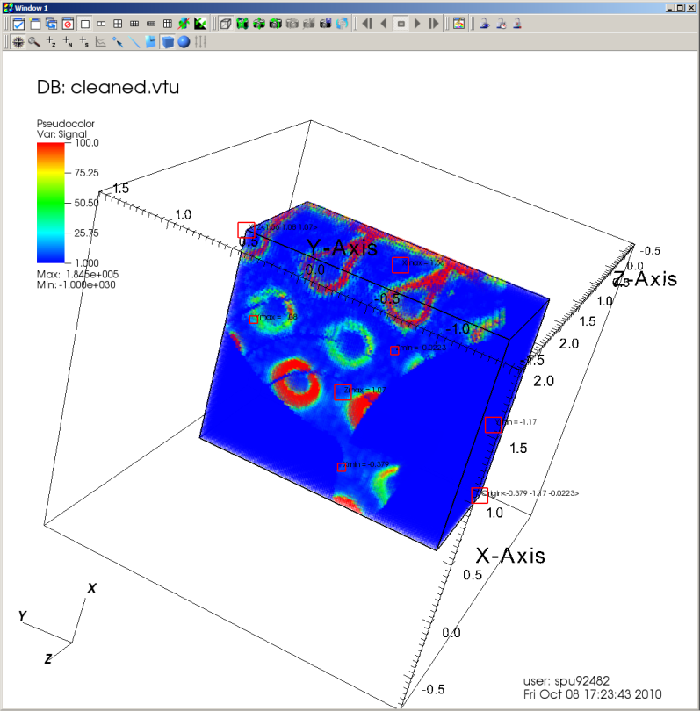
VisIT
Designed for scalable visualisation out-of-box
Pluggable mechanism for bespoke interaction with processing pipeline
Highly portable
Mature
Open Source

Slide 6
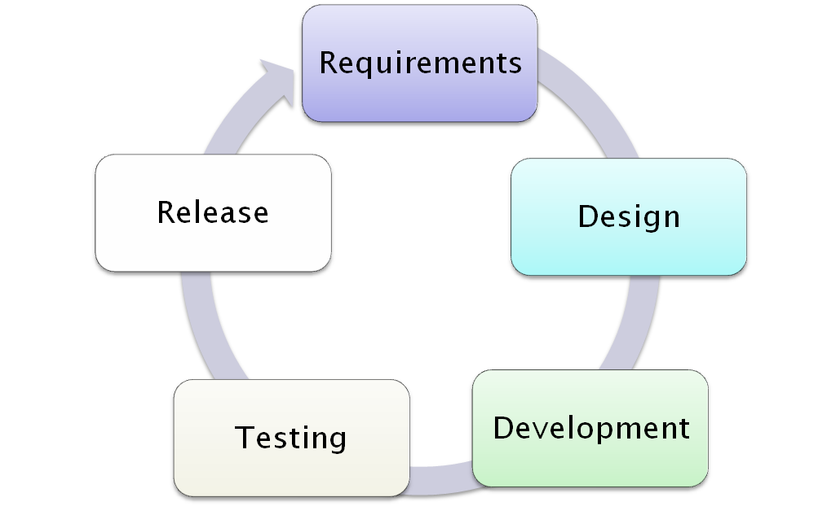
Evolutionary Development Process

Slide 7
Architectural Design - Overview
Mantid Plot
Mantid Framework
VATES UI
Algorithms
Workspaces
API
VisIT
MD Algorithms
MD Workspaces
VisIT Operators
VisIT GUI

Slide 8
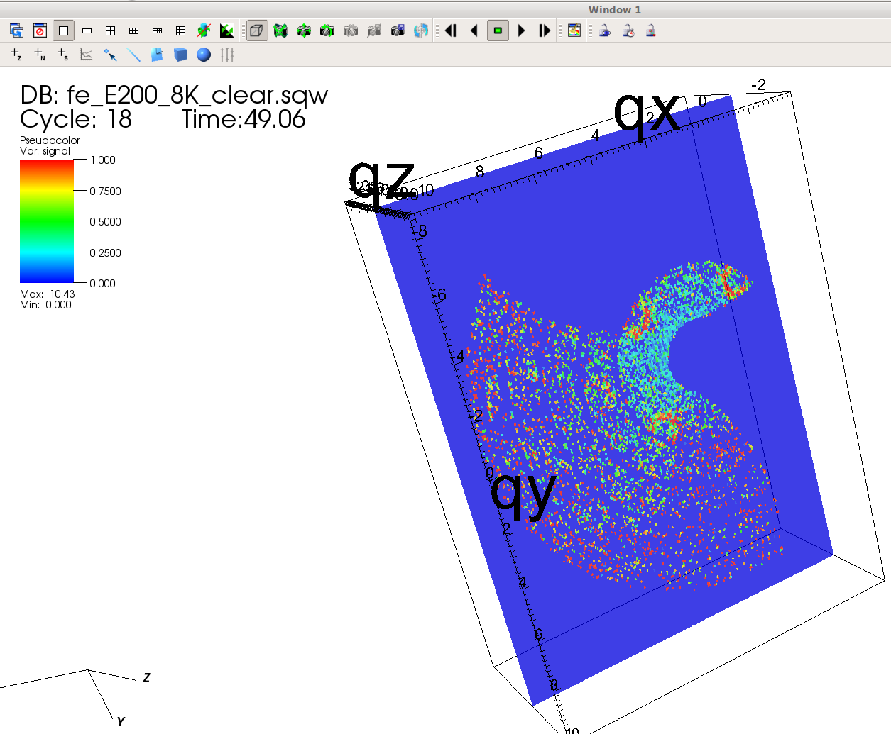
Dynamic Rebinning

Slide 9
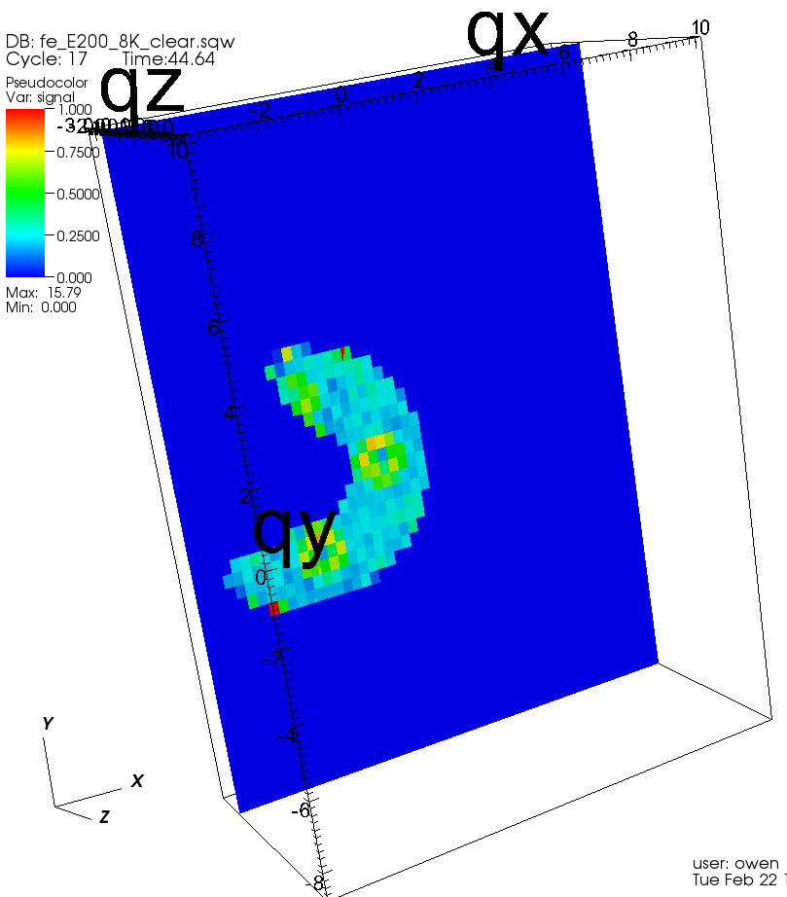
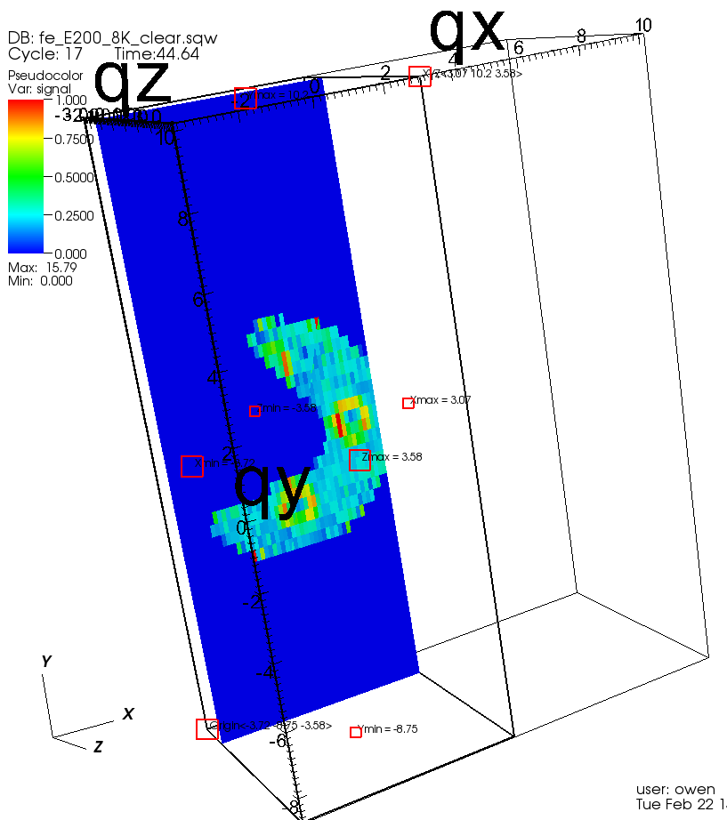
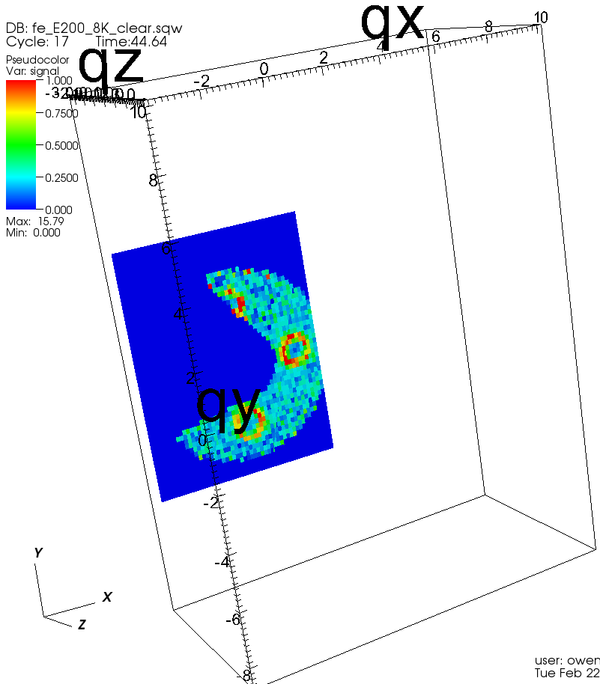
Dynamic Rebinning
Cutting, no increase in number of bins (50 bin in each dimension)

Slide 10
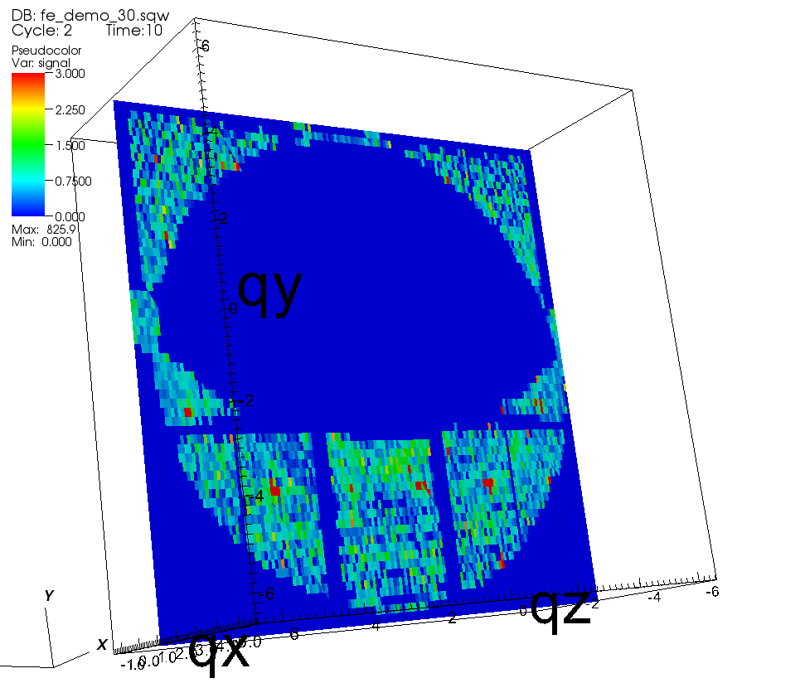
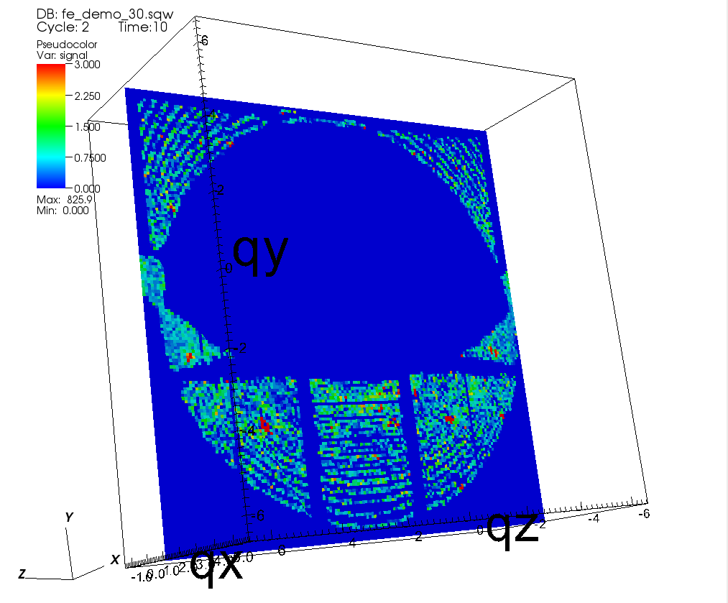
Dynamic Rebinning
Increasing resolution in qy

Slide 11
Analysis
Visualisation specifies cuts
  Multi dimensional cut operations expressed in a hierarchical format
Tobyfit
  Simulate spectrum from model sqw model
  Generate resolution function according to user defined sqw model
  Optimise predicted scattering results to experimental scattering results by modifying model parameters
Third Party Packages
  McPhase, CASTEP, GULP
  Optimise parameters in 3rd party model

Slide 12


Analysis Cluster
Mantid
Mantid
Mantid
Mantid
Your Laptop

Slide 13
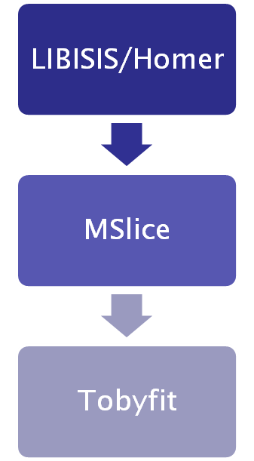

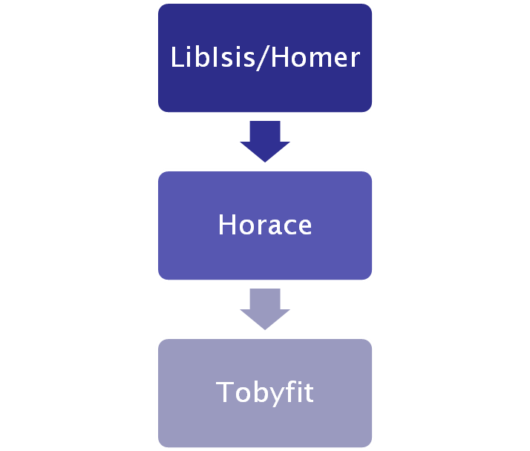
Application History
Past
Current
Future
Reduction
Slicing
Analysis

