Slide 1
Report on Guidelines and Standards for Data Treatment software
Anders Markvardsen, ISIS Facility Meeting at ILL, April 2017

Slide 2
Outline
Guidelines based on identifying commonality from a software questionnaire
Guideline specific to complex data loaders
Benchmarking tool for fit minimizers

Slide 3
What are Guidelines & Standards?
From Oxford Dictonaries:
Guideline: A general rule, principle, or piece of advice
  Example: ‘the organisation has issued guidelines for people working with prisoners’
Standard: A required or agreed level of quality or attainment
  Example: ‘half of the beaches fail to comply with European standards’

Slide 4
Questionnaire - overview
BornAgain (http://bornagainproject.org )
Mantid (http://www.mantidproject.org )
McStas (http://mcstas.org )
MuhRec (https://www.psi.ch/niag/muhrec )
SasView (http://www.sasview.org )
Thanks to Joachim Wuttke, Nick Draper, Peter Willendrup, Anders Kaestner and Wojtek Potrzebowski
(Empty fields means no answers, answers dates back to ~Dec 16)

Slide 5
Software setup
Software architecture
Software development and software quality
Any additional suggestions/comments

Slide 6
Software setup
 | BornAgain | Mantid | McStas | MuhRec | SasView
Governance model | None | Project Management Board comprised of members of the contributing facilities | Informal. Notion of core group | Advisory committee | The management team consists of 4 people

Slide 7
Software setup
 | BornAgain | Mantid | McStas | MuhRec | SasView
License | GPL3 | GPL3 | GPL (2.0) | Freeware (1) | GPL
Guideline:
Use a GNU General Public License?

Slide 8
Software setup
 | BornAgain | Mantid | McStas | MuhRec | SasView
User support | Through mail and Web contact form | Via a forum, email and phone | User mailing list and emails send directly to main authors | By direct email communication | Through the user mailing list and tutorials
Guideline:
Provide user support, as a minimum through email support?

Slide 9
Software setup
 | BornAgain | Mantid | McStas | MuhRec | SasView
User documentation | Installation instructions, tutorials and examples online. Physics manual (pdf) still incomplete | Web-based and built-in docs, training materials that can be followed in your own time and which is used in training courses | PDF’s, html online docs, wikis. We are considering to create webcasts for installation and introductory use |  | Web-based and built-in documentation and a tutorial
Guideline:
Provide user documentation

Slide 10
Software setup
 | BornAgain | Mantid | McStas | MuhRec | SasView
Release cycles | A few releases per year | ~ every 4 months | ~ 1 per year |  | ~ 1 per year
Guideline:
Software release cycles of a few times to once a year

Slide 11
Software setup
 | BornAgain | Mantid | McStas | MuhRec | SasView
Post release communication |  | Release notes emailed to user mailing list, release presentations and annual scientific steering committee meeting | User mailing list | Currently none | No. Free to use and redistribute
How is a release communicated to users

Slide 12
Software architecture
 | BornAgain | Mantid | McStas | MuhRec | SasView
Architecture principle | Standard modern C++ design | Separation of Data and Algorithms. Encapsulated “User Code”. Reuse of existing components and careful memory management when handling large datasets | “Less is more”, simplicity and readability over speed. Limit number of external dependencies |  | The software is divided into: core module, model function library and GUI. There is also a minimizer module that is separately distributed
Modularisation | Core library for modelling sample and instrument, and computing the expected detector image. Python wrapper and GUI on top of it | The framework is split into several modules, as is the user interface, and both are separate from the other | Layers: GUI tools, “core” code generator, instrument file, component codes, simulation binaries |  | Sasmodels is a separate library (separately hosted on Github) that can be interfaced with the minimization module directly
Support plug-ins | No plug-in mechanism at C++ level, but the Python wrapper allows users to implement custom form factors | Plug-in architecture that allows users to extend the framework in C++ and Python by defining their own algorithms, custom user interfaces or data objects, among many other things | Components are our plug-ins. Written as ISO C code in a structured format |  | Model functions can be supplied as plug-ins
Guideline:
Design software to be modular and to support plug-ins?

Slide 13
Software architecture
 | BornAgain | Mantid | McStas | MuhRec | SasView
Is scripting supported | Python scripting | Python scripting | Scripting is provided by the tool layer |  | Some level of scripting is supported
Guideline:
Where software needs to support scripting,
the advice is to support this through Python?

Slide 14
Software architecture
 | BornAgain | Mantid | McStas | MuhRec | SasView
GUI framework | Qt-based | Qt-based | Moving to Python-Qt, Perl-Tk is our legacy solution |  | Currently the GUI is based on wx-python but there are efforts being made to rewrite it in Qt
Guideline:
Where the software use a GUI, use Qt

Slide 15
Software development
 | BornAgain | Mantid | McStas | MuhRec | SasView
Code languages | C++ and Python | C++ and Python | C, Python and Perl (Perl in the process of being replaced with Python) | C++ and Python | C++ and Python
Guideline:
Use the programming languages C++ and/or Python

Slide 16
Software development
 | BornAgain | Mantid | McStas | MuhRec | SasView
~% of development goes into maintenance | ~10-20% | ~2 weeks after each release is devoted to code maintenance. Many other tasks can be classified as maintenance | ~10-30%
How frequently is code re-engineer | Continually; almost every new functionality requires some refactoring | Extensive or risky changes are reserved for the maintenance periods | Often
Guideline:
Factor into your project plan from the start that you will be
refactoring and doing maintenance work on your code

Slide 17
Software development
 | BornAgain | Mantid | McStas | MuhRec | SasView
Development methodology | Agile | Agile approach that has been adjusted for the distributed nature of the development team | Generally informal/undefined. On some ESS-oriented tasks, the methodology is SCRUM |  | Code sprints and kanban implemented internally at ESS (affects 3 developers). Other developers contribute mostly during code camps
Guideline:
Use some form of agile development methodology?

Slide 18
Software development
 | BornAgain | Mantid | McStas | MuhRec | SasView
Version control | Git | Git | Git | Git | Git
Guideline:
Use Git for version control?

Slide 19
Software development
 | BornAgain | Mantid | McStas | MuhRec | SasView
Issue/ticket tracking system | Redmine, soon moving to GitHub | Github | GitHub |  | Trac
Guideline:
Use a issue/ticketing system, such as Github

Slide 20
Software quality
 | BornAgain | Mantid | McStas | MuhRec | SasView
automated testing | For unit tests, functional tests, and integration tests | For unit testing, system testing and documentation testing. We are moving many of our UIs to an MVP pattern to allow for automated testing of UI logic | Yes: but not in a very strict way. Every night an integration test runs – based on a nightly build |  | Unit tests to a limited extent but are planning to do more
Continuous integration | buildbot | Jenkins, using Leeroy to run build for all of our Pull requests | Currently a home-grown script-oriented system running on OSX, Debian, Windows. We are moving to Jenkins |  | Build servers for Windows and OSX. Jenkins based
Guideline:
Use a tool for continuous integration and automated testing,
such as Jenkins

Slide 21
Software quality
 | BornAgain | Mantid | McStas | MuhRec | SasView
Acceptance testing | no | For each release we allow for 2 weeks of beta testing | Yes, but not in a formalised sense |  | no

Slide 22
Software quality
 | BornAgain | Mantid | McStas | MuhRec | SasView
Build and configuration tools | CMake | CMake | CMake |  | Python packaging: setuptools, distutils. Make for building documentation of model function library (sasmodels)
Guideline:
Use the build tool Cmake?

Slide 23
Software quality
 | BornAgain | Mantid | McStas | MuhRec | SasView
Do you do code reviews | Under consideration, as we move to GutHub | All changes to the code are reviewed by a different developer as part of the testing process | Code reviews at DTU between developers there – code, demo and comments in a weekly meeting |  | Internally at ESS through pull requests
Guideline:
Do code reviews, and use a tool such as Github?

Slide 24
Software quality
 | BornAgain | Mantid | McStas | MuhRec | SasView
Static code analysis tools | occasionally | Several, Clang format, cppcheck, coverity, pylint, clang tidy | On occasion yes, formalised no |  | pylint
Dynamic analysis tools | occasionally Valgrind | Valgrind, AddressSanitizer, very sleepy | On occasion yes, formalised no |  | no
Guideline:
Use static and/or dynamic analysis tools at least occasionally?

Slide 25
Community benefits
Open Source license – prerequisite
Same programming languages further helps the above
Same version control software, build and ticketing tools…
Using the same scripting language
Having modularized software

Slide 26
Not covered in questionnaire
(Installation)
(Nexus/HDF)

Slide 27
Documenting complex data loaders
User documentation that tells the user how to use the loaders
Developer documentation, including a good level of comments in the code of the loader

Slide 28
Complex data
Counts
sample and sample environment info
Information about the neutron beam
Instrument monitored info
Other information

Slide 29
Additional guideline when loading complex data
Document what is loaded and where it goes

Slide 30
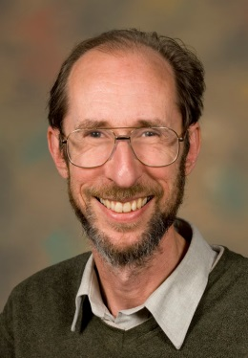
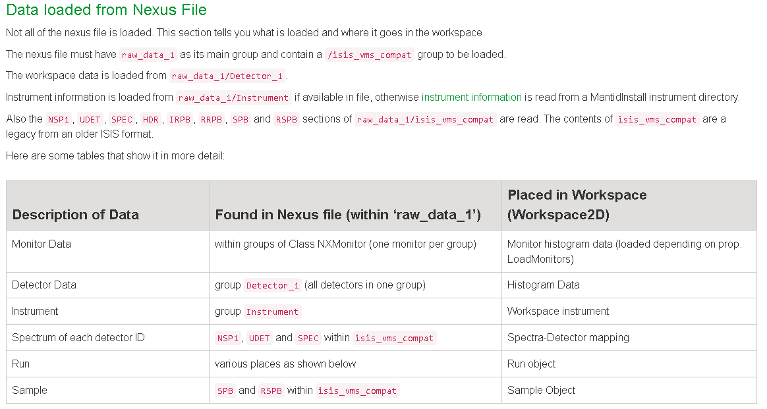
Example LoadISISNexus:
Karl Palmen
For full description see:
http://docs.mantidproject.org/nightly/algorithms/LoadISISNexus-v2.html#algm-loadisisnexus

Slide 31
Fit minimizer benchmarking tool
Prerequisite for having a standard method for comparing fit minimizers
www.sasview.org

Slide 32
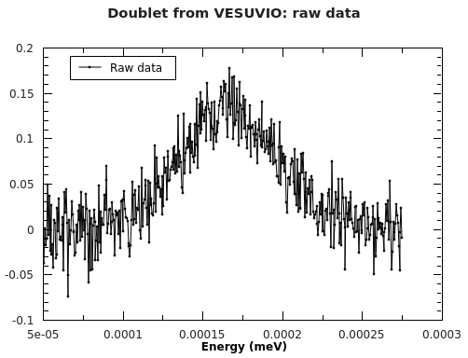
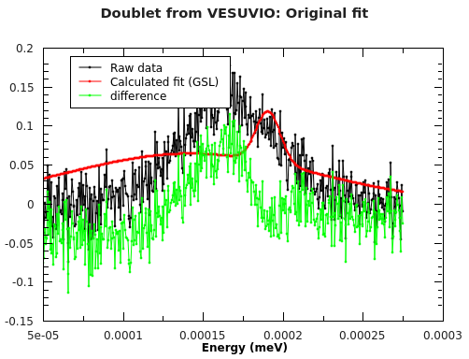
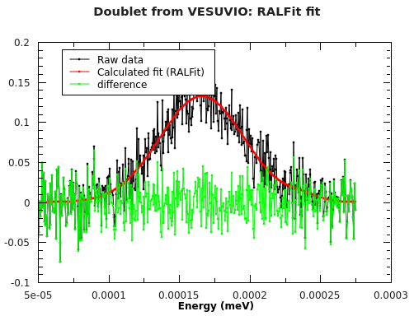
Motivation 1
No thanks
Yes please

Slide 33
Motivation 2
Go beyond perception
May explain why different neutron data treatment software favour different minimizers

Slide 34
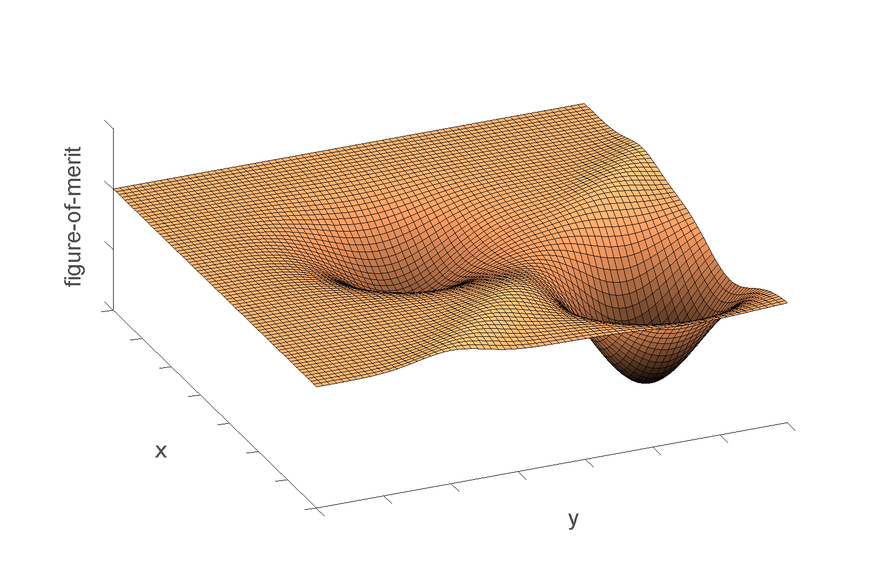
What is global optimisation?
Yes

Slide 35
No

Slide 36
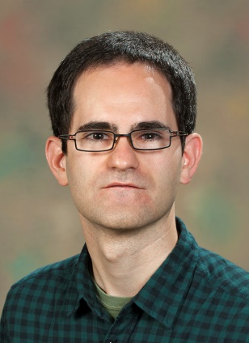
A simply tool:
Consists of a library of fit problems (targeting testing of local minimizers)
And a few Python files ( https://github.com/mantidproject/mantid/tree/master/scripts/CompareFitMinimizers)
Federico Montesino Pouzols

Slide 37
How currently used
Subset run in system-test - daily
Run manually in full before each release

Slide 38
From http://docs.mantidproject.org/nightly/concepts/FittingMinimizers.html
By default Mantid uses Levenberg-Marquardt
  We can also recommend Trust Region, in particular where stability is important

Slide 39
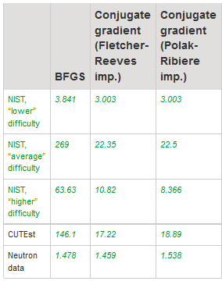

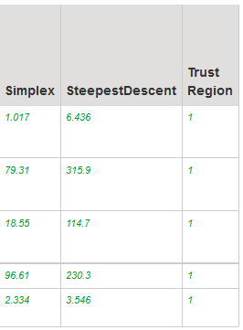
From http://docs.mantidproject.org/nightly/concepts/FittingMinimizers.html
Historical
Mathematical
Real stuff
Notation:
The closer to 1, the
better the method

Slide 40


From http://docs.mantidproject.org/nightly/concepts/FittingMinimizers.html
Notation:
The closer to 1, the
better the method
Current
default
SCD
?

Slide 41
Conclusion
Use guidelines: they benefit you and this community
Extra guideline when documenting complex data loaders
Please don’t hesitate to make use of new tool for comparing fit minimizers (and I happy to answers help)

Slide 42
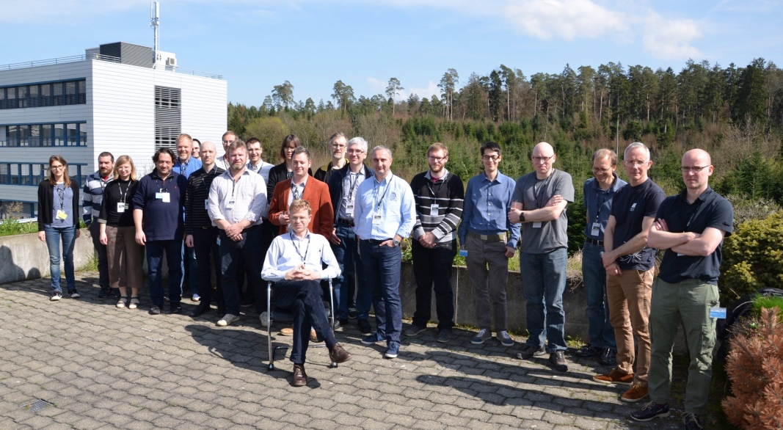
Thank you and thanks to
Federico Montesino Pouzols, was ISIS
Karl Palmen, ISIS
Steve Cottrell, ISIS
Thomas Rod Holm, ESS
Joachim Wuttke, Juelich
Nick Draper, Tessella at ISIS
Peter Willendrup, DTU
Anders Kaestner, PSI
Wojtek Potrzebowski, ESS
Ines Crespo, was TUM
Branwen Hide, STFC
Nick Gould, SCD (part of STFC)
Jennifer Scott, SCD (part of STFC)
Tyrone Rees, SCD (part of STFC)
Roman Tolchenov, Tessella at ISIS
Workshop I @ PSI (April, 2016)
This project is funded by the Horizon 2020 Framework Programme of the European Union. Project number 654000.

