Slide 1



Architecture
Visualisation and Analysis

Slide 2
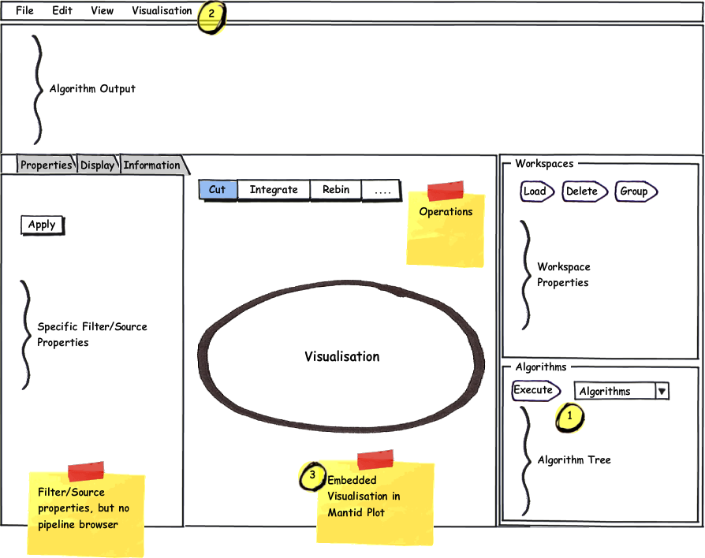
User Perspective A: Simple Mode
Open MantidPlot
Load data file
Create MD workspace
Manipulate workspace
Launch embedded visualisation
MD workspace loaded as source

Slide 3
User Perspective B: Advanced Mode
Save MD Workspace in Mantid
Close Mantid
Open visualisation (Auto load plugins)
Load MD Workspace via reader
Mantid algorithms, workspaces and back-end used to achieve this.

Slide 4
Components
Mantid
Visualisation
Reference or create instance of depending upon mode
Source/Reader
Algorithm
Filter
MD Workspace
View
Mantid QtWidget

Slide 5
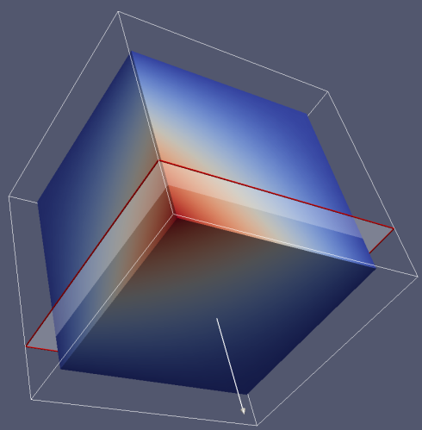
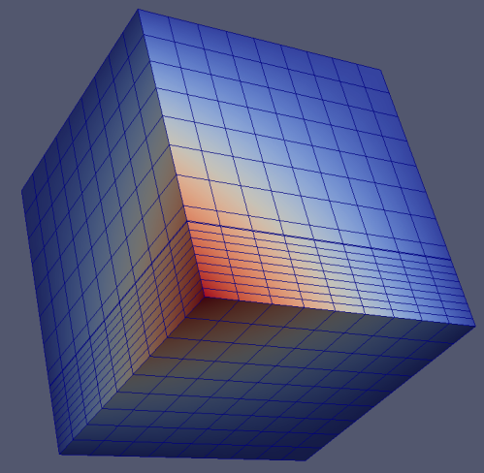
Rebinning/Slicing
Generate course volume
Use implicit functions and integrated interacting tools to sub-divide volume
Mantid rebinning algorithm
Build new dataset with specified bin-widths by revaluating dataset between implicit functions

Slide 6
Rebinning/Slicing
<<ImplicitFunctionObject>>
vtkAdapter
-adaptee : vtkImplicitFunction
vtkUnstructuredGridAlgorithm
Rebinning Datasource/Reader
Slicing Filter
uses
<<IDynamicRebinning>>
+SetImplicitFunction(:ImplicitFunctionObject)
uses

Slide 7
Rebinning/Slicing
Centre Point
Parallelepiped
Adaptive Mesh
<<IDynamicRebin>>
vtkPointSet
Parallelepiped
Adaptive Mesh
CentrePoint
vtkStructuredGrid
vtkUnStructuredGrid

Slide 8
Projections
MD Workspace, vtkImplicitFunctions and vtkContourFilter
From URD
U3.2.2.4 | Plot Intensity – For N-dimensional data, pick 3 dimensions and then integrate over a range in one or all of the others. Source: S. Campbell Issue: | M
U3.2.2.5 | Auto integration of a selected region. Integrates over one axis of the selected rectangle and plots over the other. User chooses the integration axis. Source: R Ewings Issue: | D
U3.2.2.6 | Create an isosurface of 3 Dimensions for a fixed 4th dimension. Ability to plot a surface using a user-defined function. Source: S. Campbell, R. Ewings Issue: | D

Slide 9
Client-Server
Client
Server
p0
PVServer
Mantid
p1
PVServer
Mantid
p2
PVServer
Mantid
Paraview
p3
PVServer
Mantid
p4
PVServer
Mantid
Mantid
p0
PVServer
Mantid
p1
PVServer
Mantid
p2
PVServer
Mantid
p3
PVServer
Mantid
p4
PVServer
Mantid

Slide 10
Specific Unresolved Issues
Families of visualisation plugins or plugin options?
How to consolidate visualisation farm with Mantid processes?
How to modify visualisation framework to allow shared access to Mantid instance?
What are the minimal set of tools we can provide for the simple visualisation case?
Do we need additional interactors?
How do we build minimal Mantid for visualisation processors
How do we subdivide physical data files?

