Slide 1
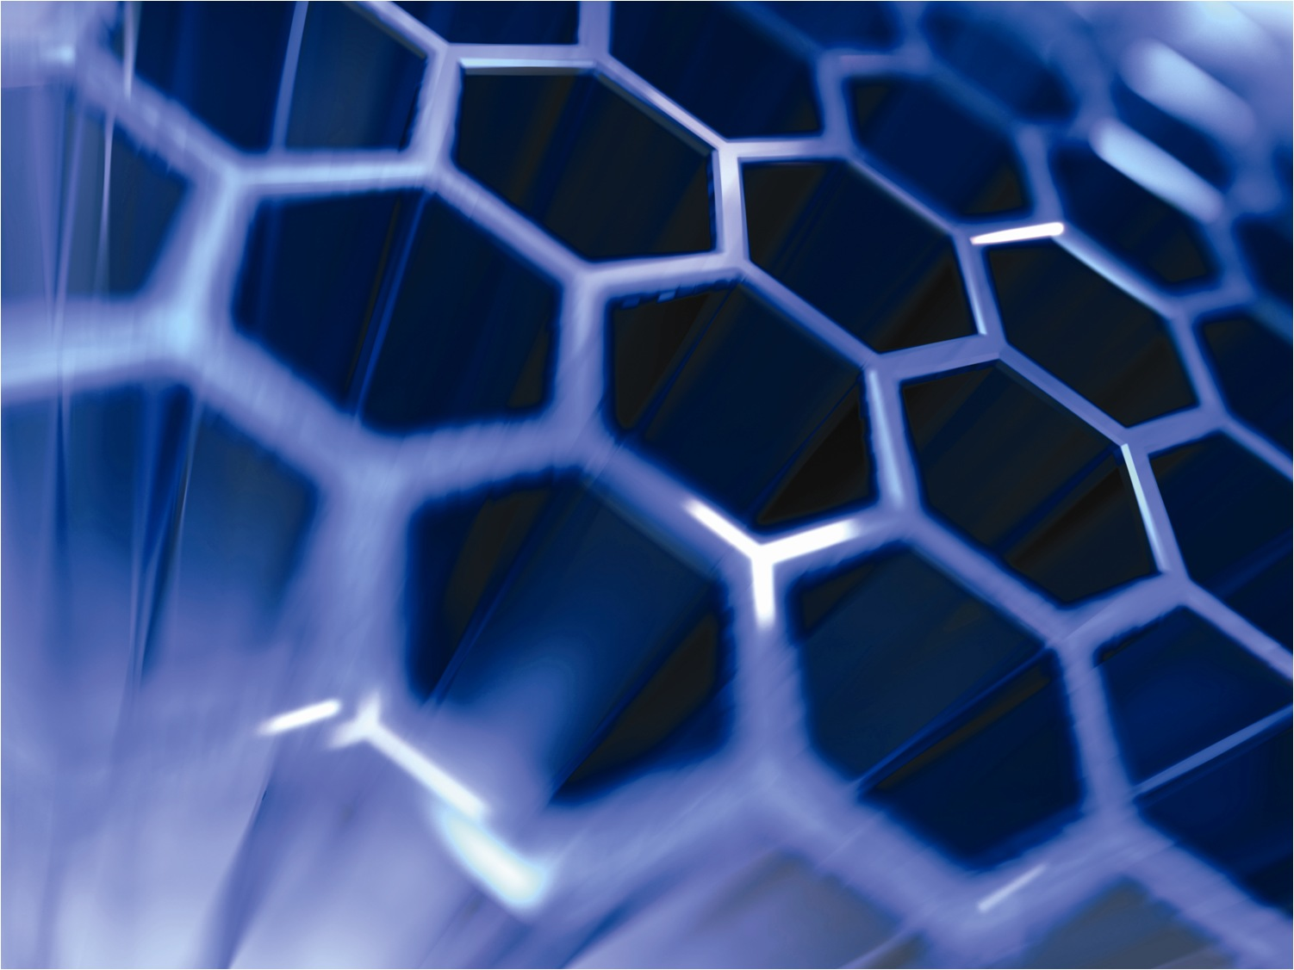


Prototype Dynamic Rebinning

Slide 2
Types of Rebinning
<<IDynamicRebin>>
vtkPointSet
Parallelepiped
Adaptive Mesh
CentrePoint
vtkStructuredGrid
vtkUnStructuredGrid

Slide 3
VTK Pipeline
Pipeline
Datasource1
Visualisation data
Filter1
Filter2
Update
Filter3

Slide 4
Dynamic Rebinning Pipeline
Pipeline
Horace/Mantid Code
RebinningDatasource
Dynamic Rebinning Module
Visualisation data with additional binning information
HDF5
RebinningDatasource
RebinningFilter1
Dynamic Rebinning Module
Specify Cut Info
Visualisation data
Filter1

Slide 5
Emerging Design
vtkRebinningAlgorithm
<<ImplicitFunctionObject>>
vtkAdapter
-adaptee : vtkImplicitFunction
Rebinning Datasource/Reader
Slicing Filter
vtkStructuredGrid
uses
<<IDynamicRebinning>>
+SetImplicitFunction(:ImplicitFunctionObject)
+CreateMesh() : vtkRebinningStrucutredGrid
uses
vtkRebinningStructuredGrid
+GetRebinningInfo()

Slide 6
Prototype Limitations
Issue | Proposed Fix | Prototyped
Pass HDF5 information | New vtk data object types | Y
Clipping limited to plane functions | Compose new implicit function types | Y
Process optimisation: Clipping should generate subset data rather than regenerating entire volume and clipping | Rebinning code capable of evaluating implicit functions to determine volume of data to regenerate | Y
vtkUnstructuredGrid instead of structured grid | Generate source data in terms of unstructured grid | Y
Rebin across multiple processors. Currently only using a single processor on a single node. | Set grid generation extend based on the known processor instance and total number of processors. | Y
Memory Upper bounds | 64-bit Development | N
No rotational aspects to rebinning cutter | Cross product plane normal and axes, decompose angles into rotational matrix. Move to rebinning code. | N
vtkCutter implementation outputs UnstructuredGrid | Determine use of standard interactors in Paraview and replicate | N

Slide 7
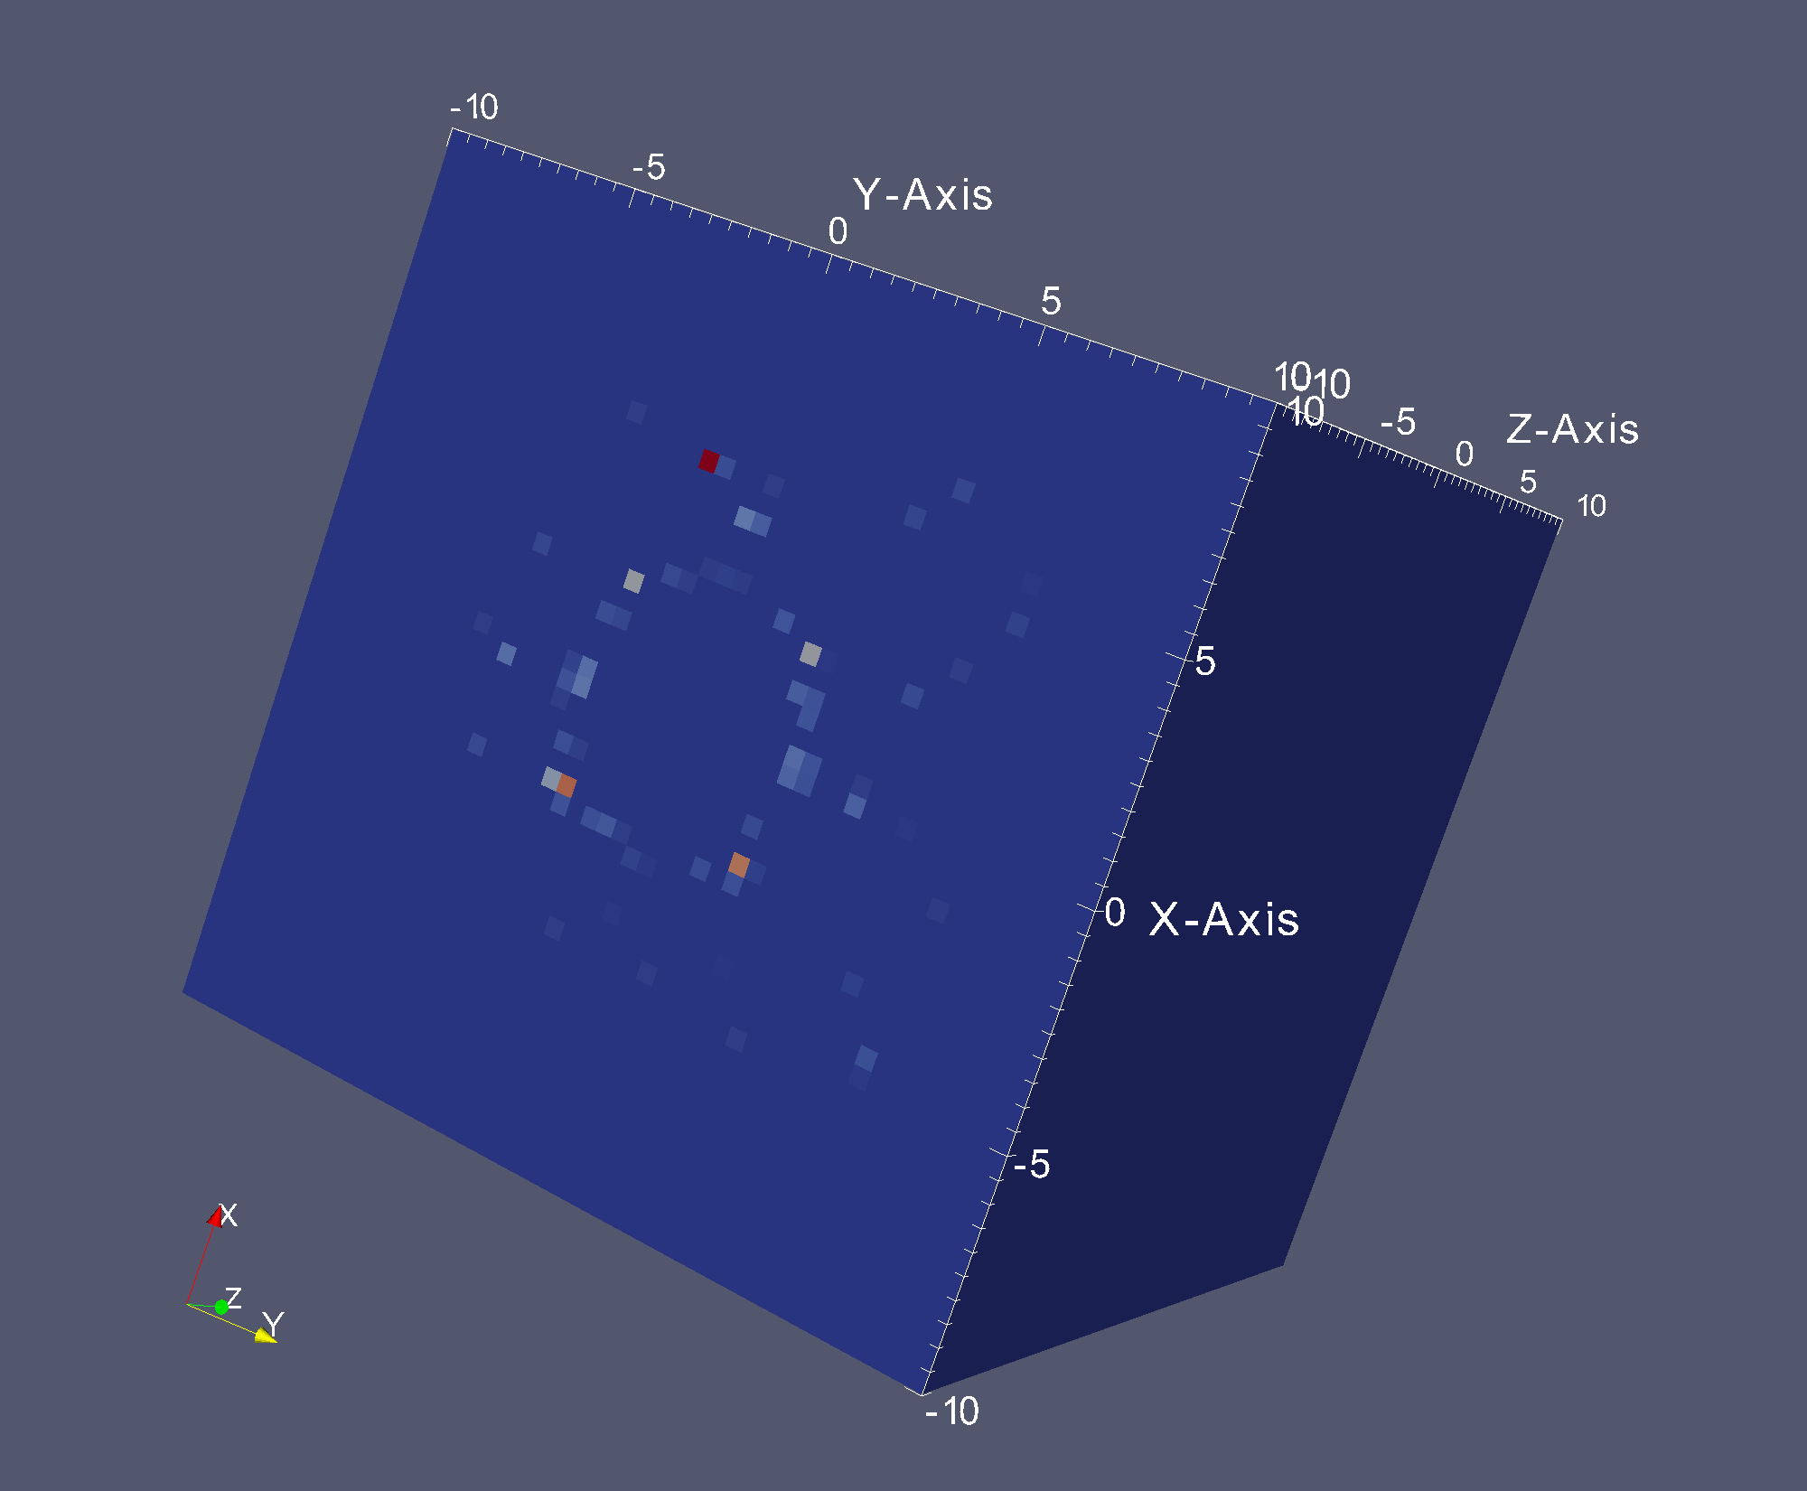
qx -10 to 10 (1/Å)
qy -10 to 10 (1/Å)
qx 0 to 500 (meV)
(50 x 50 x 50)

Slide 8
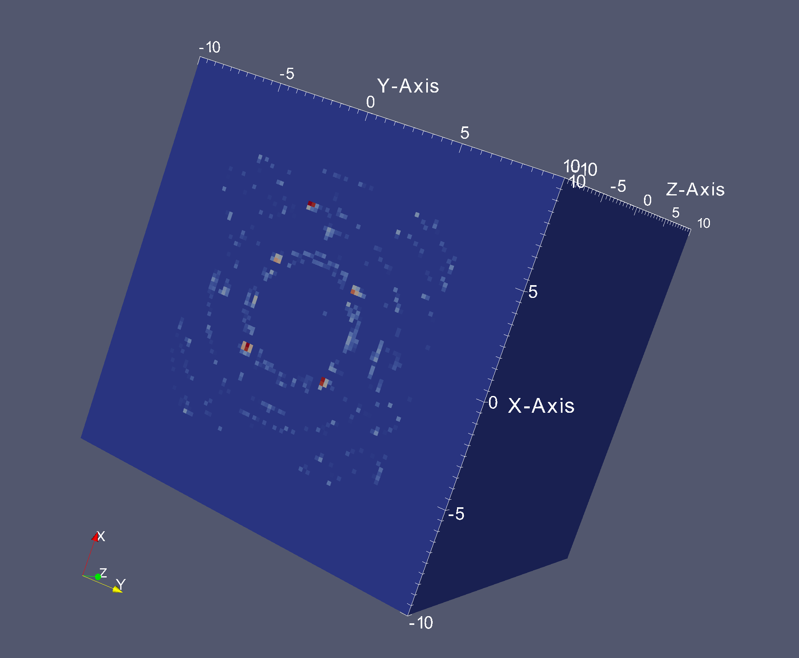
qx -10 to 10 (1/Å)
qy -10 to 10 (1/Å)
qx 0 to 500 (meV)
(100 x 100 x 100)

Slide 9
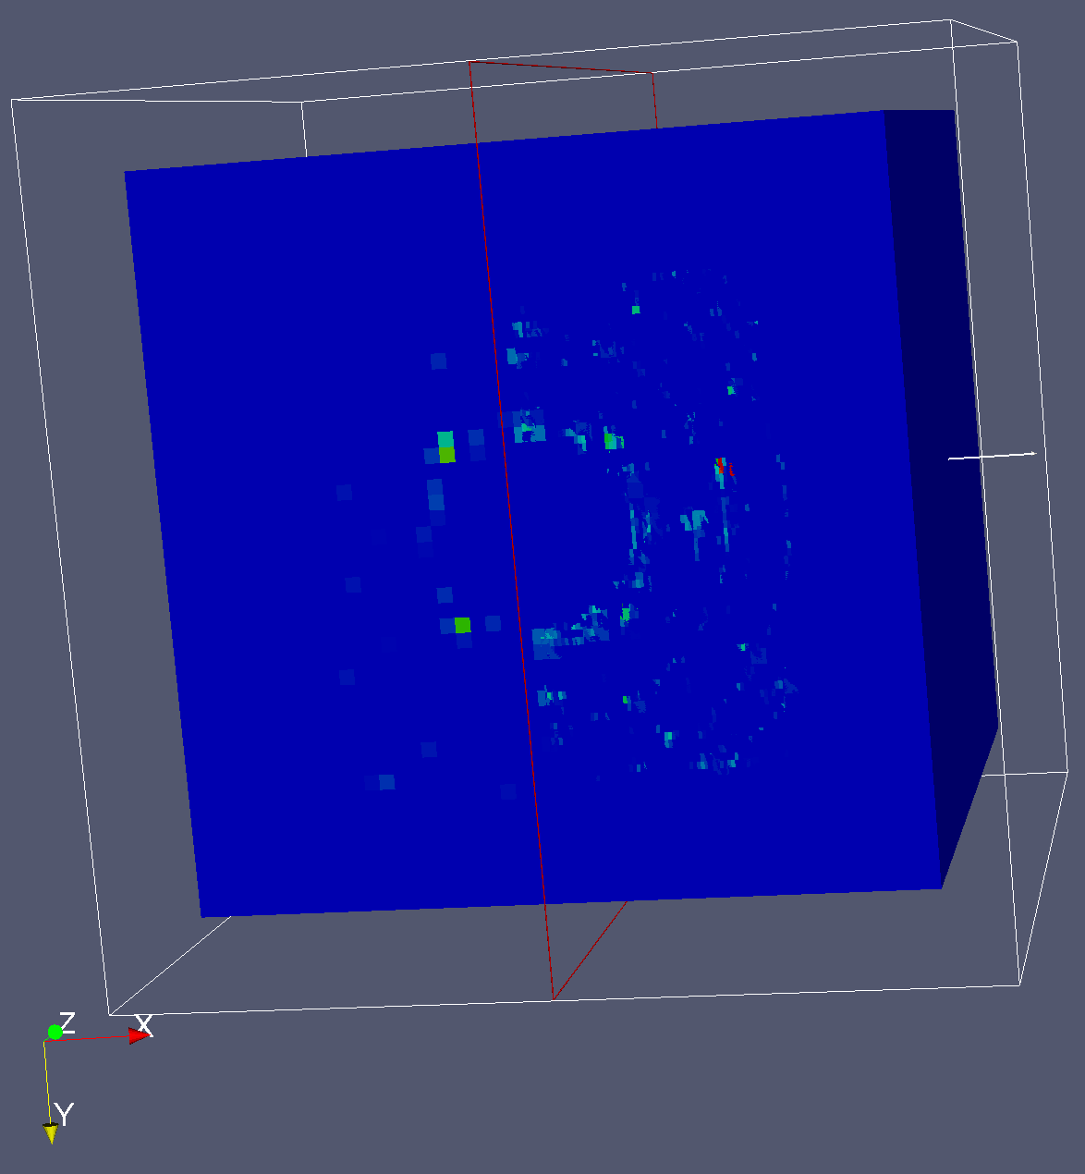
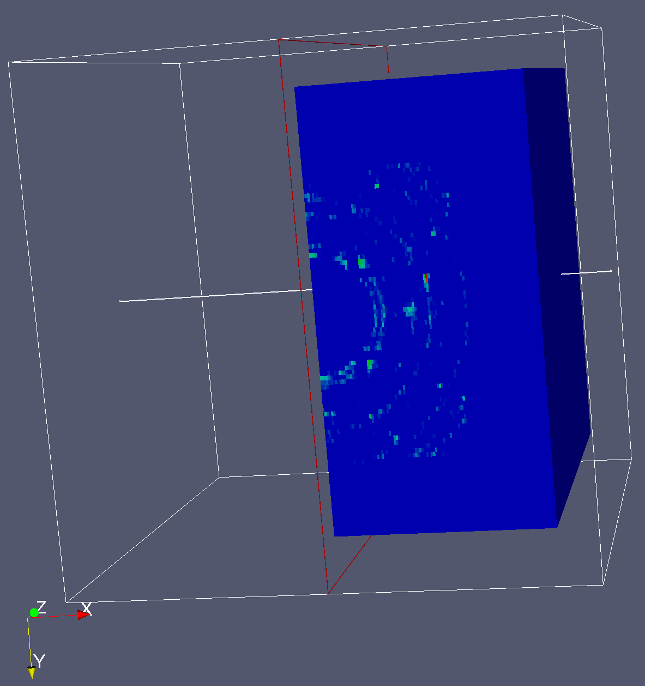

Slide 10
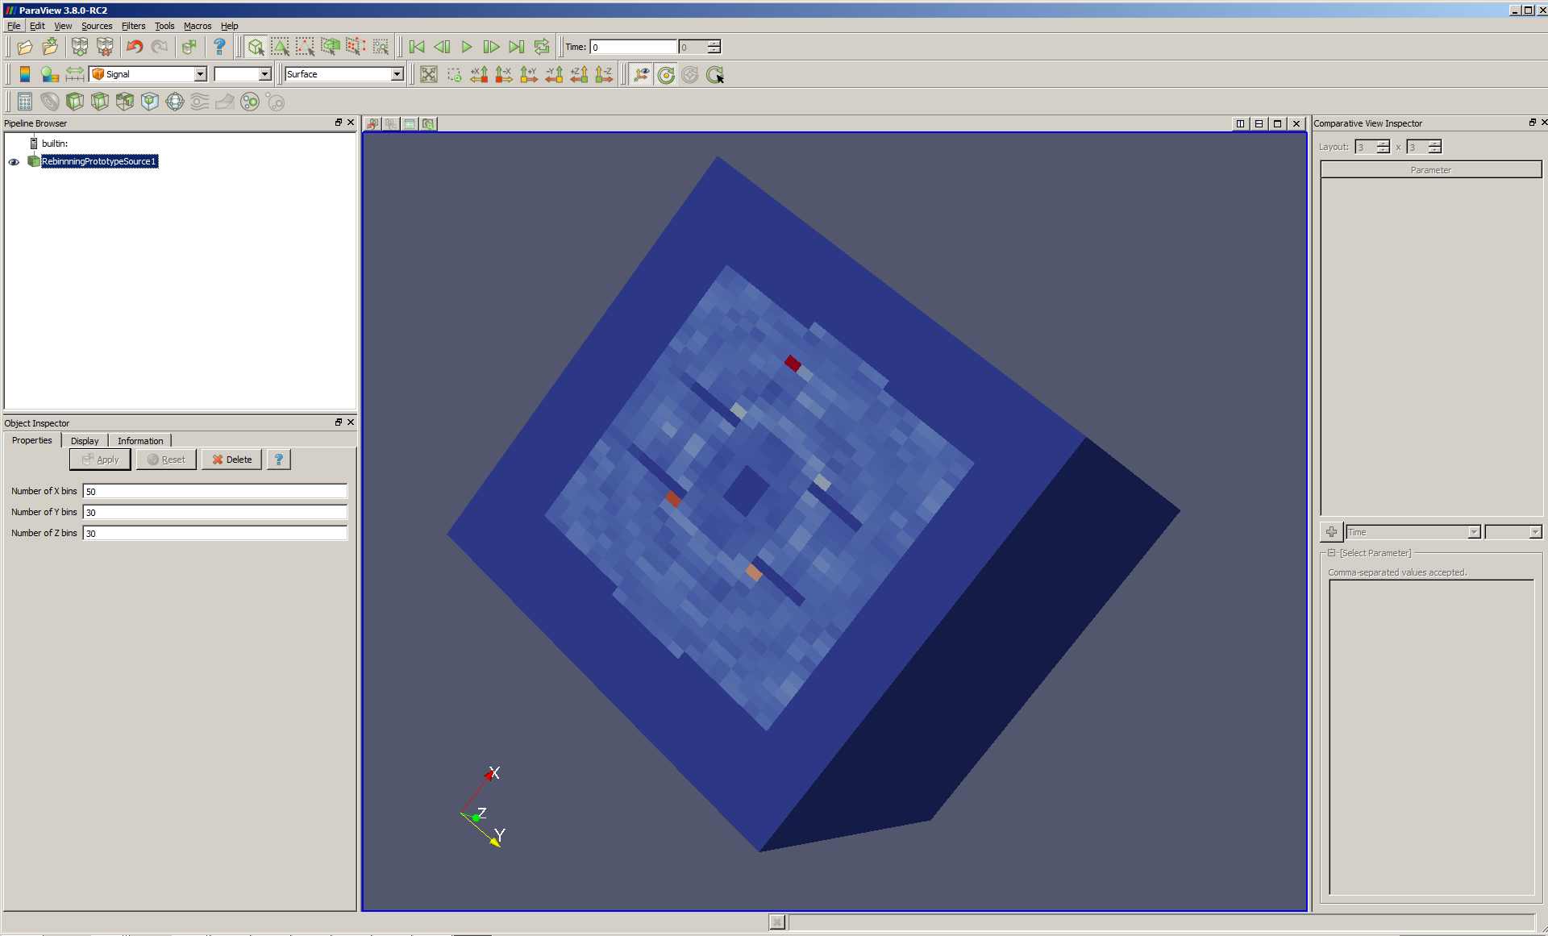

Slide 11
