Slide 1
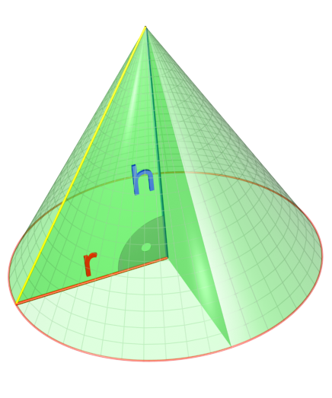
<tip-point />
<angle />
<height />
<axis />

