Slide 1
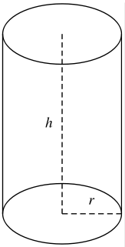
<height />
<axis />
<radius />
<centre-of-bottom-base />

