Slide 1


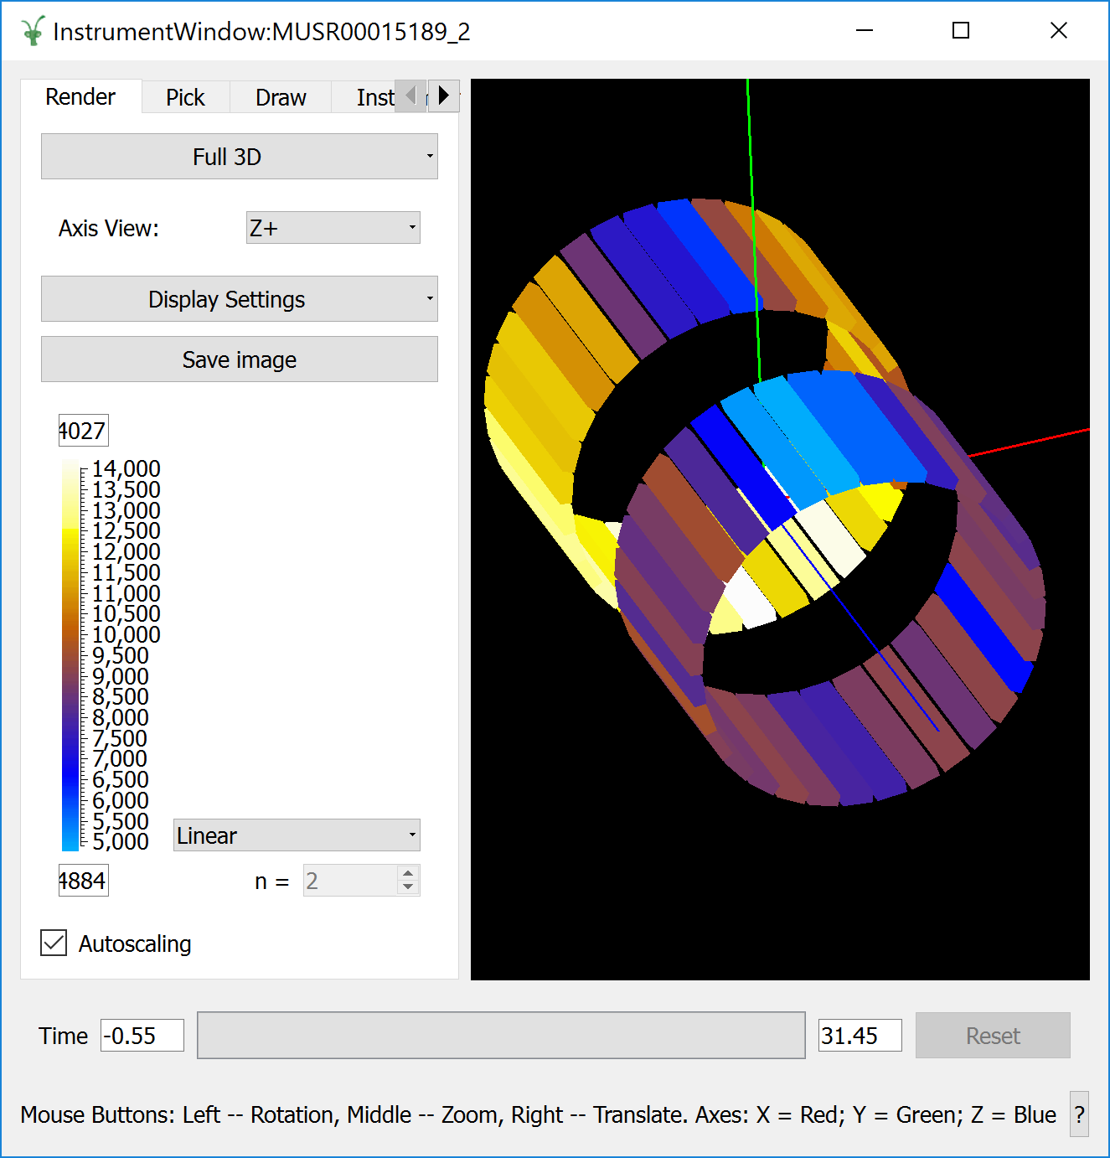
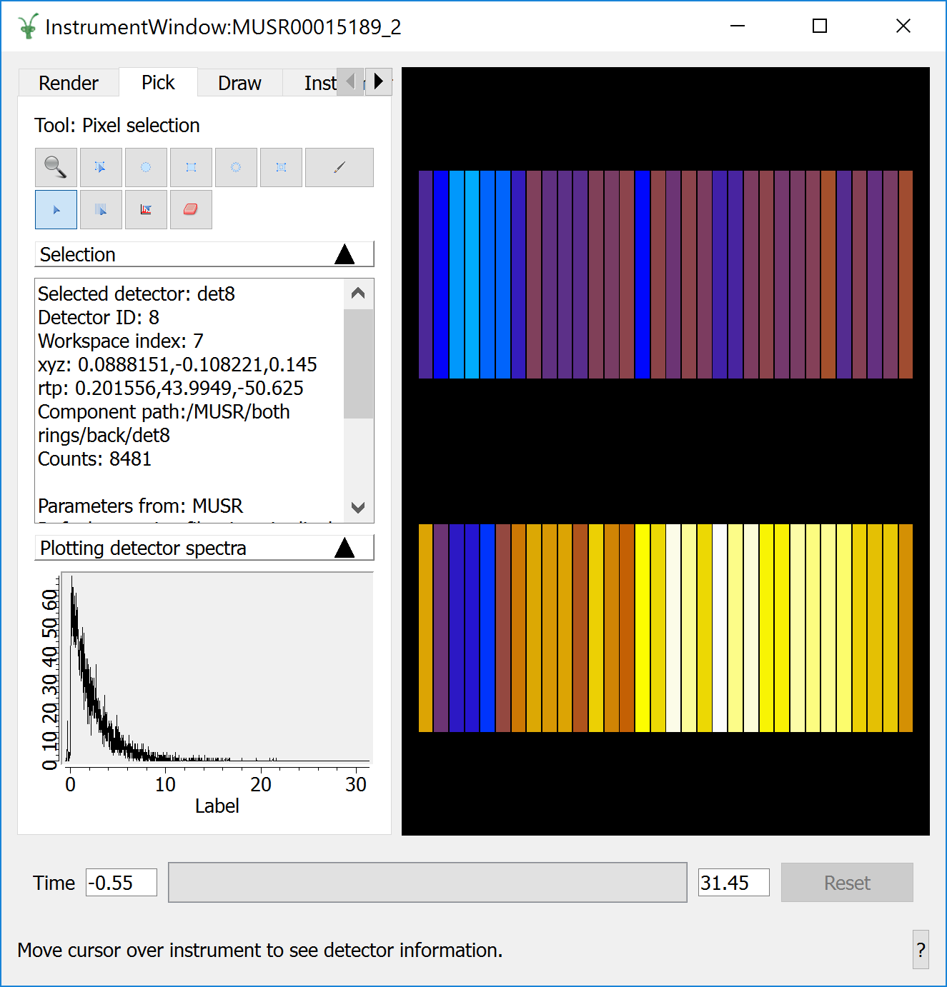
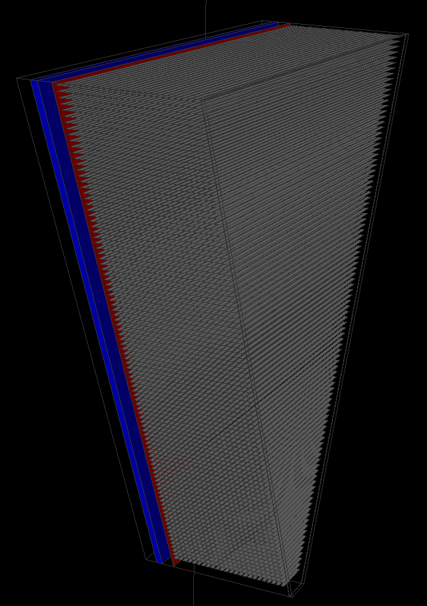
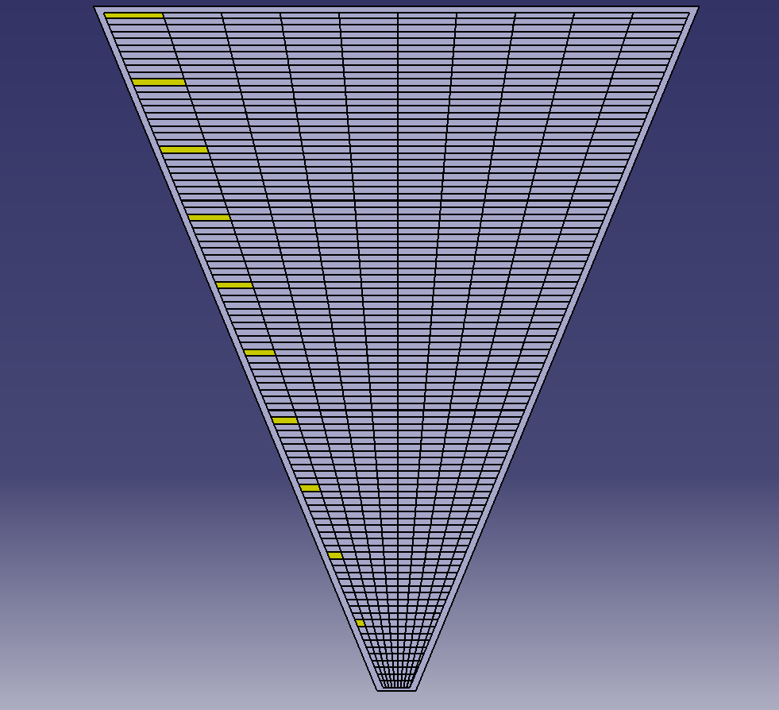
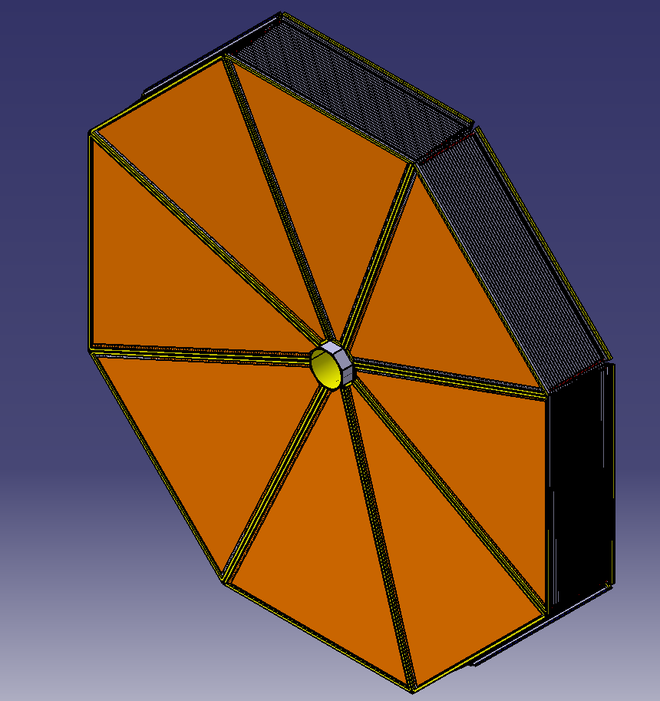
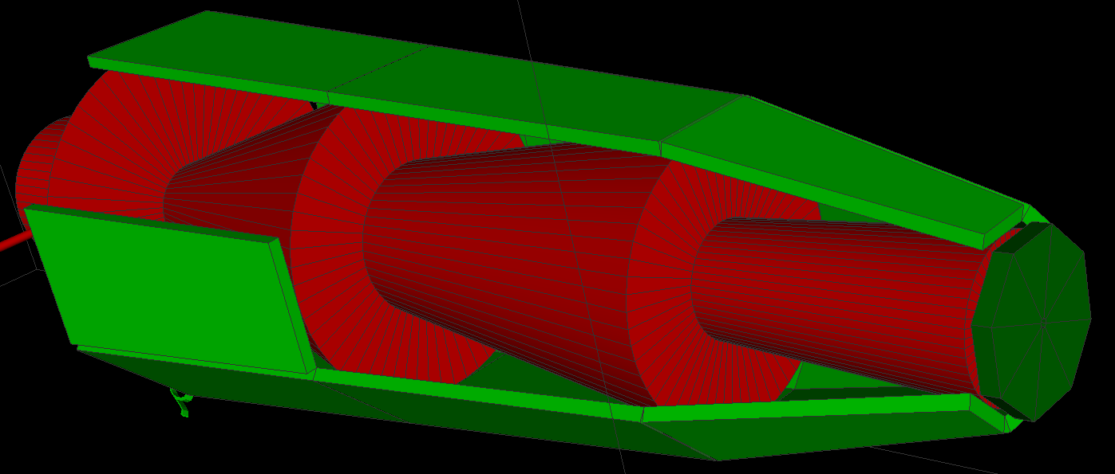
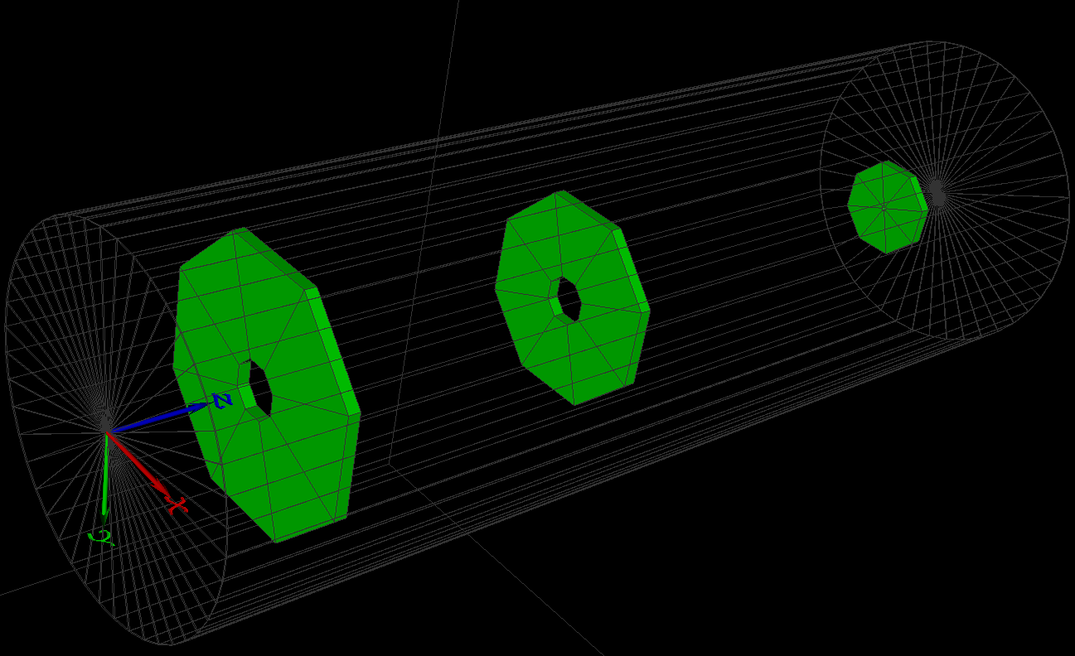
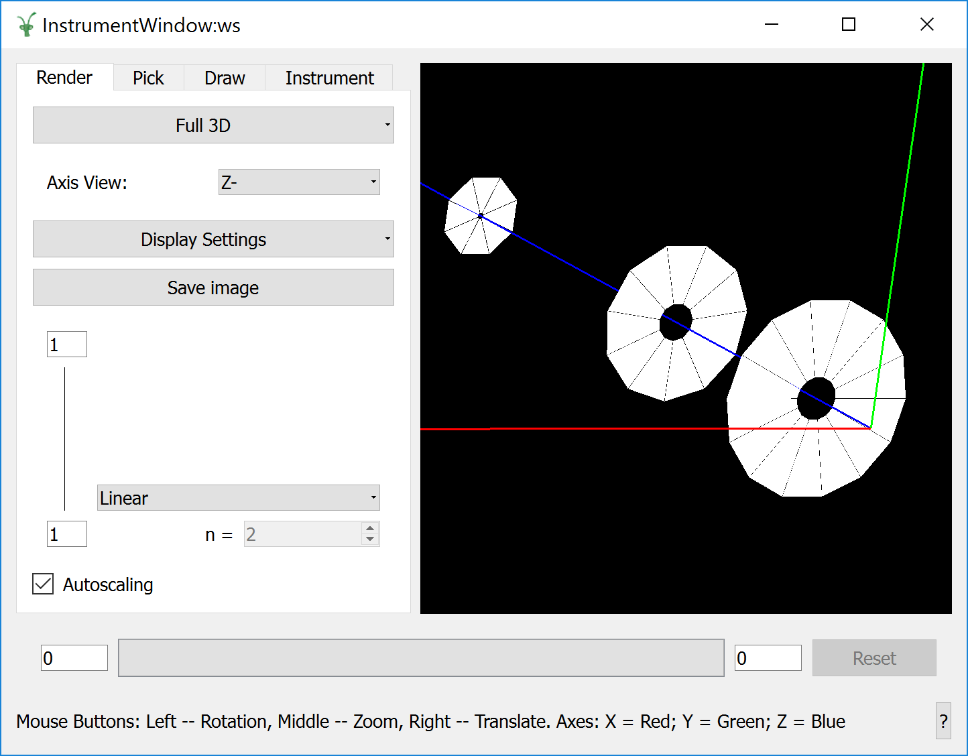
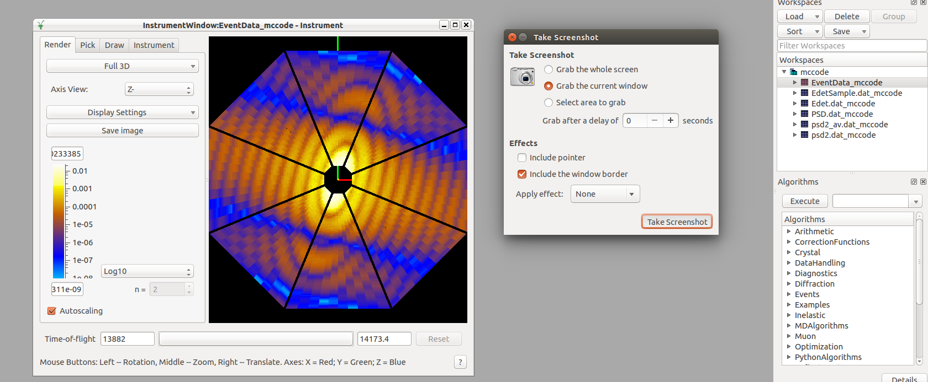
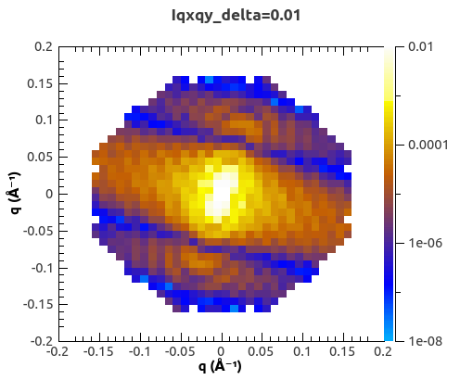
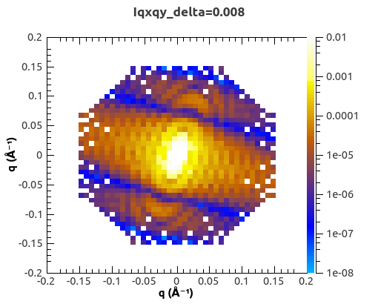
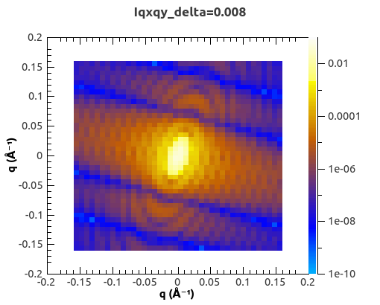
Data Reduction and Simulation for Novel Detector Geometries in Mantid
Lamar Moore, Owen Arnold, Kelly Kanaki, Torben Nielson, John Tylor, Michael Hart
The Mantid Framework
The Mantid framework is the industry standard for data reduction and visualization of neutron data. Currently in use at ISIS, SNS and ILL, this software platform was the logical choice for live data reduction at the ESS.
Mantid contains the instrument view tool for the visualization of data in 3D detector space.
Virtual instruments are defined using an XML format known as the instrument definition file (IDF).
Useful for commissioning instruments in verifying functionality of detectors.
Will be used as a service as part of the live reduction/visualization chain at the ESS.
Currently interoperable with MCSTAS neutron ray-tracing simulation tool.
Ray-tracing simulations, along with virtual instruments can be exported from the MCSTAS tool for use Mantid in the NeXus file format.
The LOKI Challenge
The LOKI instrument, for boadband Small Angle Neutron Scattering Experiments presented a major challenge for the current instrument visualization tool in Manitd which was unable to cope with the complexity of geometry presented by this instrument:
Each detector panel contains ~500-1000 individual detectors.
Each detector is uniquely shaped. src/Mantid/MantidDock.h
There will be at most 8 sectors per detector bank.
With a maximum of 3 detector banks this means ~2700 total detectors.
Initial tests with Mantid, including naïve implementations of the IDF resulted in major performance issues which rendered Mantid unusable for the proposed geometry.
  Virtual instrument load times were on the order of minutes.
  Sluggish instrument view tool.
This challenges exposed deficiencies in the way Mantid handled complex geometries which required major enhancements.
Improvements to Mantid
Introduced the StructuredDetector to the XML format for easier definition of the LOKI instruments.
  StructuredDetector allowed for considerably shorter definitions.
  Individual detectors no longer needed to be defined.
  File sizes reduced from 8MB to a few KB for the full LOKI definition.
  The StructuredDetector is fully parameterizable and can be generated using a python script.
Updated underlying codebase for loading instruments so the structured detector could be constructed and loaded faster.
  Introduced special case for loading StructuredDetector IDFs into Mantid quickly.
  Detector geometry constructed in memory at run-time.
  Drawing hexahedral primitives handles separately without unnecessary triangulation as was done previously.
  File load times reduced to ~2 seconds down from minutes for Structured Detector and legacy definiton of LOKI.
  Faster navigation of the instrument view.
Progress and Future work
The MCSTAS team is currently exporting simulation data from MCSTAS in order to iteratively test the data reduction workflow in Mantid. This involved:
  Modifying the instrument parameters for the ray-tracing simulation in MCSTAS, then exporting the new data and virtual instrument to Mantid.
  Loaded the new data into Mantid, the data reduction workflow can be tested using the new dataset.
Further work to improve compatibility between MCSTAS and Mantid must be undertaken.
  This includes bidirectional instrument geometry exports with a mechanism for defining the StructuredDetector type specifically.
Introducing the concept of voxel detectors to the Structured Detector.
Account for pad spacing in detector banks more accurately.
Improvements in solid angle calculations for StructuredDetector.
For more information: Lamar Moore (lamar.moore@stfc.ac.uk)
Owen Arnold (owen.arnold@stfc.ac.uk)
www.stfc.ac.uk

