Slide 1
Mantid: Performance of Building and Binning MDEvents
Janik Zikovsky
April 8th, 2011

Slide 2
“Boxing” parameters
MDEventWorkspace’s use recursively gridded “boxes” to implement Adaptive Mesh Refinement.
The important parameters are:
  SplitInto: How many boxes in each dimension.
  SplitThreshold: How many MDEvents in a box before it should split into several.

Slide 3
Create a MDEventWorkspace
Starting from TOPAZ_2511 run with 25 million events, ~ 1 million pixels.
Convert to reciprocal space (3D) MDEventWorkspace.

Slide 4
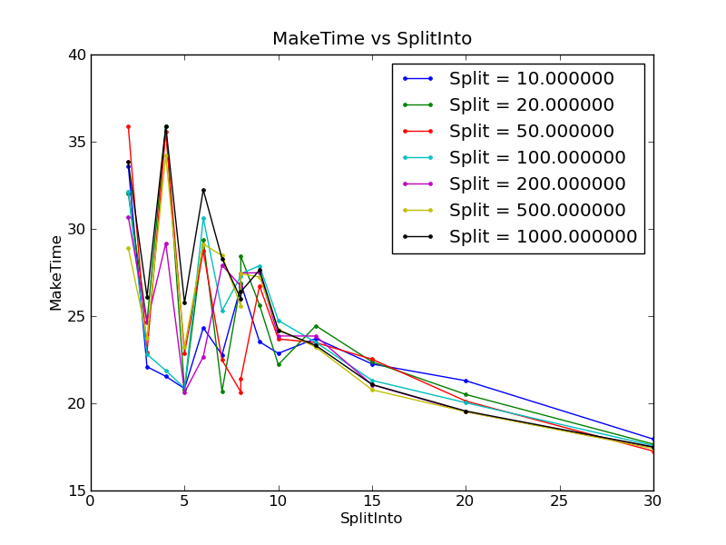
Time To Create MDEventWorkspace
In general, it takes longer for coarser splitting (small SplitInto parameter)

Slide 5
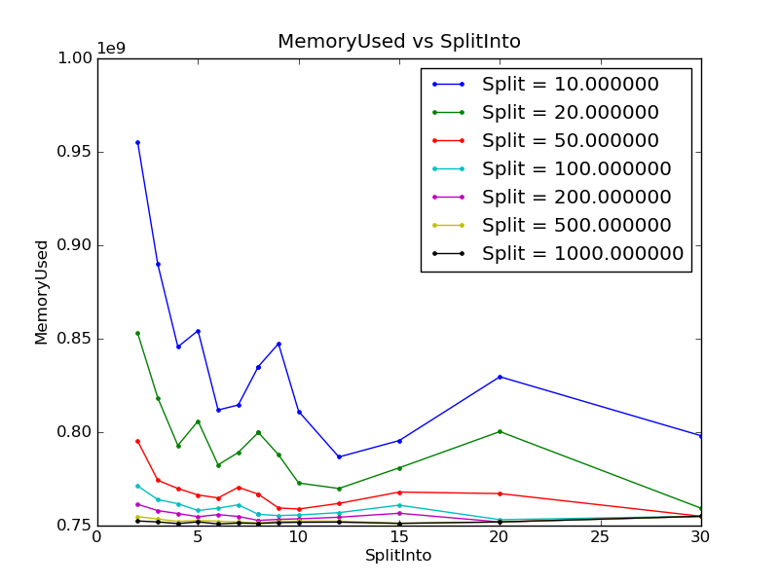
Memory Used
Small SplitInto and few events per box (small SplitThreshold) means more MDBoxes are created = extra memory required.
Reasonable parameters: ~5% memory overhead from MDBoxes.

Slide 6
Binning Procedure
Starting from the MDEventWorkspace, the time to perform “binning” (summing up events into 3D histogram bins) was calculated.
Centerpoint binning

Slide 7
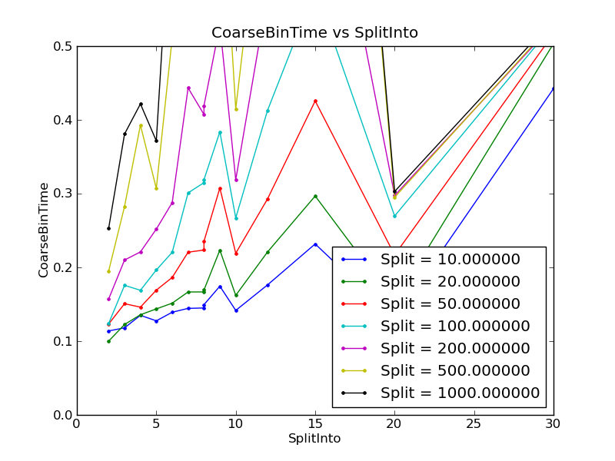
Coarse Binning
20x20x20
Very quick for almost any parameters.

Slide 8
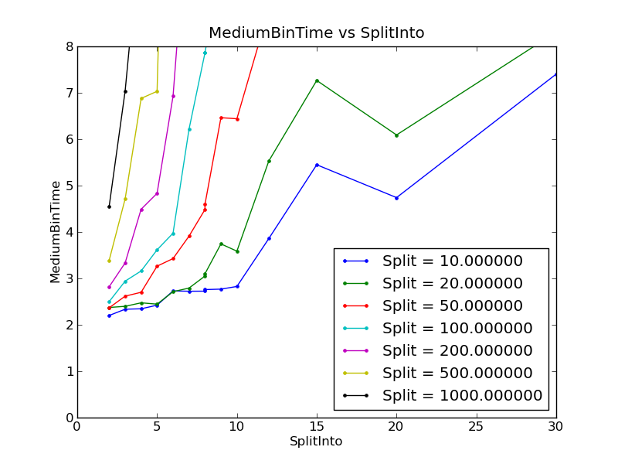
Medium Binning
100x100x100
Strong dependence on the SplitThreshold: a large threshold means fewer, large MDBoxes. Each histogram bin then has to iterate over many more events to find which belong to it.
Optimal parameters: SplitInto = 5 or so
Threshold = 10-20 events per fine box.

Slide 9
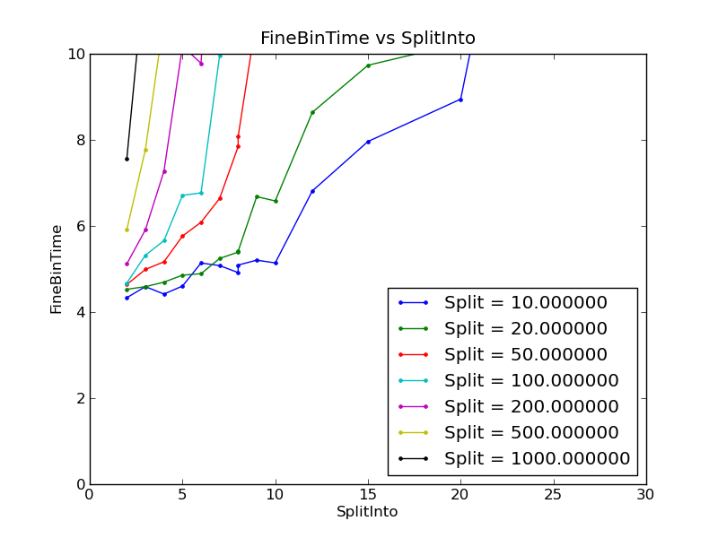
Fine Binning
100x100x100, zoomed in on a smaller volume.
We see that if the split threshold is too high, then each fine bin is iterating through possibly 1000s of events – a different algorithm (going through events and placing them in bins) would be more efficient.

Slide 10
Conclusions
The optimal parameters are: splitting into ~ 5x5x5 boxes when the number of MDEvents reaches ~10-20 events per split box.
The time to create MDEventWorkspaces with more events should be ~ linear with the number of events.
But I expect that binning time will be sub-linear with the number of events (as Boxes get smaller due to more events, fewer events will need to be iterated over). For example, binning to 200³ bins:
  25 million events: 12.47 sec
  50 million events: 12.70 sec
  75 million events: 13.13 sec

