Slide 1
Mantid: Performance of Building and Binning MDEvents,
Using The Binary Splitting Method
Janik Zikovsky
May 27th, 2011

Slide 2
“Binary Splitting” Method
Events are added to a “MDSplitBox” class.
When the number of events exceeds a split threshold, the box is split along the middle in 2 parts (left/right).
  The dimension to split is picked as the one with the widest variation.
  The split point along that dimension = the mean of the events along that dimension.
The important parameter is:
  SplitThreshold: How many MDEvents in a box before it should split into several.

Slide 3
Create a MDEventWorkspace
Starting from TOPAZ_2511 run with 25 million events, ~ 1 million pixels.
Convert to reciprocal space (3D) MDEventWorkspace.

Slide 4
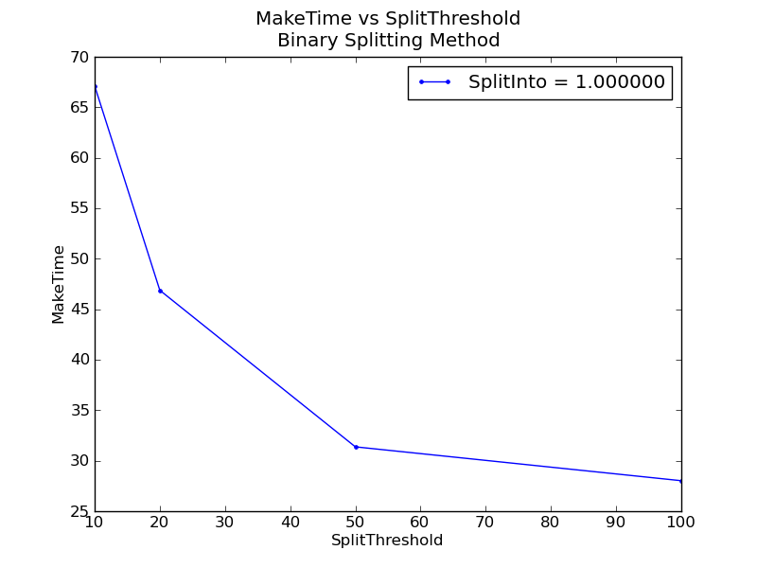
Time To Create MDEventWorkspace
Higher threshold = far fewer boxes and less recursion, which can be done faster.
Somewhat slower than grid boxing, except at small thresholds.

Slide 5
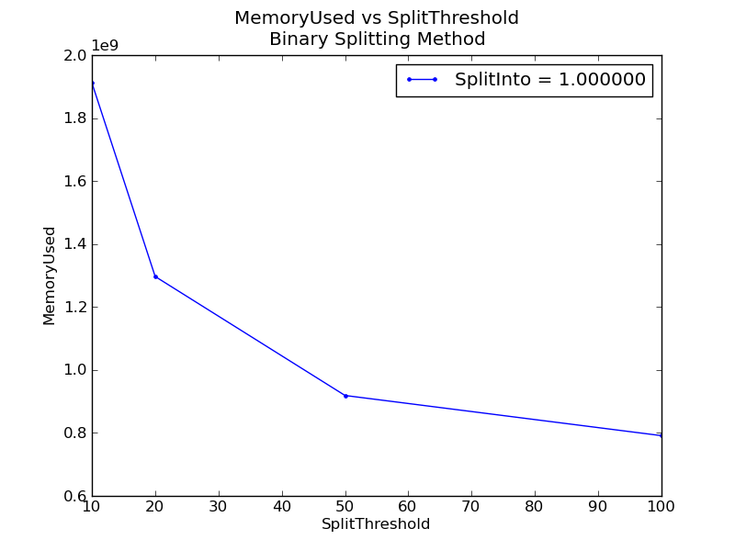
Memory Used
Small threshold = very deep recursion (>~50 levels), meaning lots and lots of MDSplitBoxes.
This means memory used can be large.
At threshold of ~50 it is comparable to the grid method.

Slide 6
Binning Procedure
Starting from the MDEventWorkspace, the time to perform “binning” (summing up events into 3D histogram bins) was calculated.
Centerpoint binning

Slide 7
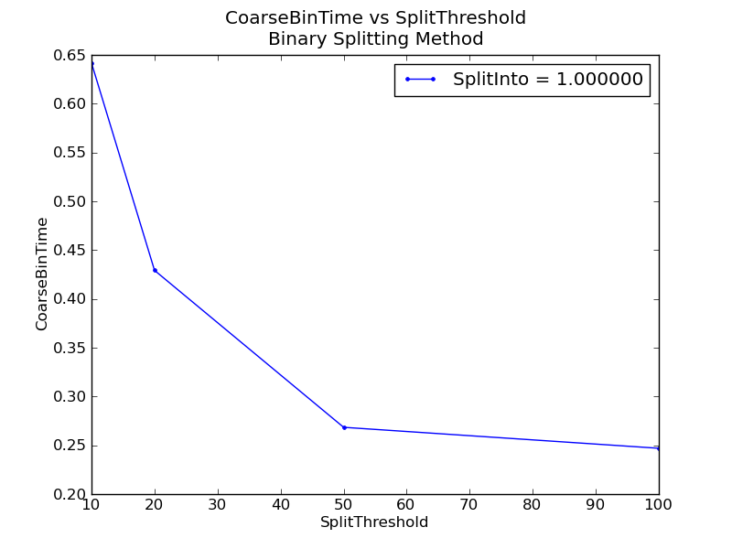
Coarse Binning
20x20x20
Very quick for almost any parameters.
The finer split one means it needs more recursion before getting to the right spot = slower at small thresholds.
Same or slower than grid “boxing”.

Slide 8
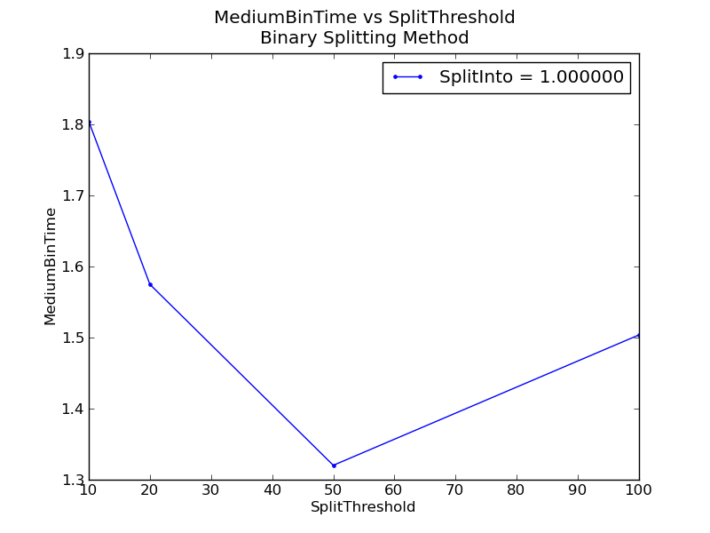
Medium Binning
100x100x100
Faster in general by 10 – 40 % than the grid “boxing”.

Slide 9
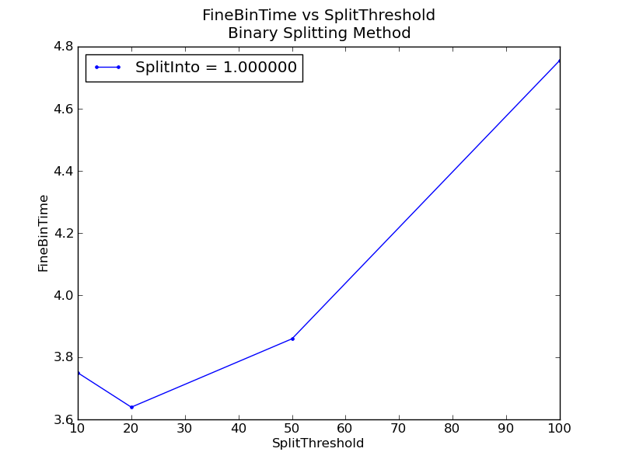
Fine Binning
100x100x100, zoomed in on a smaller volume.
Reverse behavior: rather than recursion slowing down the process, it is iterating through lots of events that is slowing it down.
Somewhat faster than grid boxing.

Slide 10
Conclusions
The optimal parameters are: splitting into ~ 5x5x5 boxes when the number of MDEvents reaches ~10-20 events per split box.
The time to create MDEventWorkspaces with more events should be ~ linear with the number of events.
But I expect that binning time will be sub-linear with the number of events (as Boxes get smaller due to more events, fewer events will need to be iterated over). For example, binning to 200³ bins:
  25 million events: 12.47 sec
  50 million events: 12.70 sec
  75 million events: 13.13 sec

