Slide 1
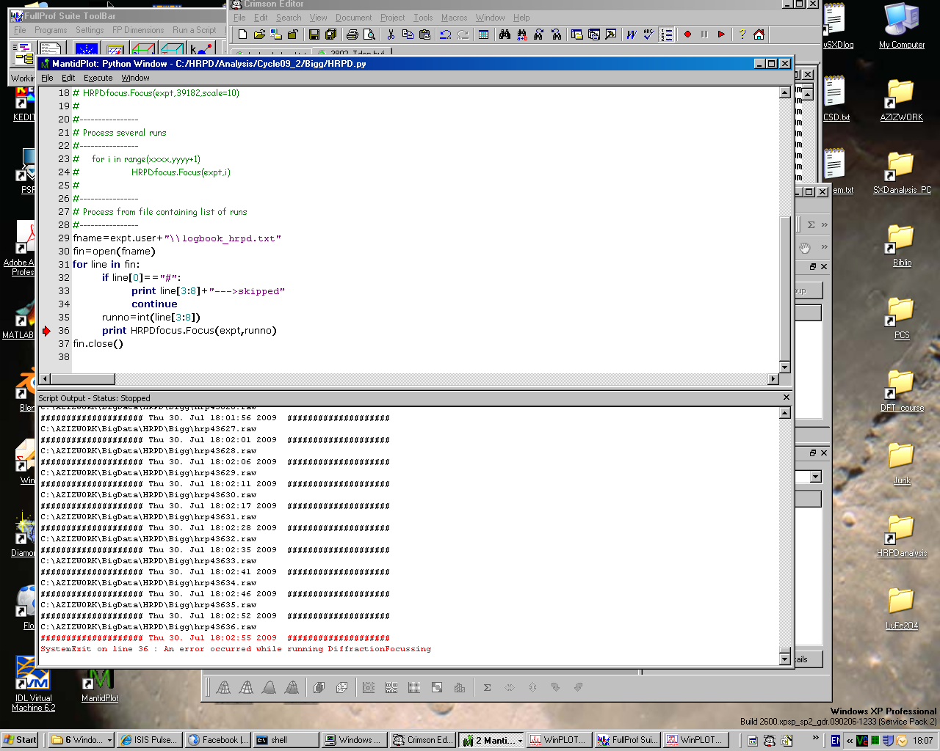
-> Runs taken from this logbook file,
In this extreme case, it lists ~800 files to focus…
Note: If the Data access is on
Small local data repository on my machine
-> processing takes ~6sec/run
2) Huge local archive on instrument PC
-> processing takes ~15sec/run
3) LoadRaw on network is still 20~30sec on my machine,
So didn’t tried to use it…
-> Errors happen inducing SystemExit
(here, in DiffractionFocusing)
about every ~300 files

Slide 2
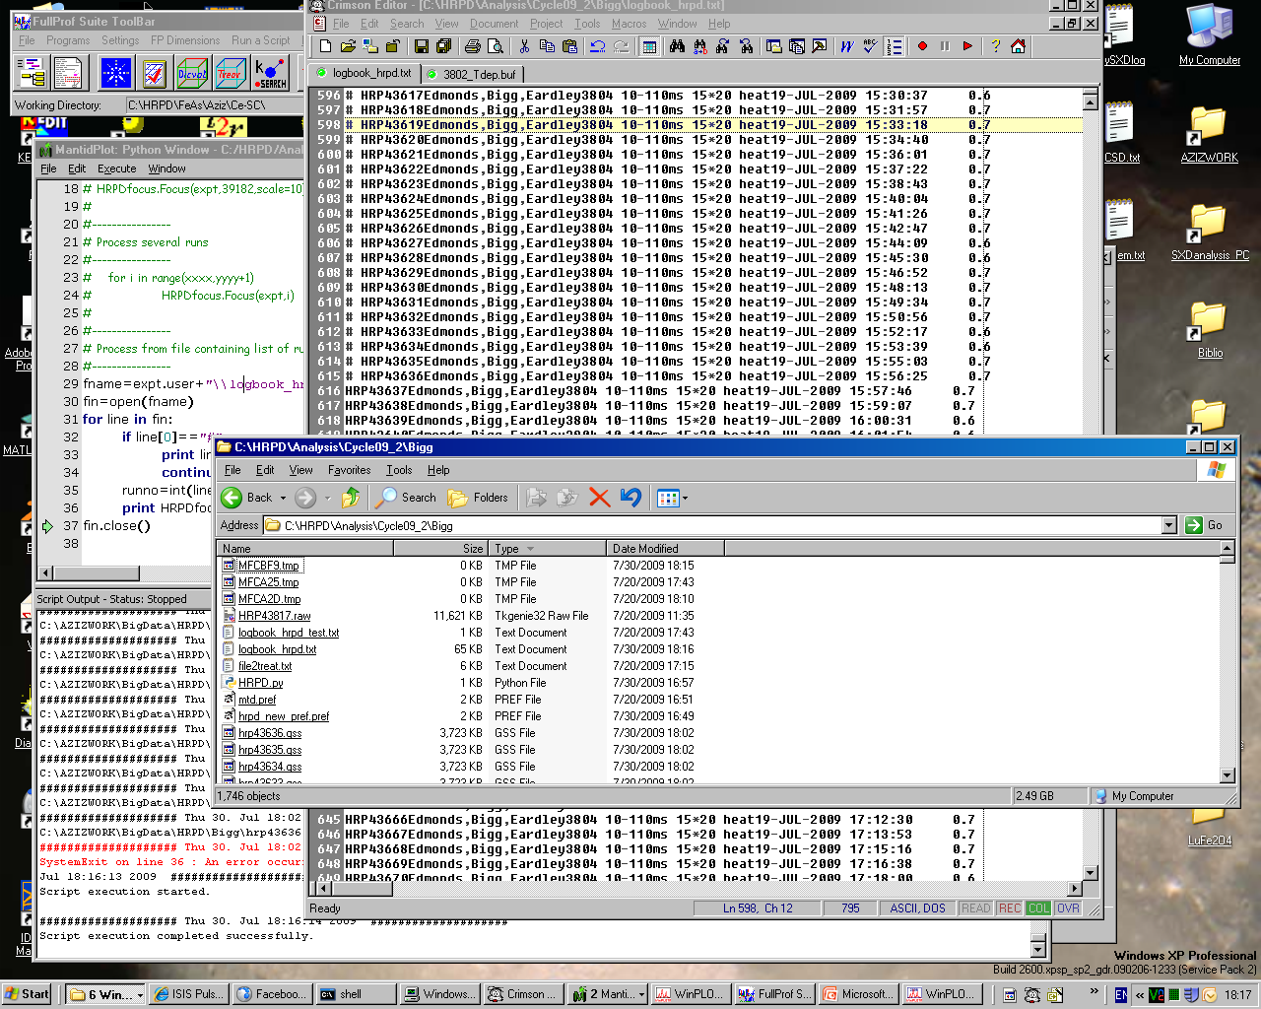
3) Running the script from here =>
Unexpected SystemExit error in
LoadNexusProcessed of the existing
Corrected Vanadium run (see next slide)
2) I’m commenting already treated runs using #
up to last file generated
1) I manually end the script by manually closing the logbook file

Slide 3
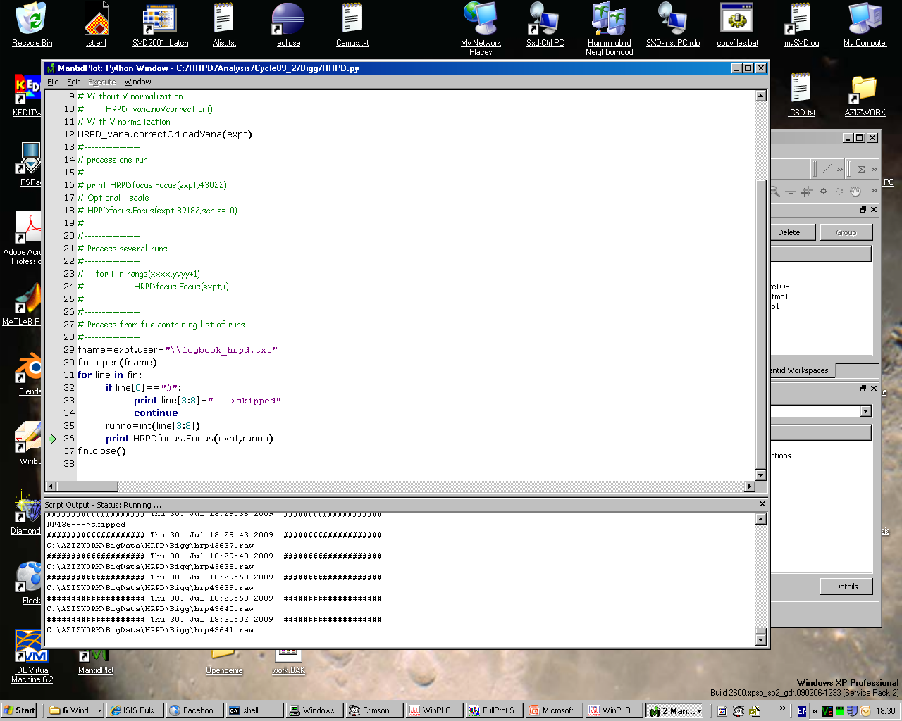
At step 3) Unexpected SystemExit error occurred
Here where the module calls LoadNexusProcessed
4) After closing/reopening Mantid,
The potentially corrupted data (hrp43637.raw)
Is focused properly without error, neither
In LoadNexusProcessed, nor in DiffractionFocusing.
And the loop continues…

Slide 4
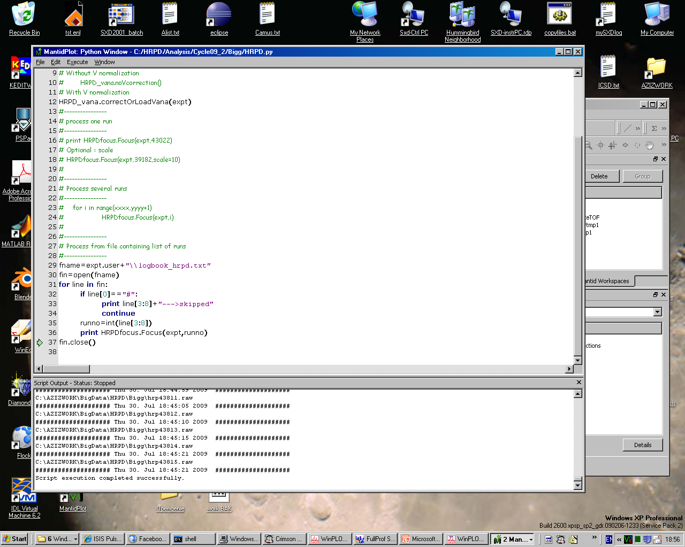
5) In this case, as only <200 runs remains,
the loop continues until the end…

