Slide 1
Vesuvio Mantid calibration

Slide 2
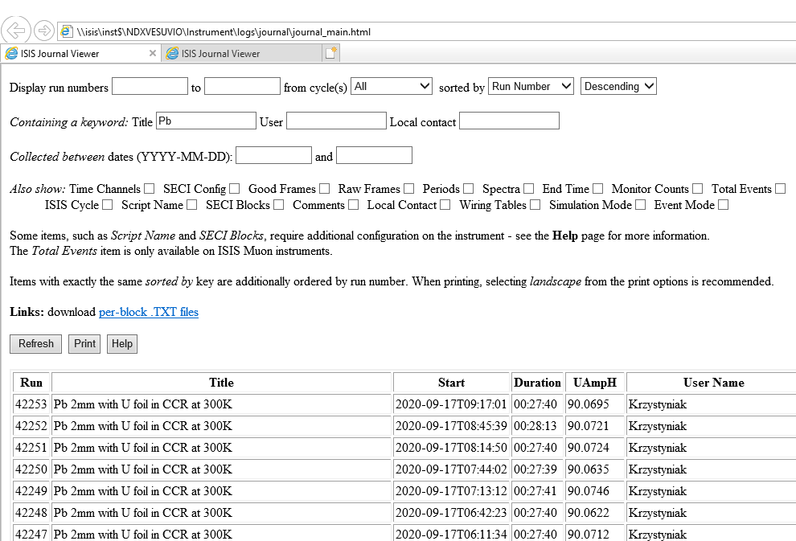
1. Download and install Mantid version: 3.9.2
2. Open and run the calibration script: calibrate_vesuvio_uranium_martyn_MK4.py
3. In Microsoft Internet Explorer (only!) open:
\\isis\inst$\NDXVESUVIO\Instrument\logs\journal\journal_main.html
This will display Vesuvio journal.
In the journal, look for run numbers for V and Pb calibration by typing Pb (V) and using the settings:
It will display the run numbers. They will correspond to different runs with different binning

Slide 3
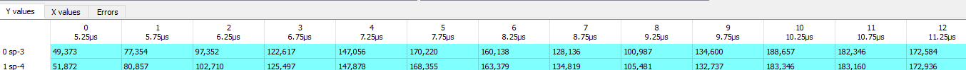

4. The first problem encountered during testing of the script was that not all combinations
of V and Pb runs (corresponding to background and signal, respectively) gave physically
meaningful results:
V runs binning | Pb runs binning | Meaningul results (Y/N)
20 ms, 0.5 us | 20 ms, 0.5 us | Y
40 ms, 0.1 us | 20 ms, 0.5 us | Y
40 ms, 0.1 us | 40 ms, 0.5 us | N
40 ms, 0.1 us | 40 ms, 0.1 us | N
20 ms, 0.5 us | 40 ms, 0.1 us | N
20 ms, 0.5 us | 40 ms, 0.5 us | N
In the table above, the first entry (20/40ms) corresponds to the length of the frame in the TOF domain (which translates into the length of the data vector). The second entry (0.5 us or 0.1 us) corresponds to the bin width for data below 650 us (above 650 us the binning changes from linear to logarithmic to accommodate diffraction data better). Both settings are in DAE section of the instrument dashboard
controlled by IBEX (these are not to be set in Mantid). In the example, below, the LoadVesuvio algorithm with FoilOut used by the script produces the following matrix workspace with 0.5 us binning below 650 us:
and with logarithmic binning above 650 us:

Slide 4
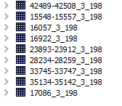
Some of the V and Pb data used in testing are displayed below:
All of them have been obtained using LoadVesuvio Algorithm in Mantid 3.9.2
with the option FoilOut (as described in the previous slide).
(The first number is the run number from the Vesuvio journal,
and the numbers _n_m correspond to the first and last detector number)

Slide 5
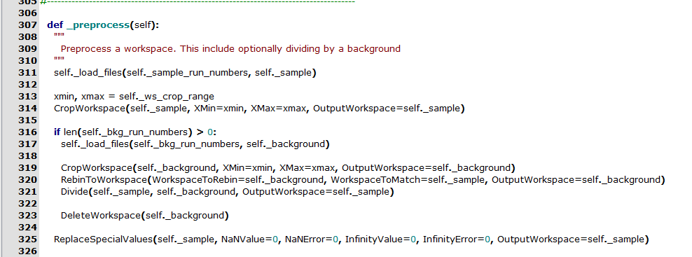
Most likely, the errors reported in table above are caused by the function preprocess:
5. Due to 4, a mitigation strategy has been chosen to avoid non meaningful calibration results.
For bot the sample (Pb) and the background (V) runs, the following specifications should be used:
Both Pb and V should have good statistics (in the region of 900 uAmph or more);
Ideally, both Pb and V should have been recorded using the 20ms frame;
The critical parameter for a successful calibration is the linear binning constant in TOF region below 650 us
in the DAE (IBEX DAE setting). It should be set to 0.5 us or more for both Pb and V runs. Any shorter
binning constant (e.g. 0.1 us) will lead to problems with the Mantid Fit algorithm. The algorithm
will not cope to fit E1 from Pb recoil peaks. It will then propagate as unphysical values of E1 into
the L1 calculation. Both L1 and E1 being unphysical, leads to unphysical values of theta.

Slide 6
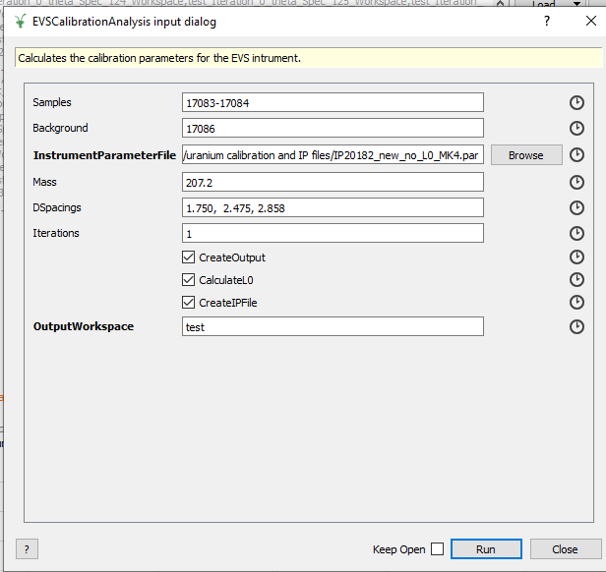
Example
Mantid version: 3.9.2
Calibration scripts: calibrate_vesuvio_uranium_martyn_MK4.py
Variant when L0 and t0 are calibrated
In case CreateIPFile box is ticked, the algorithm saves a .par file with the same name as the
Output workspace into the predefined output directory (usually the same as the input IP file directory)
Pb runs
V runs
Initial instrument
parameter file
Mass corresponding to Pb
D-spacing values
of Pb

Slide 7
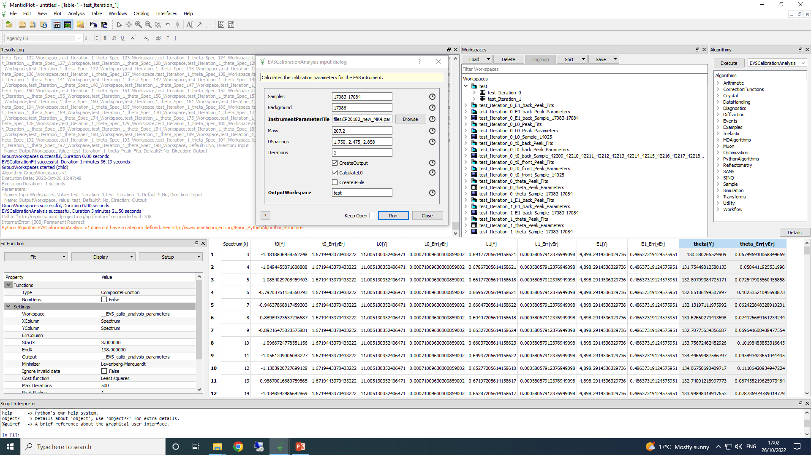
Example
Mantid version: 3.9.2
Calibration scripts: calibrate_vesuvio_uranium_martyn_MK4.py
Variant when L0 and t0 are calibrated
In case CreateIPFile box is ticked, the algorithm saves a .par file with the same name as the
Output workspace into the predefined output directory (usually the same as the input IP file directory)

Slide 8
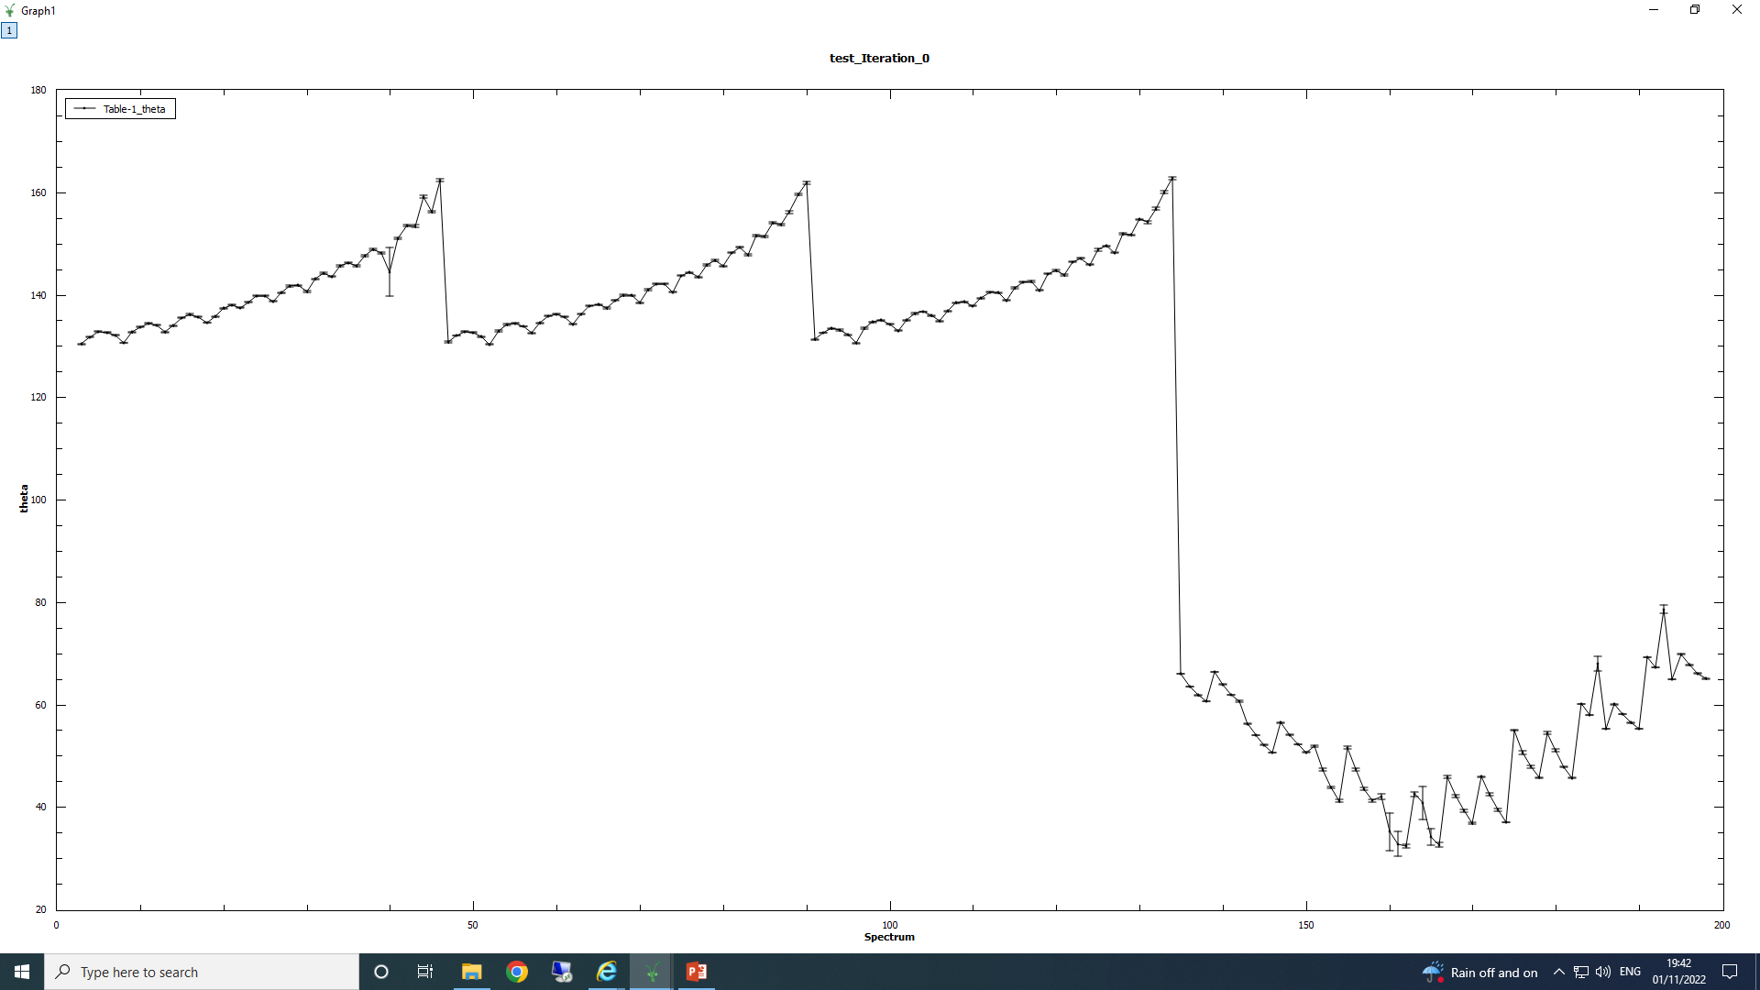
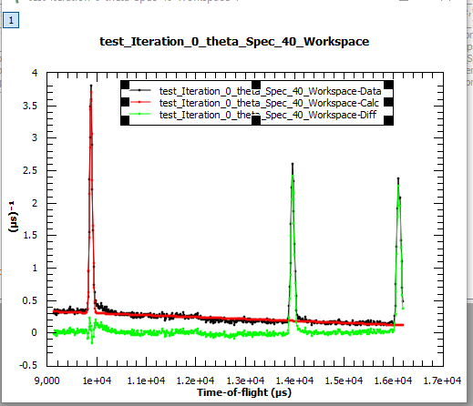
Calibrated values of the scattering angle vs detector numbers
outliers
Outliers are caused by incomplete fits to the diffraction data. In the algorithm, for each peak
above, the Bragg equation is solved for the scattering angle theta. Here, only one out of 3 thetas
are given and thus the statistics is poor (average form one value only).

Slide 9
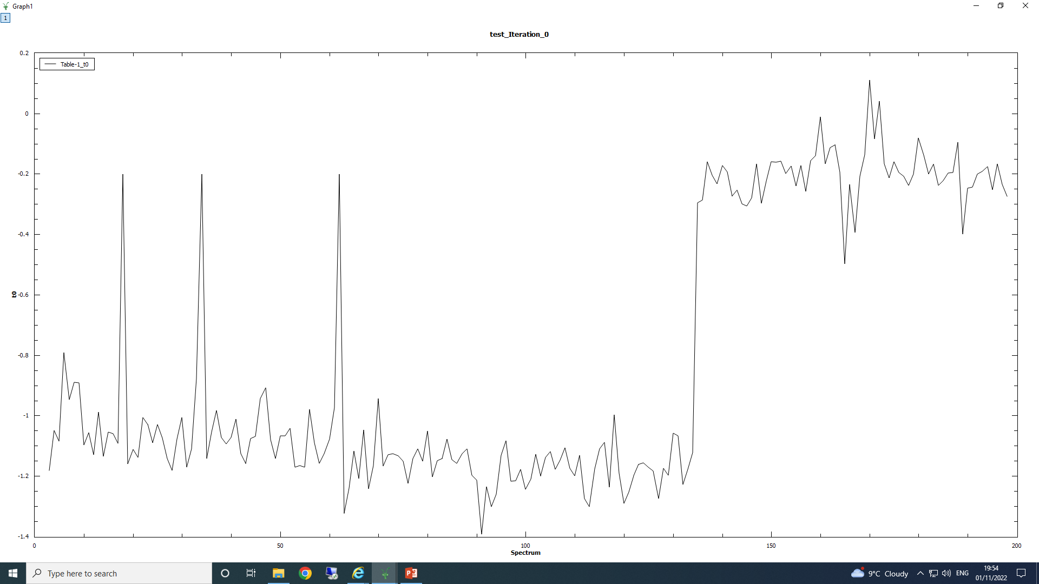
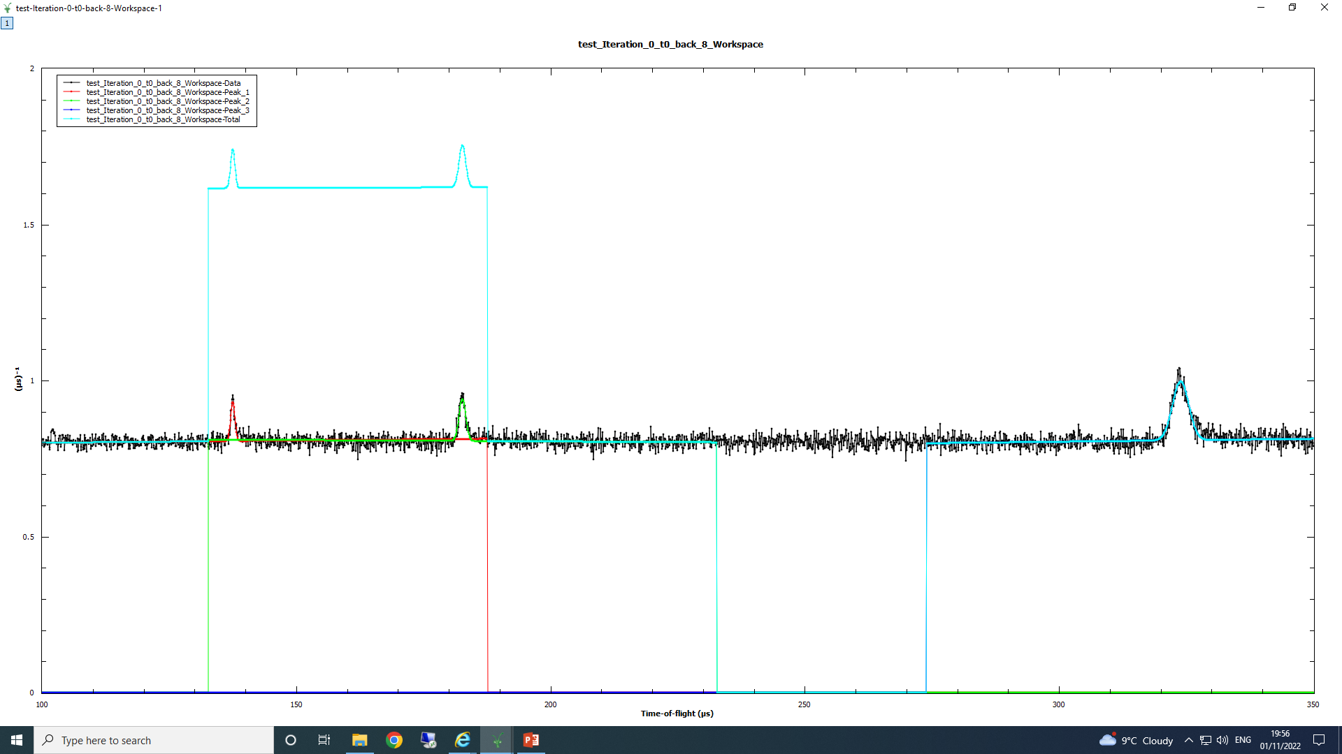
Calibrated values of t0 vs detector numbers
outliers
Outliers are caused by incomplete fits to the resonance data. In the algorithm, for each peak
above, an equation is solved for the value of t0. Here, only one out of 3 equations can be solved
and thus the statistics is poor (average form one value only).

Slide 10
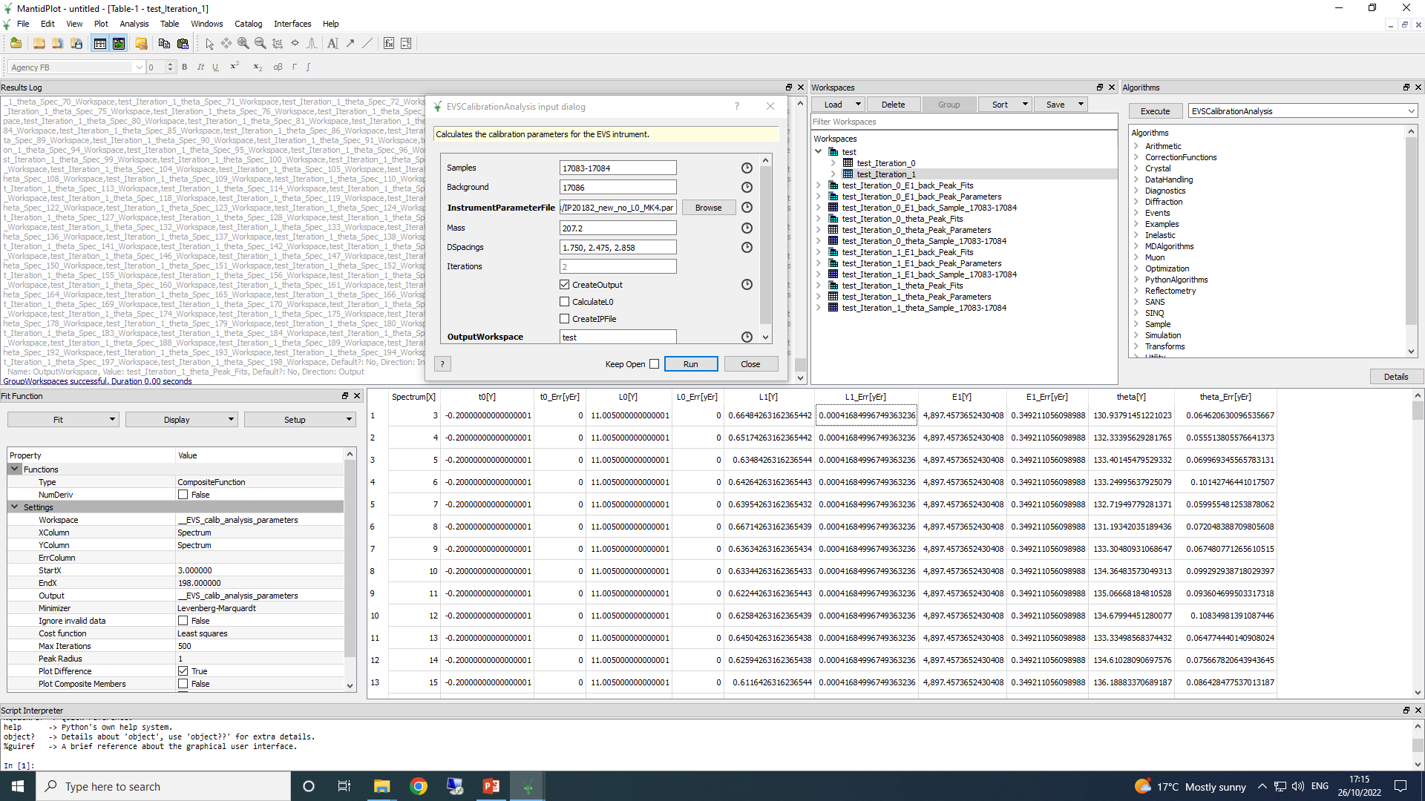
Mantid version: 3.9.2
Calibration scripts: calibrate_vesuvio_uranium_martyn_MK4(5).py
Variant when L0 and t0 are not calibrated, but taken from the initial IP file
In case CreateIPFile box is ticked, the algorithm saves a .par file with the same name as the
Output workspace into the predefined output directory (usually the same as the input IP file directory)

Slide 11
Outlook:
A better peak finder/fitter algorithm can be employed;
The script should be made compatible with the most recent version of Mantid;
The problems with fitting different Vanadium/Pb data sets should be solved;

