Slide 1
Vesuvio calibration
Comparison of old calibration runs with new runs with CCR in the beam

Slide 2
CCR calibration based on Mantid routines
3 different initial starting IP files:
IP0004
IP0005
IP from 2015 survey (CAD) with t0 and L0 columns replaced by values taken from IP0005 file;
Old runs:
run_range = "17083-17084“ - lead
background = "17086“ – Vanadium
New runs:
run_range = "18121-18139“ lead in CCR
background = "17891“ vanadium in CCR

Slide 3
CCR calibration based on VMS Fortran routines.
New runs:
run_range = "18121-18139“ lead in CCR
background = "17891“ vanadium in CCR

Slide 4
Mantid version: 3.9.2
Calibration scripts: calibrate_vesuvio_uranium_martyn_MK4(5).py
Variant when L0 and t0 are calibrated
In case CreateIPFile box is ticked, the algorithm saves a .par file with the same name as the
Output workspace into the predefined output directory (usually the same as the input IP file directory)
Both calibrate_vesuvio_uranium_martyn_MK4(5).py require the sample (Pb) and background (V)
Runs with the following specifications:
Both Pb and V should have good statistics (in the region of 900 uAmph or more);
Ideally, both Pb and V should have been recorded using the same 20ms or 40 ms frame, but
both routines should cope with mixed 20/40ms frames;
The critical parameter for a successful calibration is the linear binning constant in TOF region below 650 us
in the DAE (IBEX DAE setting). It should be set to 0.5 us or more for both Pb and V runs. Any shorter
binning constant (e.g. 0.1 us) will lead to problems with the Mantid Fit algorithm. The algorithm
will not cope to fit E1 from Pb recoil peaks. It will then propagate as unphysical values of E1 into
the L1 calculation. Both L1 and E1 being unphysical, leads to unphysical values of theta.

Slide 5
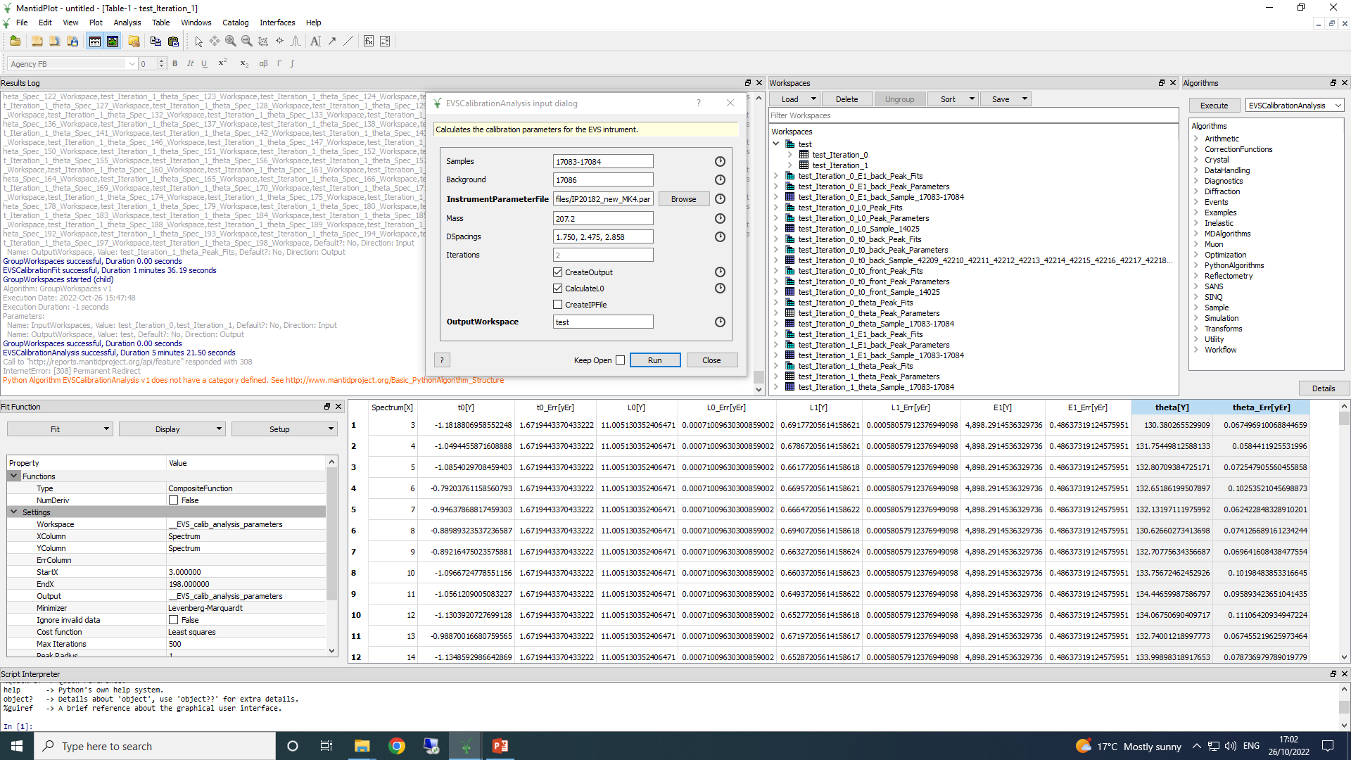
Mantid version: 3.9.2
Calibration scripts: calibrate_vesuvio_uranium_martyn_MK4(5).py
Variant when L0 and t0 are calibrated
In case CreateIPFile box is ticked, the algorithm saves a .par file with the same name as the
Output workspace into the predefined output directory (usually the same as the input IP file directory)

Slide 6
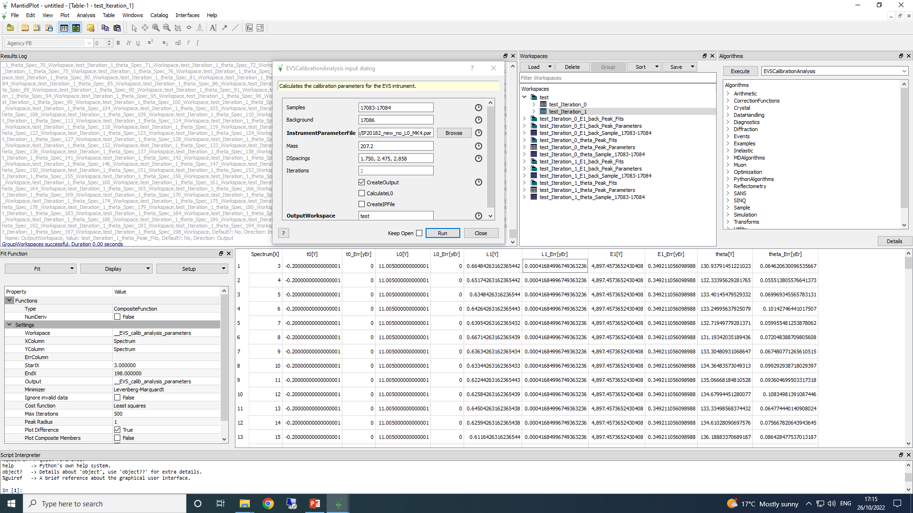
Mantid version: 3.9.2
Calibration scripts: calibrate_vesuvio_uranium_martyn_MK4(5).py
Variant when L0 and t0 are not calibrated, but taken from the initial IP file
In case CreateIPFile box is ticked, the algorithm saves a .par file with the same name as the
Output workspace into the predefined output directory (usually the same as the input IP file directory)

Slide 7
comparison of L1 values from different calibration starting points

Slide 8
comparison of E1 values from different calibration starting points

Slide 9
comparison of theta values from different calibration starting points

Slide 10
comparison of t0 values from different calibration starting points

Slide 11
comparison of L0 values from different calibration starting points

Slide 12
CCR calibration based on VMS Fortran routines – additional information
Setup:
New runs:
run_range = "18121-18139“ lead in CCR
background = "17891“ vanadium in CCR

Slide 13
L0 resolution function
L0res (135-198):
CALCULATE MEAN VALUES
ENTER FIRST AND LAST SPECTRUM NUMBERS
1 64
Wtd Mean dt= 0.3819361 +- 1.1590591E-02
Mean= 0.3282174 St dev= 1.8783847E-02
Wtd Mean dL= 2.292068 +- 7.8573026E-02
Mean= 2.105789 St dev= 9.7702019E-02

Slide 14
L1 and t0 resolution function
ltres (3-90):
ENTER FIRST AND LAST SPECTRUM NUMBERS
3 90
Wtd Mean dt= 0.3905772 +- 1.3227118E-02
Mean= 0.3391633 St dev= 1.7077133E-02
Wtd Mean dL= 3.349169 +- 4.7280148E-02
Mean= 3.328438 St dev= 6.0077030E-02
Enter value of DL0
2.29
Wtd Mean dL1= 2.399815 +- 4.7280148E-02
Mean DL1= 2.415675 St dev= 7.9949789E-02
PLOT DL1 VALUES (1),DT VALUES(2),NO PLOT (0)
ltres (91-134)
CALCULATE MEAN VALUES
ENTER FIRST AND LAST SPECTRUM NUMBERS
1 44
Wtd Mean dt= 0.3957492 +- 1.8820470E-02
Mean= 0.3413751 St dev= 2.5977572E-02
Wtd Mean dL= 3.205979 +- 7.0191704E-02
Mean= 3.098940 St dev= 8.7278746E-02
Enter value of DL0
2.29
Wtd Mean dL1= 2.192405 +- 7.0191704E-02
Mean DL1= 2.197295 St dev= 0.1087550
PLOT DL1 VALUES (1),DT VALUES(2),NO PLOT (0)

Slide 15
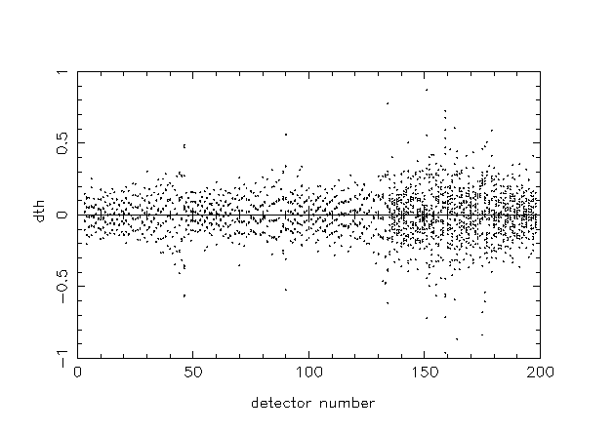
Deviations from the mean of the values contained in
Pb Bragg peaks in runs 18121-18138

Slide 16
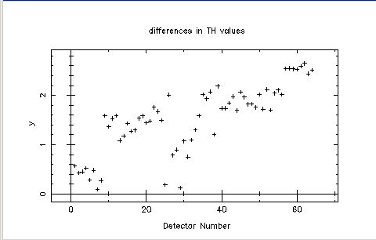
Differences in L0, L1, t0 values between the first and the second iteration of the calibration
are minimal. Only the difference in calibrated values of scattering angles are shown:
Detectors 135-198 (1-64) in forward scattering:

Slide 17
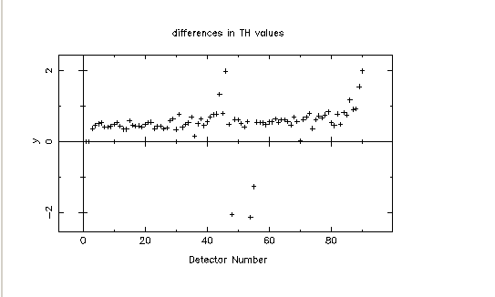
Differences in L0, L1, t0 values between the first and the second iteration of the calibration
are minimal. Only the difference in calibrated values of scattering angles are shown:
Detectors 3-90 in back-scattering:

Slide 18
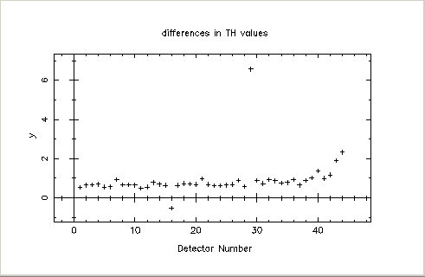
Differences in L0, L1, t0 values between the first and the second iteration of the calibration
are minimal. Only the difference in calibrated values of scattering angles are shown:
Detectors 91-134 in back-scattering:

Slide 19
Energy resolution from Pb recoil peaks, runs 18121 – 18138
Detectors 3-90
WEIGHTED MEAN ENERGY= 4889.327 +- 0.3616042
MEAN ENERGY= 4888.976 STANDARD DEVIATION= 3.353462
WEIGHTED MEAN LORENZIAN HWHM= 57.55604 +- 1.495098
MEAN LORENTZIAN HWHM= 58.90231 STANDARD DEVIATION= 4.129919
WEIGHTED MEAN GAUSSIAN WIDTH= 81.28121 +- 1.267896
MEAN GAUSSIAN WIDTH= 74.47047 STANDARD DEVIATION= 3.153275

Slide 20
Energy resolution from Pb recoil peaks, runs 18121 – 18138
Detectors 91-134
WEIGHTED MEAN ENERGY= 4902.117 +- 0.3996506
MEAN ENERGY= 4900.841 STANDARD DEVIATION= 2.447103
WEIGHTED MEAN LORENZIAN HWHM= 81.57863 +- 1.394901
MEAN LORENTZIAN HWHM= 65.30816 STANDARD DEVIATION= 3.869351
WEIGHTED MEAN GAUSSIAN WIDTH= 71.18367 +- 1.443864
MEAN GAUSSIAN WIDTH= 68.89130 STANDARD DEVIATION= 3.518112

Slide 21
Energy resolution from Pb recoil peaks, runs 18121 – 18138
Detectors 135 - 198
WEIGHTED MEAN ENERGY= 4905.936 +- 0.3655033
MEAN ENERGY= 4902.953 STANDARD DEVIATION= 1.727237
WEIGHTED MEAN LORENZIAN HWHM= 26.90205 +- 1.342764
MEAN LORENTZIAN HWHM= 32.75595 STANDARD DEVIATION= 3.123089
WEIGHTED MEAN GAUSSIAN WIDTH= 75.62093 +- 1.048077
MEAN GAUSSIAN WIDTH= 68.69099 STANDARD DEVIATION= 2.790778

