Slide 1


Performance profiling
Pete Peterson
https://developer.mantidproject.org/ProfilingOverview.html

Slide 2

Notes:
This is math heavy
Goal is to familiarize not teach

Slide 3
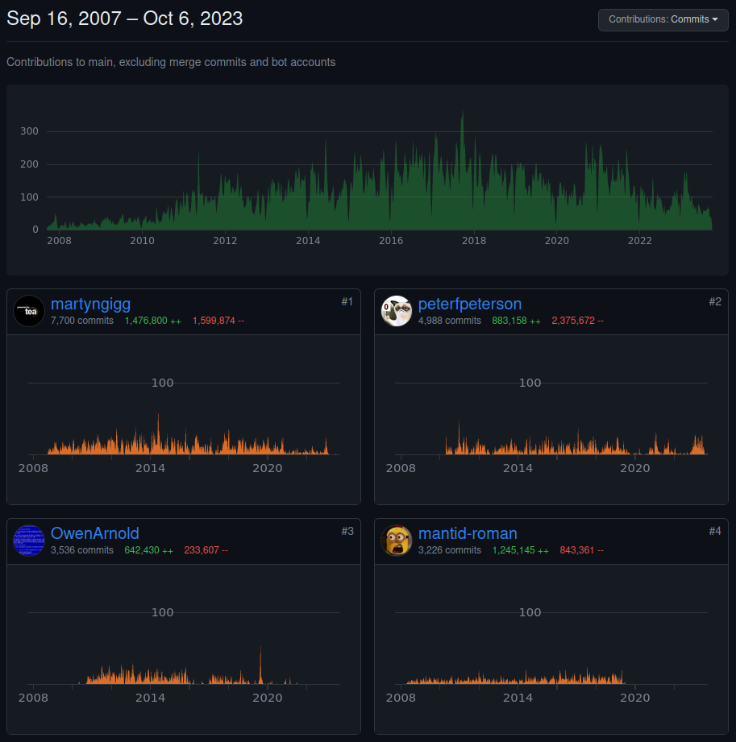
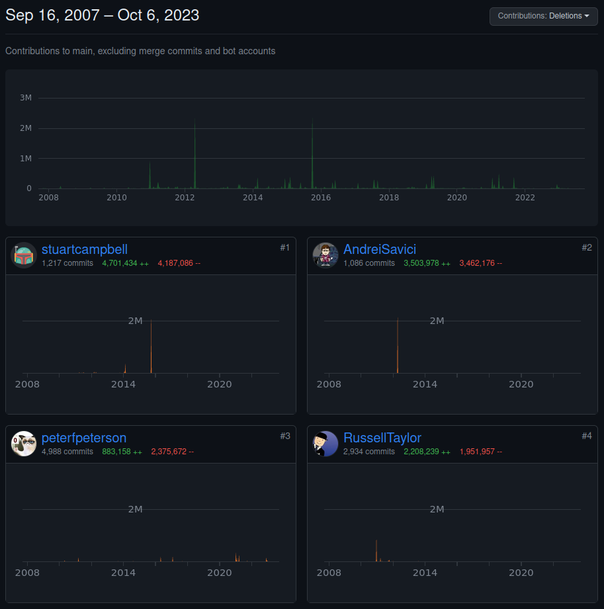
Tiny bit about me
1st & only job since university
Contributing to Mantid since 2010
Mantid TWG chair
Deleted more of Mantid than almost everyone

Slide 4

What you will learn
Mantid is (quantitatively) slow
You can measure it
Algorithm Profiler
Mantid::Kernel::Timer
Perf
Intel's vtune
Don't trust your intuition

Slide 5
Change your cmake configuration
https://stackoverflow.com/questions/48754619/what-are-cmake-build-type-debug-release-relwithdebinfo-and-minsizerel
Mantid::API::AlgoTimeRegister

Slide 6
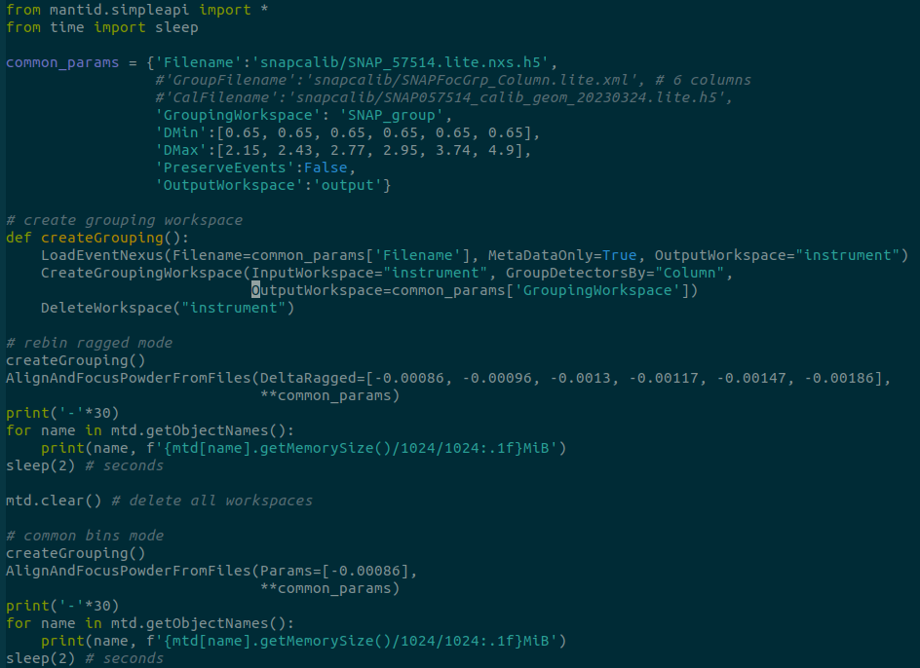
Our example – from TOFPD

Slide 7
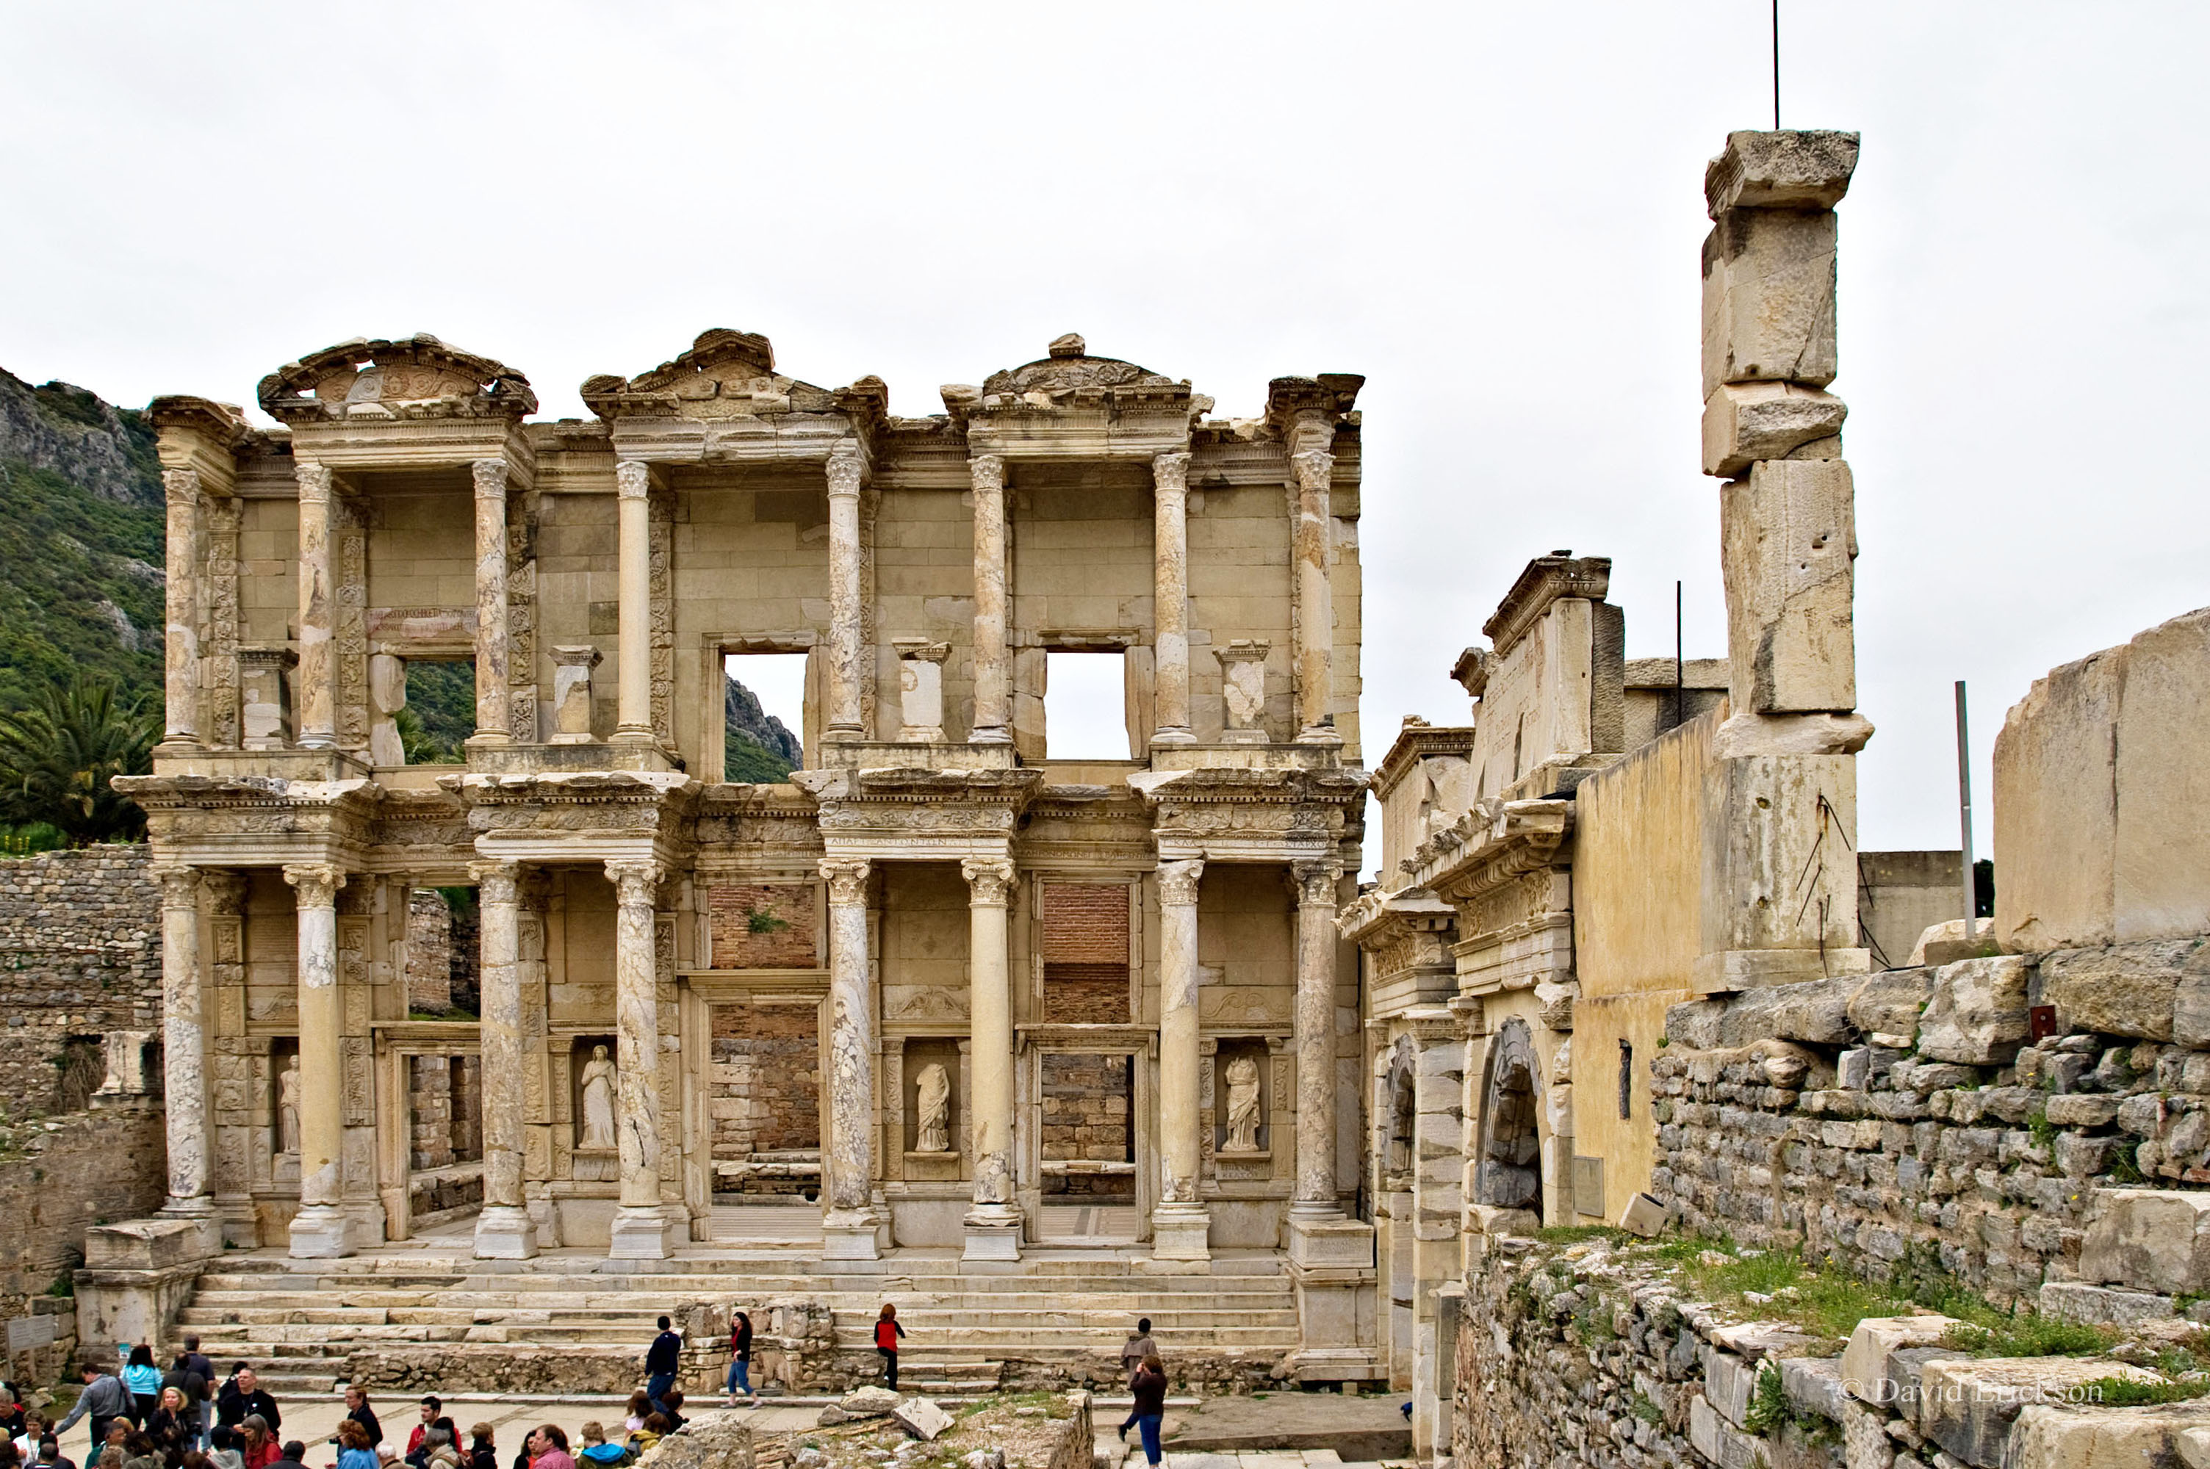
https://docs.mantidproject.org/nightly/algorithms/AlignAndFocusPowderFromFiles.html

Slide 8
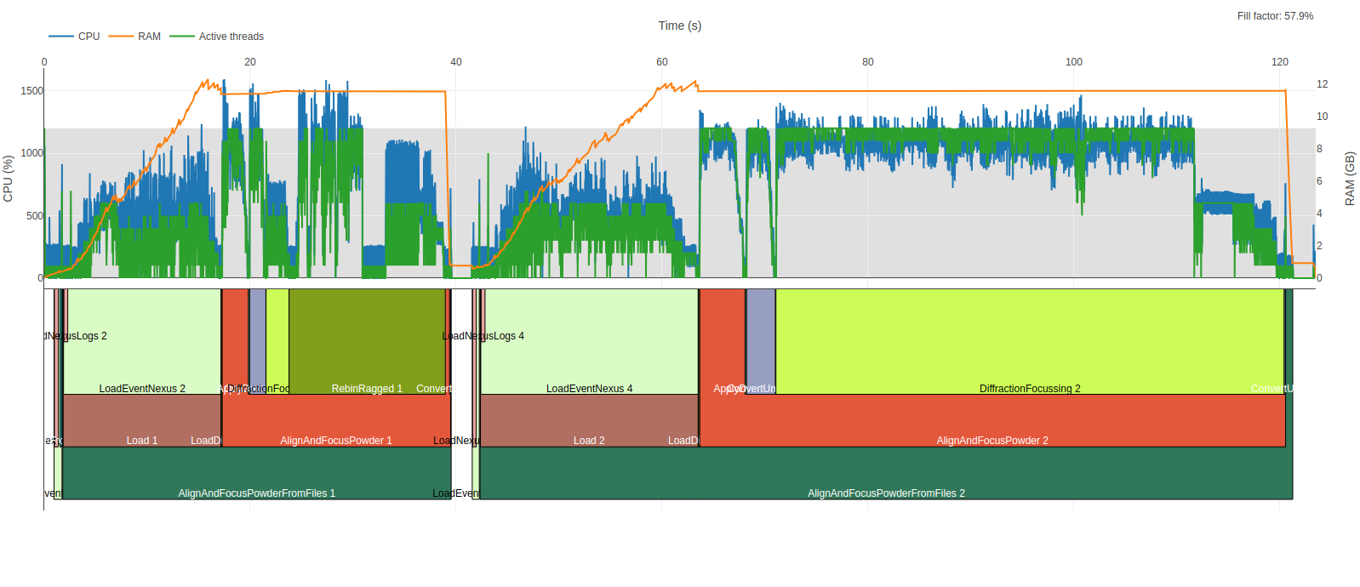
Algorithm Profiler
Records thread, start/stop time, and “algorithm name”
mantid-profiler.py combines this with process table
https://github.com/mantidproject/mantid-profiler

Slide 9


Slide 10
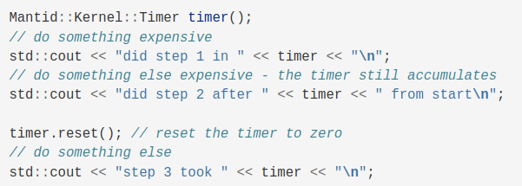
How about debug print statements?
Framework/Kernel/inc/MantidKernel/Timer.h

Slide 11
Permanent “print” statements
FilterEvents example

Slide 12
Linux Perf

Slide 13
Intel vtune

