Slide 1

Lightning Talk – Use of
What is Compiler Explorer?
  https://godbolt.org/
Online featherweight developer environment which allows you to interactively select compilers.
Outputs the assembly code generate as a result of compilation.
Supports multiple languages, including c++
Created in 2012 by Matt Godbolt to test speed of new c++ features

Slide 2
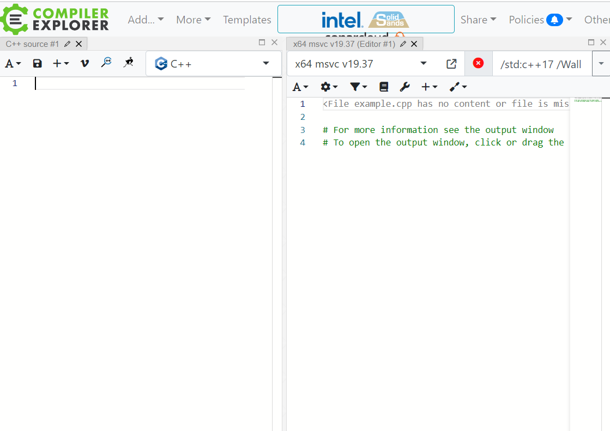
Compiler Explorer – Basic Anatomy
Source code editor
Resultant assembly code
Language selector
Compiler selector
Compiler flag input
Compiler output summary
(3)
(4)
(5)
(1)
(2)
(6)

Slide 3
Use Case 1
constexpr char *URL_PREFIX = "http://data.isis.rl.ac.uk/where.py/windir?name=";
const std::string fname = “file_name”;
inetHelper.sendRequest(URL_PREFIX + fName, os);
Update URL_PREFIX from C-style string.
Why?
  Modernise C++
  Warning on some compilers

Slide 4
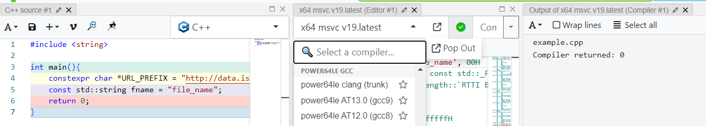
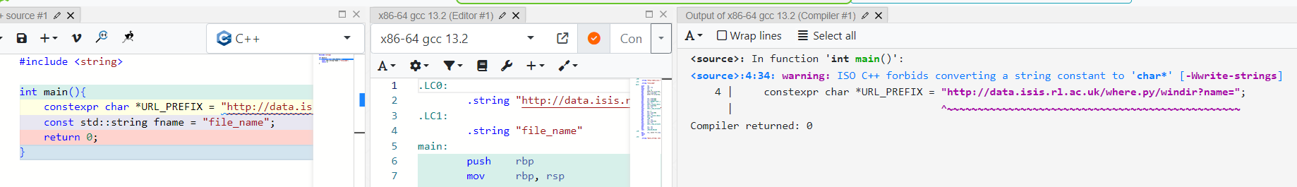
Use Case 1
x64 msvc v19.latest:
x86-64 gcc 13.2:

Slide 5
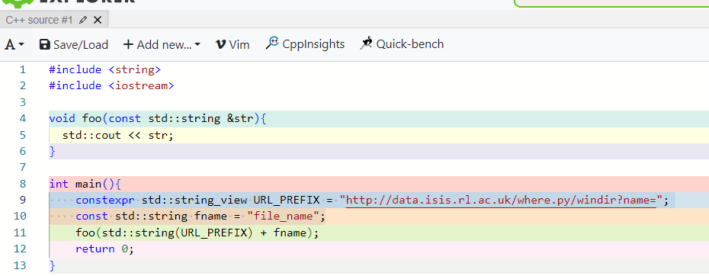
Use Case 1
constexpr std::string_view URL_PREFIX = "http://data.isis.rl.ac.uk/where.py/windir?name=";
const std::string fname = “file_name”;
inetHelper.sendRequest(std::string(URL_PREFIX) + fName, os);
Question: does using `std::string(std::string_view) + std::string` create an additional `std::string`, or is this optimised away by the compiler?

Slide 6
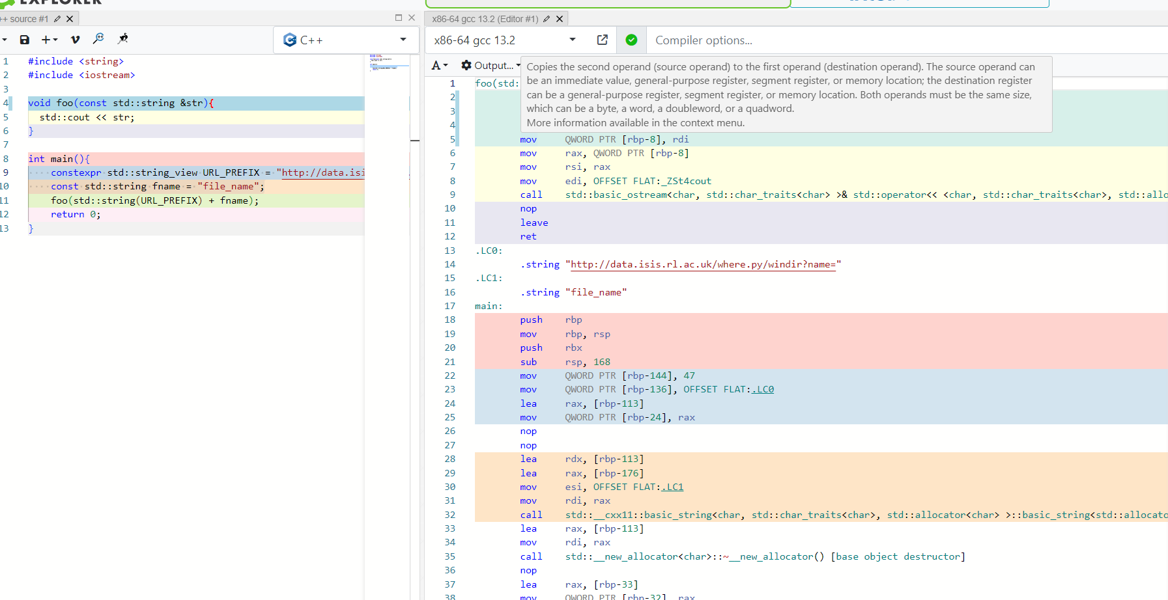
Source code to Assembly code is highlighted
Can mouse over the assembly instruction (blue) for info
Can see assembly code for different functions

Slide 7
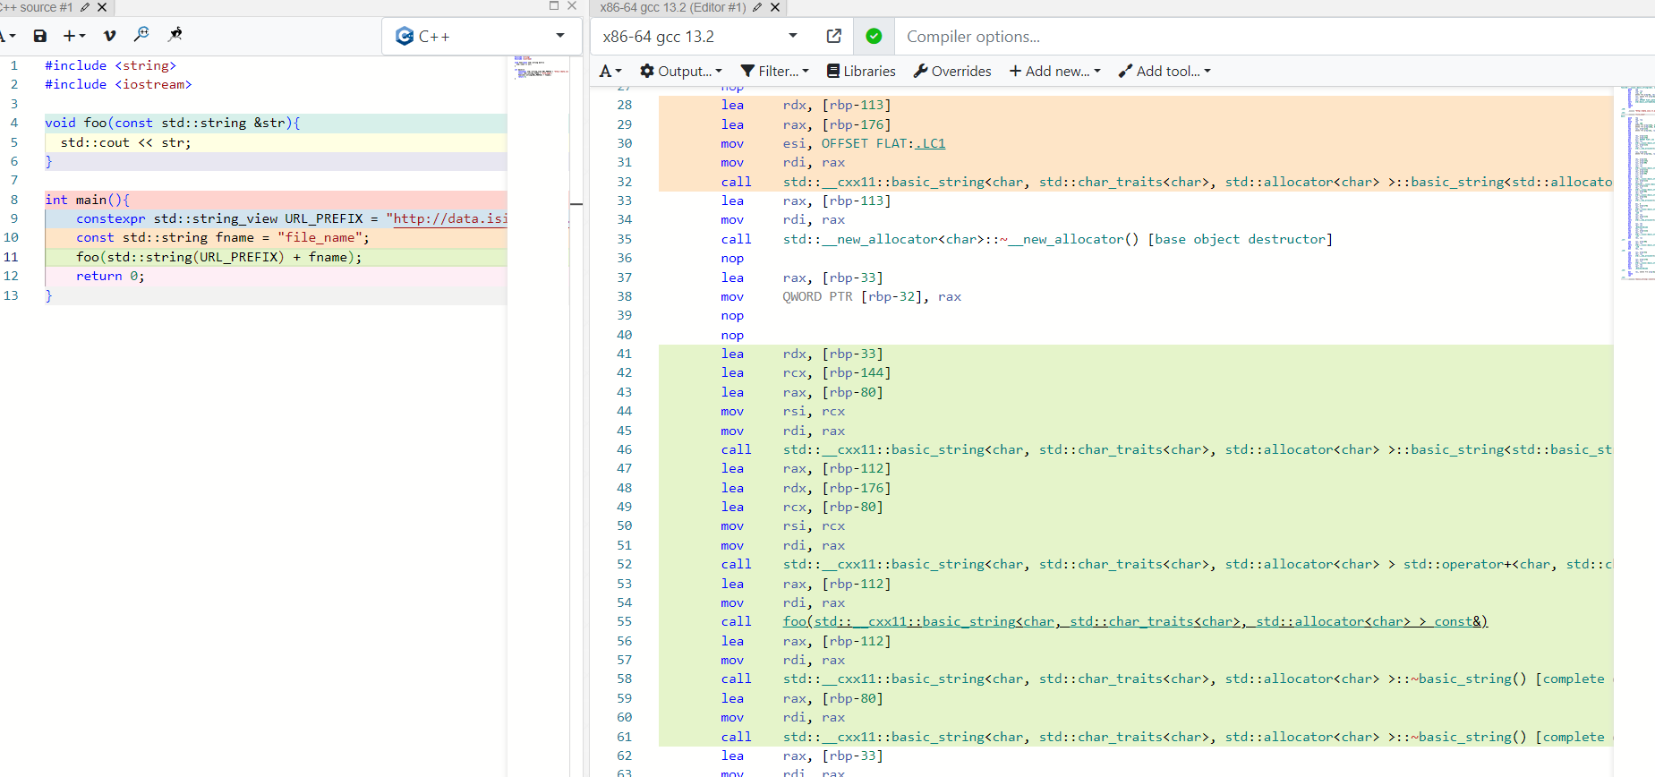
Constructor for `fname`
Constructor for rvalue string std::string(URL_PREFIX)
+ operator for the two strings
Constructor for the resultant rvalue string.
Destructors for both rvalue strings
Answer: YES

Slide 8
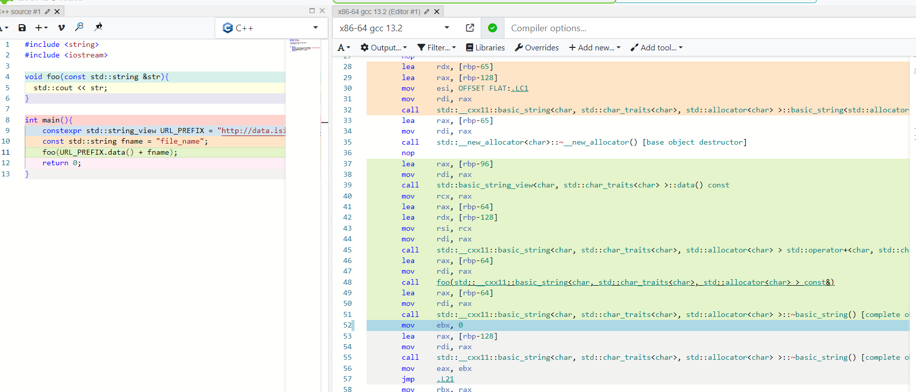
Constructor for `fname`
+ operator for the two strings
Constructor for the resultant rvalue string.
Destructor for the sole rvalue string

Slide 9
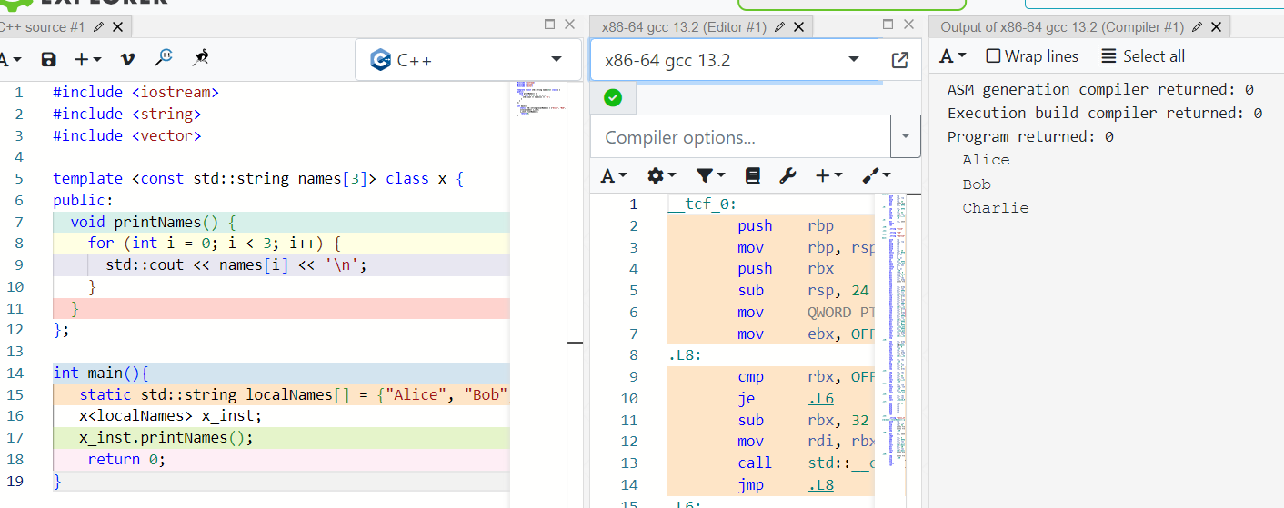
Use Case 2

Slide 10
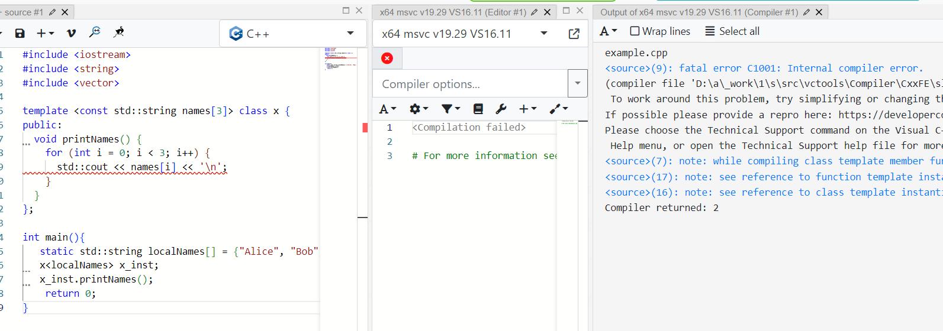
Use Case 2
<source>(7): note: while compiling class template member function 'void x<& localNames>::printNames(void)'
<source>(17): note: see reference to function template instantiation 'void x<& localNames>::printNames(void)' being compiled
<source>(16): note: see reference to class template instantiation 'x<& localNames>' being compiled
Compiler returned: 2

Slide 11
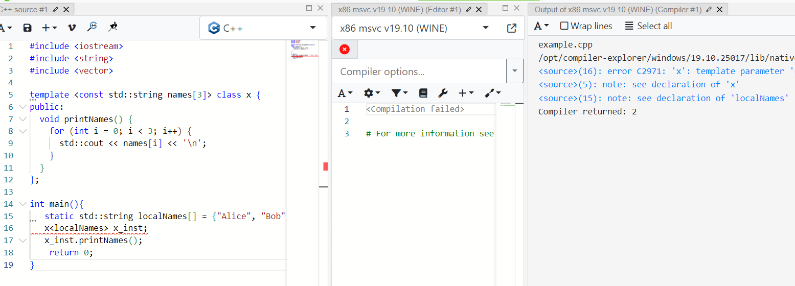
Use Case 2
<source>(16): error C2971: ‘x': template parameter 'names': 'localNames': a variable with non-static storage duration cannot be used as a non-type argument
<source>(5): note: see declaration of ‘x'
<source>(15): note: see declaration of 'localNames'
“No, that is not possible. Template non-type arguments must be available at compile time. If you don't have your value until runtime, you can only pass it in as a function argument.”
“C++ has limited non-type template parameters to integral types, enumerations, pointers, and references”.
https://godbolt.org/z/qTK6MhrYT

