Slide 1
SHIVER – Spectroscopy HIstogram Visualization for Event Reduction
Andrei Savici

Slide 2
Why SHIVER?
Events are smaller in size
We have a statistically correct way to reduce the data
Algorithms already implemented in Mantid
The most often used aspect is taking slices / cuts
A. T. Savici et al. - J. Appl. Cryst. (2022). 55, 1514-1527 https://doi.org/10.1107/S1600576722009645

Slide 3
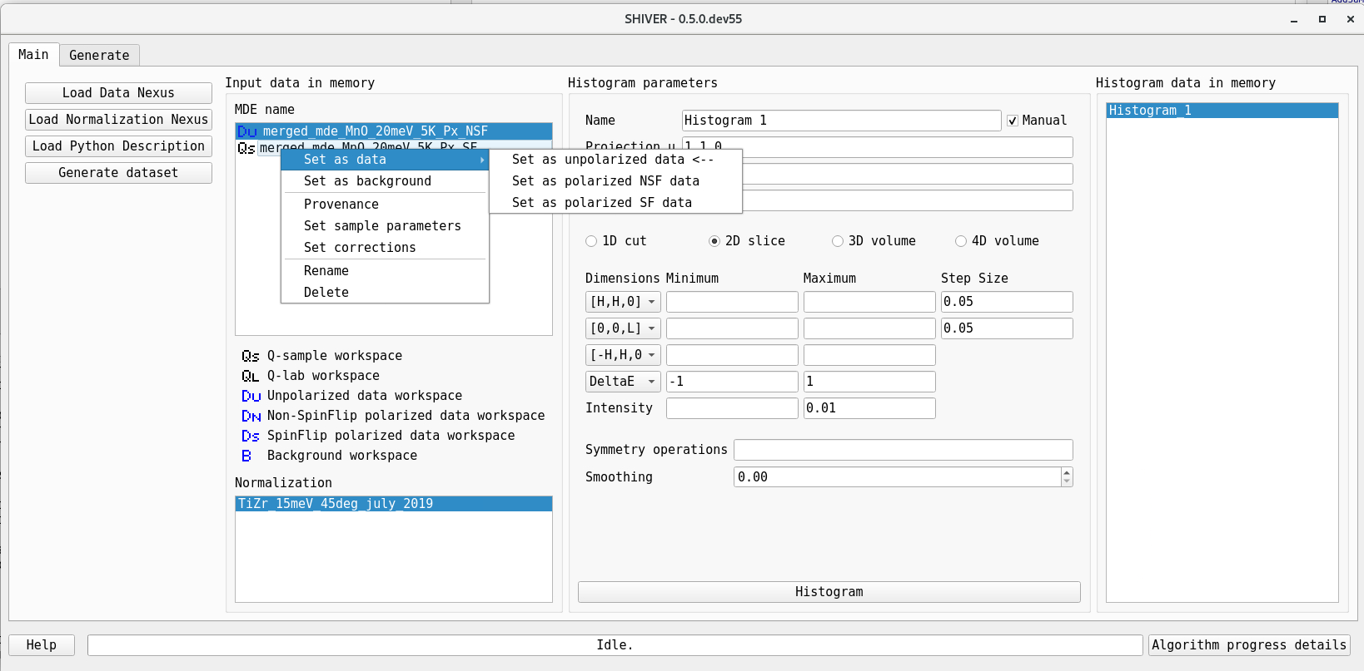
Main entry point

Slide 4
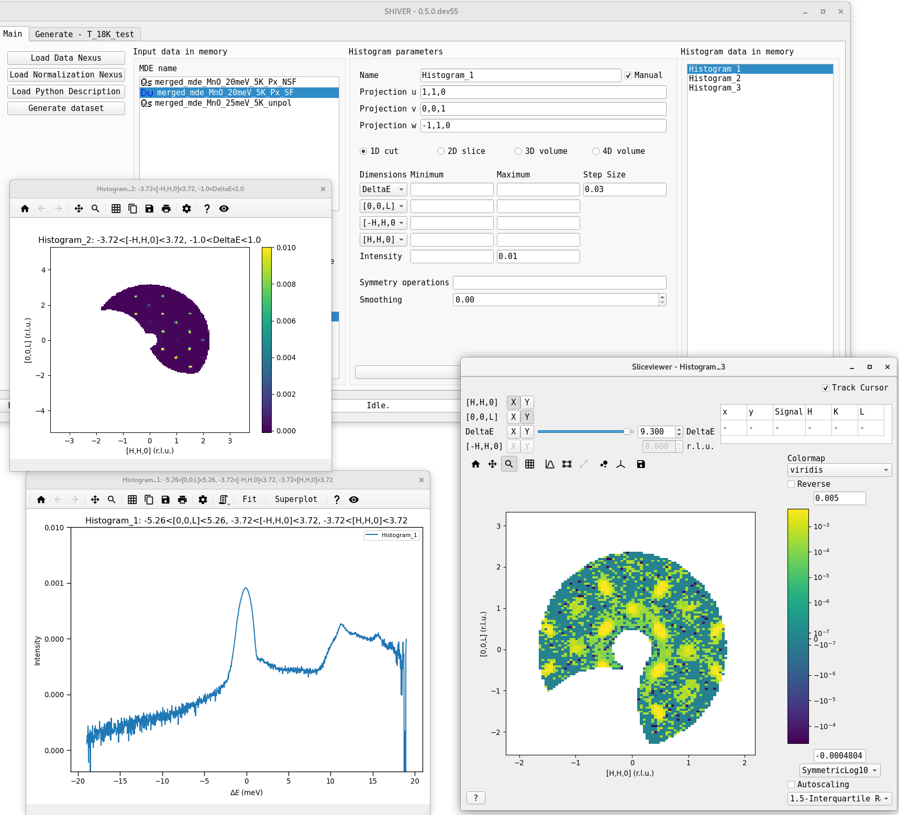
Plotting

Slide 5
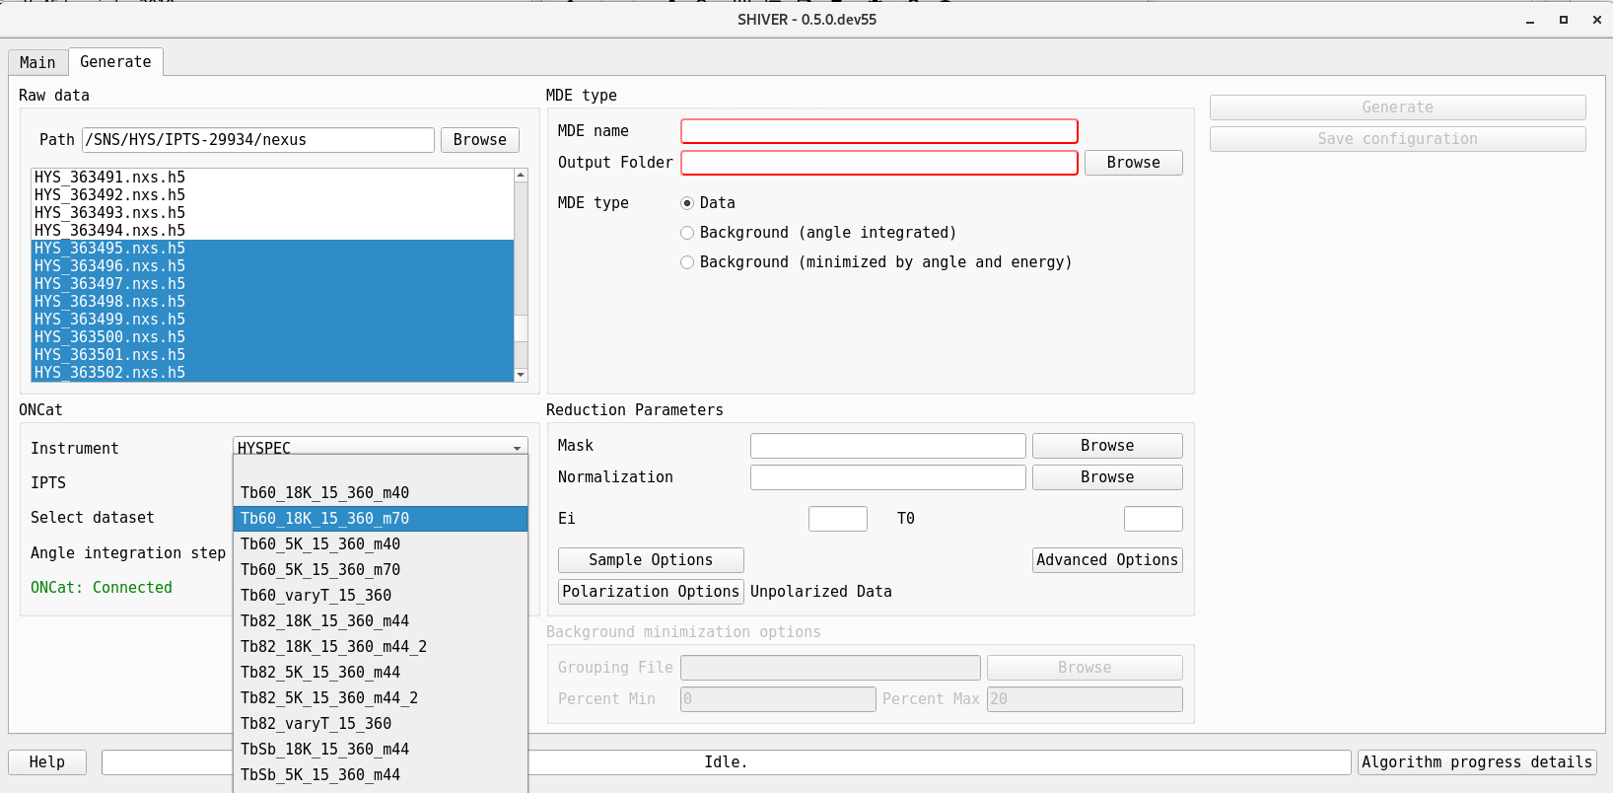
Generating intermediate data sets

Slide 6
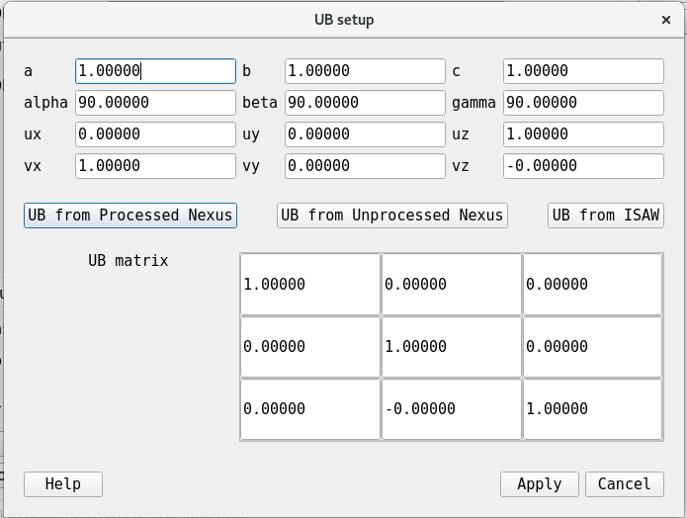
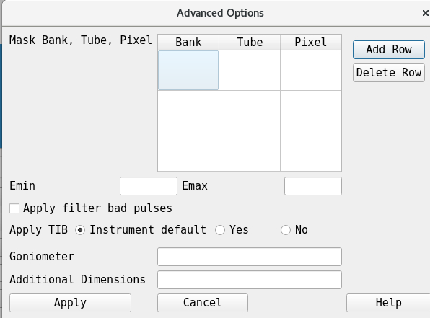
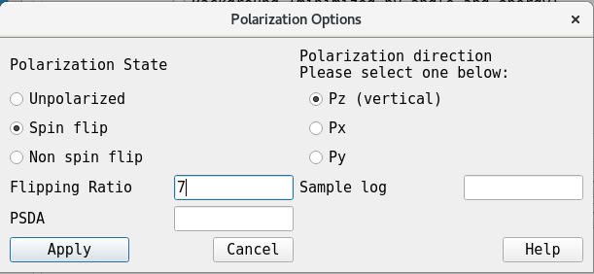
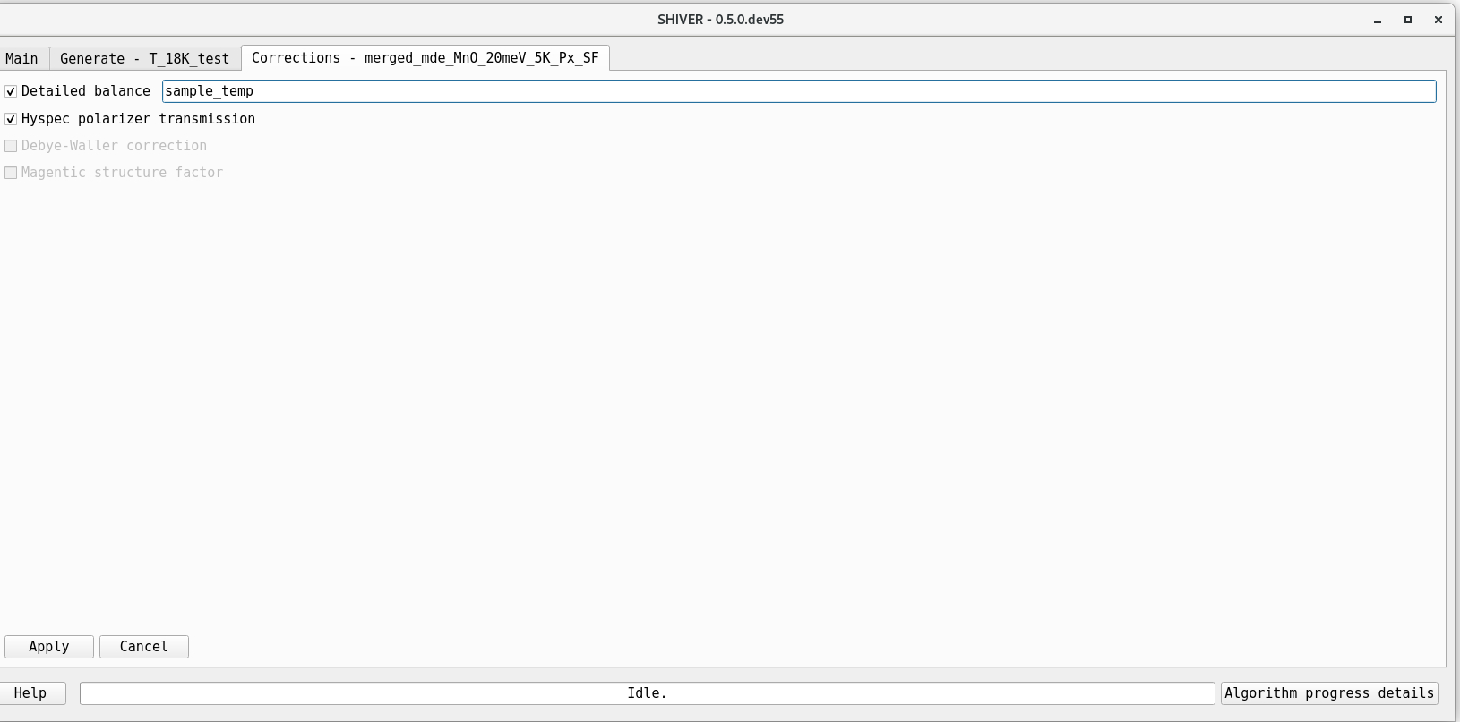
Other options
Lattice parameters
Reduction parameters
Polarization options
Other corrections

Slide 7
Current and future work
Polarization options
Lattice parameters/orientation refinement
Adding more correction options

