Slide 1
Changes to the
Time-Slicing
Backend

Slide 2
A Working Definition for Time Slicing
The partition of the time elapsed during one (or more) experiments
The partition is usually governed by measurable environmental quantities
(temperature, electromagnetic fields, sample orientation)
Ω
2π
DateAndTime
Each partition element can be labeled by the values taken by the environmental quantities of interest

Slide 3
Targets of Time Slicing
Any set of time-stamped objects
Convention: the value of the log extends in time until the next entry
A list of events (EventList)
A time series log (TimeSeriesProperty)
Ω
(t₁,v₁), (t₂,v₂), (t₃,v₃), …
value
time
Algorithms involving Time Slicing
FilterBadPulses
FilterByLogValue
FilterByTime
FilterByXValue
FilterLogByTime
GetTimeSeriesLogInformation
ExportTimeSeriesLog
GenerateEventsFilter
FilterEvents
RebinByTimeAtSample

Slide 4

Types of Time Slicing?
Filtering
DateAndTime
Splitting
DateAndTime

Slide 5
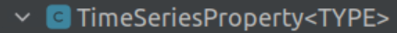
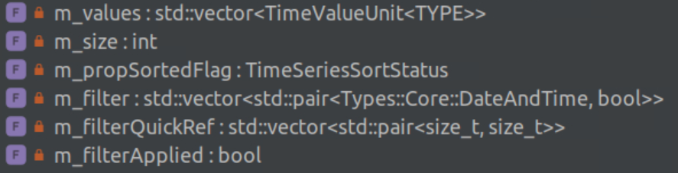

Status of the time-series Log class (≤ v6.6)
true
false
true
false
m_filter
[ )
[ )
DateAndTime
m_filterQuickRef
m_filterApplied
Allows for each log in a workspace to have its own filter (rare case)

Slide 6


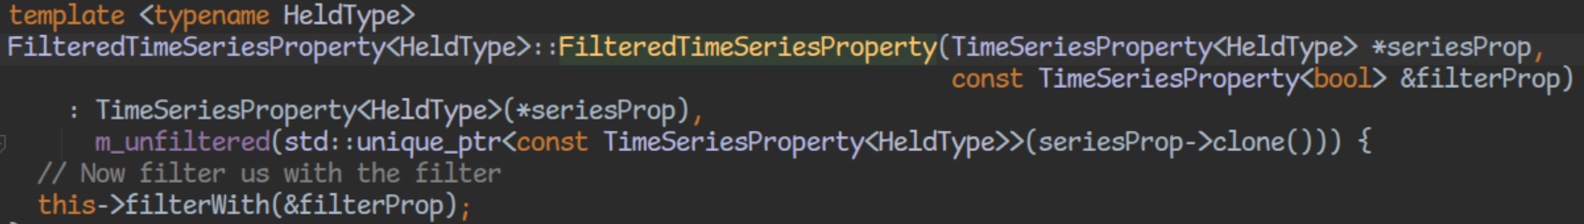
FilteredTimeSeriesProperty (≤ v6.6)
Duplicates the (t₁,v₁), (t₂,v₂), (t₃,v₃), … sequence

Slide 7

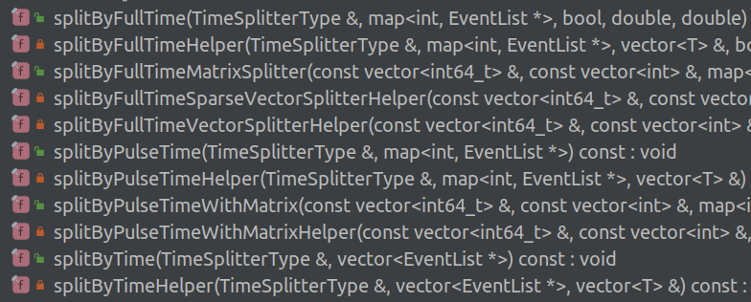
EventList Responsible for Splitting itself (≤ v6.6)
5 public and 6 private helper methods

Slide 8
Splitting a TimeSeriesProperty (≤ 6.6)
Workspace_1
Filter by a high-frequency periodic log (e.g $\vec{B}\left(t\right)$)
7 entries
8 entries
1 entry
Workspace_2
3 entries
Splitting the other time series introduced spurious entries in the series’ values
Increased memory footprint
Decreased execution speed
Overestimation of the integrated proton charge

Slide 9


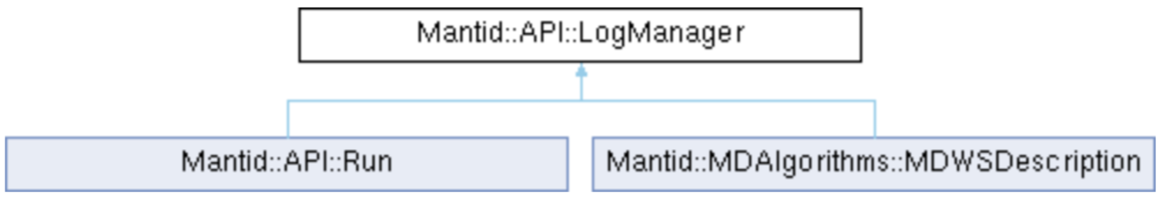
The TimeROI Object (> 6.6)
A list of Regions-Of-Interest as time elapses
[ )
[ )
DateAndTime
even number of entries
One TimeROI for all the TimeSeriesProperty in a given Run object

Slide 10
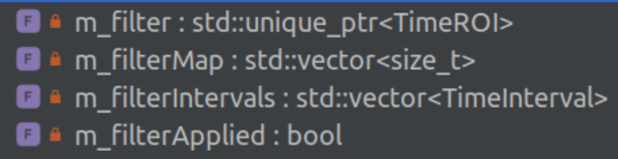
Status of the time-series Log class (> v6.6)

Slide 11


TimeSplitter object (> 6.6)
Meant to substitute std::vec<SplittingInterval>
Takes on the responsibility of filtering lists of events (EventList)
Workspace Index → 2 -1 0 -1
[ )
[ )
DateAndTime
Reserved for unfiltered, or “lost” events

Slide 12


TimeSplitter Responsible for Splitting EventList

Slide 13
TimeSeries Filtering (>6.6)
Each Workspace ends up with cloned logs and its own TimeROI
Workspace_1
Filter by a high-frequency periodic log (e.g $\vec{B}\left(t\right)$)
m_roi
1 entry
Workspace_2
m_roi
3 entries
Time-weighted computations (such as average) consider the TimeROI

Slide 14
The Log Replication Problem
Non-period, fast changing logs are ideally split into very many chunks
Filter by a fast-changing log (e.g ramping T)
1
2
(Mantid ≤ 6.6)
3
50
roughly same memory as before

Slide 15
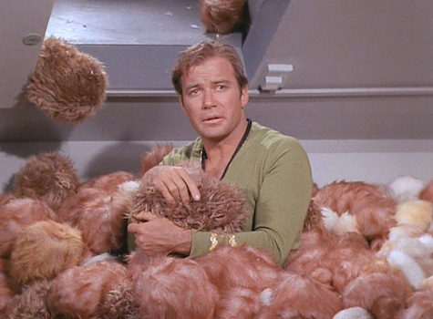
The Log Replication Problem
Keeping full logs for each Workspace significantly increases the allocation of memory when splitting according to non-periodic, fast changing logs
1
Filter by a fast-changing log (e.g ramping T)
(Mantid > 6.7)
50

Slide 16
Log Capping
For each time series, copy only the values within the ROIs, plus the values immediately before and after each ROI
Filter by a fast-changing log (e.g ramping T)
1
(Mantid > 6.7)
50

Slide 17
..a work in progress
Optimizations are underway to speed up the generation of TimeSplitter objects (GenerateEventsFilter) and the filtering+splitting of events (FilterEvents)

