Slide 1
The Numbers… What Do They Mean?
Conor Finn (they/them)

Slide 2
Introduction
There are many ways to refer to the parts of a workspace or instrument:
The main Three:
Workspace Index
Spectrum Number
Detector ID
Additionally:
Detector Index (From DetectorInfo)
Component Index (From ComponentInfo)

Slide 3
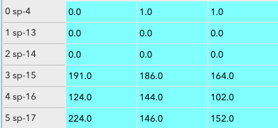
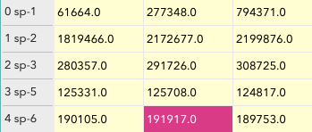
Workspace Index
Most useful for programmatic workspace work
Begins at 0
Useful for iteration
Specific to the workspace, will be reset to start at 0 if the workspace is cropped/stitched.

Slide 4
Spectrum Number
Represents a spectrum in the data, assigned during the creation of the loaded file(one or more detectors)
Defined during the creation of the nexus/raw file
Useful when referring to a specific spectrum
Will remain when a workspace is separated/cropped/stitched

Slide 5
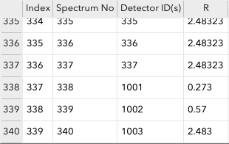
Detector ID
Defined in the Instrument Definition File (IDF)
Used to refer to a specific detector in the instrument
A spectrum number can refer to multiple detectors
Can be found in the “Detectors” table workspace created by the “Show Detectors” option.
Notes:
Many instruments use a system in their detector IDs. Such as a leading 10 to indicate monitors, or the first digit being the bank, like the room naming system in hotels.

Slide 6
Detector Index
Comes from the DetectorInfo class.
Indexable class from 0, to N-1 (where N is the number of detectors).
The Detector Index is NOT the detector ID. The indexOf method from a DetectorInfo object can be used to find the index from a detector ID
Allows for iteration over all detectors for masking/transformation/rotation/etc.

Slide 7
Component Index
Comes from the ComponentInfo class. Describes all instrument components.
Indexable class from 0, to N-1 (where N is the number of instrument components).
The detector indexes and component indexes map directly.
A detector with an index of 7 will also have a component index of 7.
isDetector will return true if the given component index is a detector.
The remaining indexes beyond the number of detectors are other instrument components defined in the IDF.
indexOfAny will find a component by its name (the first matching, if there are multiple).

Slide 8
Questions?
Thank you

