Slide 1
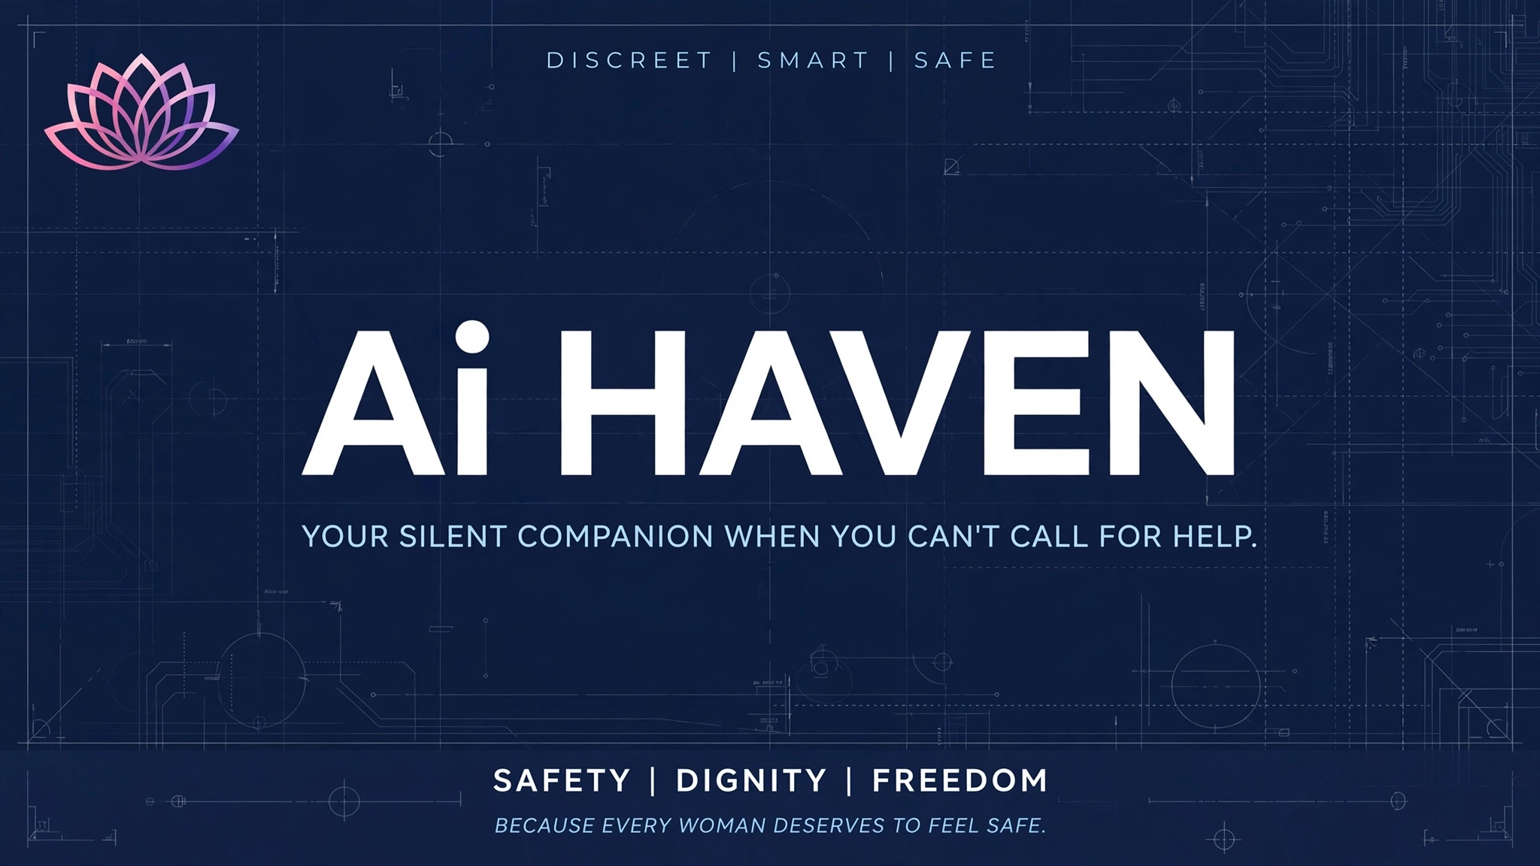
Ai HAVEN
THE SILENT SAFETY BUTTON
A discreet, low-cost wearable that can trigger an emergency alert and share location when speaking or reaching for a phone may not be possible.
HACKATHON CONCEPT • SOUTH AFRICA
DISCREET | SMART | SAFE
Safety • Dignity • Freedom

Slide 2

01 | THE PROBLEM
Why a silent, rapid safety trigger matters
37.9%
of people aged 16+ said they felt safe walking alone in their neighbourhood when it is dark in 2025/26.
46.6%
said they had taken some action to protect themselves against crime in 2025/26.
264,000
individuals experienced psychological violence in 2025/26; reporting to police was only 30.7%.
Source: Statistics South Africa, Victims of Crime Release 2026 (2025/26 data). The figures describe reported survey experiences/perceptions, not all incidents of GBV.
02

Slide 3
02 | THE EVIDENCE
Recent national evidence shows a large safety challenge
7.3 MILLION
women aged 18+ estimated to have experienced physical violence during their lifetime.
2.15 MILLION
women aged 18+ estimated to have experienced sexual violence during their lifetime.
3.2 MILLION
reported physical intimate-partner violence during their lifetime.
HSRC national prevalence study released in 2024; figures are lifetime estimates.
Source: Human Sciences Research Council (HSRC), First South African National Gender-Based Violence Prevalence Study, 2024; figures reiterated by the National Council on GBVF, 31 Aug 2026.
03

Slide 4
03 | THE SOLUTION
Ai HAVEN turns one deliberate action into a coordinated alert
1
2
3
4
ACTIVATE
LOCATE
TRANSMIT
RESPOND
Double-press / hold button
Capture GPS coordinates
Send alert through available network
Notify trusted contacts; future emergency-service integration
DESIGN PRINCIPLE
The device should reduce the number of actions needed during a high-stress moment—without requiring the user to unlock a phone or speak.
04

Slide 5
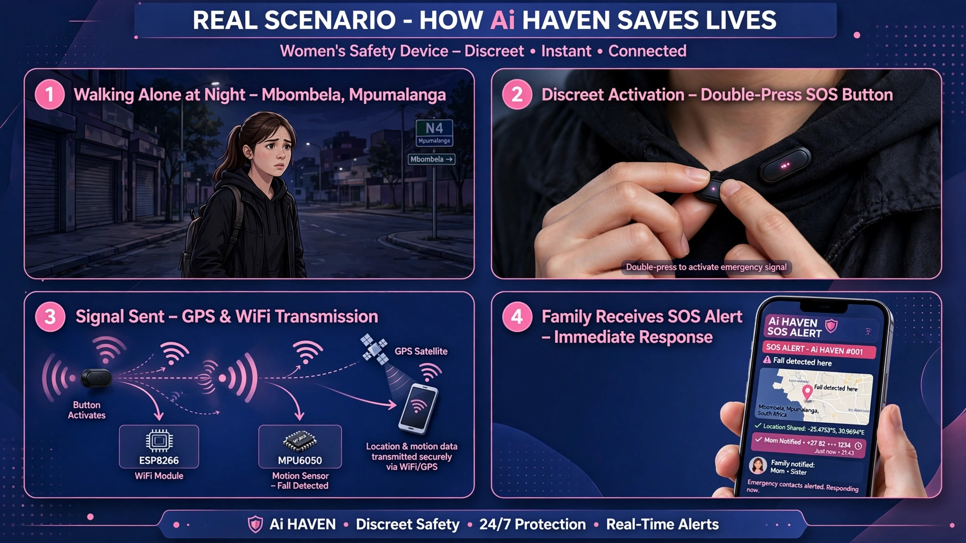
04 | REAL-WORLD SCENARIO
A simple sequence a judge can understand in 20 seconds
Demo sequence: threat → discreet activation → location + alert → trusted person receives the signal
05

Slide 6
05 | HOW THE PROTOTYPE WORKS
A beginner-friendly hardware architecture—with the important real-world corrections
SOS BUTTON
ESP8266
GPS MODULE
ACCELEROMETER
Deliberate double-press / hold
Microcontroller + Wi‑Fi
u-blox NEO-6M or similar
MPU6050: optional fall/motion signal
POWER
NETWORK
OUTPUT
Li‑Po battery + protection/charging circuit
Low-power sleep when idle
Wi‑Fi → cloud/app → trusted contacts
(Prototype limitation: Wi‑Fi is not everywhere.)
Alert ID + coordinates + timestamp
Optional motion/fall flag
IMPORTANT
GPS determines location; the ESP8266 does not contain GPS. For operation without Wi‑Fi, add a phone/BLE gateway or a cellular module in a later version.
06

Slide 7
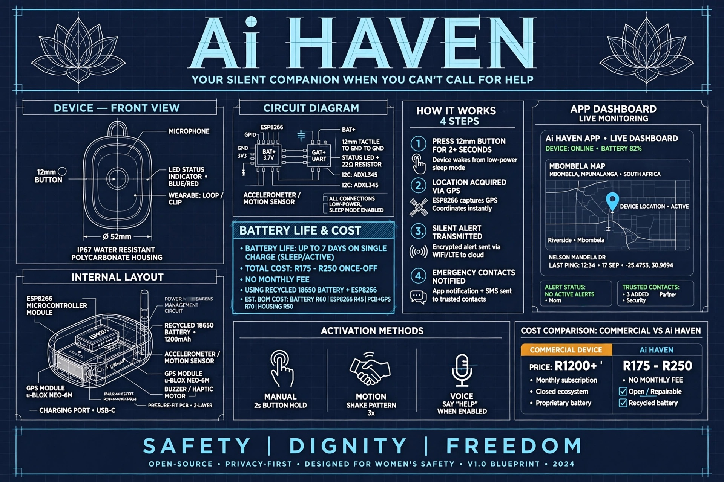
06 | PROTOTYPE DESIGN
Compact form factor + modular internals
07

Slide 8

07 | ACCESSIBILITY & VALUE
The prototype is designed around affordability, repairability and simplicity
LOW-COST PROTOTYPE
Target: roughly R175–R250 based on the supplied component estimate. Treat this as a prototype estimate—not a production price.
NO SUBSCRIPTION — CONCEPT
The prototype can demonstrate alerts over Wi‑Fi without a paid cellular plan. Production deployment would have connectivity and cloud costs.
SOCIAL VALUE
Discreet activation • faster notification • trusted-contact network • privacy-first design • potential for local manufacture.
08

Slide 9
08 | TROUBLESHOOTING
What can go wrong—and how the team would diagnose it
SYMPTOM | LIKELY FIX | DEMO / ENGINEERING CHECK
Button does nothing | Check GPIO, ground and pull-up/down; add a debounce; confirm battery voltage. | Test button input with a serial monitor.
GPS shows no location | Move outdoors; allow time for satellite fix; check UART wiring and baud rate. | Display 'SEARCHING' until a valid fix is available.
Alert not delivered | Check Wi‑Fi credentials, signal strength and cloud/API endpoint. | Queue the event locally and retry.
False activation | Use double-press/long-press + short countdown/cancel window. | Require deliberate input rather than a single tap.
Battery drains quickly | Use deep sleep; wake only on button/motion; reduce GPS polling. | Measure current in sleep and active modes.
Device gets hacked | Use authenticated APIs, encrypted transport, unique device credentials and signed firmware. | Never expose secrets in source code.
09

Slide 10
09 | FREQUENTLY ASKED QUESTIONS
Questions a hackathon judge is likely to ask
Does it work without a phone?
Does GPS work indoors?
The hardware can trigger an alert, but the current Wi‑Fi prototype still needs network access. A cellular module or phone/BLE gateway is the next step for wider coverage.
GPS can be weak indoors. The device should show a clear status and use the last valid location when appropriate, rather than pretending the location is exact.
Will it accidentally activate?
Can it contact SAPS directly?
The prototype uses deliberate double-press/hold activation. A short cancel window can be added before the alert is finalized.
For the prototype, demonstrate trusted-contact alerts. Direct SAPS dispatch would require an approved integration/API and operational agreement; it should not be claimed as a live feature without that integration.
What if the device is hacked?
Why call it 'AI' Haven?
Use TLS, authentication, unique device keys, secure firmware updates, rate limiting and minimal stored personal data. No connected device can honestly be promised to be 'unhackable'.
AI can be added later for anomaly/fall detection or alert prioritisation. The core SOS button itself does not need AI to demonstrate the safety workflow.
10

Slide 11
10 | LIMITATIONS → ROADMAP
Be transparent about what is prototype-ready and what comes next
TODAY — PROTOTYPE
NEXT — ENGINEERING
FUTURE — SCALE
• Physical SOS button
• Microcontroller logic
• GPS location capture
• Wi‑Fi alert demonstration
• Trusted-contact notification
• Battery / sleep-mode concept
Goal: prove the core interaction end-to-end.
• Cellular fallback
• Better enclosure + waterproofing
• Secure provisioning
• Battery-life testing
• Accessibility testing
• Location-confidence handling
• Offline event queue
Goal: make it robust outside the lab.
• Smartphone/BLE gateway
• Optional fall/anomaly detection
• Partnerships with NGOs / safety networks
• Emergency-service integration where approved
• Manufacturing + repair network
Goal: move from demo to responsible deployment.
Hackathon principle: prove the smallest reliable version first, then scale connectivity and intelligence.
11

Slide 12
Ai HAVEN
THE 30-SECOND HACKATHON PITCH
THE PITCH
“When someone cannot safely reach their phone or speak for help, every extra step matters. Ai HAVEN is a discreet safety button that lets a user deliberately trigger an emergency signal, capture their location and notify trusted contacts through a connected system. We are building the prototype around affordable, repairable hardware—and we are honest about the next challenge: reliable connectivity beyond Wi‑Fi. Our goal is simple: fewer steps between danger and a person who can respond.”
DISCREET • LOW-COST • PRIVACY-FIRST • CONNECTED
Safety | Dignity | Freedom
12

Slide 13
11 | SOURCES & DATA NOTES
Primary / official sources used for the recent evidence
1. Statistics South Africa (2026), Victims of Crime Release 2026 — 2025/26 household and individual safety data.
2. Human Sciences Research Council (2024), First South African National Gender-Based Violence Prevalence Study.
3. South African Government (31 Aug 2026), National Council on Gender-Based Violence and Femicide — evidence and 2026/27 Q1 GBVF figures.
4. South African Government (28 Aug 2026), First-quarter 2026/27 crime statistics release.
5. SAPS (2025), Annual Report 2024/25 — crimes against women, detection and conviction indicators.
Data note: crime and GBV statistics measure reported/recorded or survey-reported experiences. They should not be interpreted as a complete count of all incidents. Prototype claims in this deck are intentionally separated from verified national statistics.
Prepared for hackathon presentation • Ai HAVEN
13

