Slide 1
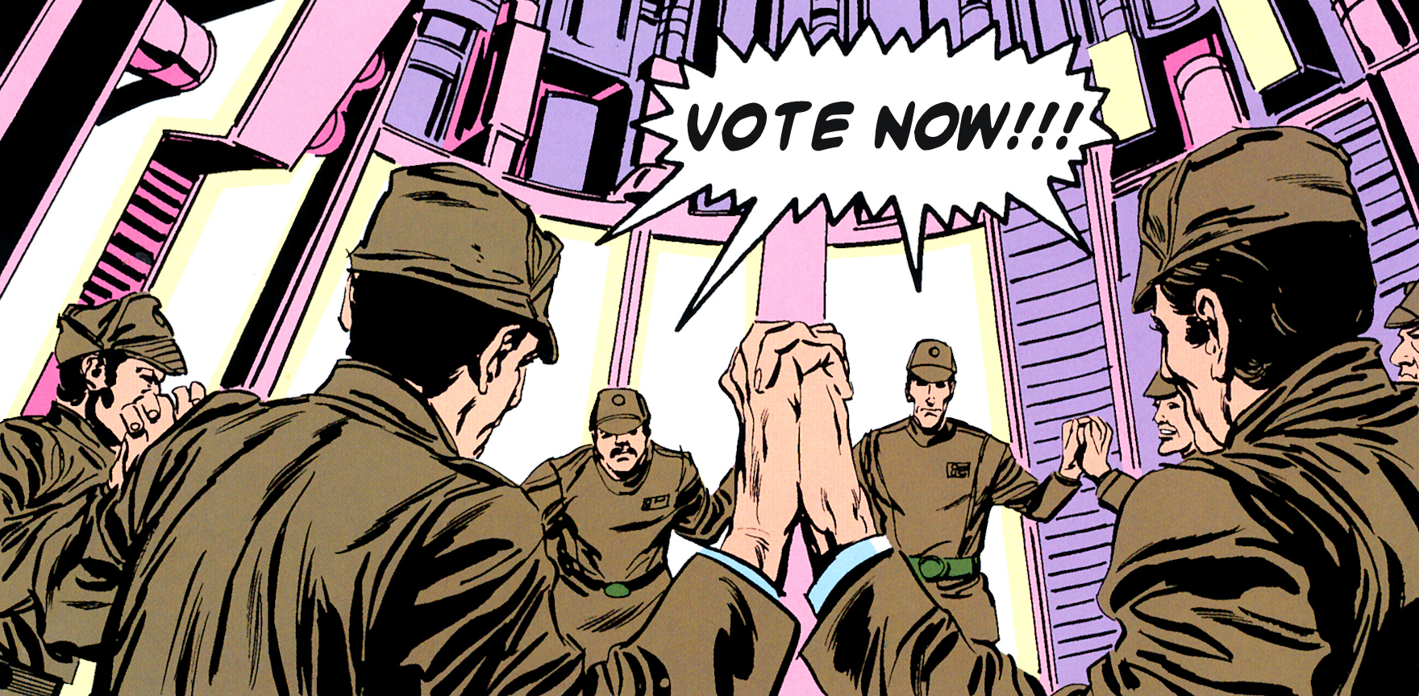
Classic Paxos Implemented in Orc
Term Project CS380D (Distributed Computing)
Hemanth Kumar Mantri
Makarand Damle

Slide 2
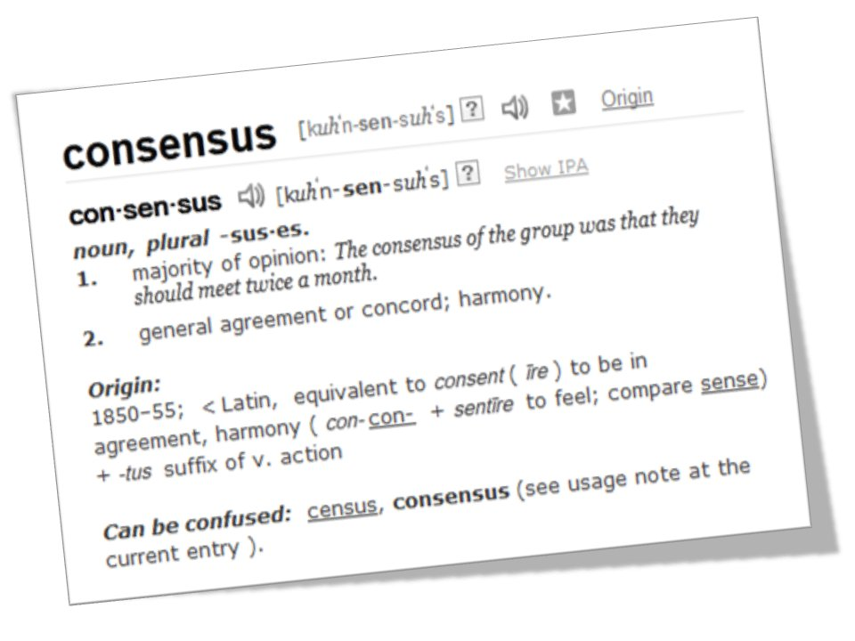
Consensus
Agreeing on one result among a group of participants
Consensus protocols are the basis for the state machine approach in distributed computing
Difficult to achieve when the participants or the network fails

Slide 3
Introduction
To deal with Concurrency
Mutex and semaphore
Read/Write locks in 2PL for transaction
In distributed system
No global master to issue locks
Nodes/Channels Fail

Slide 4
Applications
Chubby
Distributed lock service by Google
Provides Coarse grained locking for distributed resources
Petal
Distributed virtual disks
Frangipani
A scalable distributed file system.

Slide 5
Why Paxos?
Two Phase Commit (2PC)
Coordinator Failures!!
Three Phase Commit (3PC)
Network Partition!!!
Paxos
Correctness guaranteed
No liveness guaranteed

Slide 6
2PC
Coordinator
Participant
Initial
Initial
Prepare
(to all)
Prepare
Ready
U
Ready
Abort
Abort (to all)
Abort
ACK
All Ready
Commit
(to all)
Commit
ACK
Commit
Abort
Commit
Abort
TimeOut
Abort
(to all)

Slide 7
What’s Wrong?
Coordinator Fails
In Phase1
Participants can reelect a leader and restart
In Phase2
Decision has been taken
If at least 1 live participant knows – OK!
Participant(s) who know it die(s):
Reelection: Inconsistent
BLOCKED till coordinator recovers!!
Participant Fails
In Phase1
Timeout and so Abort
In Phase2
Check with leader after recovery
None are Blocked

Slide 8
Problems
2PC not resilient to coordinator failures in 2nd phase
Participants didn’t know about the leader’s decision: Abort/Commit
So, a new phase is introduced to avoid this ambiguity
‘Prepare to Commit’

Slide 9
Solution – 3 PC
Coordinator
Participant
Init
Init
Prepare
Ready
Prepare
(to all)
Prepare
Abort
U
R
All Ready
Prepare Commit
(to all)
Abort
A
Abort
Abort (to all)
PrepareCommit
OK
BC
TimeOut
Abort
(to all)
After Recovery
PC
All OK
Commit
(to all)
A
Not All OK
Abort (to all)
Commit
C
C

Slide 10
Recovery
Coordinator Fails in 2nd Phase and also a participant fails
Participant: Should have been in PC
Coordinator: Should have been in BC
Others can re-elect and restart 3PC (nothing committed)
Coordinator fails in 3rd Phase:
Decision Taken and we know what it is
No need to BLOCK!

Slide 11
So, what’s wrong again?
Network partition!!
A
B
New Leader
Hub
Leader
C
D

Slide 12
Problem
How to reach consensus/data consistency in a given distributed system that can tolerate non-malicious failures?

Slide 13
Requirements
Safety
Only a value that has been proposed may be chosen
Only one value is chosen
A node never learns that a value has been chosen unless it actually has been
Liveness
Eventually,
some proposed value is chosen
a node can learn the chosen value
When the protocol is run in 2F+1 processes, F processes can fail

Slide 14
Terminology
Classes/Roles of agents:
Client
issues a request, waits for response
Proposers
Proposes the Client’s request, convinces the Acceptors, resolves conflicts
Acceptors
Accept/Reject proposed values and let the learners know if accepted
Learners
Mostly serve as a replication factor
A node can act as more than one agent!

Slide 15
Paxos Algorithm
Phase 1:
Proposer (Prepare)
selects a proposal number N
sends a prepare request with number N to all acceptors
Acceptor (Promise)
If number N greater than that of any prepare request it saw
Respond a promise not to accept any more proposals numbered less than N
Otherwise, reject the proposal and also indicate the highest proposal number it is considering

Slide 16
Paxos algorithm Contd.
Phase 2
Proposer (Accept):
If N was accepted by majority of acceptors, send accept request to all acceptors along with a value ‘v’
Acceptor (Accepted):
Receives (N,v) and accept the proposal unless it has already responded to a prepare request having a number greater than N.
If accepted, send this value to the Listeners to store it.

Slide 17
Paxos’ properties
P1: Any proposal number is unique
If there are T nodes in the system, i^{th} node uses {i, i+T, i+2T, ……}
P2: Any two set of acceptors have at least one acceptor in common.
P3: Value sent out in phase 2 is the value of the highest-numbered proposal of all the responses in phase 1.

Slide 18
Learning a chosen value
Various Options:
Each acceptor, whenever it accepts a proposal, informs all the learners
Our implementation
Acceptors inform a distinguished learner (usually the proposer) and let the distinguished learner broadcast the result.

Slide 19
Successful Paxos Round
Client
Proposer
Acceptors
Learners
Request(v)
Prepare(N)
Promise(N)
Accept(N,v)
Accepted(N)
Response

Slide 20
Acceptor Failure – Okay!
Client
Proposer
Acceptors
Learners
Request
Prepare(N)
FAIL!
Promise(N)
Accept(N,v)
Accepted(N)
Response

Slide 21
Proposer Failure – Re-elect!
Client
Proposer
Acceptors
Learners
Request
Prepare(N)
Promise(N)
FAIL!
Prepare(N+1)
Promise(N+1)
.
.
.
New Leader

Slide 22
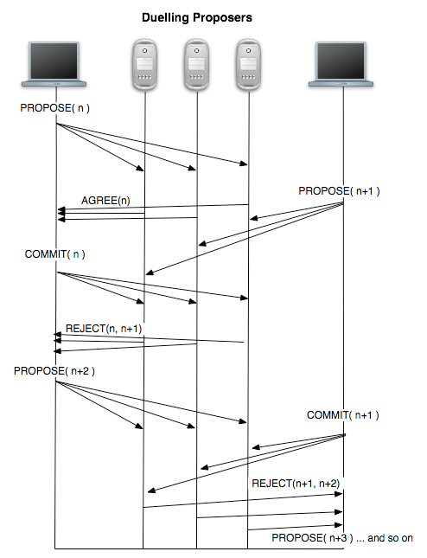
Dueling Proposers
Source: http://the-paper-trail.org/blog/consensus-protocols-paxos/

Slide 23
Issues
Multiple nodes believe to be Proposers
Simulate Failures
def class faultyChannel(p) =
val ch = Channel()
def get() = ch.get()
def put(x) =
if ((Random(99) + 1) :> p)
then ch.put(x)
else signal
stop

Slide 24
Implementation
Learn which nodes are alive
HeartBeat messages, Timeouts
Simulate Node Failures
Same as failing its out channels
Stress test
Fail and Unfail nodes at random times
Ensure leader is elected and the protocol continues

Slide 25
Optimizations
Not required for correctness
Proposer:
Send only to majority of live acceptors (Cheap Paxos’ Key)
Acceptor can Reject:
Prepare(N) if answered Prepare(M): M > N
Accept(N,v) if answered Accept(M,u): M > N
Prepare(N) if answered Accept(M,u): M > N

Slide 26
Possible Future Work
Extend to include Multi-Paxos, Fast Paxos, Byzantine Paxos etc
Use remoteChannels to run across nodes

Slide 27
Questions

Slide 28
References
Paxos made Simple, Leslie Lamport
Orc Reference Guide
http://orc.csres.utexas.edu/
http://the-paper-trail.org/
Prof Seif Haridi’s Youtube Video Lectures

