Slide 1
E‑Commerce Sales Dashboard Analysis

Slide 2
What is E-commerce Data?
E-commerce data is the information generated from online shopping platforms when customers browse, buy, review, or interact with products.
Key Points
Customers can purchase products online using websites or mobile apps.
Businesses sell products without a physical store.
Transactions happen through digital payments and online orders.
It allows businesses to reach customers worldwide.
Examples include platforms like Amazon, Flipkart, and eBay.

Slide 3
Objectives
Analyze total revenue, orders, and sales performance.
Understand monthly revenue trends.
Identify top performing product categories.
Analyze customer purchase journey.
Monitor key business KPIs in one dashboard.

Slide 4
Problem Statement
E‑commerce companies generate large volumes of sales and customer data.
It is difficult to quickly understand revenue trends, product performance, and customer behavior using raw data.
The goal is to create a dashboard that helps analyze sales performance and support better business decisions.

Slide 5
Dataset Details
The dataset contains multiple tables used for analysis:
Orders – order information
Order Items – product level order details
Products – product category and details
Users – customer information
Events – user actions (view, cart, purchase)
Reviews – product ratings and feedback

Slide 6
Tools & Technologies Used
Power BI – Dashboard and data visualization
SQL – Data querying and preparation
Excel / CSV – Data storage format
Data Modeling – Relationships between tables
DAX – Calculated measures (Revenue, AOV, Conversion Rate)

Slide 7
KPIs Used in Dashboard
Total Revenue
Total Orders
Average Order Value (AOV)
Conversion Rate
Units Sold
These KPIs provide a quick overview of business performance.

Slide 8
Dashboard Insights
Electronics category generates the highest revenue.
Monthly revenue trend shows seasonal fluctuations.
Some products have high revenue but low customer ratings.
A large number of users view products but fewer complete purchases.
Customer behavior insights help improve conversion rates.

Slide 9
Dashboard Visuals
Line Chart – Shows monthly sales or revenue trends.
Bar Chart – Displays sales by product category.
Donut Chart – Represents order status distribution.
Funnel Chart – Shows customer journey from product view to purchase.
Table – Provides detailed product or customer sales data.
Slicers – Filters the dashboard by month, product category.

Slide 10
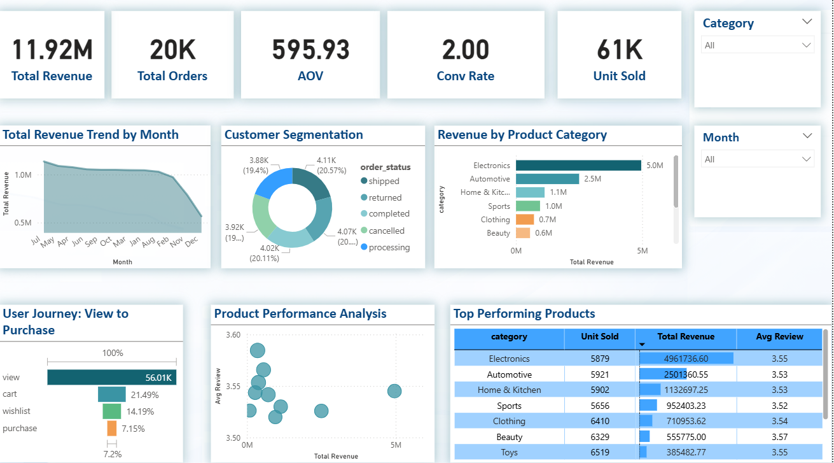
E-Commerce Sales Overview

Slide 11
Business Insights
Focus marketing on high performing categories.
Improve product pages to increase conversions.
Promote products with high ratings and demand.
Analyze customer journey to reduce drop‑offs.

Slide 12
Challenges Faced
Cleaning and organizing raw data.
Creating relationships between multiple tables.
Writing DAX measures for KPIs.
Designing an effective dashboard layout.
Ensuring the dashboard is easy to understand.

Slide 13
Conclusion
The Power BI dashboard provides a clear view of e‑commerce performance.
It helps stakeholders quickly understand revenue trends, product performance, and customer behavior.
This dashboard supports better data‑driven decision making for business growth.

