Slide 1
E‑Commerce Data Analysis using SQL
Project Presentation
Database: ecommerce
Focus: SQL Data Analysis

Slide 2
What is E‑Commerce?
E‑commerce refers to buying and selling products online.
Customers purchase products through websites or apps.
Businesses store transaction data in databases.
Data helps analyze sales, customers, and product performance.

Slide 3
Project Objectives
Build an e‑commerce database using SQL.
Store data about users, orders, products, and reviews.
Analyze revenue and customer behavior.
Identify top customers and best‑selling products.

Slide 4
Problem Statement
E‑commerce platforms generate large amounts of data.
Businesses need insights about revenue and customers.
Raw data is difficult to interpret directly.
SQL queries are used to analyze and extract insights.

Slide 5
Dataset Overview
Tables used in the database:
users – customer information
products – product details
orders – order records
order_items – product purchase details
events – customer actions
reviews – ratings and feedback

Slide 6
Database Design
Database: ecommerce
Relationships:
users → orders
orders → order_items
products → order_items
products → reviews
users → events

Slide 7
SQL Queries Used
Queries used:
Join orders and users
Revenue calculation
Customer order analysis
Product performance analysis
Monthly sales trend
Conversion rate analysis

Slide 8
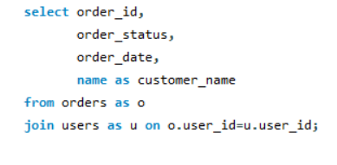
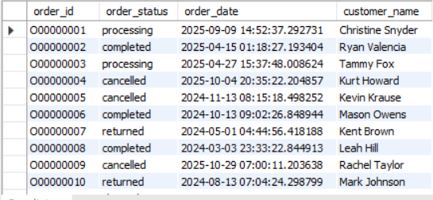
Get all orders with customer details
Query:
Output:

Slide 9
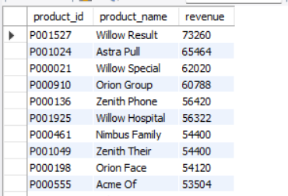
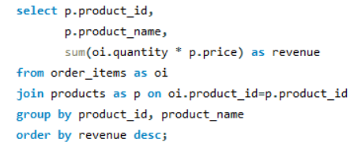
Total revenue per product
Query:
Output:

Slide 10
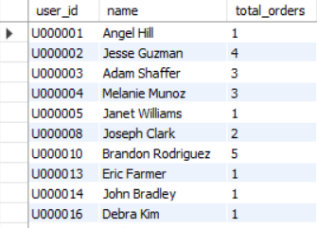
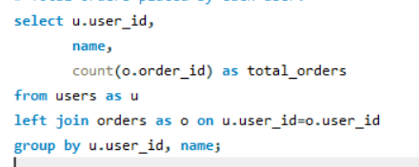
Total orders placed by each user
Query:
Output:

Slide 11
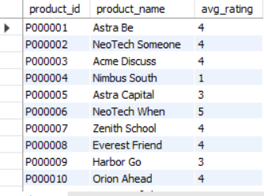
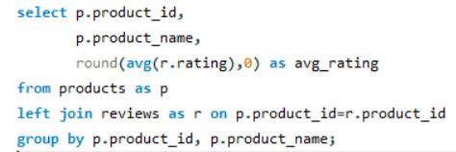
Average rating of each product
Query:
Output:

Slide 12
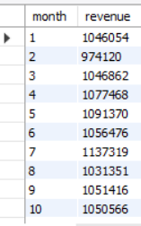
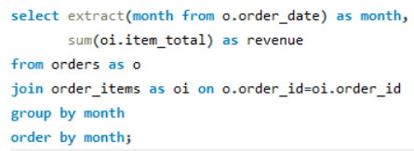
Monthly revenue trend
Query:
Output:

Slide 13
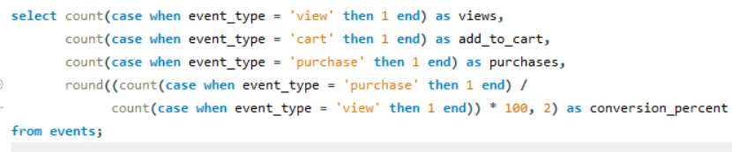

Conversion rate
Query:
Output:

Slide 14
Insights from Analysis
Identified top 10 customers by spending.
Determined best‑selling products.
Analyzed monthly revenue growth.
Calculated product ratings and reviews.
Measured conversion rate from views to purchases.

Slide 15
Business Insights
Popular products drive most revenue.
Some customers purchase repeatedly.
Conversion rate helps evaluate marketing success.
Product ratings influence customer purchases.

Slide 16
Conclusion
SQL helps organize and analyze e‑commerce data.
Businesses can track sales performance and customer behavior.
Insights help improve marketing and product strategies.
Data‑driven decisions increase business growth.

