Slide 1
Sample Superstore – Sales & Profit Analysis Dashboard
Done by M.Neeharika

Slide 2
Project Overview
Analyzing Sample Superstore dataset using Power BI.
Focus on Sales, Profit, and Customer Segments.
Identify performance trends and business insights.

Slide 3
Objective
Understand sales trends month-wise.
Identify top-performing categories and products.
Analyze profit distribution across segments.
Provide interactive dashboard for business decisions.

Slide 4
Problem Statement
Business unable to identify profitable areas.
No clear visibility of sales patterns.
Lack of interactive reporting.

Slide 5
Dataset Details
Contains Order, Sales, Profit, Quantity, Category, Region, Segment fields.
Used for building KPIs, charts, and customer analysis.
Dataset from Superstore sales across multiple regions.

Slide 6
Approach
Data cleaning and preparation.
Exploratory data analysis.
Power BI dashboard creation.

Slide 7
Challenges
Handling missing and inconsistent values.
Understanding variations across regions.
Building clear dashboard layout.

Slide 8
Methodology
Data cleaning: removed nulls, duplicates.
DAX measures created for KPIs.
Visualizations: Bar chart, Line chart, Donut, Table.
Slicers applied for Region and Segment.

Slide 9
KPIs Used
Total Sales
Total Orders
Total Quantity
Total Profit
Profit Margin

Slide 10
Dashboard Visuals
Sales trend by month
Sales by category
Profit by sub-category
Customer segment breakdown
Top 10 products

Slide 11
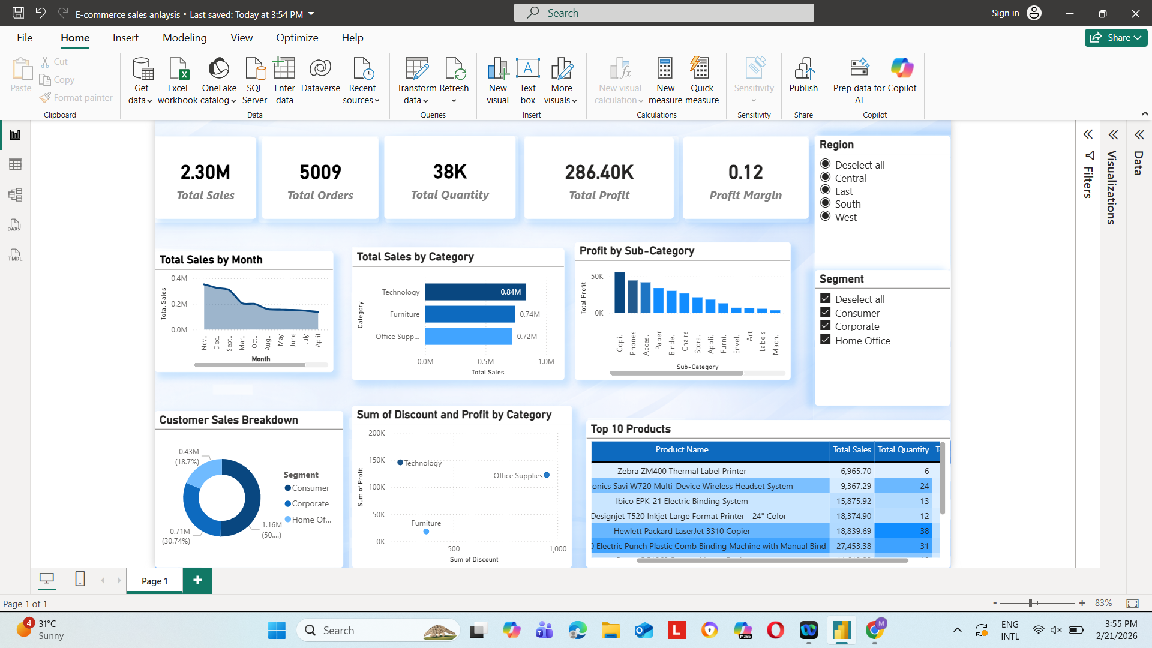
Sample Superstore – Sales & Profit Analysis Dashboard

Slide 12
Insights
Technology category generated highest sales.
Profit varies significantly across sub-categories.
Consumer segment contributes the most revenue.
Certain products delivered very high sales and quantity.

Slide 13
Conclusion
Dashboard helps understand performance clearly.
Useful for business strategy and inventory planning.
Future scope: forecasting, advanced analytics.

