Slide 1
Home Depot vs. Lowe’s Financial Comparison and Valuation
Analysis
Sharang Mantri
Mike Feistel
Shreya Ahuja
Priyanka Chandramohan
Group 17
FIN 529 Applied Financial Analysis Final Project – Spring 2025

Slide 2
Overview
Section
Section
Section
Section
Section
Industry & Company Overview
Normalized Income Statement
DCF Models
Multiple Comparison
Final Recommendation
Overview

Slide 3
Industry & Company Overview
1
Industry & Company Overview

Slide 4






Home Improvement Retail Industry Overview
$500B+ global industry, led by the U.S. (~60% of global market)
Fueled by rising home ownership, renovation trends, and aging housing stock
Two main players dominate U.S. market: Home Depot (~17% share), Lowe’s (~10% share)
Industry sensitive to interest rates, DIY culture, and housing demand
Post-COVID slowdown, but long-term growth expected from infrastructure and aging homes
Shift toward e-commerce and Pro customer segment (contractors, remodelers)
Industry & Company Overview

Slide 5
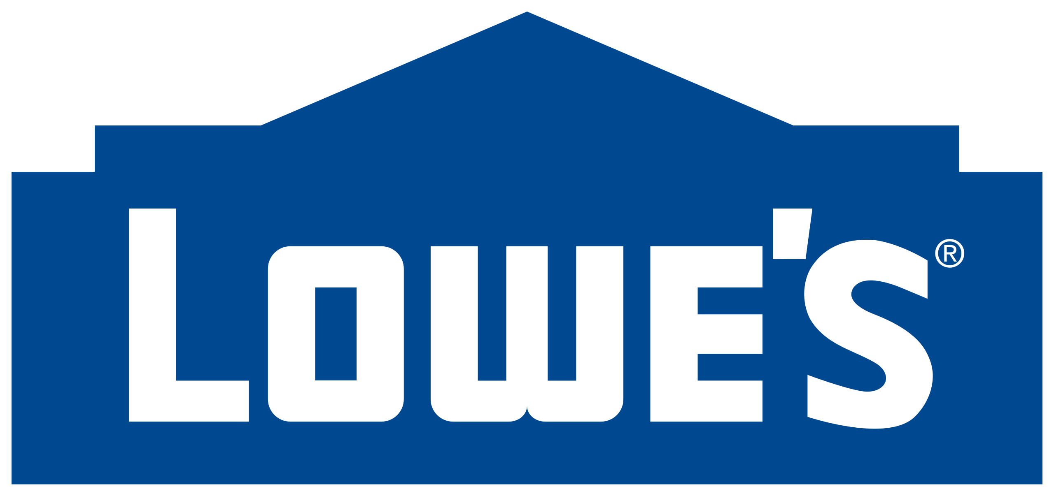

Lowe’s Overview
BACKGROUND
Founded in 1921 by L.S. Lowe in North Wilkesboro, North Carolina
Headquartered in Mooresville, North Carolina
Fortune® 50 company and the world’s second-largest home improvement retailer
WHAT LOWE'S DOES
Home Improvement Retailer
Installation Services
Pro Customer Services
Omnichannel Shopping
LOWE'S BY THE NUMBERS (2024)
~300,000 associates employed in the United States
16M+ customer transactions served weekly
$83.7 billion in annual sales
Operates 1,748 home improvement stores and outlets across the U.S
Industry & Company Overview

Slide 6
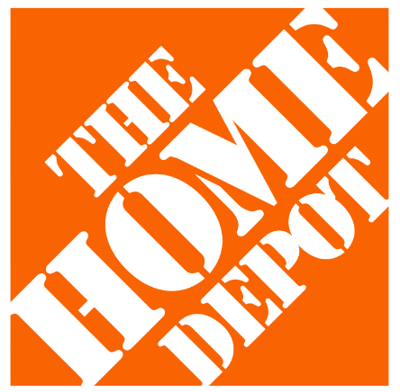
Home Depot Overview
BACKGROUND
Founded in 1978, incorporated in Delaware
Headquartered in Atlanta, Georgia
WHAT HOME DEPOT DOES
World’s Largest Home Improvement Retailer based on net sales for fiscal 2024
Offers a wide range of products, including building materials, home improvement, lawn and garden, décor, and MRO products, both in-store and online
Provides installation services, tool and equipment rental, and more.
The Home Depot Foundation has invested over $550 million in veteran causes, improved 65,000+ veteran homes
HOME DEPOT BY THE NUMBERS (2024)
470,100 associates employed
Operates 2,347 stores across the U.S., Canada, and Mexico
Acquired SRS in 2024, a leading residential specialty trade distributor with 780 branch locations across the U.S.
Industry & Company Overview

Slide 7
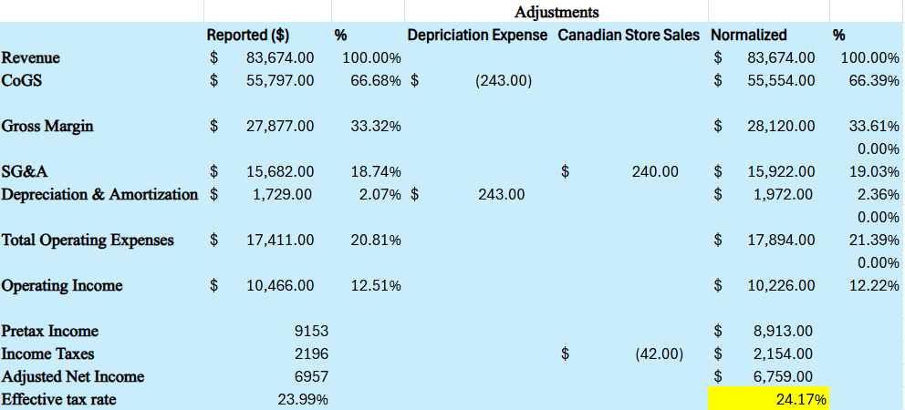
Lowe's FY24-25 Normalized Statement
Normalized Income Statement & RoIC

Slide 8
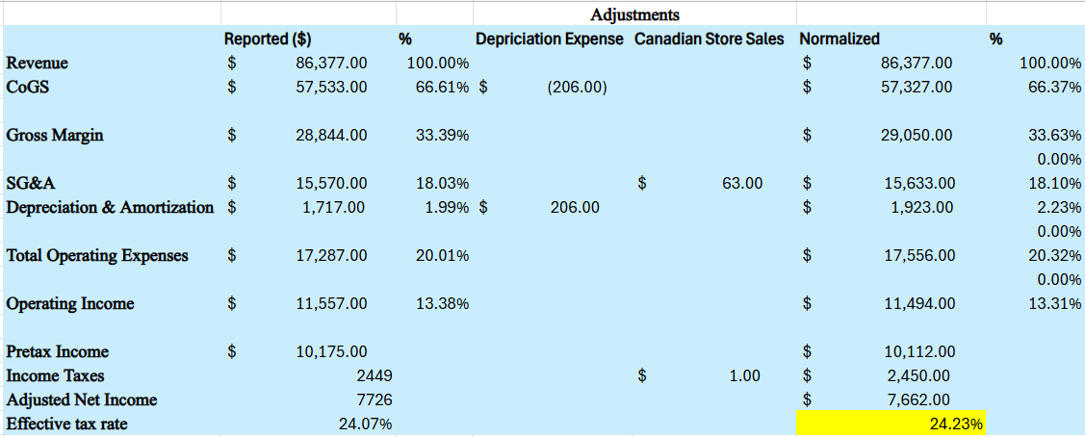
Lowe's FY23-24 Normalized Statement
Normalized Income Statement & RoIC

Slide 9
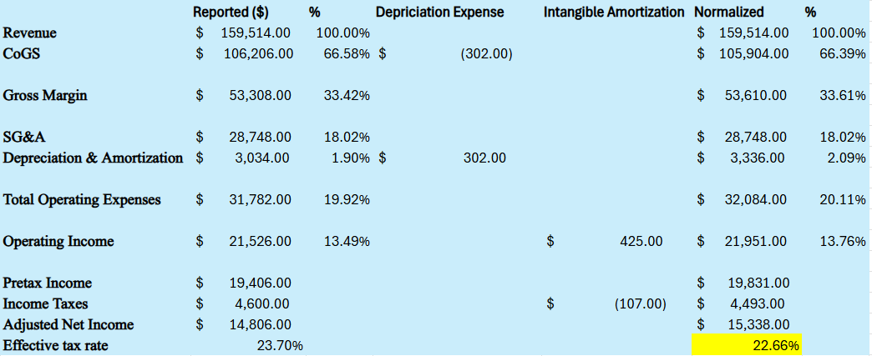
Home Depot FY24-25 Normalized Statement
Normalized Income Statement & RoIC

Slide 10
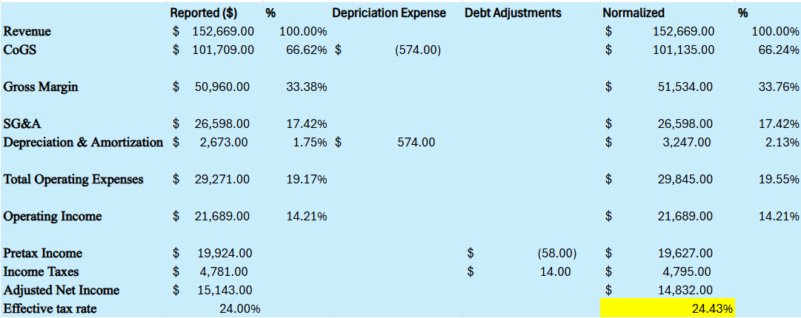
Home Depot FY23-24 Normalized Statement
Normalized Income Statement & RoIC

Slide 11
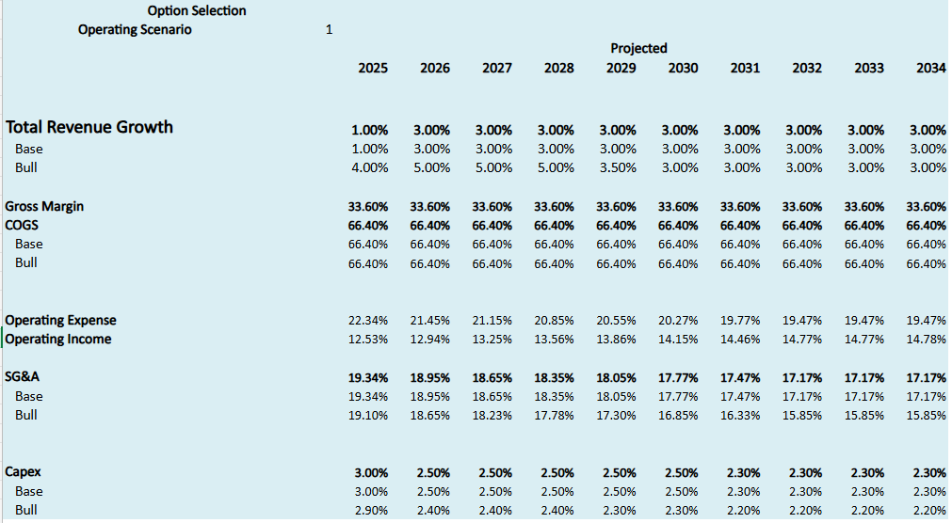
Lowe's DCF
Lowe's DCF

Slide 12






Lowe's DCF
Discount Rate
Cost of Equity (Ke) = 8.128%
Risk-Free Rate = 4.23%
Risk Premium = 4.47%
Beta = 0.872
Cost of Debt (Kd) = 4.40%
Tax Rate = 25.00%
Capital Structure
Debt = 22%
Equity = 78%
WACC = 7.06%
Key Financial Metrics
Metrics | Values
Terminal growth | 0.75%
RoIC | 28.88%
Profit Margin | 9.26%
Asset Turnover | 311.66%
Shares Outstanding | 568.00
Debt | $35,487 mil
Cash | $1761 mil
Valuation Scenarios
Base Case
Price: $235.02
Upside: 6.39%
Bull Case
Price: $289.54
Upside: 31.07%
Lowe's DCF

Slide 13
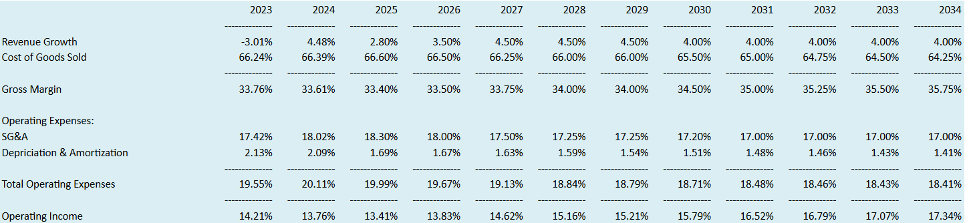
Home Depot DCF
Home Depot DCF

Slide 14

Home Depot DCF
Discount Rate
Cost of Equity (Ke) = 8.218%
Risk-Free Rate = 4.23%
Risk Premium = 4.53%
Beta = 0.88
Cost of Debt (Kd) = 4.10%
Tax Rate = 24.50%
Capital Structure
Debt = 13%
Equity = 87%
WACC = 7.55%
Key Financial Metrics
Metrics | Values
Terminal growth | 0.75%
RoIC | 26.48%
Profit Margin | 10.64%
Asset Turnover | 248.78%
Shares Outstanding | 993
Debt | $53,383 mil
Cash | $1659 mil
Valuation Scenarios
Base Case
Price through DCF: $331.62
Market Price: $357.58
Downside: 7.26%
Home Depot DCF

Slide 15
Multiple Comparison
4
Multiple Comparison

Slide 16
Valuation Comparison: Lowe’s vs. Home Depot (2025-26)
Metric | Lowe’s | Home Depot
ROIC | 28.9% / 30.41% | 22.70%
Profit Margin | 9.40% / 9.62% | 10.12%
Asset Turnover | 307.48% / 316.14% | 224.22%
EV/EBITDA | 12.89x | 15.92x
P/E Ratio | 17.96x | 23.74x
DCF Value / Share | $235.02 / 289.54 | $331.62
Market Price | $220.91 | $357.58
DCF Upside | +6.39% / 31.07% | -7.26%
Lowe’s shows stronger return on capital and lower valuation multiples, suggesting it's potentially undervalued relative to Home Depot.
Multiple Comparison
Notes:
“Let’s start by looking at the core performance and valuation metrics for Lowe’s and Home Depot.”
“ROIC stands out — Lowe’s is earning nearly 29–30%, significantly above Home Depot’s 22.7%, which reflects stronger capital efficiency.”
“Although Lowe’s profit margins are slightly lower, its asset turnover is much higher — meaning it uses its assets more effectively to generate revenue.”
“From a valuation standpoint, Lowe’s trades at a discount — both EV/EBITDA and P/E ratios are meaningfully lower.”
“Most notably, our DCF model shows Lowe’s is undervalued with a ~6% upside, while Home Depot is about 7% overvalued.”
“This combination of stronger capital returns and lower valuation multiples points to a potential opportunity in Lowe’s favor.”

Slide 17
Valuation Comparison: Lowe’s vs. Home Depot (2025) II
ROIC is 27% higher for Lowe’s, highlighting more efficient and profitable capital deployment.
While profit margins are slightly lower, Lowe’s compensates with 37% higher asset turnover, driving strong revenue per dollar of assets.
Lowe’s trades at a 24% discount on P/E and a 19% discount on EV/EBITDA, despite stronger operational metrics.
DCF valuation shows upside for Lowe’s, while Home Depot’s share price exceeds its fair value by over 7%.
These metrics point to a compelling mispricing opportunity: Lowe’s is both more efficient and more attractively valued.
Multiple Comparison
Notes:
“This chart helps visualize how Lowe’s stacks up relative to Home Depot, with Home Depot normalized to 1.0.”
“Starting on the left, you see Lowe’s ROIC is about 27% higher, again showing capital efficiency.”
“Even though Lowe’s margin is a bit lower, its asset turnover is much stronger — almost 40% higher — which helps it still deliver superior returns.”
“On valuation, Lowe’s is clearly cheaper: it trades at a 24% discount on P/E and a 19% discount on EV/EBITDA.”
“DCF valuation again supports this — Lowe’s is underpriced, while Home Depot trades above fair value.”
“All of this suggests that Lowe’s may be mispriced relative to its fundamentals — offering more efficiency and better value.”

Slide 18
Final Recommendation
5
Final Recommendation

Slide 19

Which Stock Would We Buy?
“If forced to choose between two good companies, pick the one priced like it’s not.”
Recommendation: Buy Lowe’s
Why?
Higher ROIC (29.6%) → stronger operational efficiency
Undervalued: trades ~6% below DCF-based fair value
P/E is ~24% lower than Home Depot despite more efficient capital use
Home Depot:
High-quality business, but valuation looks stretched
Current share price exceeds DCF valuation
Final Recommendation
Notes:
If we had to pick one, we would buy Lowe’s.
It shows stronger operational efficiency, more capital discipline, and better value across metrics.
Despite this, Lowe’s trades at significantly lower valuation multiples, including a 24% discount on P/E.
Our DCF model shows clear upside for Lowe’s and downside risk for Home Depot.
While Home Depot is a great business, the current price doesn’t justify the valuation.
As the quote says: “Pick the one priced like it’s not” — and in this case, that’s Lowe’s.

Slide 20
THANK YOU!
Thankyou!

Slide 21
Questions?
Questions?

